Slide 1




GUARDIANS
Smart solutions to empower
small- and medium-sized farms as guardians of the territory
Tech # X
Pilot <place>
KoM - Asturias, 21-22 June 2023

Slide 2
Use the questions in the following slides as a guide, but include as much information as possible, not only “Yes/No” answers to the questions.
We know that you may not have the answers to all the questions. It’s OK to say: this aspect needs to be decided, don’t know the details of…, we need first to have input from…
Be realistic about the current status and the expectations: what is done and what can be done in GUARDIANS
There are a lot of questions because in this stage we are trying to get a general idea of all the characteristics. But some answers can be generic, for example you can say that we need some sensors to be installed on the farm, we don’t need to know the details and quantity of the sensors.
This presentation should be around 10 minutes.

Slide 3
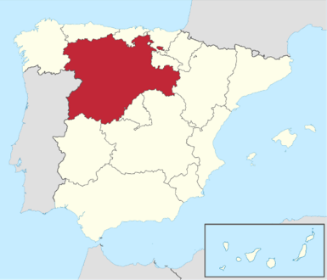
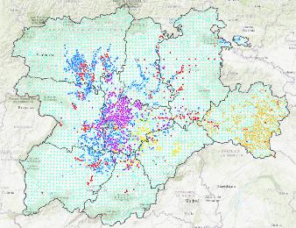
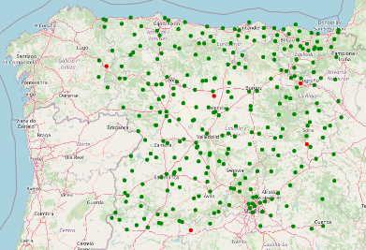
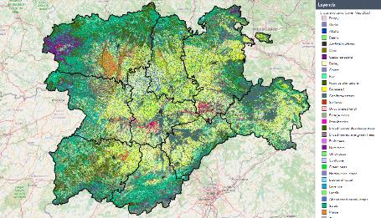
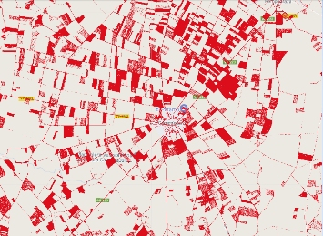
Organization's Profile and Expertise
Research and IT public entity that belong to the Regional Ministry of Agriculture of Castile and León –Spain-
300 employees in research, Infrastructure development, IT, field extension and food certification and promotion
Two departments specialized in Geo-technologies for agriculture.
CAP support (LPIS upkeeping, Checks by Monitoring, etc. )
Research and innovation (Earth Observation, agrometeorology and soil science, crop modelling, GNSS, DSS for farmers development)

Slide 4
Technology SATIVUM: Current status
Do a presentation of the technology trying to answer these questions:
FMIS with satellite monitoring, field book records and nutrient advise. Provides information to monitor the crop and fulfil regulation regarding field book and nutrient balance.
Status of this technology. TRL 9 for satellite monitoring, TRL 8 for nutrient advise and TRL 7 for field book. Used in real cases but still within demo environment for many users
Why did you create this technology?. Yes, fully developed by ITACyL Is it a market opportunity for your entity? The tool is free but is opening many new opportunities. Has this technology been created in another project? Yes, the core for nutrient advise comes from the Farm Advisory Tool For Nutrients project.
In which language is the interface? Is it easy to integrate new languages? Only in Spanish. Accepts automatic translation.
What parts is this technology composed of (software and hardware)? (for example, a user interface that is accessed by a web, an installable software program for Windows, a server, a set of IoT devices, a drone, etc.) it is a webapp frontend with several API in the backend
If possible, show some screenshots/pictures of the technology.

Slide 5
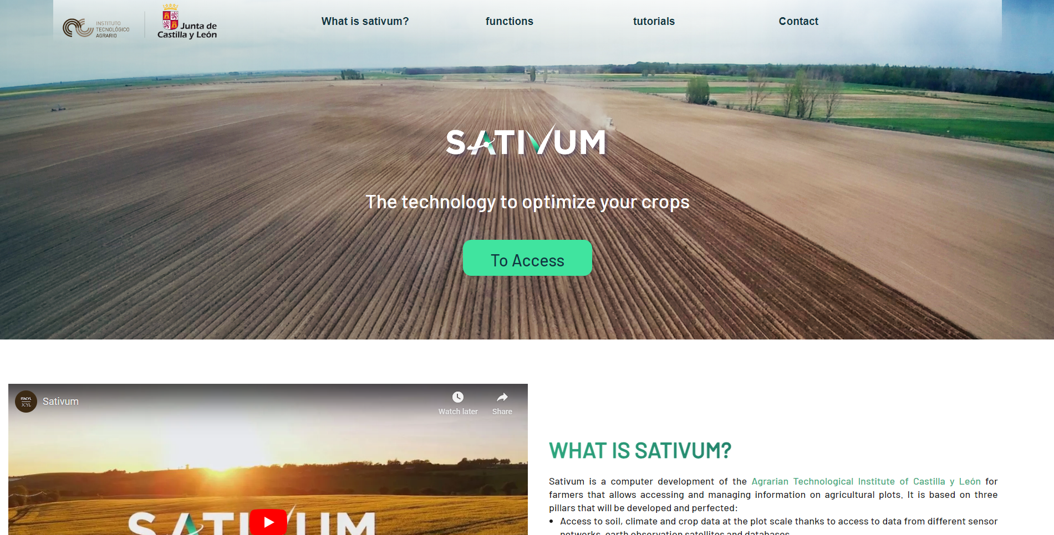

Slide 6
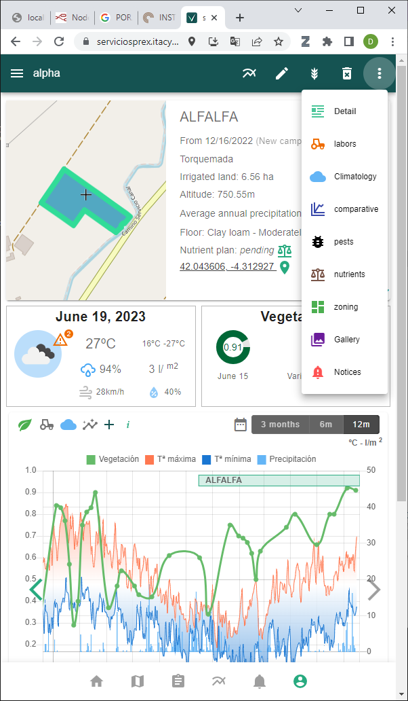
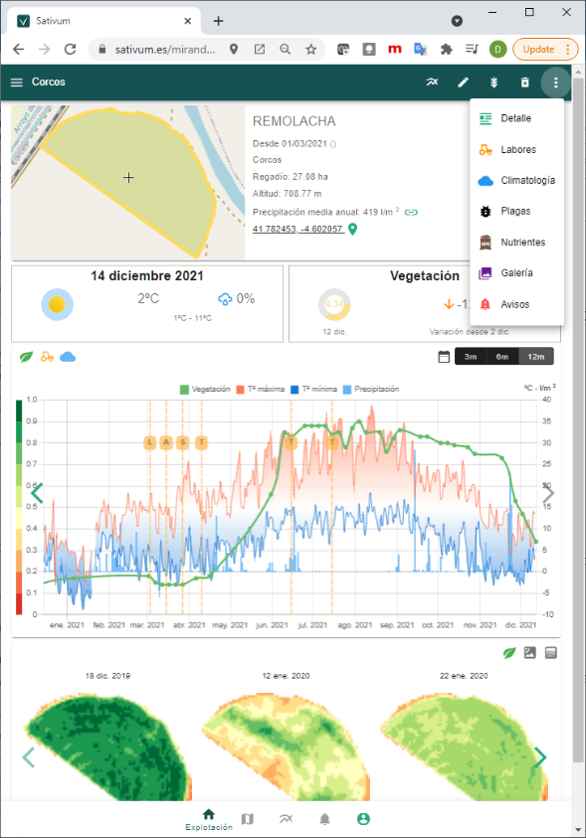

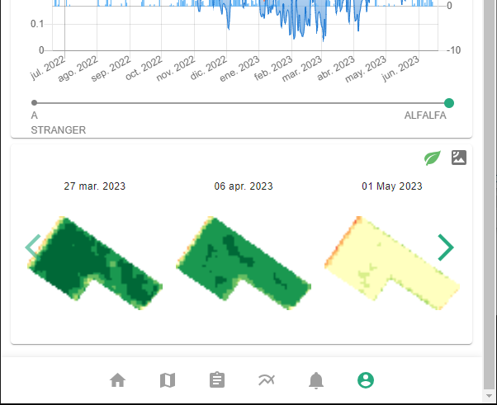
Sativum is a free public APP for agronomic advise based on agricultural parcels from IACS with:
Satellite (and aerial) data
Soil data(0,3 samples/km2 density)
Climate/meteo data (0,002 stations /km2)
Decision support systems integrated:
Crop nutrition (FAST)
Pest management
Irrigation (beta)
Open API por 3rd party APP

Slide 7
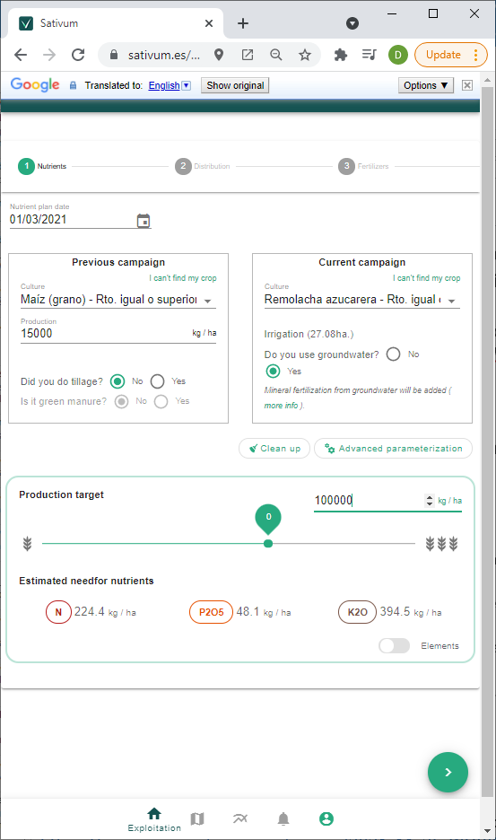
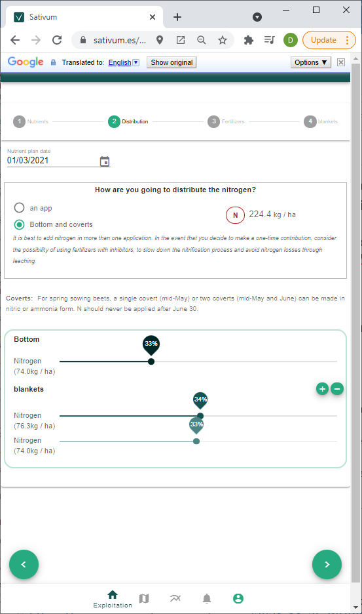
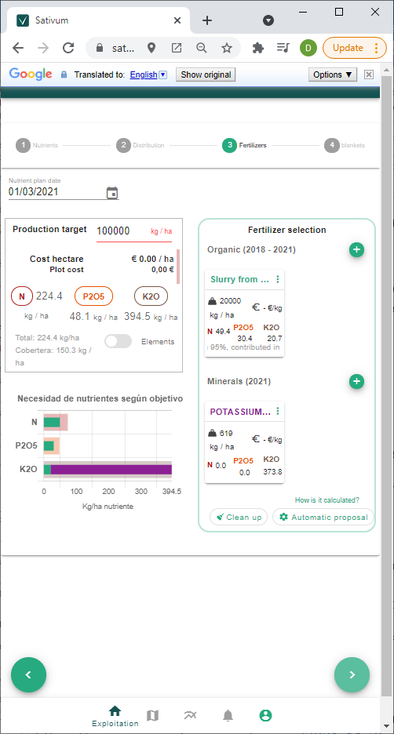
Crop Nutrition advice

Slide 8
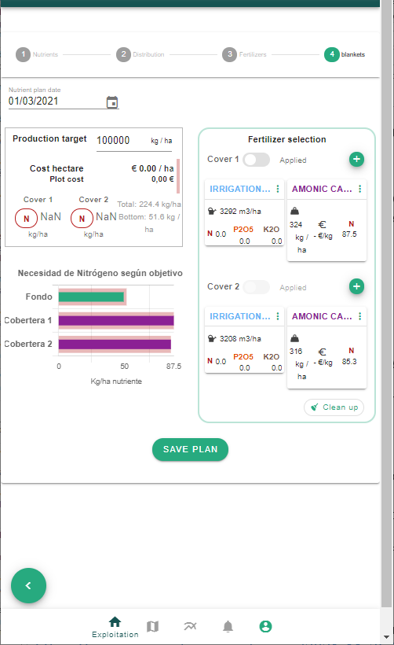
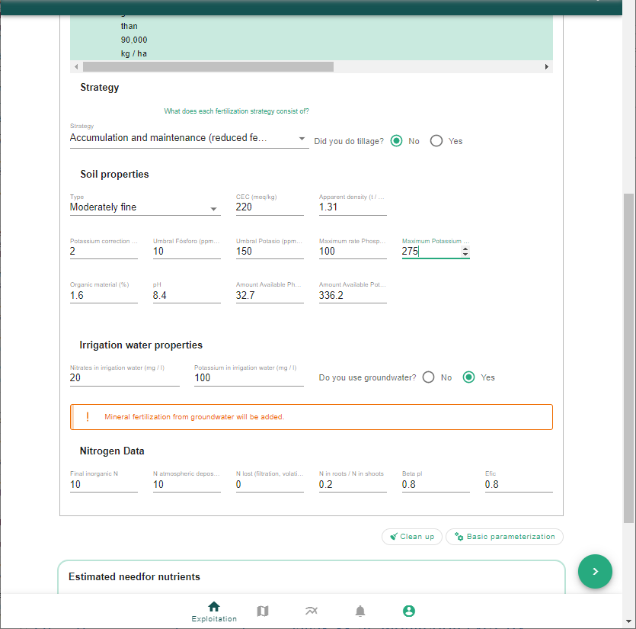
ADVANCED PARAMETRIZATION

Slide 9
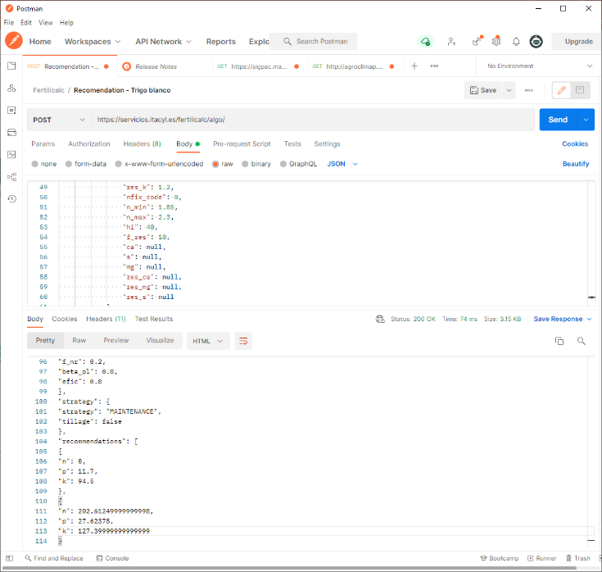
Open API for crop nutrition from FAST phase 1. Based on Fertilicalc algorithm
API URL
PARAMETERS TO SEND
RECEIVED NPK NEEDS

Slide 10
Technology SATIVUM: Development in GUARDIANS
Answer the following questions related to how do you expect to develop your technology during GUARDIANS. Please, take into account that during the co-creation time, your initial expectations may be re-defined but it is expected that each technology developer knows what would be the potential evolution of each technology:
What are the main aspects in which your technology will improve during GUARDIANS?
Make it more affordable for small farmers
Which are the main new functionalities expected?
Easy field book
Will it solve new problems or will it improve the solving of already defined problems?
Improve already defined problems in relation with de government and some sp
Are there any challenges for the development? (for example, you need a set of data to train the system, your system will only work under certain conditions…)
Which TRL is it expected to reach? 9

Slide 11
Technology SATIVUM: Legal and data protection aspects
Answer the following questions related to legal / data protection for your technology:
Do you currently have all the rights for your technology? yes
Has any other entity participate in the creation of your technology (for example, if this technology has been created for another collaboration Project). Free software dependencies and API for satellite image
Which kind of data do you need to store? Are personal data stored? Where are data stored?
Farm data with legal binding is transmitted to the government. A copy is sotrd in ITACyL servers
Do we need any permissions to implement this technology? (for example, in the case of the drones, specify the legal procedure needed).NO
Check if your technology can imply some ethical issues with the following aspects: humans; personal data; animals; non EU-countries; environment, health and safety; artificial intelligence; other [The EC has told GUARDIANS that we need an ethical board for these categories] Personal data could be an issue

Slide 12
Technology SATIVUM : Implementation in a farm
Answer the following questions related to what do you need to implement and test your technology in the pilot:
What type of farm do you need? Agricultural land with any crop
Which crops/animals do you need the farm to have?[Please have a look at the description of the DoA so it should be aligned] any grain or forage crop is preferred
Does it require the installation of some hardware/software? No
Are there any must-have technical requirements? (for example, Internet connection). Internet connection, smartphone or desktop computer
Does the technology need to be tested in a specific season or month of the year? NO, but nutrition advise happens at specific time windows
What does the farmer need to do to test your technology? (for example, will the farmer need to measure something and enter the data in another system? will the Farmer need to directly manage the drone or Will it be automatic?...) Farmer must use the interface and introduce data for every parcel

Slide 13
Pilot <place>
Answer the following questions related to the description of your pilot:
Describe the type of farms in which the technology will be tested: how many farms, location, general description.
Explain the crops/animals available.
Explain your relation with these farms (for example, you are a cooperative and the farms are within your cooperative; you are the owner of the farm; you usually collaborate with this farm…).
Have the owners of these farms already been contacted?
You can include some pictures of the farm if possible.

Slide 14

Any quesions?
David A. nafría
ITACyL
nafgarda@itacyl.es
Thank you very much!

Slide 15






















