Slide 1
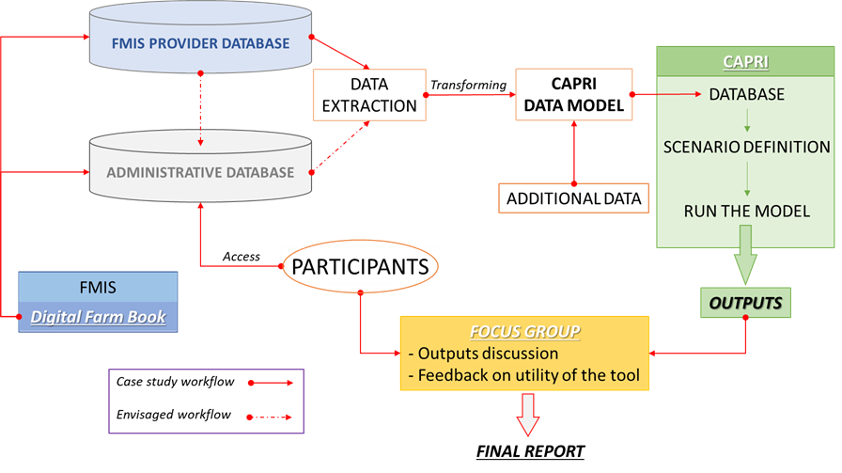
combined use of Digital Farm Book aggregated data and CAPRI model
SPAIN
1. Brief presentation of the tool and its implementation in CS
Case studies: Session 3

Slide 2
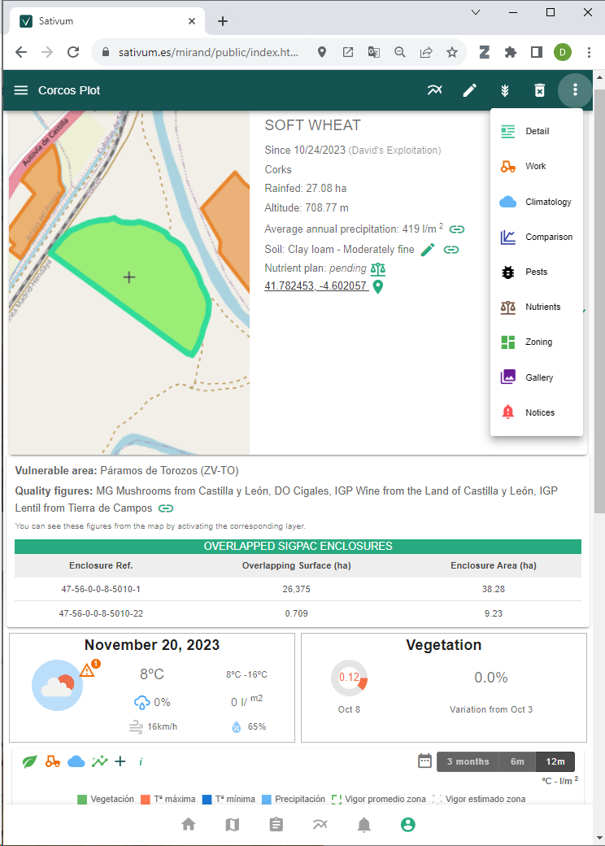
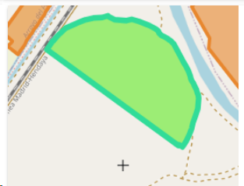

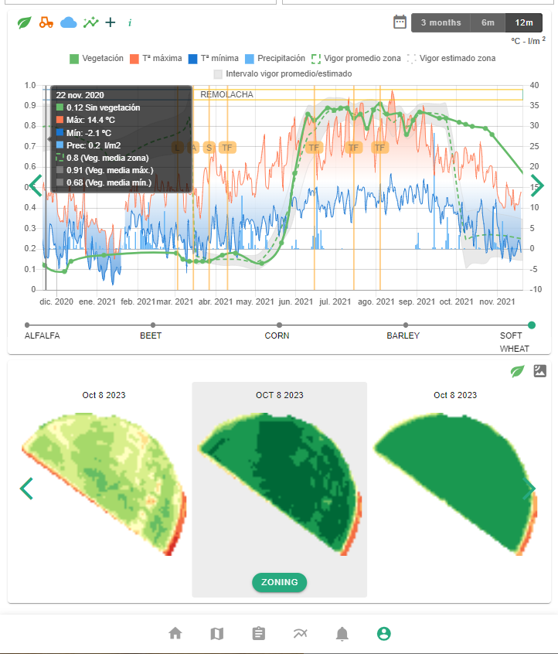
1. FMIS we are using (and how we extracted the data)
Case studies: Session 3
Data available
Agricultural parcels from IACS (shared data)
Copernicus data
Aerial or Satellite VHR
Public Soil data(0,3 samples/km2 density)
Public Climate/meteo data (0,002 stations /km2)
Decision support systems integrated:
Crop nutrition (derived from FaST project)
Variable Rate Application
Pest management
More to come (irrigation)
Digital field Book

Slide 3
Data extraction and processing
No personal data included, no parcel identification (in theory)
Data extracted for each application in the FMS:
Task ID
Date
Crop
Province
Municipality
Plot Area
Work Area
Registration Number
Trade Name
Product Type
Formulated Product
Active Substance (EU Name)
Concentration
Applied Dose
Unit
Data added trough DG SANTE’s EU Pesticides Database API
DGSANTE_SUBSTANCE_ID
CAS_NUMBER
SUBSTANCE_CATEGORY

Slide 4
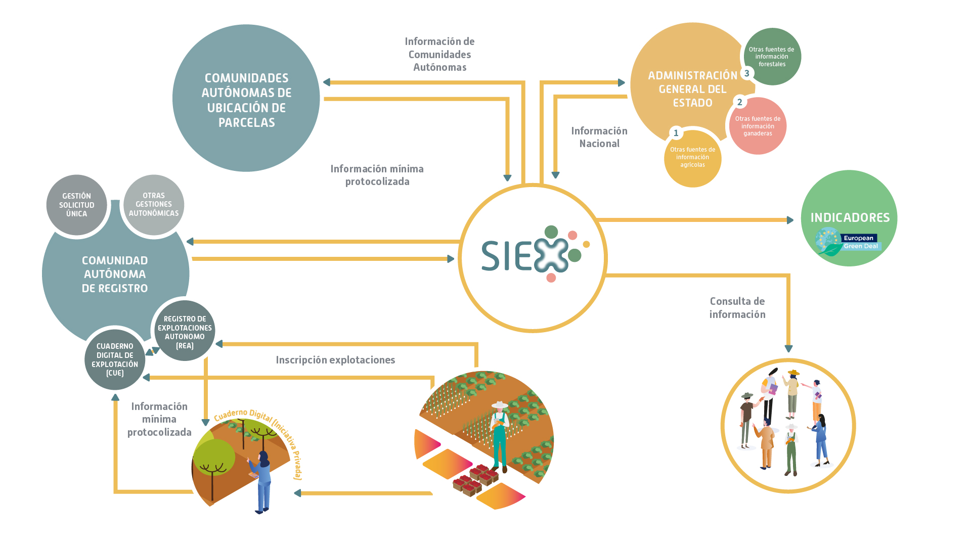
The current status of the digital book in Spain
General Use: At present, use of the digital field book is voluntary, following farmers’ mobilizations.
Mandatory Use: Starting January 1, 2026, digital recording will be mandatory for Plant Protection Product (PPP) applications. Applications made before that date may still be reported using paper-based formats (PDF, Excel tables, etc.).
Data Submission: Farmers are not required to send their data to the government on a regular basis. Data will only need to be provided if a farm inspection is scheduled. Farmers are notified at least one week in advance. Inspections may focus specifically on pesticide use or be part of broader CAP conditionality checks.
Case studies: Session 3

Slide 5
The current status of the digital book in Spain
Digital Tools: Farmers and their advisors can record information either through a public web form or by using a commercial Farm Management Information System (FMIS).
To be used officially, commercial FMIS platforms must undergo a formal approval process by both the government and the farmer.
Authorized FMIS tools can access farm data (e.g., parcel geometry, crops, machinery) from government databases and can upload field book data through a structured JSON format.
Recording Deadlines: Pesticide applications must, in principle, be recorded in the digital system within one month of application.
Case studies: Session 3

Slide 6
Commission Implementing Regulation (EU) 2023/564 (records for plant protection products)
The Standing Committee on Plants, Animals, Food and Feed (PAFF Committee) agreed to postpone the entry into force for one year last Oct 2nd 2025
Scope & timing: applies from 1 January 2026 onward
Record content: must include, among others: • the type of use, product name and authorisation number • time of use (with hours when relevant), dose per hectare, treated area/volume • identification of treated location (ideally via geospatial / land unit codes) • crop or land use (using EPPO codes) and growth stage (using BBCH) • for closed spaces or seed treatments, additional parameters (e.g. volume, cubic metres, batch number)
Format: records must be kept electronically in a machine-readable format (per Directive (EU) 2019/1024)
Timing and transition:
• If initially recorded in a non-electronic format, users have up to 30 days to convert into the prescribed electronic format.
Member States may allow longer transition periods (for uses before 2030) as long as final conversion is completed by 31 January of the year following the year of use.
Obligations to authorities & third parties: • If the request explicitly demands the records in the prescribed electronic format, the user must supply them before the relevant conversion deadline or within 10 working days, whichever is sooner.
Case studies: Session 3

Slide 7
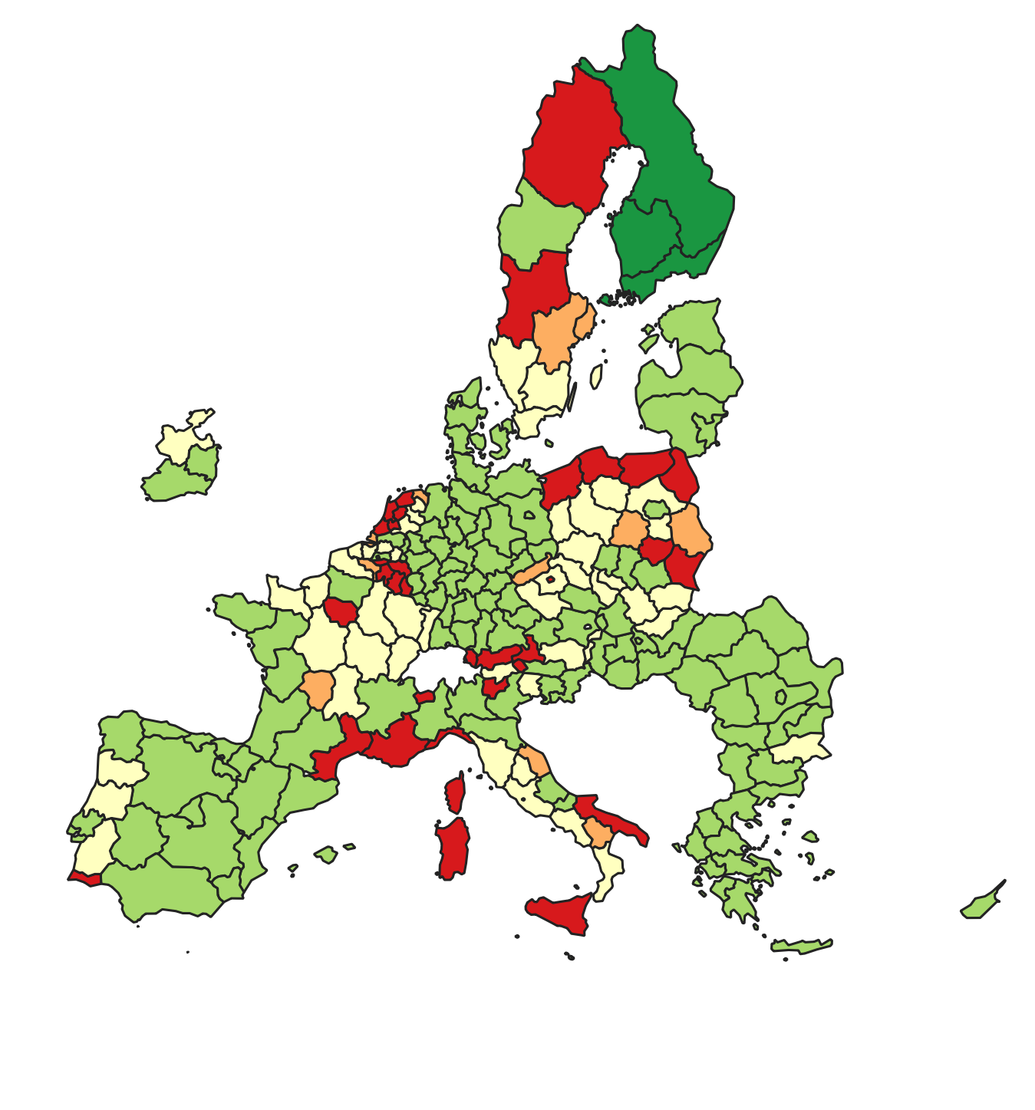
Supply module in CAPRI
SPAIN
Regional programming model for ~280 regions (NUTS2)
Representation of disaggregated crop(groups) and animals
Data on acreage, herds, yields, prices, inputs (incl. pesticides) based on EUROSTAT, national statistics, literature, and expert knowledge
Case studies: Session 3

Slide 8

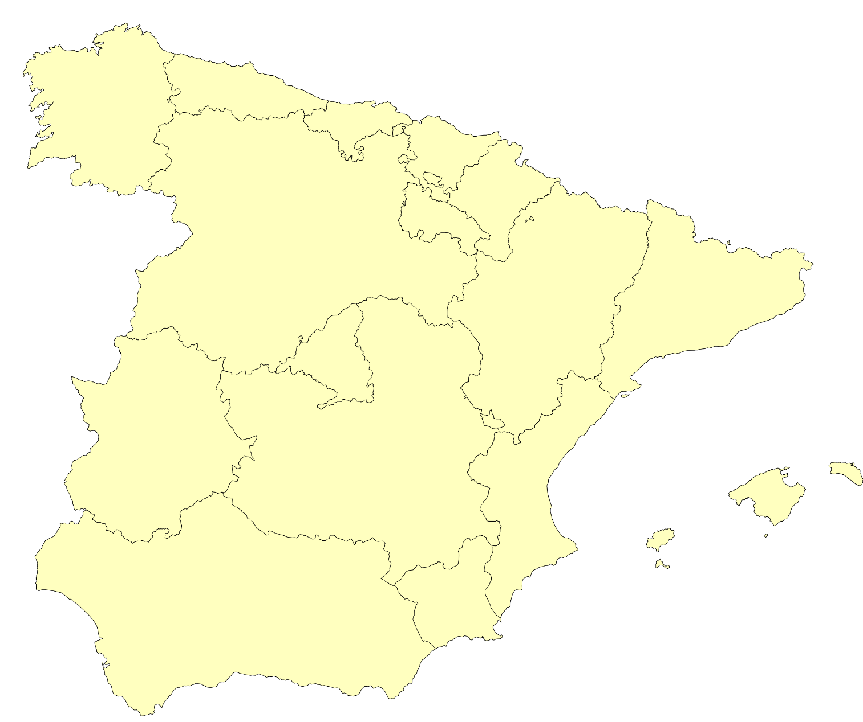
Pesticide Structure in CAPRI
SPAIN
Pesticides
Case studies: Session 3
PESTOH (Herbicides)
PESTOF (Fungicides)
PESTOI (Insecticides)
PESTOO (Other pesticides)
PESTOG (Growth regulator)
To improve the assessment of policies affecting pesticide use, we need:
Crop-specific pesticide group application quantities on the regional level

Slide 9
Current database for pesticides
SPAIN
 | Julius-Kühn-Institut (JKI) PAPA data | Udias et al. (2024) (PIST) JRC project | EUROSTAT (COCO) Pesticide sales data
Origin | Sample survey | Estimation | Census data
Available data level | Active ingredient | Active ingredient | Product category
Number of AIs/CCs | 254 | 215 | 47
Regional availability | German values (MS) | NUTS3 | MS level
Crop specific | Yes | No | No
Case studies: Session 3
Weakest assumption: Average crop-specific application rates from Germany are valid EU-wide

Slide 10
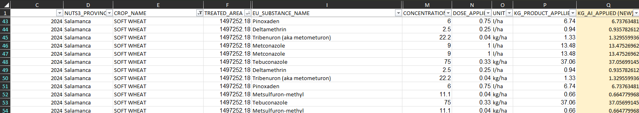
FMIS data in CAPRI
SPAIN
Improvement of CAPRI through FMIS data
Case studies: Session 3
Assumption: FMIS data improves pesticide-use information for Spain through the underlying soil and climatic conditions, adjusting application rates for crops grown and adding data for crops rarely (or not at all) grown in Germany

Slide 11
Results regional coverage
SPAIN
Coverage in % of total agricultural land
Case studies: Session 3
NUTS2 | Region | Agricultural area coverage (2024) – [in % of total UAAR)
ES41 | Castile and León | 0.71%
ES51 | Catalonia | 2.03%
ES11 | Galicia | 0.49%
ES42 | Castile – La Mancha | 0.08%
ES22 | Navarre | 0.12%
ES24 | Aragon | 0.02%
ES61 | Andalusia | 0.01%
ES62 | Region of Murcia | 0.05%
ES52 | Valencian Community | 0.01%
ES21 | Basque Community | 0.01%
ES43 | Extremadura | 0.001%
Regional coverage is limited, with sparse or no observations across large parts of Spain.

Slide 12
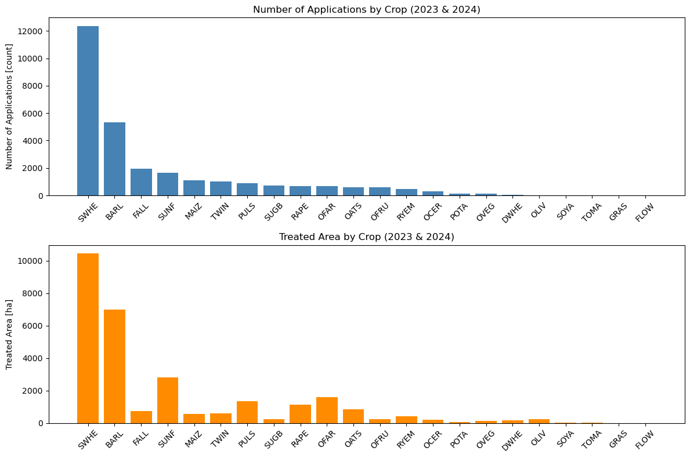
Results Crop coverage
SPAIN
Higher number of applications for cereals (SWHE, BARL)
Very observations of tomatoes (TOMA) and olive groves (OLIV)
Missing crops (apple, tobacco,…)
Many crops with few or no observations, leading to zero applications for some pesticide groups
Case studies: Session 3

Slide 13
Implementation in CAPRI
SPAIN
Distribution of pesticide use by group
Case studies: Session 3
Lower fungicide use in Spain due to lower humidity
Higher herbicide application linked to eco-schemes with no-tillage
 | FMIS | JKI | PIST
PESTOF | 8.52% | 74.71% | 43.55%
PESTOH | 87.17% | 16.65% | 45.01%
PESTOI | 4.21% | 6.83% | 9.49%
PESTOG | 0.01% | 0.73% | 1.55%
PESTOO | 0.1% | 1.07% | 0.4%

Slide 14
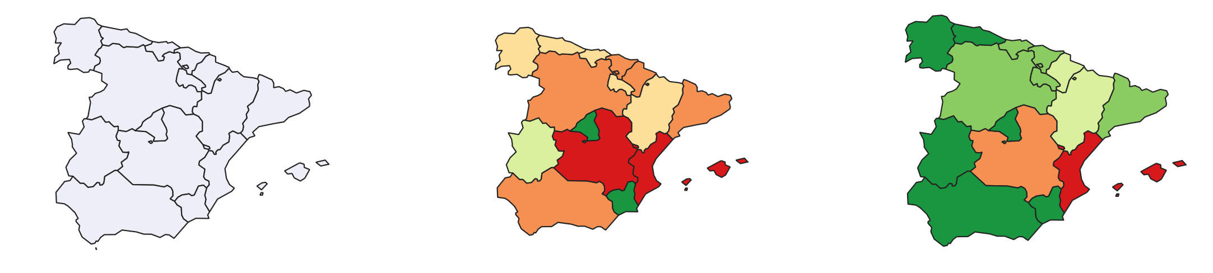
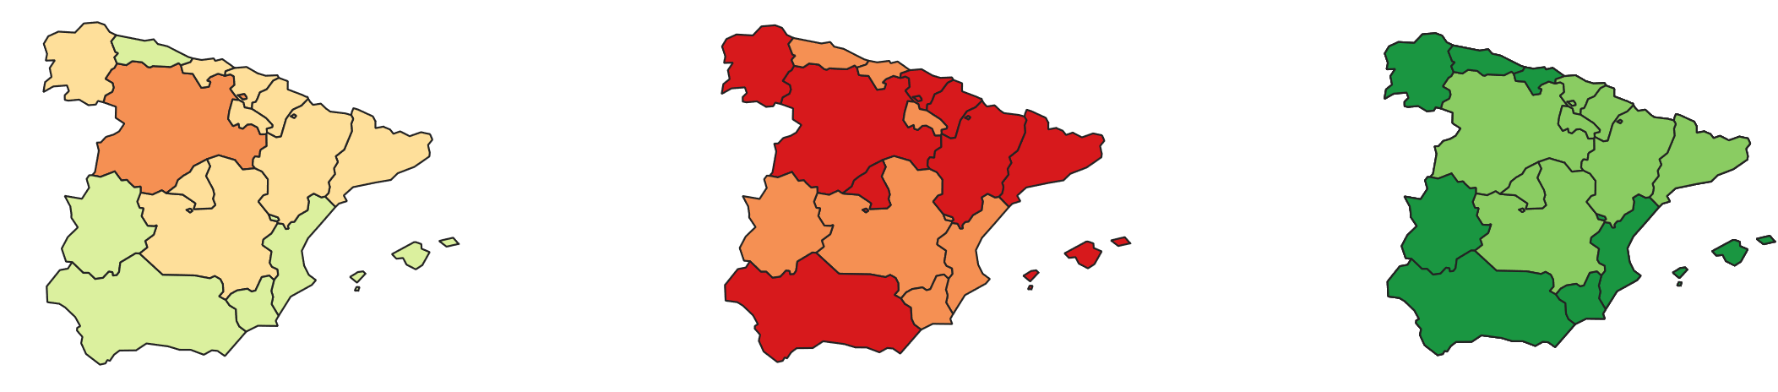

Results – Application quantities
SPAIN
Fungicide application quantities in soft wheat
Case studies: Session 3
FMIS data with JKI for missing observations
Only JKI data
Only FMIS data
Fungicide application in (g/ha)

Slide 15
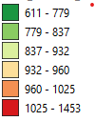
Results – Application quantities
SPAIN
Herbicide application quantities on traditional fallow
Case studies: Session 3
FMIS data with JKI for missing observations
Only JKI data
Only FMIS data
Herbicide application in (g/ha)

Slide 16
Learnings
SPAIN
The Digital Farm Book is a promising opportunity to provide information on pesticide use for large-scale ex-ante models (not only CAPRI)
Interpretation of the data requires at least some expertise in the domain of pesticides and agronomy
Involvement of stakeholders such as farmer unions could provide explanations for missing crop groups
Mandatory reporting poses risk to accuracy of data
Case studies: Session 3
This type of data is sparse and can outperform the accuracy of expert knowledge
Outlier detection, reasonable values for pesticide groups/active ingredients, etc.
Data on tomatoes, citrus trees, and olive groves was limited
Farmers could fear penalties due recorded data violating regulations

Slide 17
Broader perspective
SPAIN
The digitalization of the farm field book makes its completion more rigid and complex, adding yet another layer of difficulty to a sector that is seeking ways to reduce bureaucracy.
When data are recorded to meet official requirements, it is difficult to find evidence of improper pesticide use within them. No one consciously self-incriminates for misuse. Therefore, the truth contained in the official farm record database is limited.
The pesticide registration system covers very specific uses and excludes many real use cases due to the lack of interest from the companies that carry out the registration. This mainly affects minor crops. Although the administration can grant exceptional authorizations, this is not a common process for these types of crops.
Some crops may appear to have a higher number of phytosanitary applications, but this could be because they have more registered products and certain applications are being attributed to them.
Considering these factors, it is necessary to assess to what extent the digital field book will actually be a useful tool compared to the bureaucratic burden it represents for farmers.
Case studies: Session 3

