Slide 1
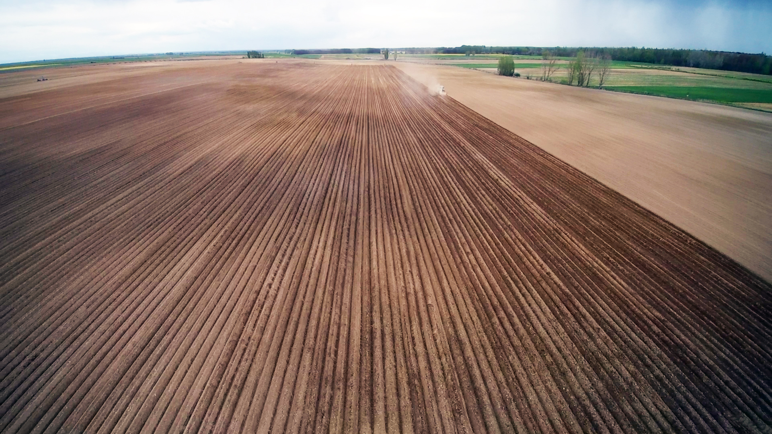




SATIVUM and Farm Sustainability tool for nutrient functionality across Spain
BEST PRACTICE APPLICATIONS OF THE FARM SUSTAINABILITY TOOL (FaST) FOR NUTRIENTS IN MEMBER STATES
MEETING OF THE EXPERT GROUP FOR HORIZONTAL QUESTIONS CONCERNING THE CAP. Wednesday 06 March 2024 from 09:00 to 12:30
Rodríguez Sendon, Bibiana <brodrigu@mapa.es>
Nafría García, David A. <nafgarda@itacyl.es>
Notes:
Agradecimiento.
Qué se va a exponer.

Slide 2
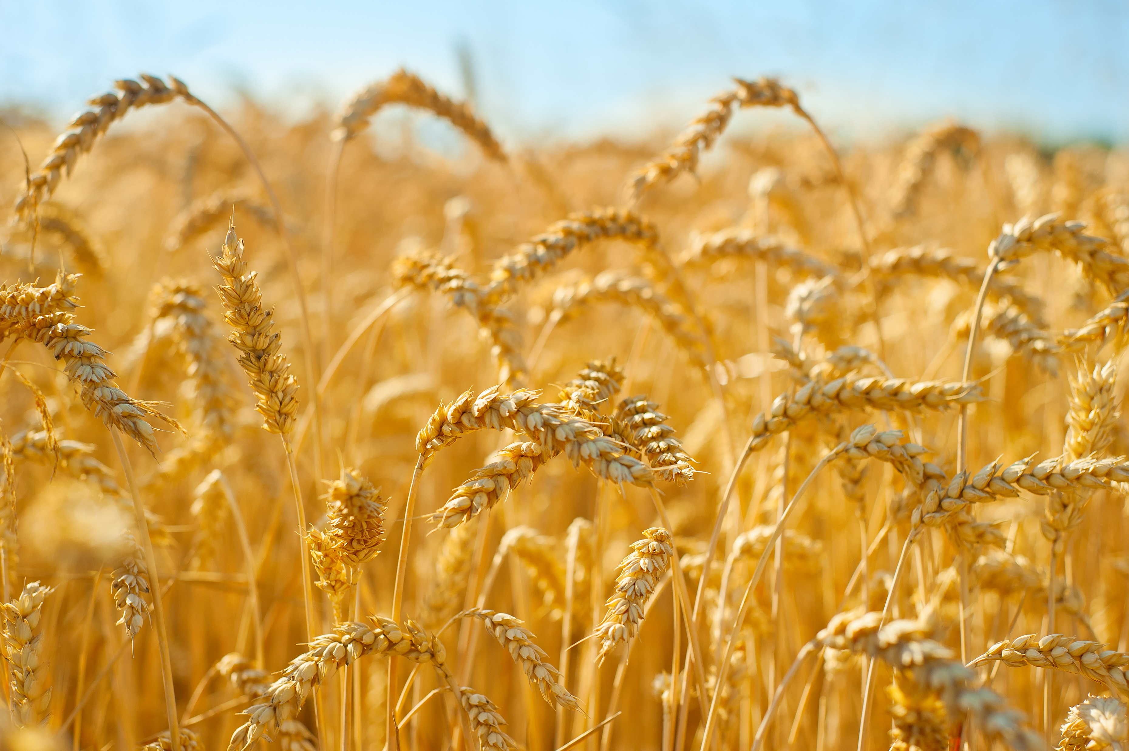
INTRODUCTION AND REGULATIONS
Why did Spain need a Royal Decree that regulate fertilization?
National implications: Royal Decree 1051/2022
National implications: Royal Decree 1054/2022, SIEX, REA and CUE
INDEX
SATIVUM
What is SATIVUM?
Algorithm
Mapping
APIs
CONCLUSIONS

Slide 4
1. Why did Spain need a Royal Decree that regulate fertilization?
Fertilization is an indispensable work in productive agriculture
Environmental problems linked to inappropriate fertilization: need to control and to prevent
Opportunity to improve farm profitability
Water
DIR 91/676/EEC
Air
GHG (climatic neutrality 2050)
Soil
Circular economy
Pollutants (HAP16, PCDD/PCDF, heavy metals, …)
Royal Decree 47/2022 with new criteria for defining vulnerable zones:
Surface waters: 25 mg/l;
Groundwaters: 37,5 mg/ml
↓ 3% (2005): 2020 – 2029 ≈ 467,5 kt
Microplastics
…
NH₃ (Directive 2016/2284)
Organic matter
↓ 16% since 2030
Macroscopic impurities

Slide 5
2. National implications: Royal Decree 1051/2022, Sustainable nutrition in agricultural soils.
Purposes:
Holistic approach
Structure of the RD classified by materials
Tools:
  Field book
  Fertilization budget
  Fertilizing adviser (it can be substituted by an app similar to FaST) to make the fertilizing plan
  Measures depending on the nutrient / on the material
Productivity
Protection of the environment

Slide 6
Fertilization plan
Take into account
Different sources
N
+20%
P₂O₅
+30%
5 years
K₂O
+20%
5 years
Product choice: nutrient limits
Digital tool
Crop needs
Crop
Expected yield
Nutrient availability in soil
Soil
Former crop
Application rate
Splitting
Form / product
Irrigation water
Distribution
Mitigation measures for reducing ammonia and GHG emissions

Slide 7

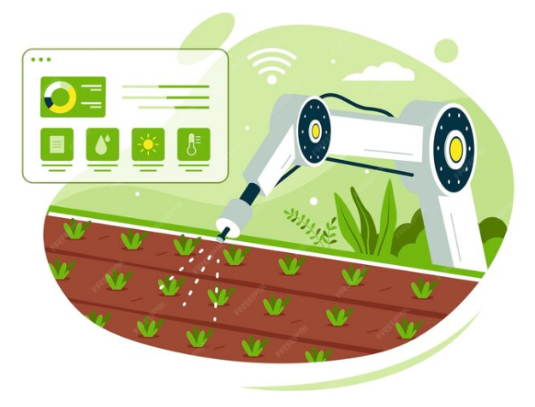

3. National implications: Royal Decree 1054/2022, SIEX, REA and CUE
FROM JANUARY 1, 2024
MUST include
Regulation (EU) 2021/2115
RD 1051/2022
RD 1054/2022
the functionality of the farm sustainability tool for nutrients
Public Field book

Slide 9
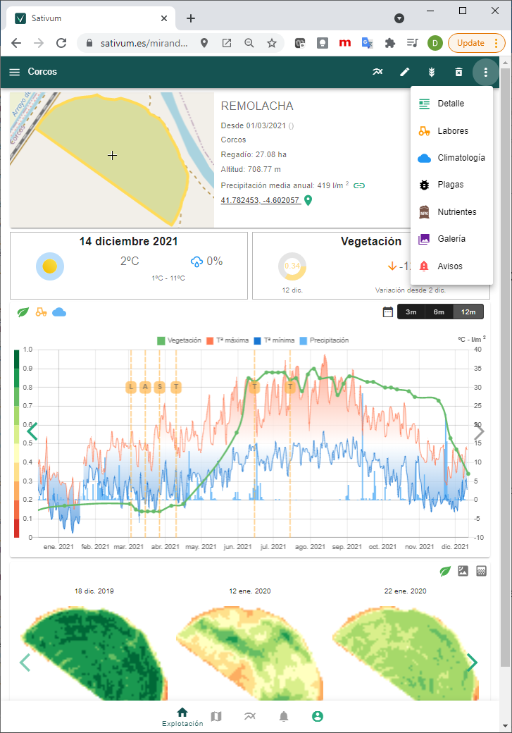


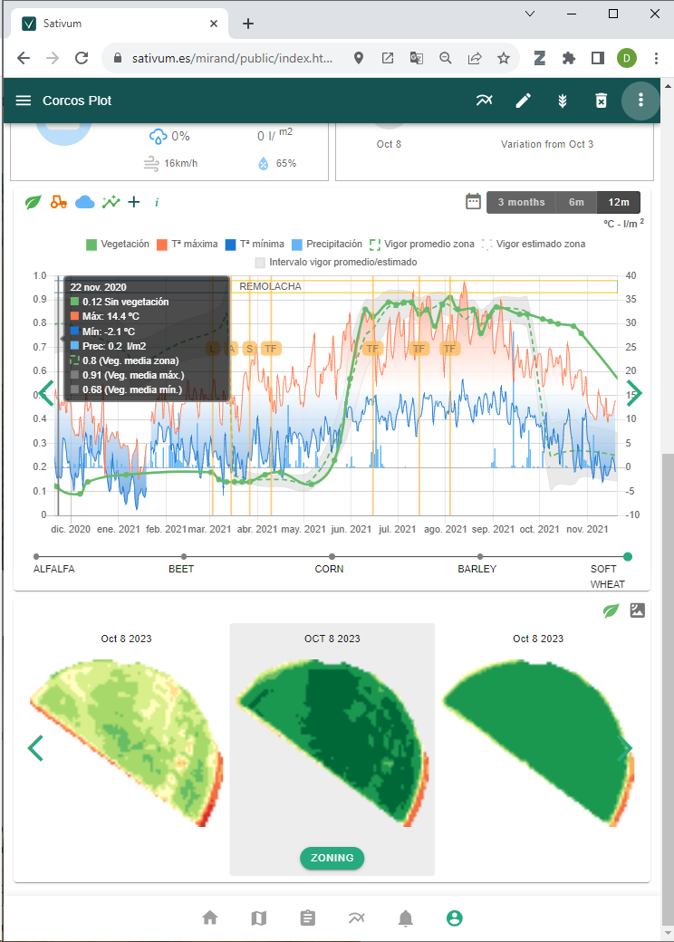
What is SATIVUM?
https://www.sativum.es/
Free public Web user interface for agronomic advise developed as a Progressive Web App.
Can be installed directly as an APP for mobile and desktop
1
Backend of services as API
Some of the API are open to developers
2

Slide 10



FERTILICALC
Algorithm
(Python GPL)
Development started in 2019, launched in 2021
FaST (Spain) Start in year 2020
SOIL DATA
LPIS+GSAA
NPK NUTRIENT ALGORITHM
(API)
FERTILIZATION FRONTEND
End of phase I (year 2021)
WORKING IN RELEASE 48 AND 49
Merging elements: FERTILICALC + FaST + SATIVUM

Slide 11
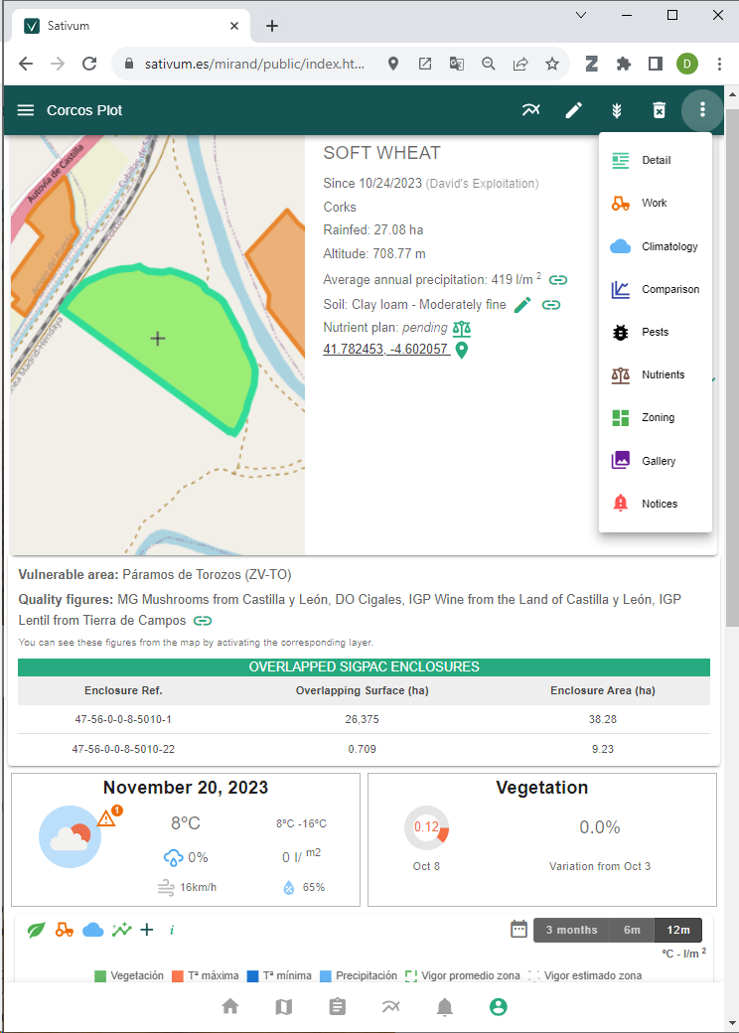
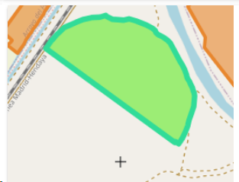
6. What is SATIVUM?
Data available
  Agricultural parcels from IACS (shared data)
  Copernicus data
  Aerial or Satellite VHR
  Public Soil data(0,3 samples/km2 density)
  Public Climate/meteo data (0,002 stations /km2)
Decision support systems integrated:
  Crop nutrition (derived from FaST project)
  Variable Rate Application
  Pest management
  More to come (irrigation)
Digital field Book
https://www.sativum.es/

Slide 13
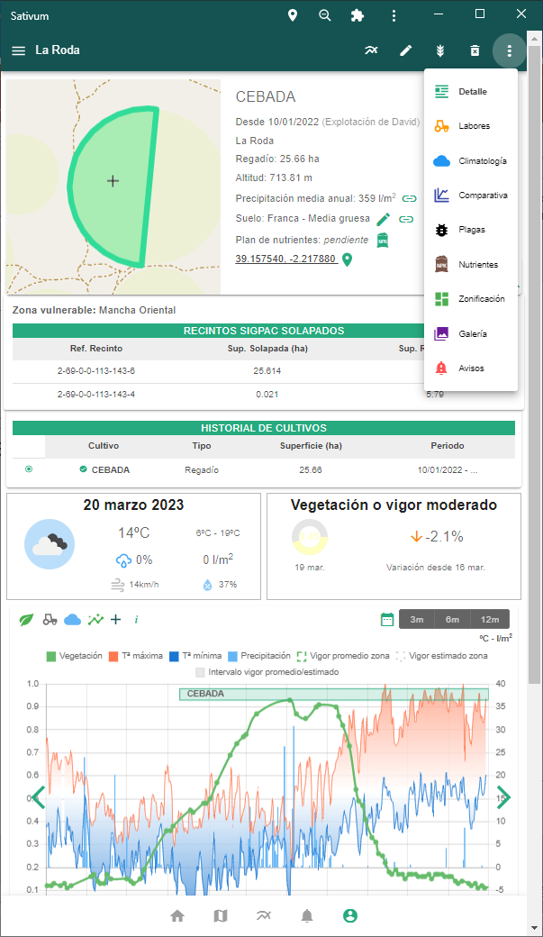
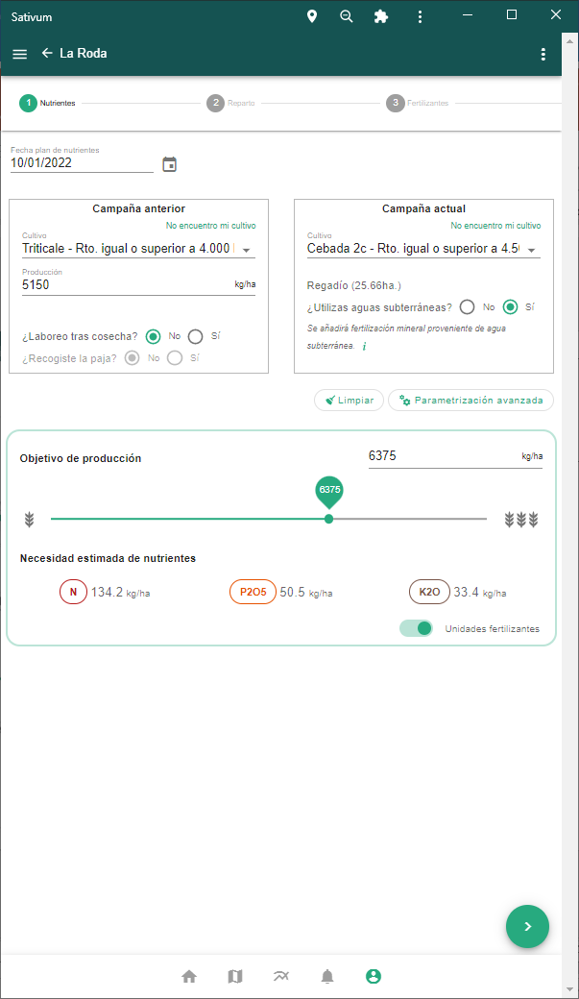
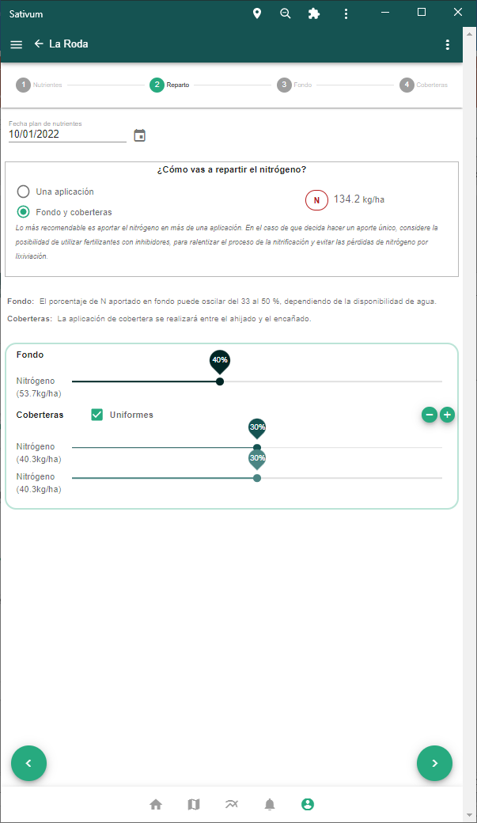
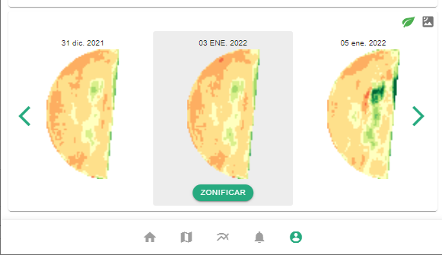

Slide 14
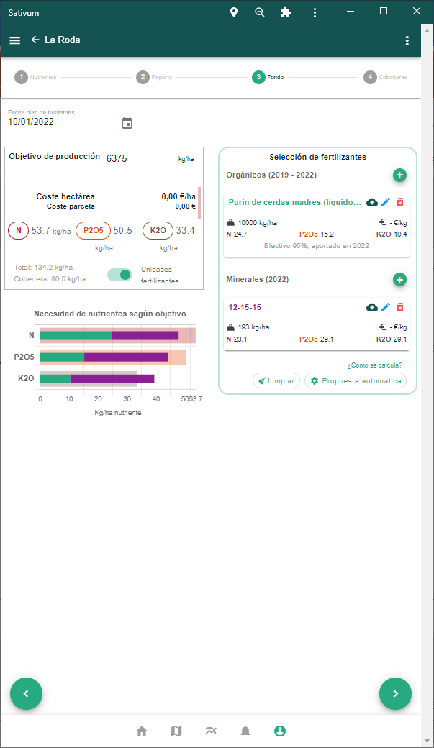
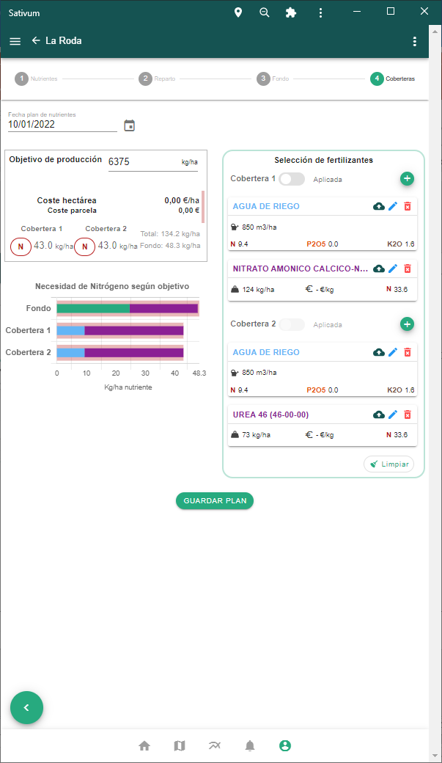
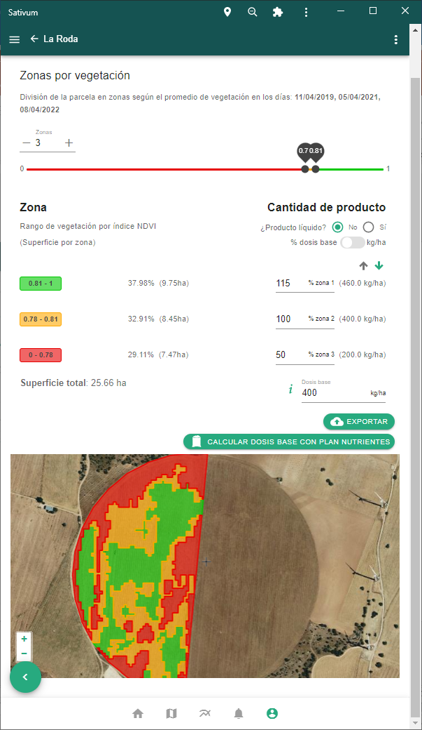

Slide 15
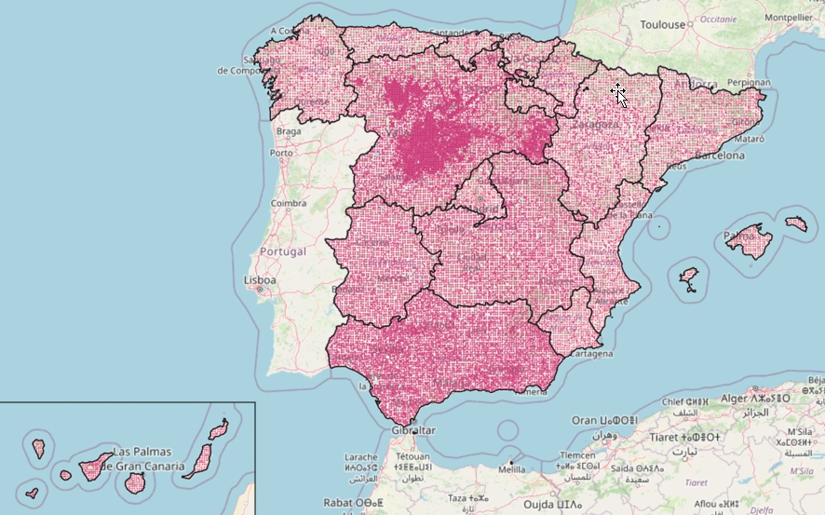
Soil points > Digital Soil Mapping > API
The services behind the APP: Backend
About 50.000 georeferenced soil samples collected all over Spain from multiple sources, including private sector.
National government will collect and analyse 16,000 new points in 2024 with two depths.
Soil texture, organic matter, P and K are interpolated using Digital Soil Mapping techniques with covariate variables

Slide 16
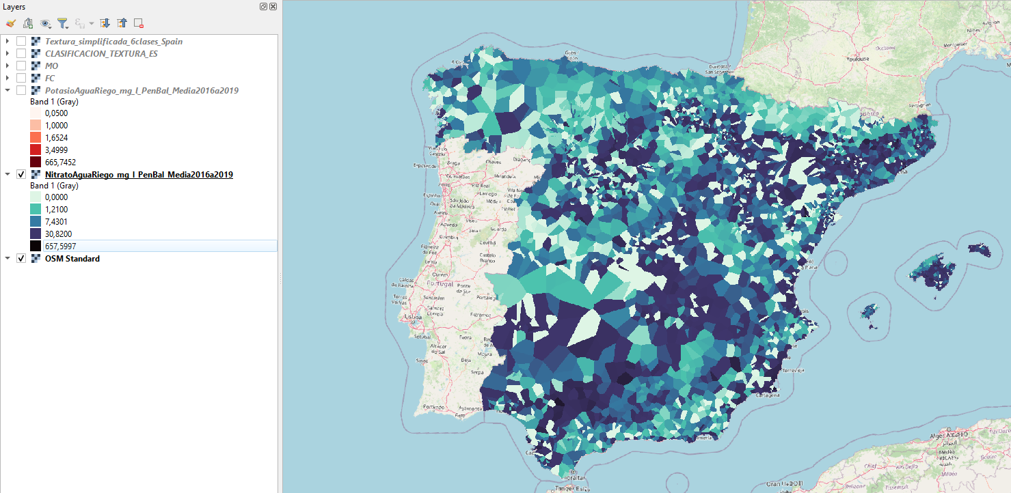
N-NO3 content in groundwater

Slide 17



New plethora of API for third parties funded by CAP Coordinating body of Spain (FEGA)
Crop nutrient budgetting (balance)
API B for crop parameters for nutrition algorithm
API C for nutrient balance calculation
Fertilizer recommendation
API D for organic fertilizer listing
API E for inorganic fertilizer listing
API G for automatic fertilizer proposal service
Geospatial data services
API A for soil query (from interpolated maps)
API F for N and K content of irrigation water
HTML demo interface: simple PWA and request sequence documentation
API H access to SIGPAC enclosures
OAS 3.1

Slide 18
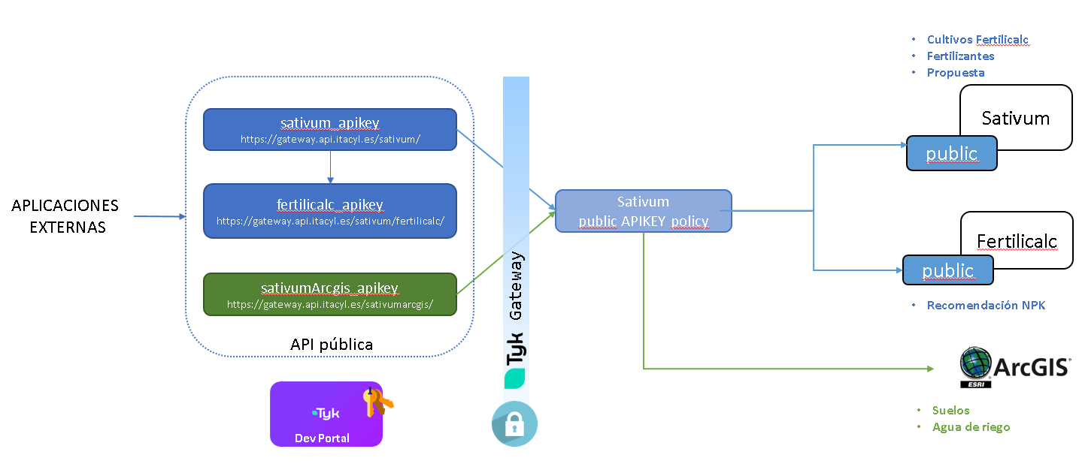
API schema for third party APPs

Slide 19
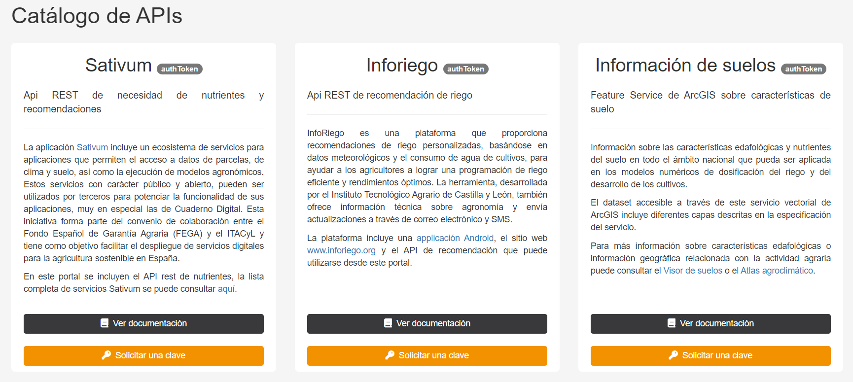
Developper portal
https://portal.api.itacyl.es/portal/apis/

Slide 20
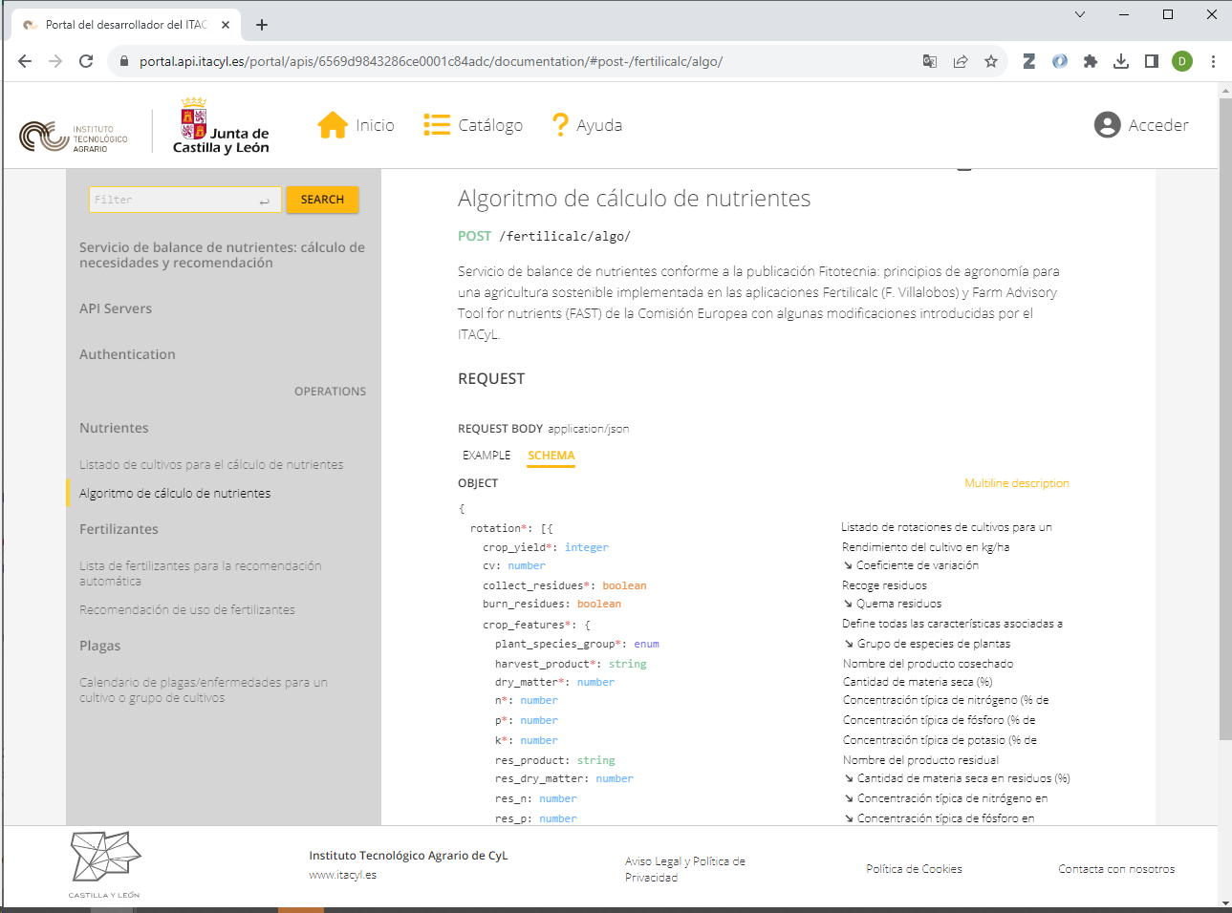

Slide 21
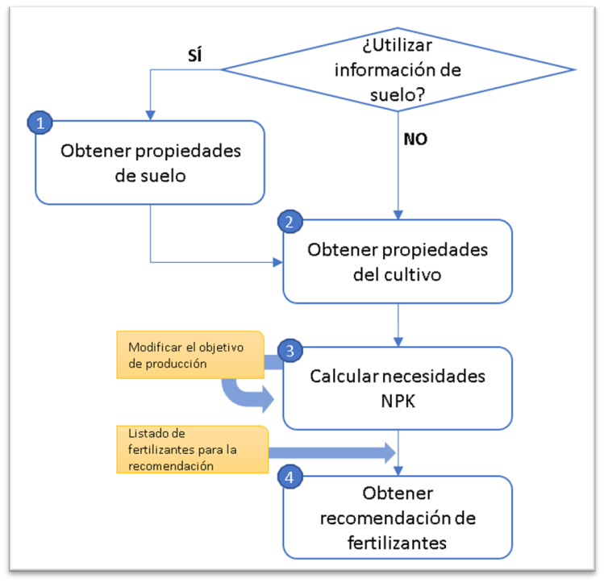
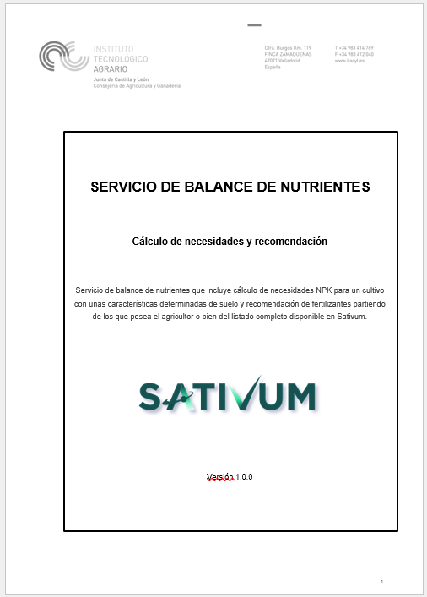
Doc descriptivo

Slide 22
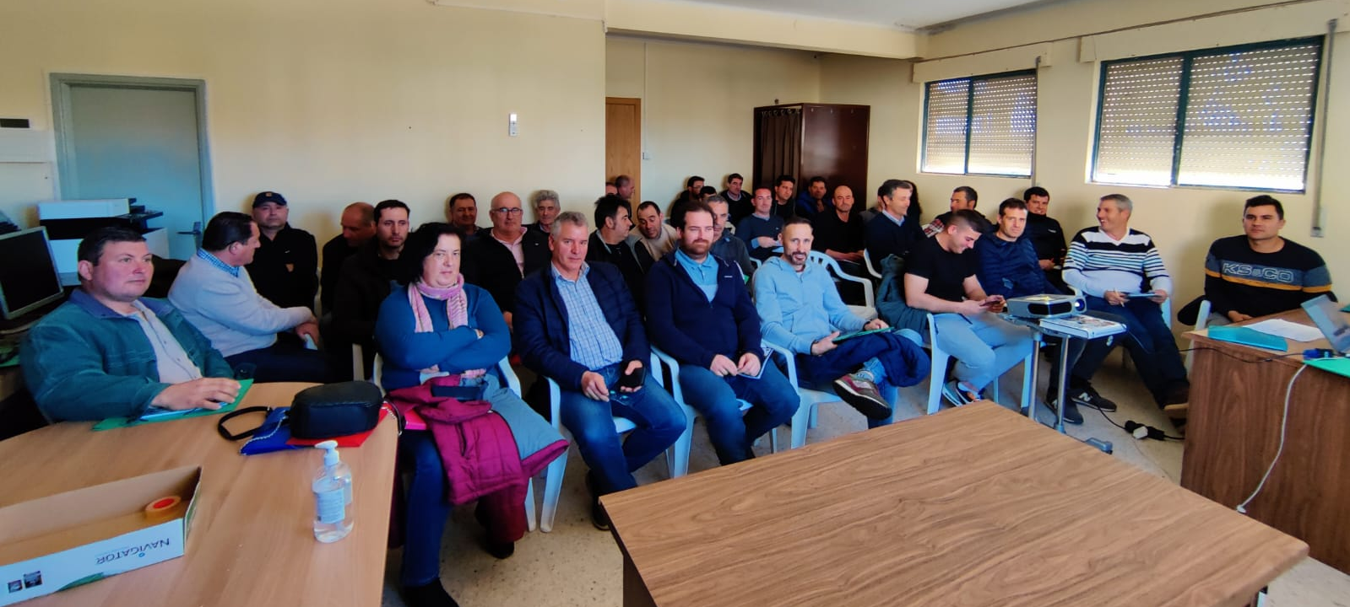
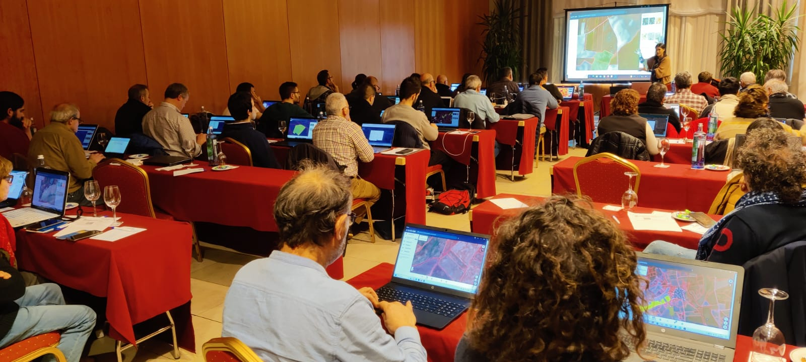
User experience (march 2024 data)
Farmer and advisors
  Users active: 3,999
  Parcels included: 311,211 (26,759 of them with nutrient plan)
  Training sessions in 2023: 74
  Farmers/advisors audience in 2023: 2,300
Developers
  Registered with API Key: 25
  API petitions for nutrient budget during Feb. 2024: 6,481 from SATIVUM + 1,837 from third parties

Slide 23
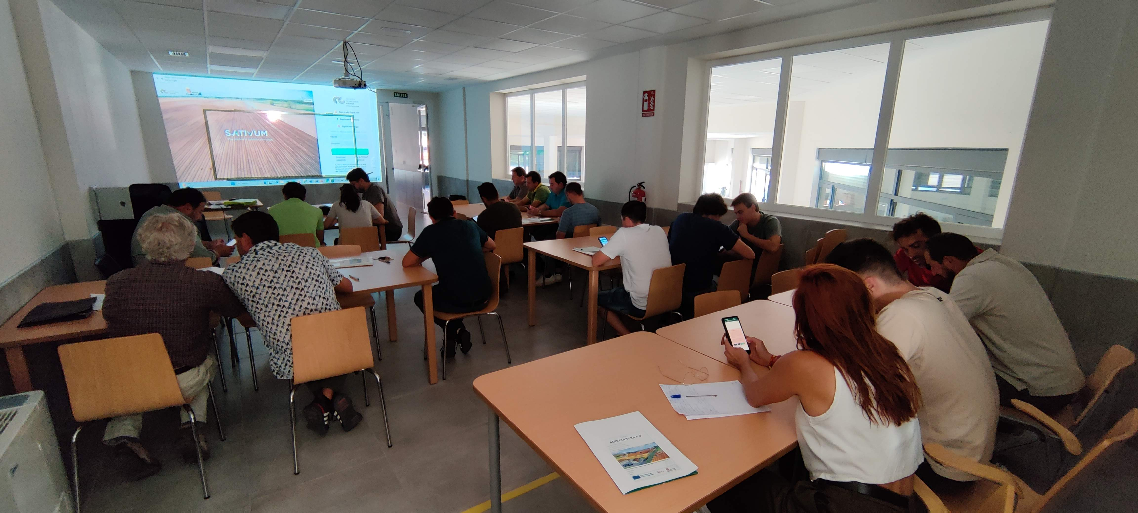
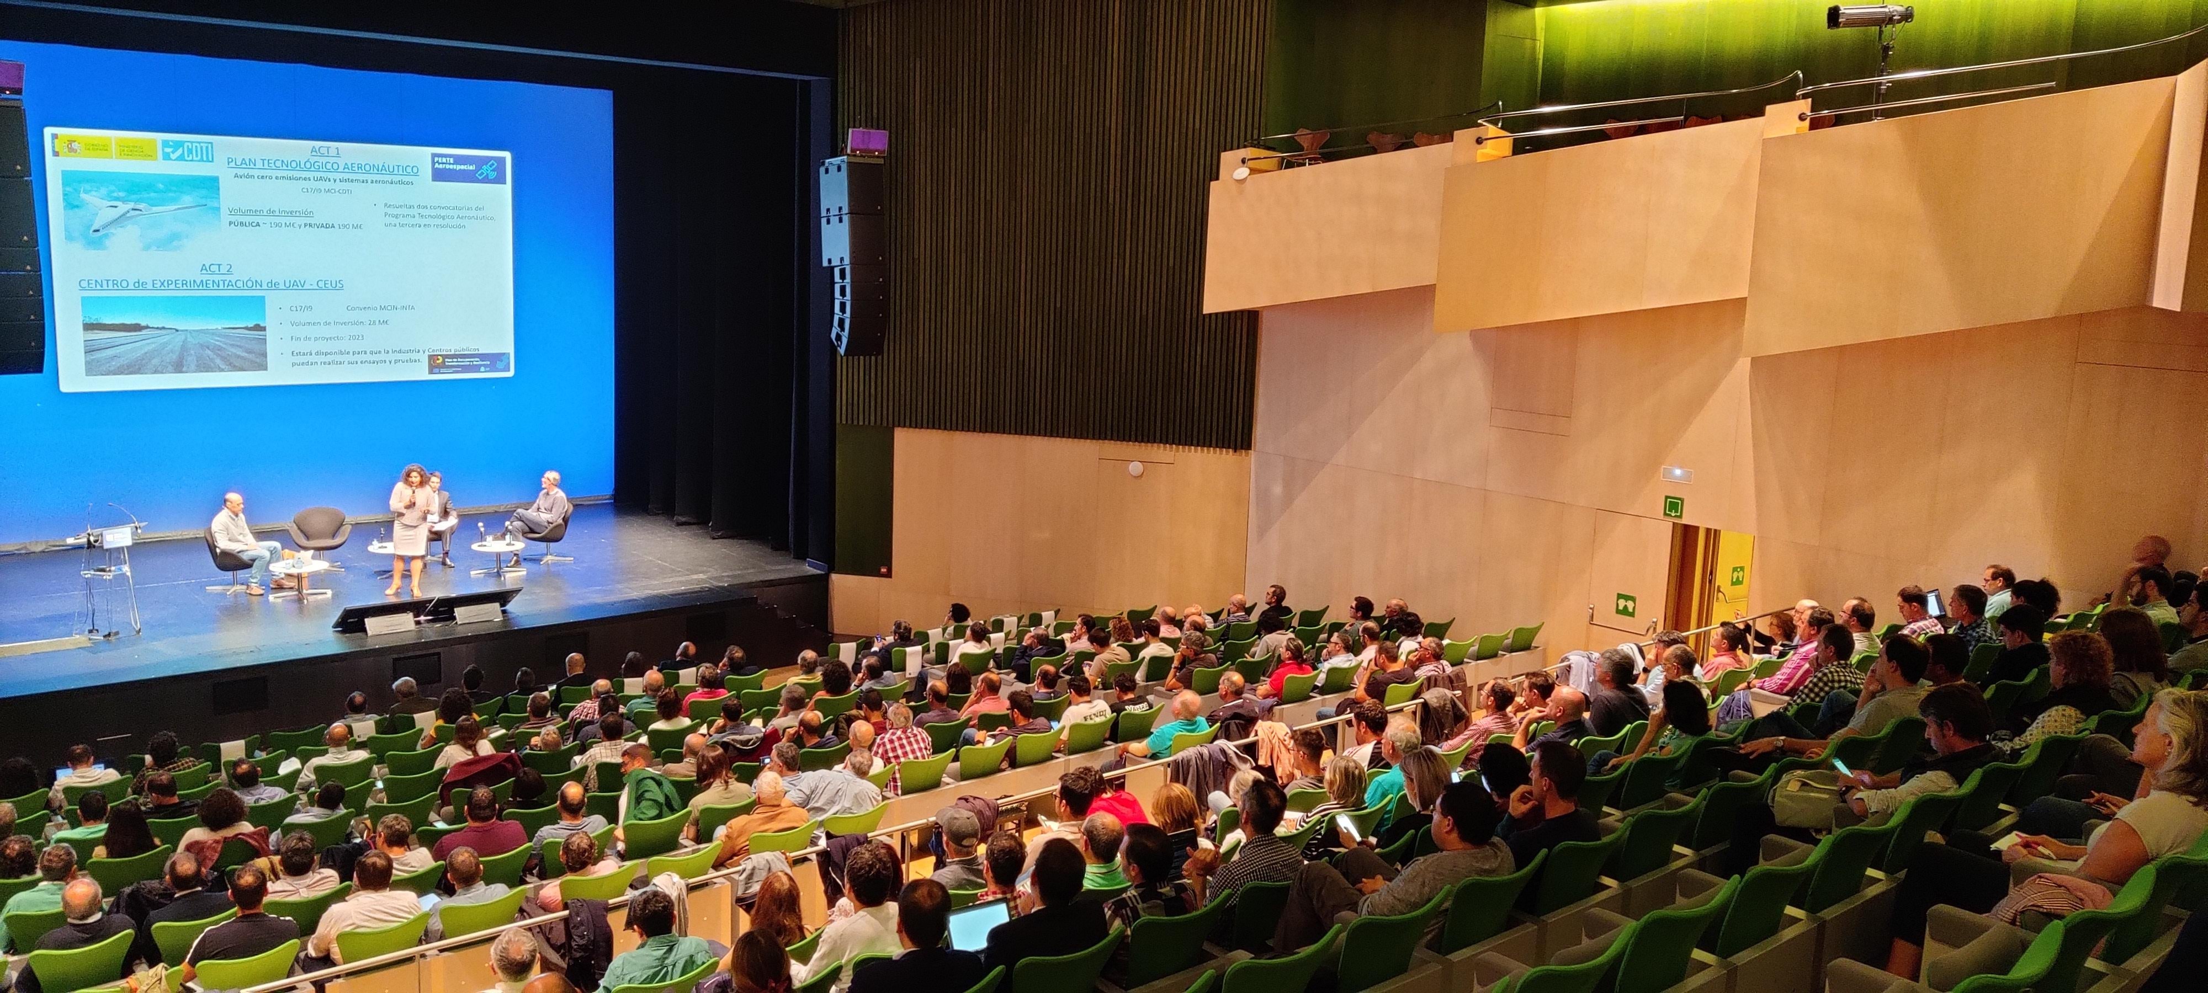
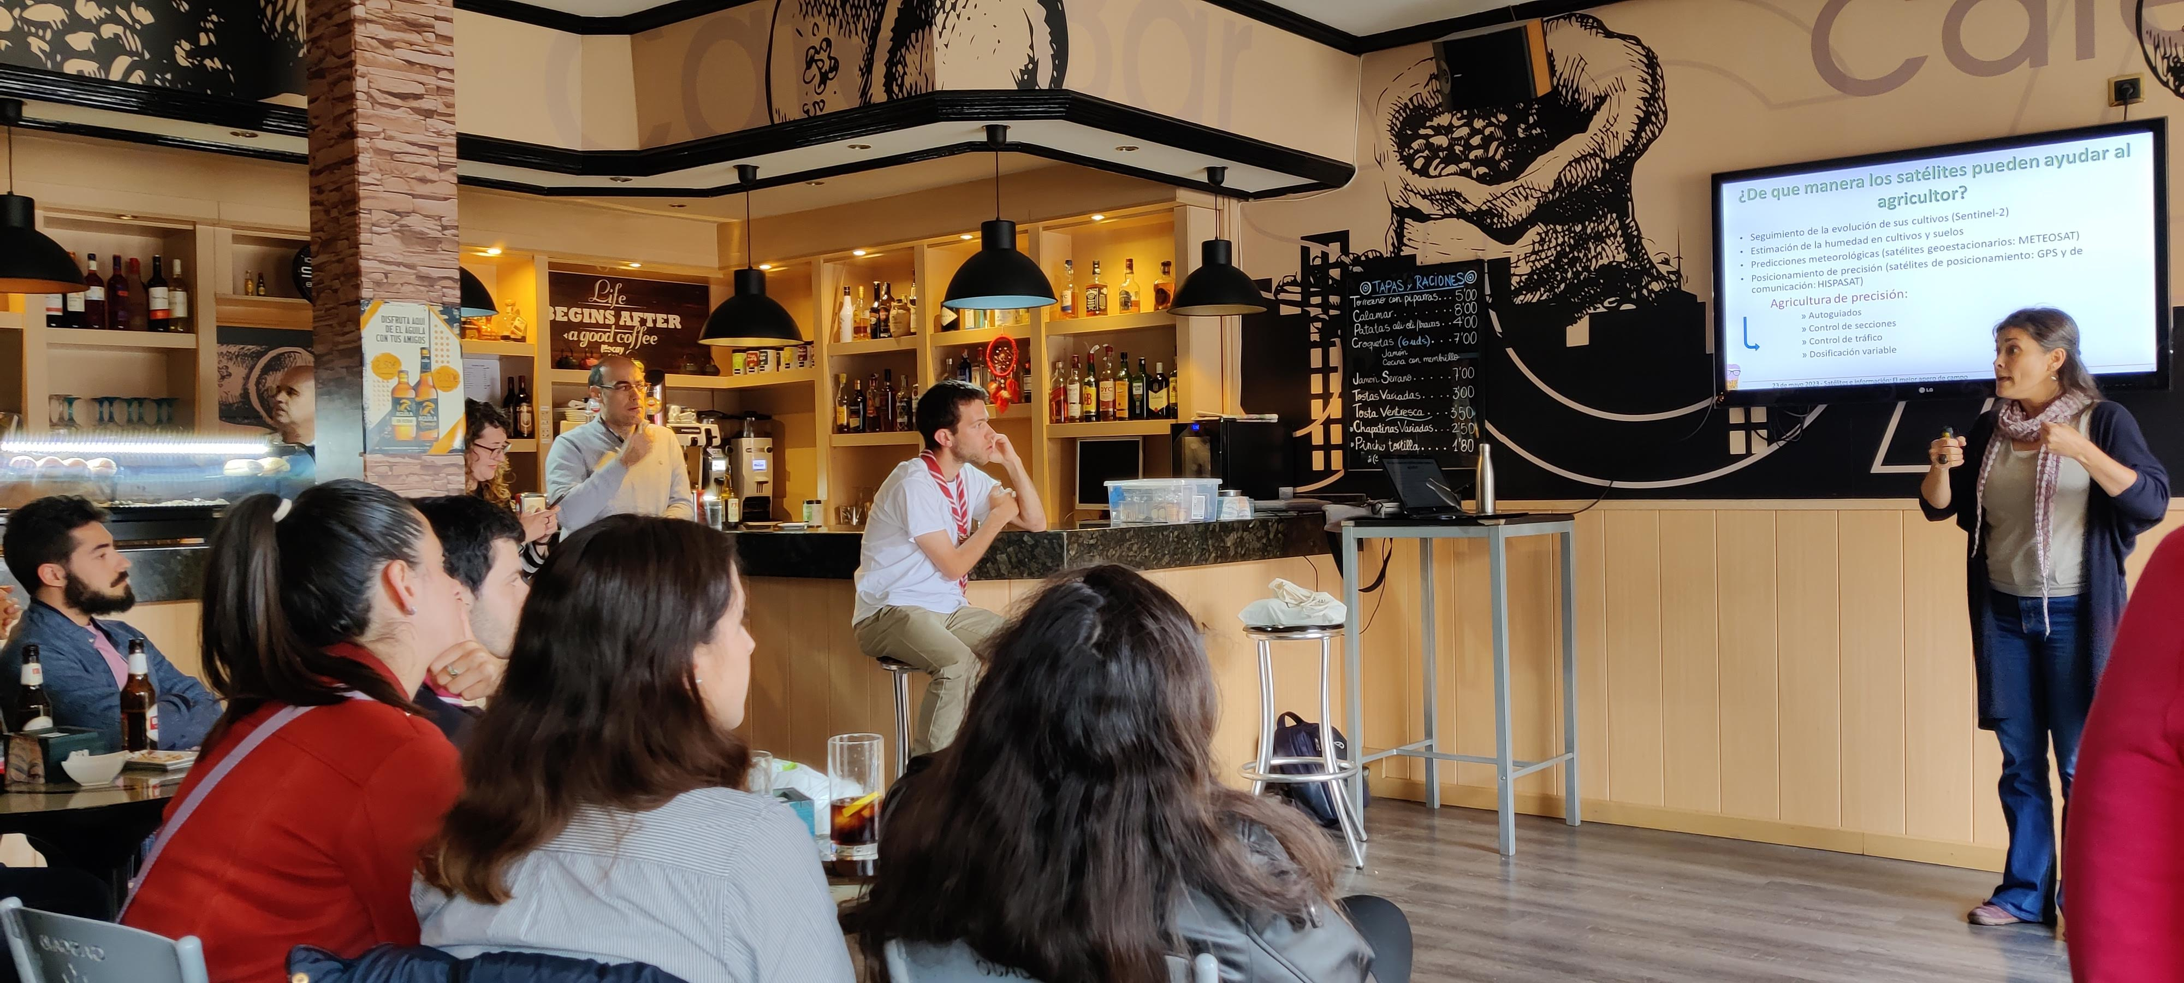
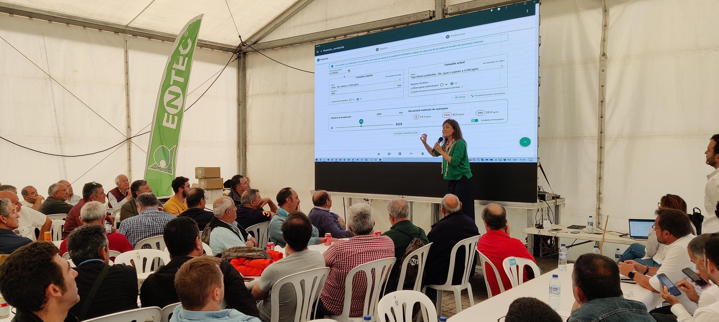
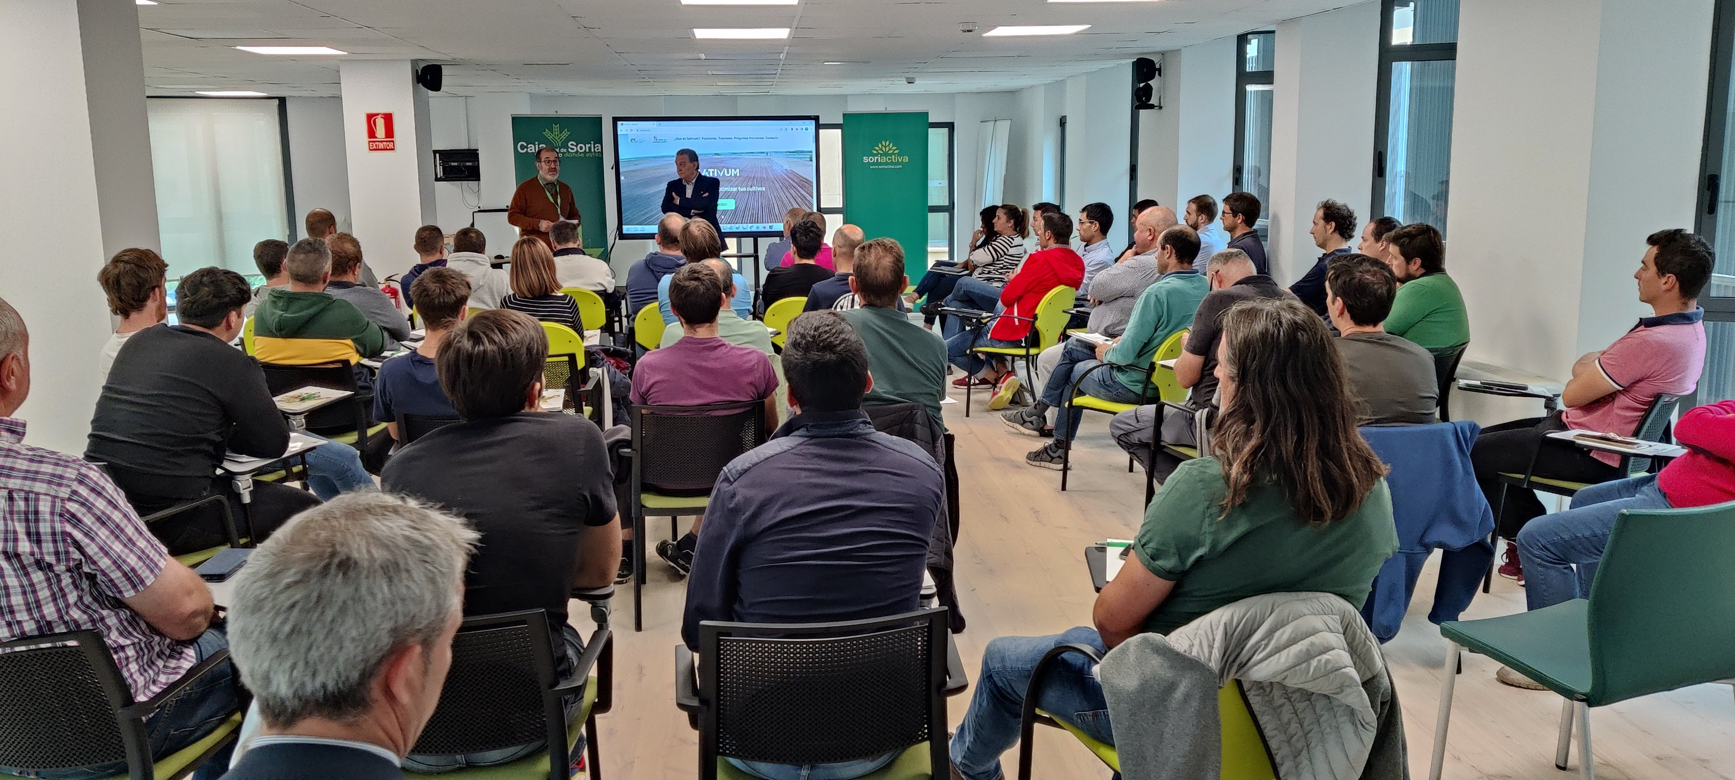
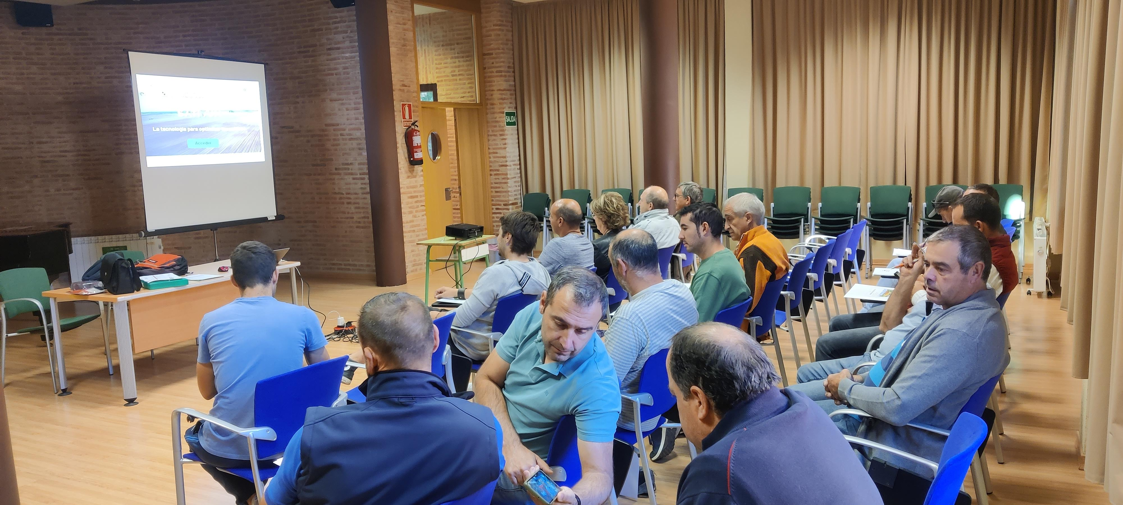
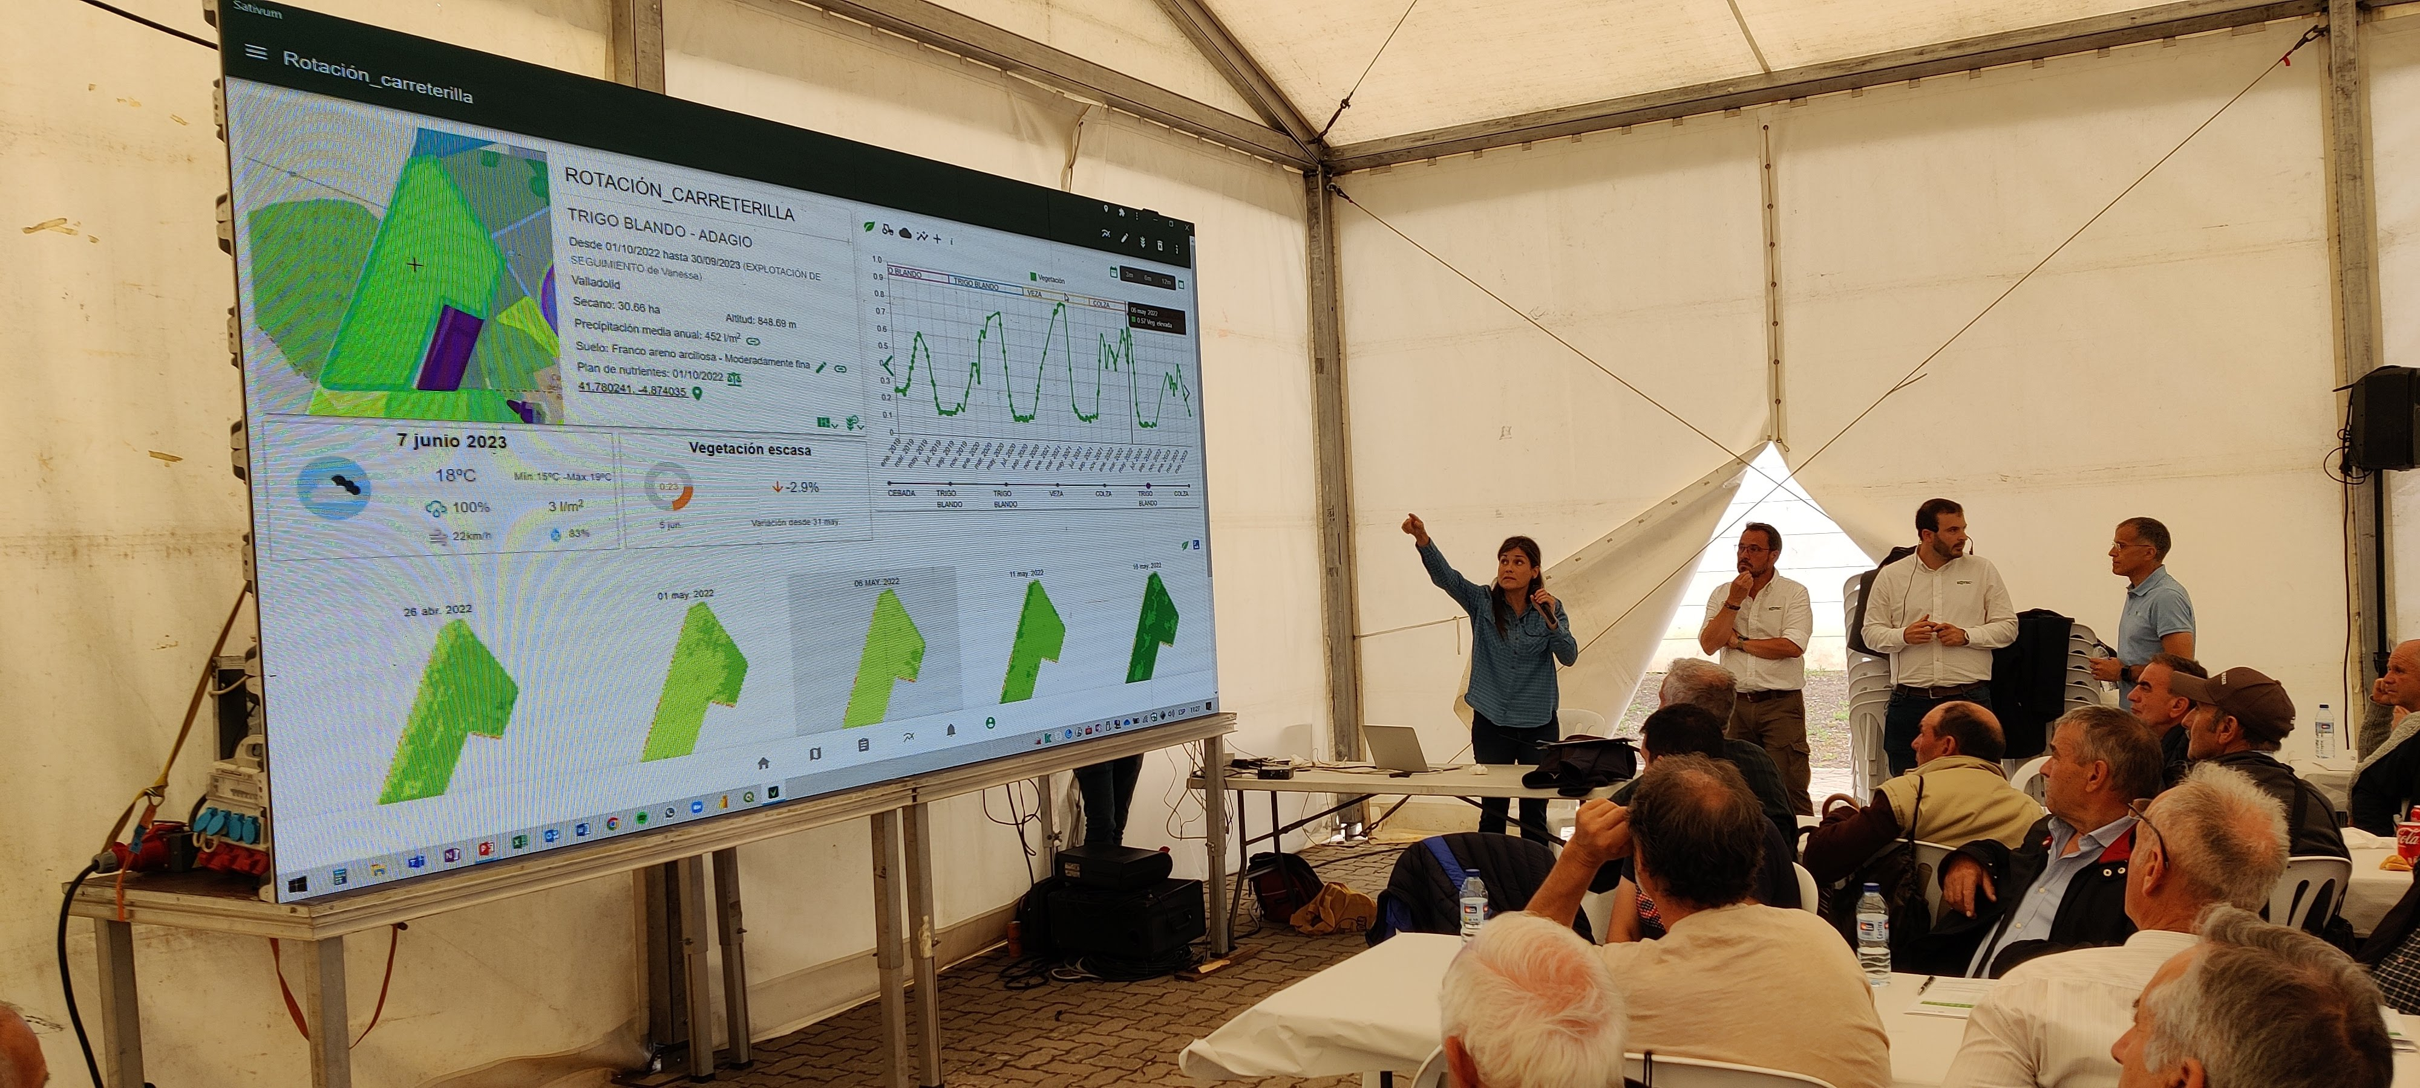
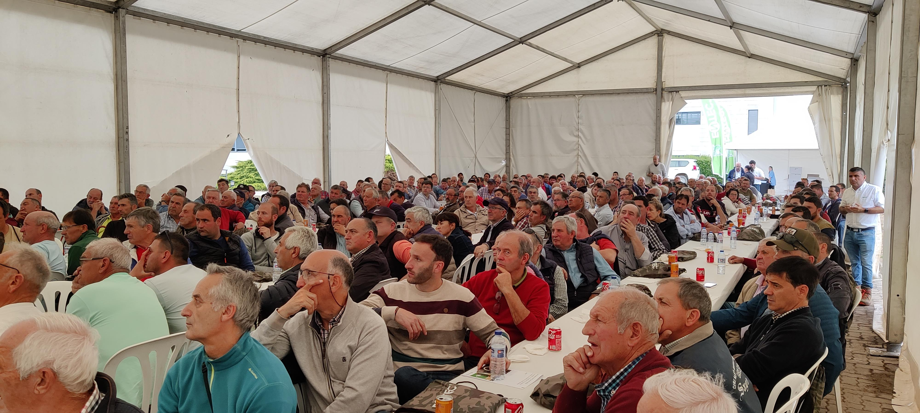
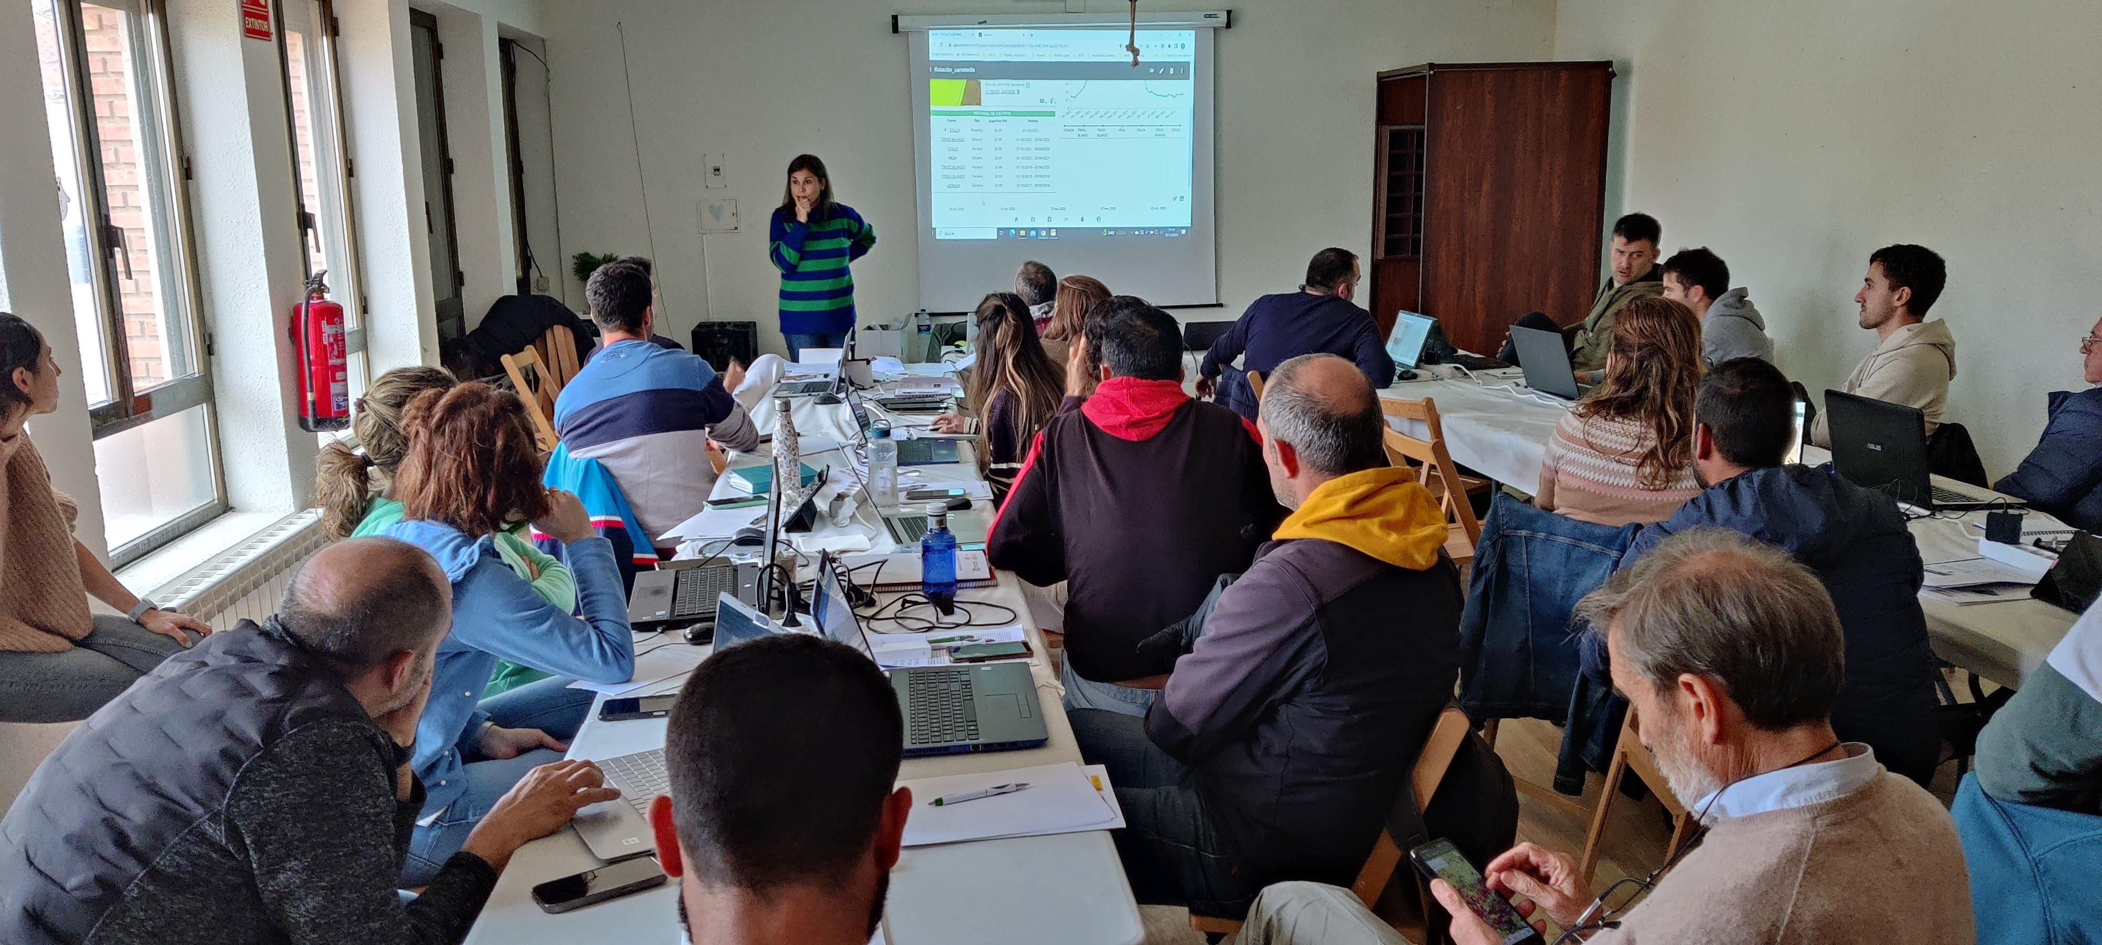

Slide 26
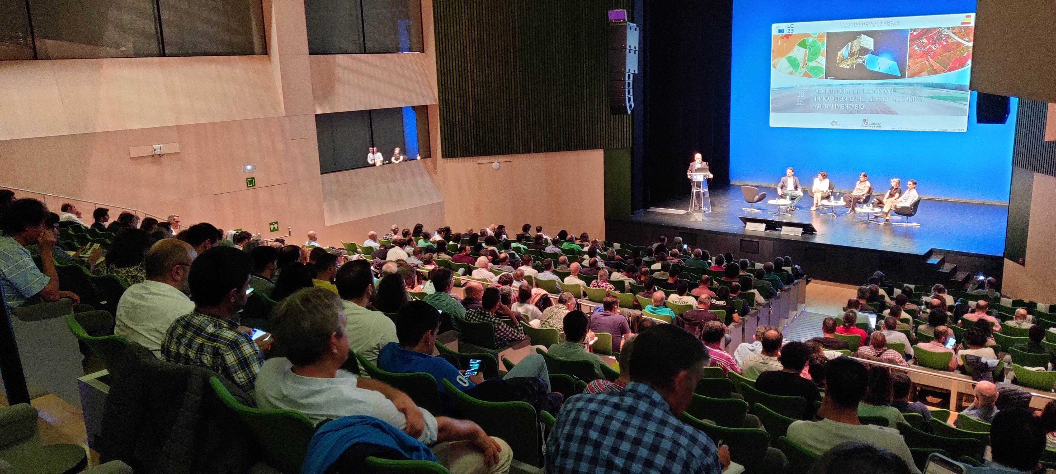

Slide 30



Farmers and their advisors feedback
The ability to perform nutrient balances has made the tool famous
The direct interaction with farmers evolved the tool but Still more evolution is needed. Many farmers don’t pass the testing phase.
What truly motivates them is regulatory pressure or the possibility of escaping it.
Much of the success lies in the fact that the pressure to create nutrient plans already exists within regulations or is being established, while SATIVUM emerges as a problem solver.

Slide 31
Examples of integrations in third party APP

Slide 32

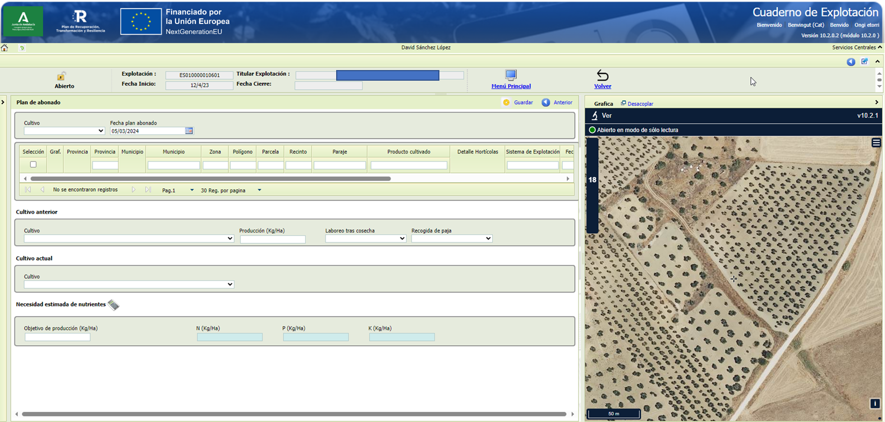
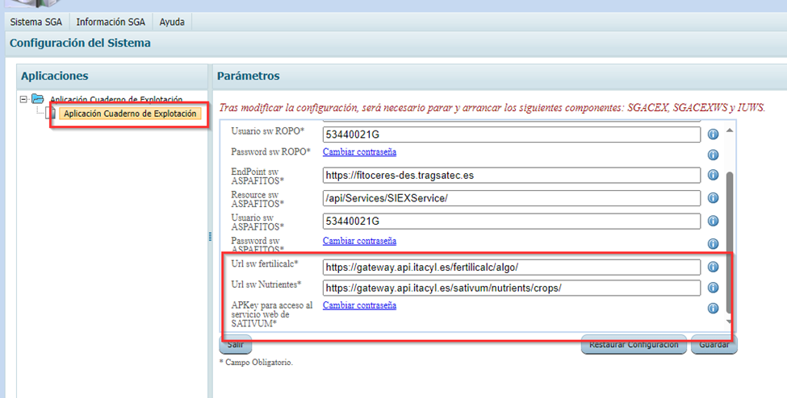

Slide 33

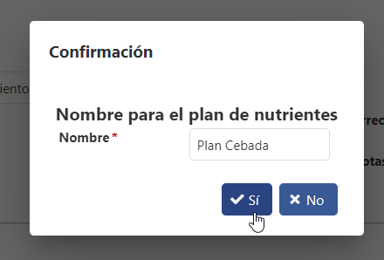
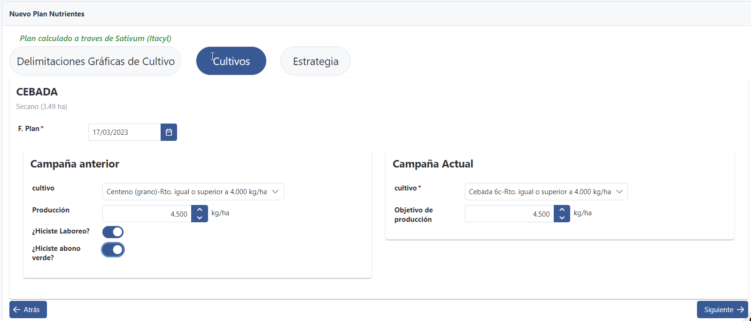
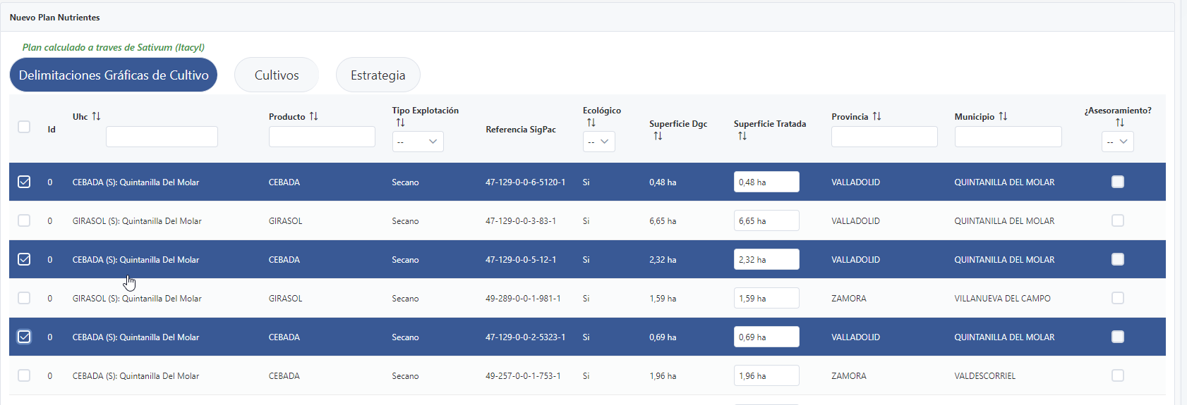

Slide 34
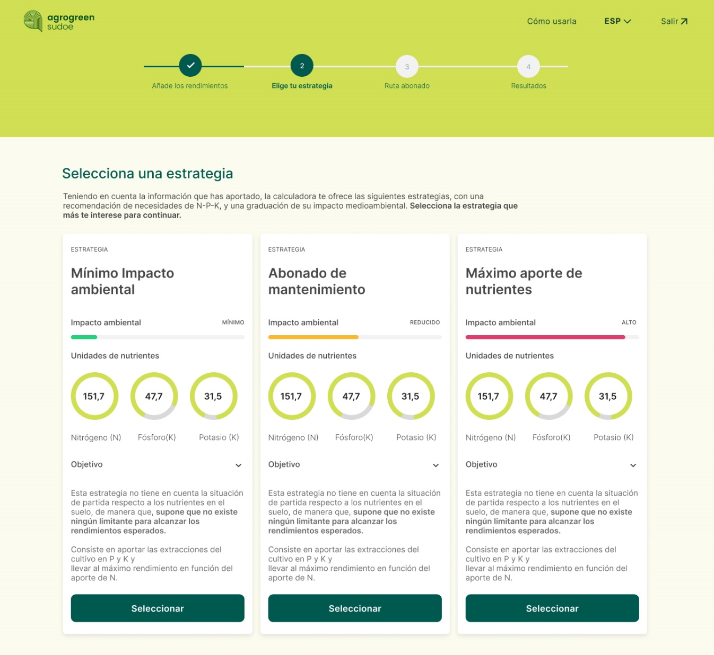


Slide 35
Conclusions
SATIVUM enables Spain to fulfill the obligations of having a Farm Sustainability tool for nutrients.
Spain has gone one step further by making the FAST functionality mandatory in all digital field books.
A plethora of SATIVUM APIs and a portal with call examples allow developers to create their own frontend with the same functionality as SATIVUM.
Be cautious about making a tool mandatory because crop nutrition is incredible complex and agriculture practices is incredibly diverse.
What drives our development is provide service to the farmers.

Slide 36
THANK YOU FOR YOUR ATTENTION
Notes:
Agradecimiento.
Qué se va a exponer.

