Slide 1
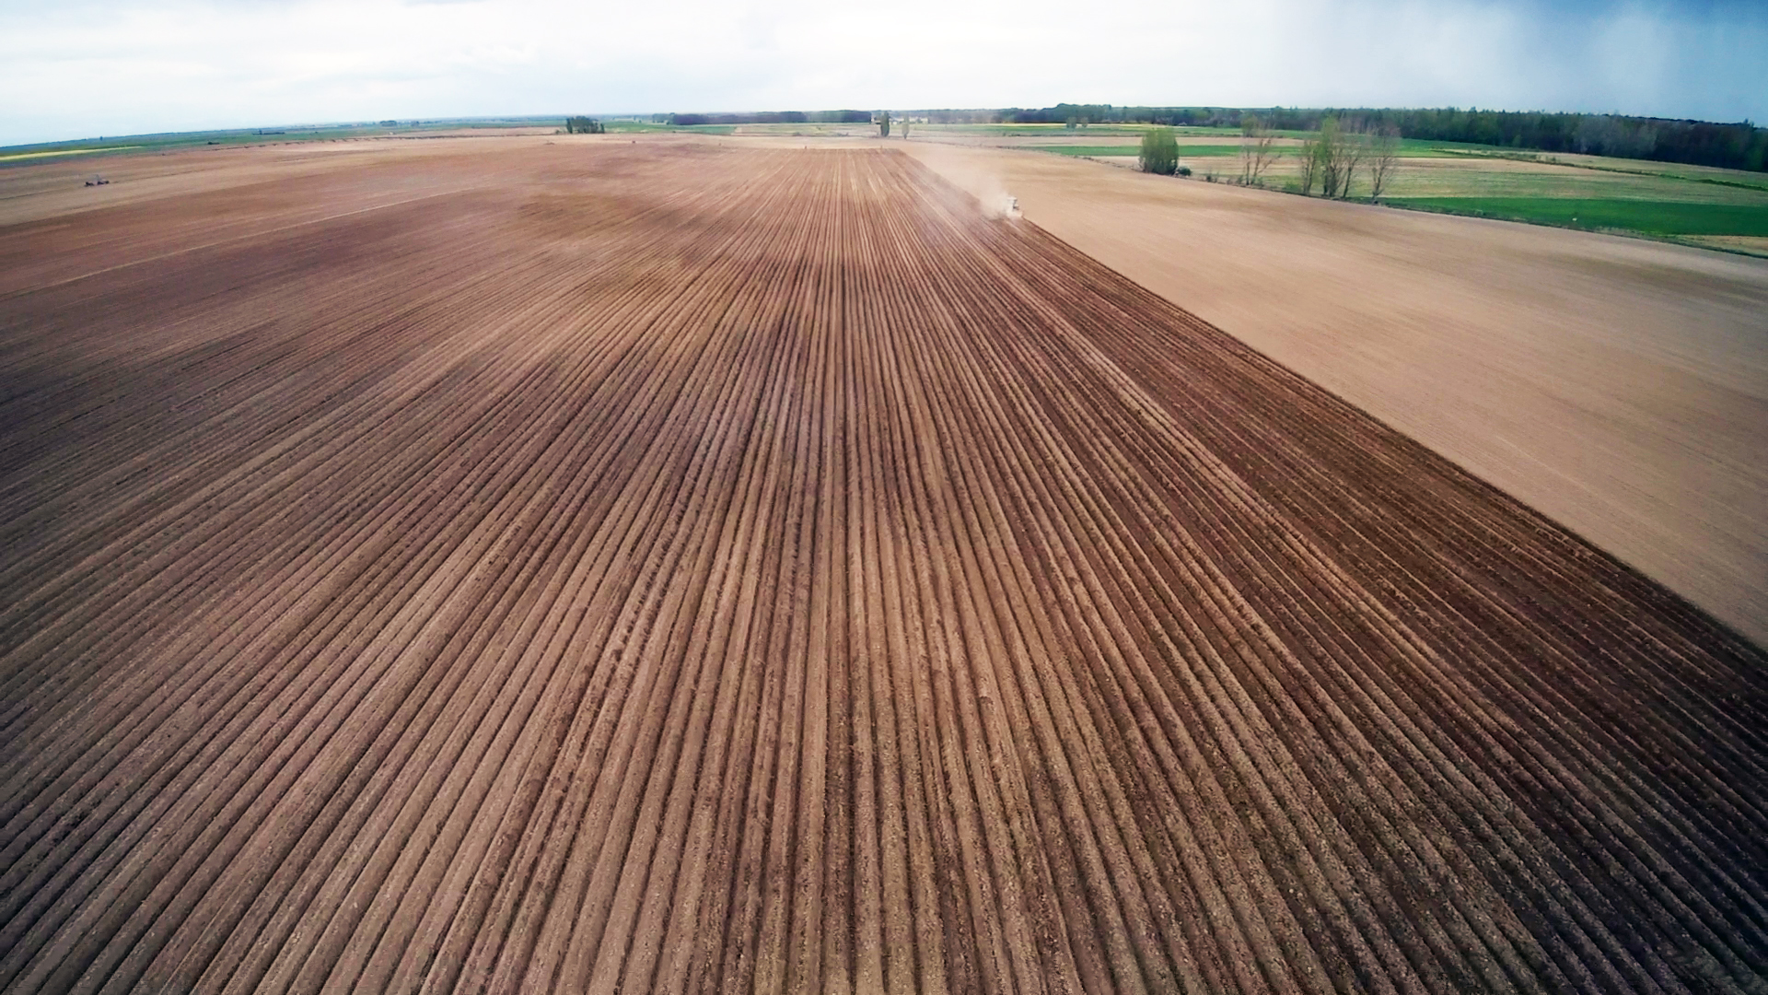




SATIVUM and Farm Sustainability tool for nutrient functionality across Spain
BEST PRACTICE APPLICATIONS OF THE FARM SUSTAINABILITY TOOL (FaST) FOR NUTRIENTS IN MEMBER STATES
MEETING OF THE EXPERT GROUP FOR HORIZONTAL QUESTIONS CONCERNING THE CAP. Wednesday 06 March 2024 from 09:00 to 12:30
Notes:
Agradecimiento.
Qué se va a exponer.

Slide 2




JORNADAS
IACS DATA SHARING
SATIVUM and Farm Sustainability tool for nutrient functionality across Spain
Martes 9 de abril 2024

Slide 3
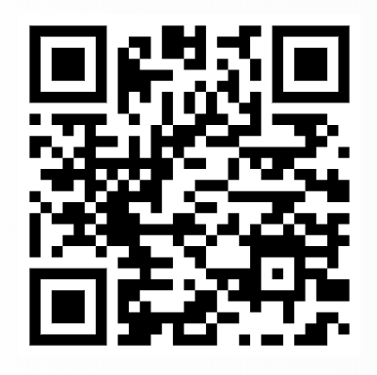
JORNADAS
IACS DATA SHARING
FORMULARIO DE PREGUNTAS
Martes 9 de abril 2024

Slide 4
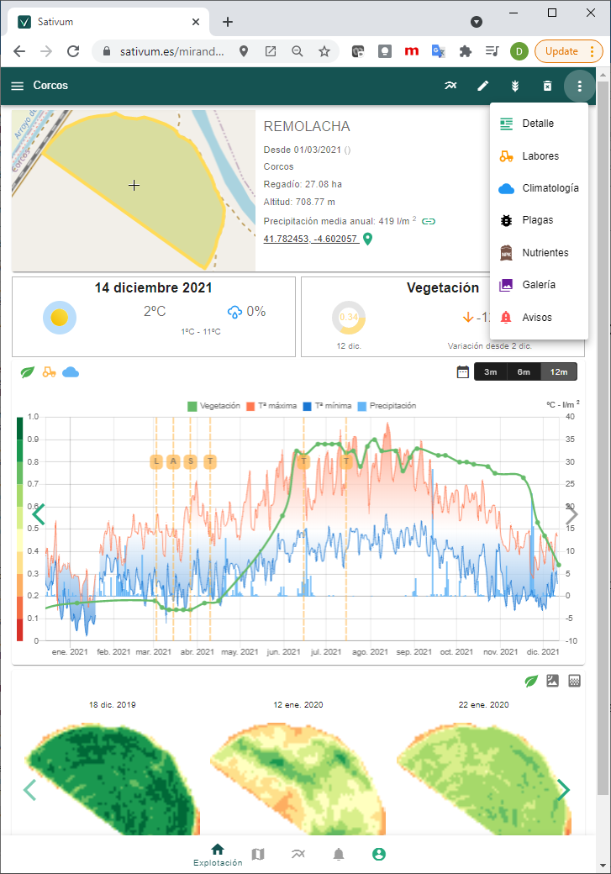


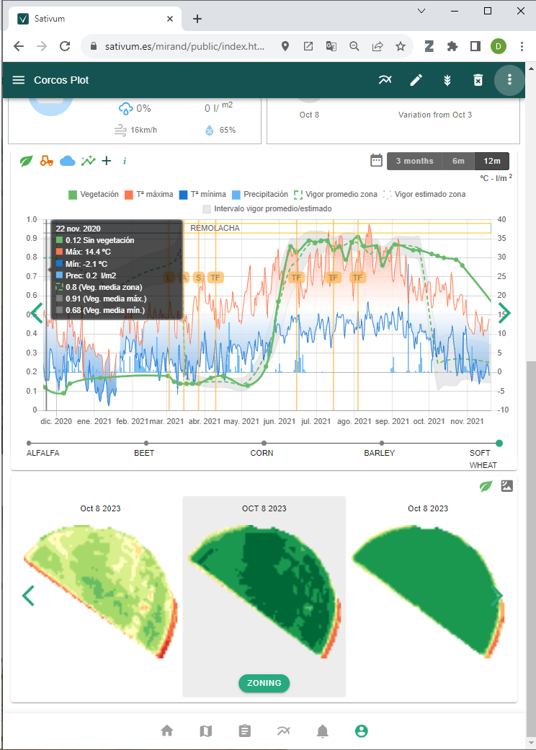
What is SATIVUM?
https://www.sativum.es/
Free public Web user interface for agronomic advise developed as a Progressive Web App.
Can be installed directly as an APP for mobile and desktop
1
Backend of services as API (some open to developers)
Supported by IACS Data Sharing (and other public data)
2

Slide 5
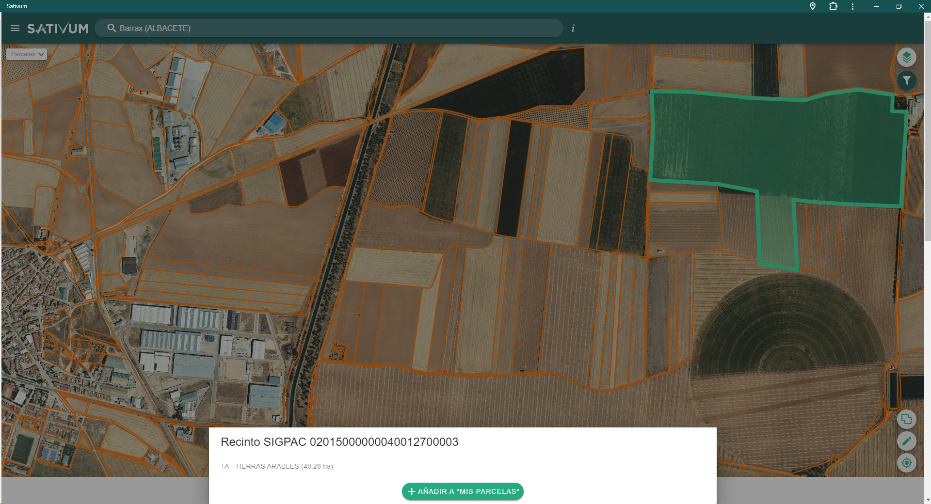
LPIS Data Sharing

Slide 6
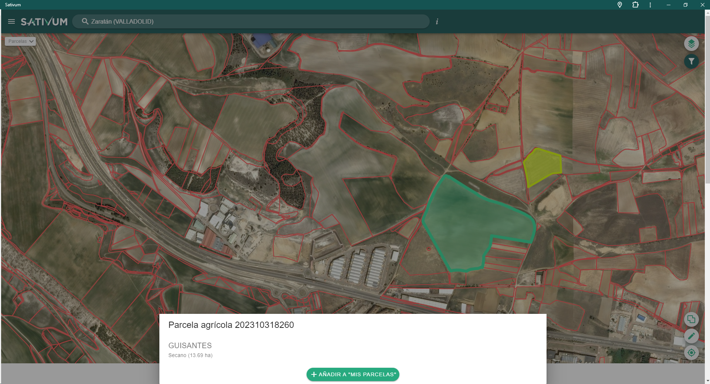
GSAA Data Sharing

Slide 7



FERTILICALC
Algorithm
(Python GPL)
Development started in 2019, launched in 2021
FaST (Spain) Start in year 2020
SOIL DATA
LPIS+GSAA
NPK NUTRIENT ALGORITHM
(API)
FERTILIZATION FRONTEND
End of phase I (year 2021)
WORKING IN RELEASE 48 AND 49
Merging elements: FERTILICALC + FaST + SATIVUM

Slide 8
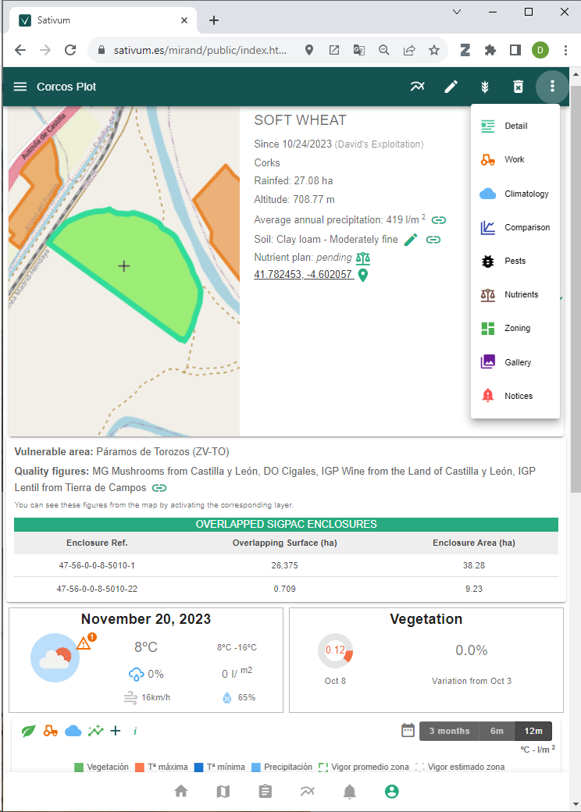
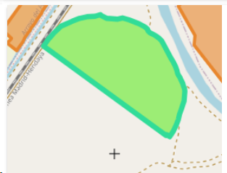
6. What is SATIVUM?
Data available
Agricultural parcels from IACS (shared data)
Copernicus data
Aerial or Satellite VHR
Public Soil data(0,3 samples/km2 density)
Public Climate/meteo data (0,002 stations /km2)
Decision support systems integrated:
Crop nutrition (derived from FaST project)
Variable Rate Application
Pest management
More to come (irrigation)
Digital field Book
https://www.sativum.es/

Slide 10
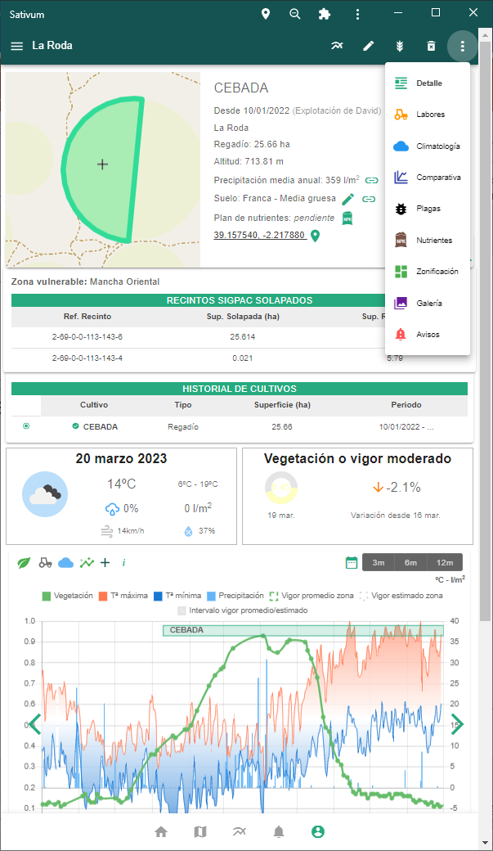
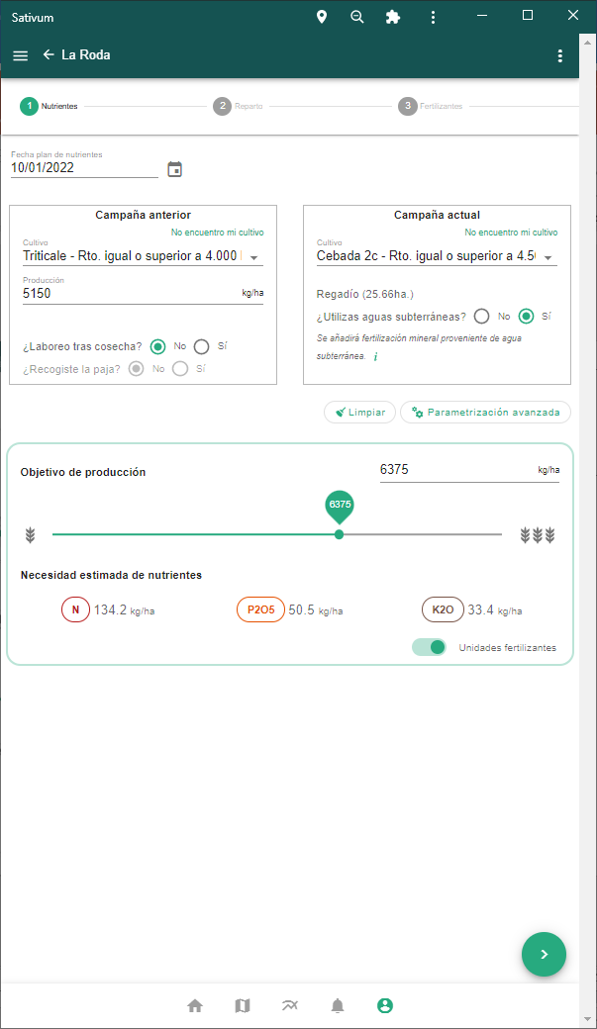
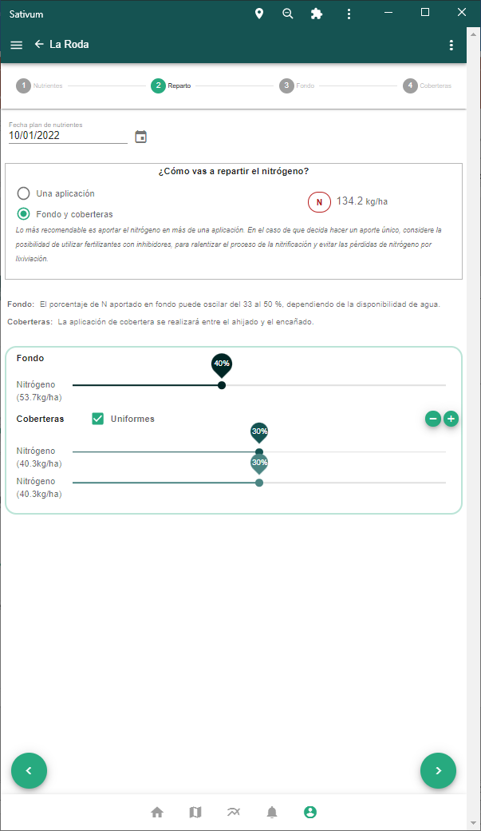
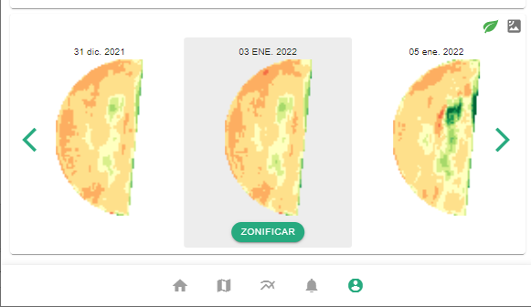

Slide 11
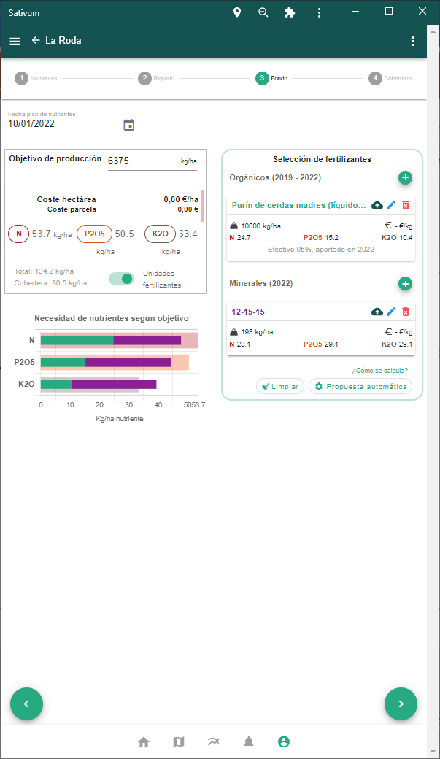
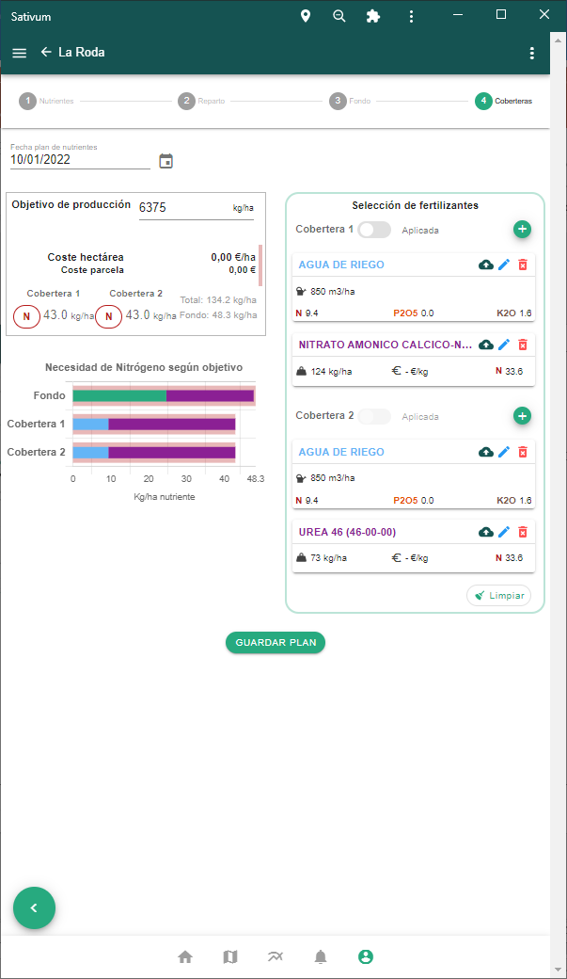
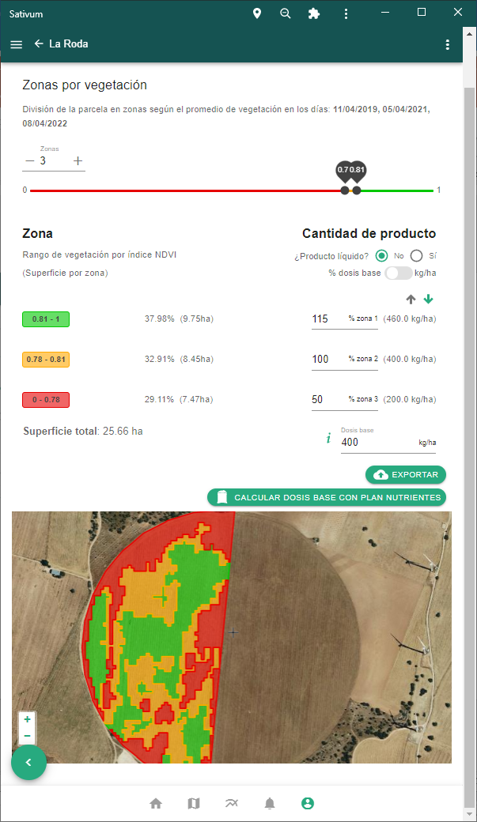

Slide 12
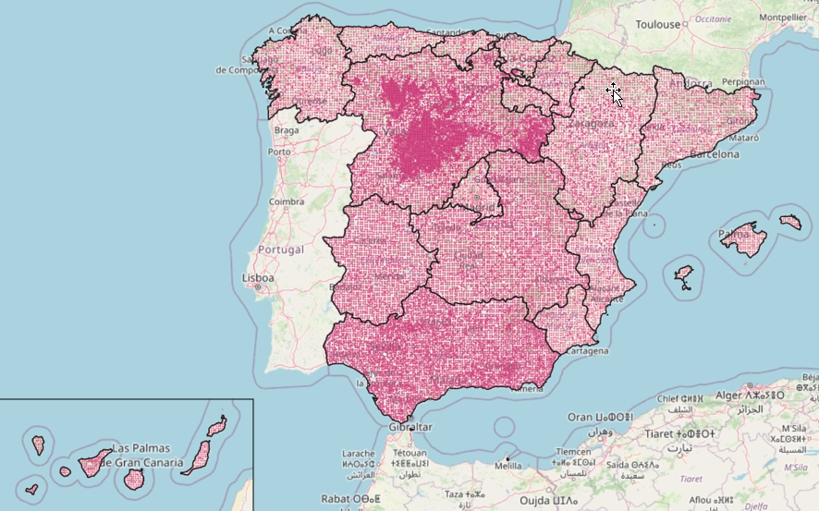
Soil points > Digital Soil Mapping > API
The services behind the APP: Backend
About 50.000 georeferenced soil samples collected all over Spain from multiple sources: Labs,
Coops, Government (INES, LUCAS…)
National government will collect and analyse 16,000 new points in 2024 with two depths.
Soil texture, organic matter, P and K are interpolated using Digital Soil Mapping techniques with covariate variables

Slide 13
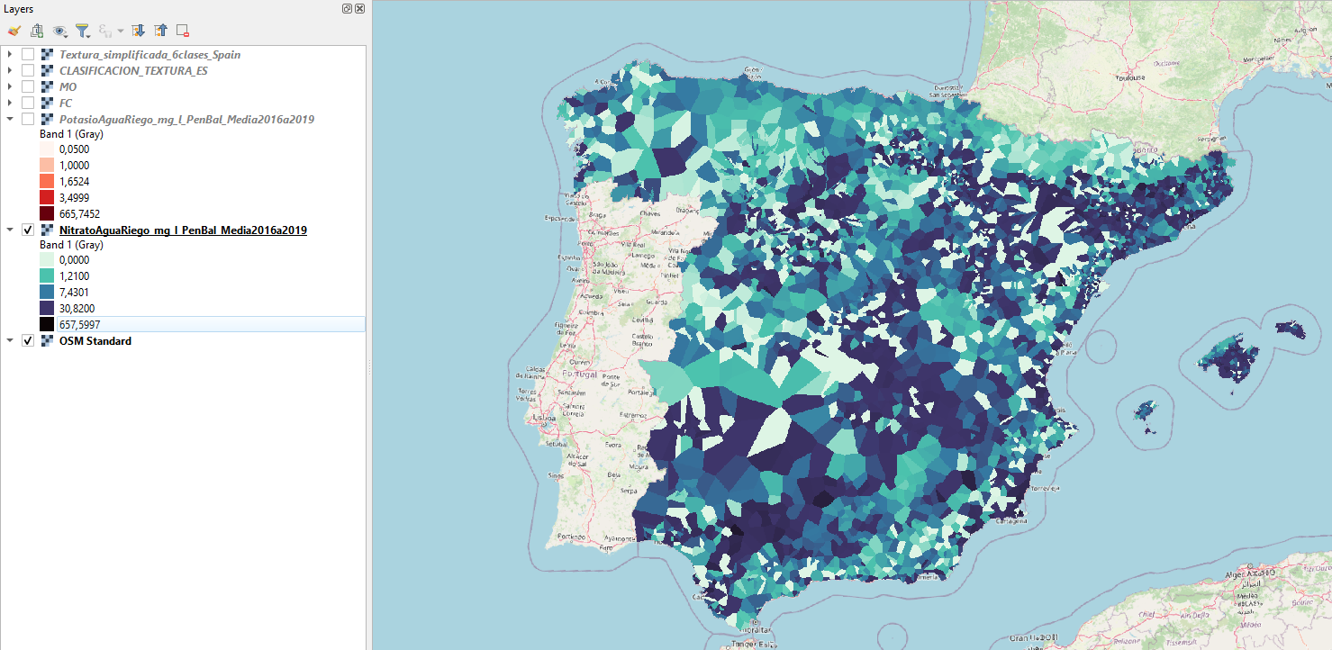
N-NO3 content in groundwater

Slide 14
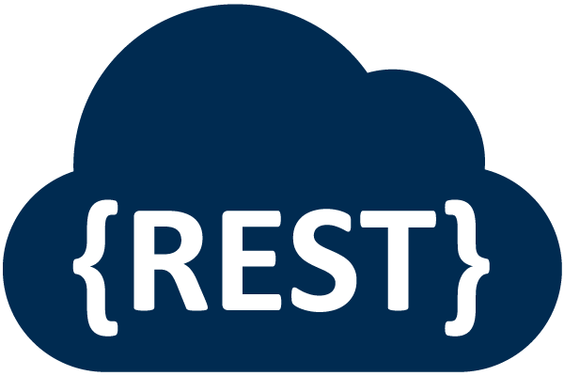


New plethora of API for third parties funded by CAP Coordinating body of Spain (FEGA)
Crop nutrient budgetting (balance)
API B for crop parameters for nutrition algorithm
API C for nutrient balance calculation
Fertilizer recommendation
API D for organic fertilizer listing
API E for inorganic fertilizer listing
API G for automatic fertilizer proposal service
Geospatial data services
API A for soil query (from interpolated maps)
API F for N and K content of irrigation water
HTML demo interface: simple PWA and request sequence documentation
API H access to SIGPAC enclosures
OAS 3.1

Slide 15
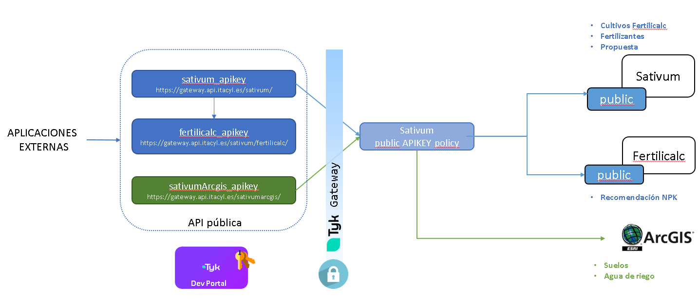
API schema for third party APPs

Slide 16
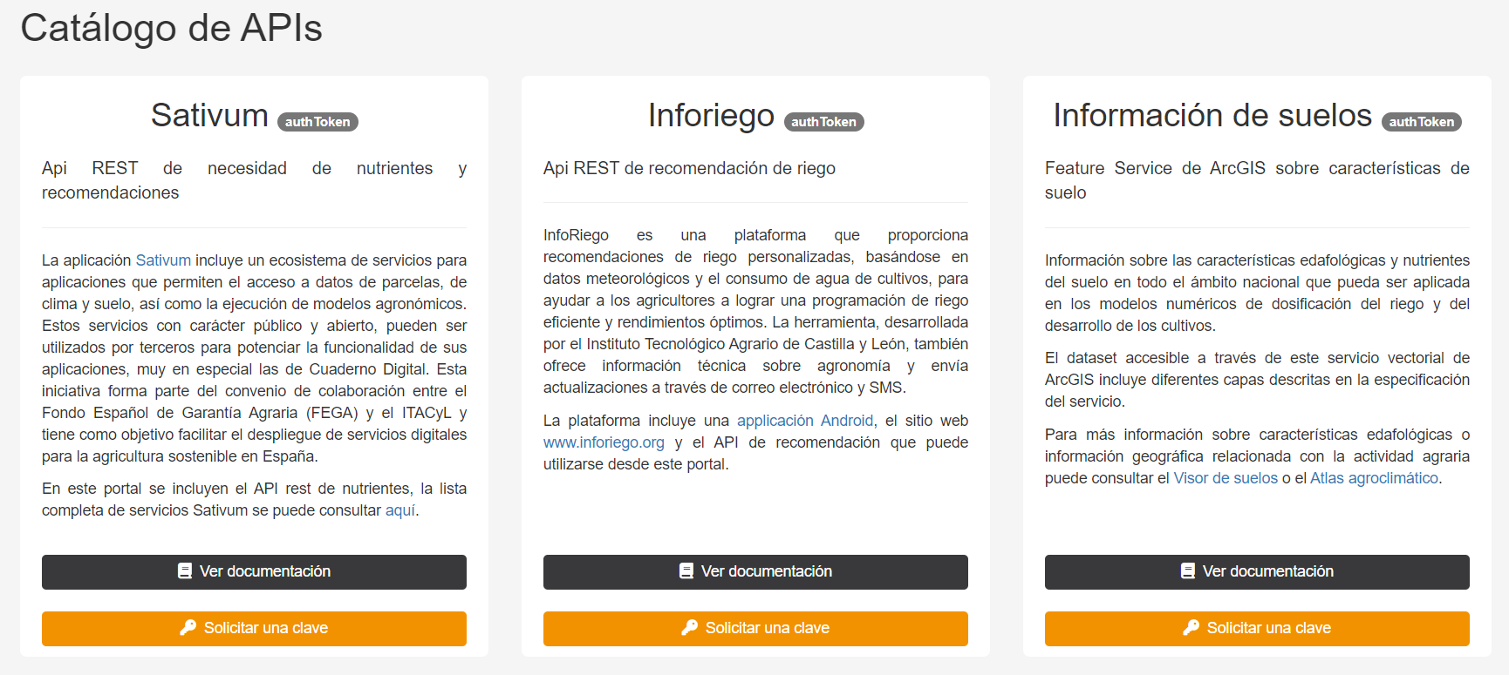
Developper portal
https://portal.api.itacyl.es/portal/apis/

Slide 17
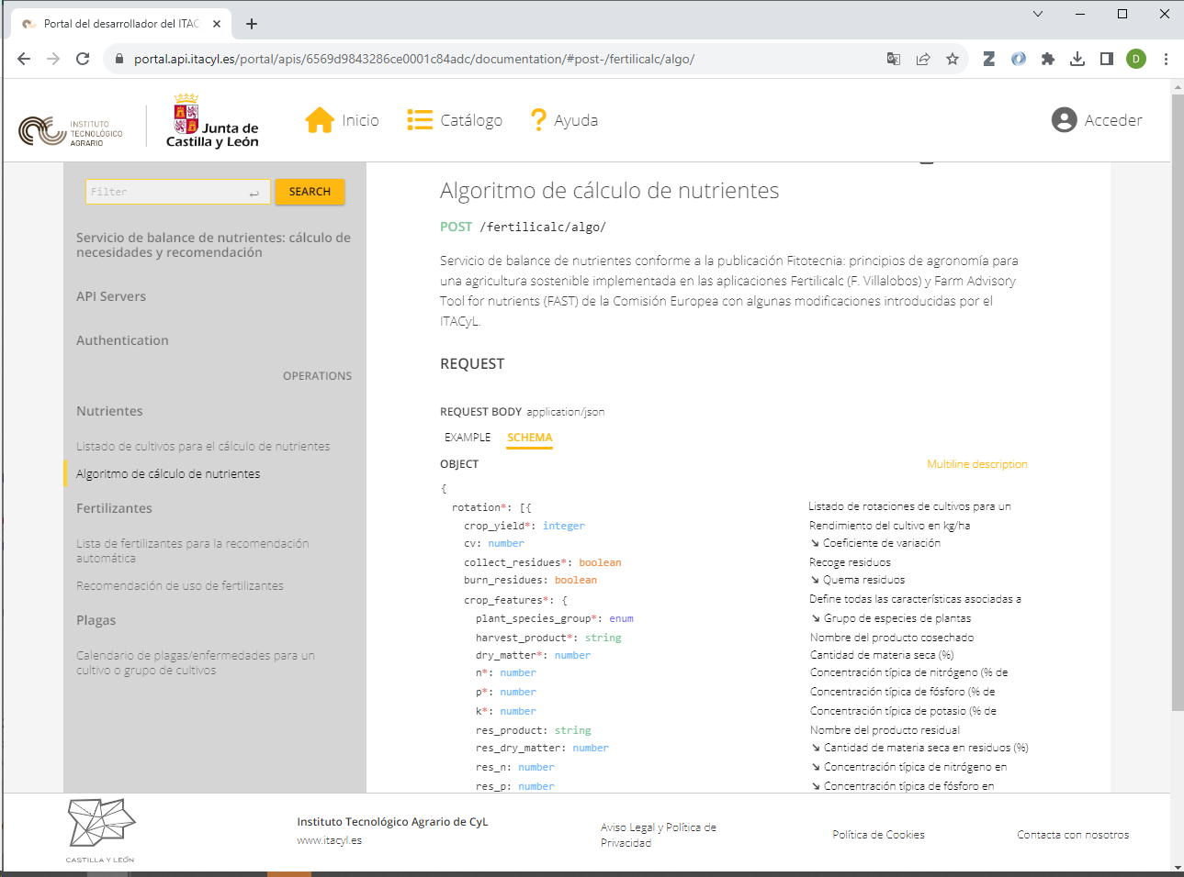

Slide 18
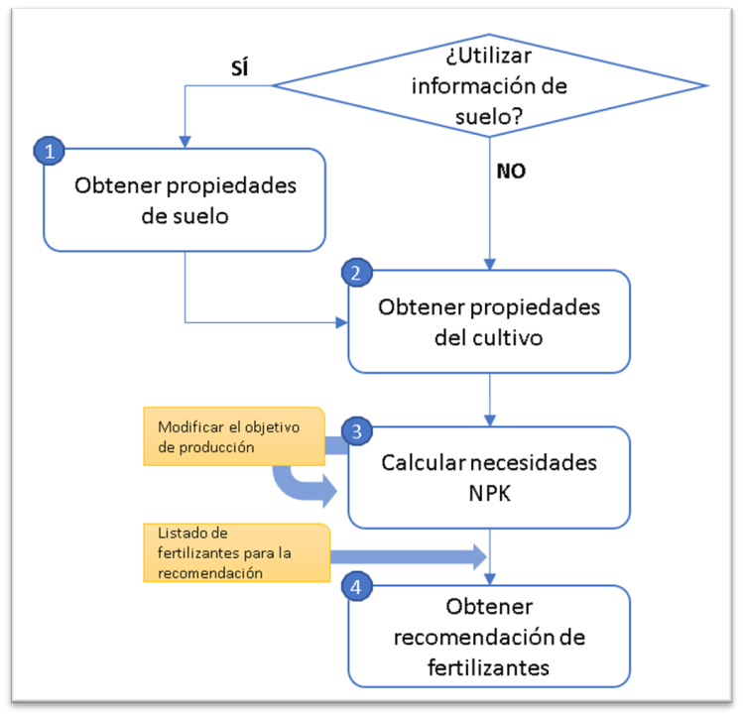
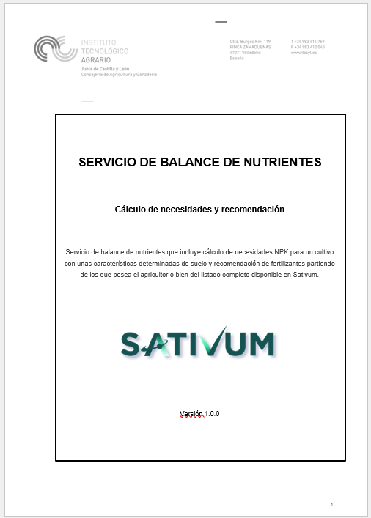
Doc descriptivo

Slide 19
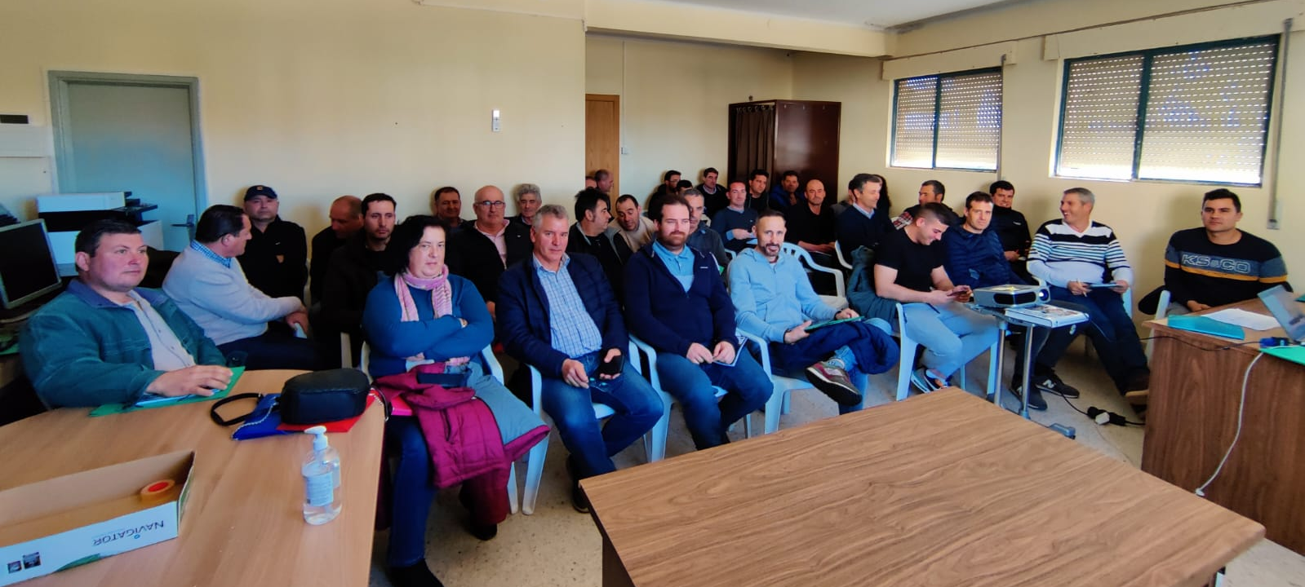
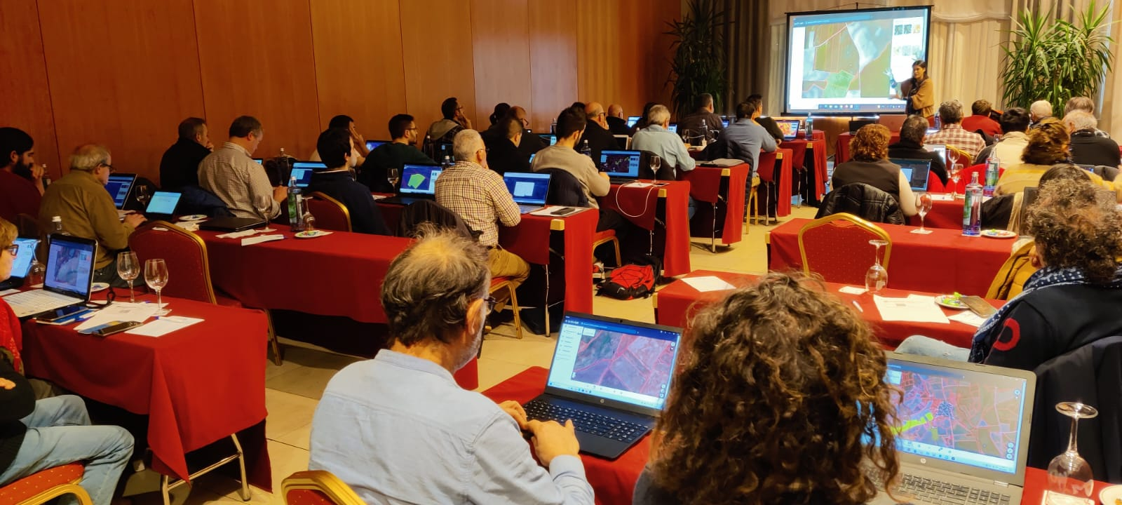
User experience (march 2024 data)
Farmer and advisors
Users active: 3,999
Parcels included: 311,211 (26,759 of them with nutrient plan)
Training sessions in 2023: 74
Farmers/advisors audience in 2023: 2,300
Developers
Registered with API Key: 25
API petitions for nutrient budget during Feb. 2024: 6,481 from SATIVUM + 1,837 from third parties

Slide 20
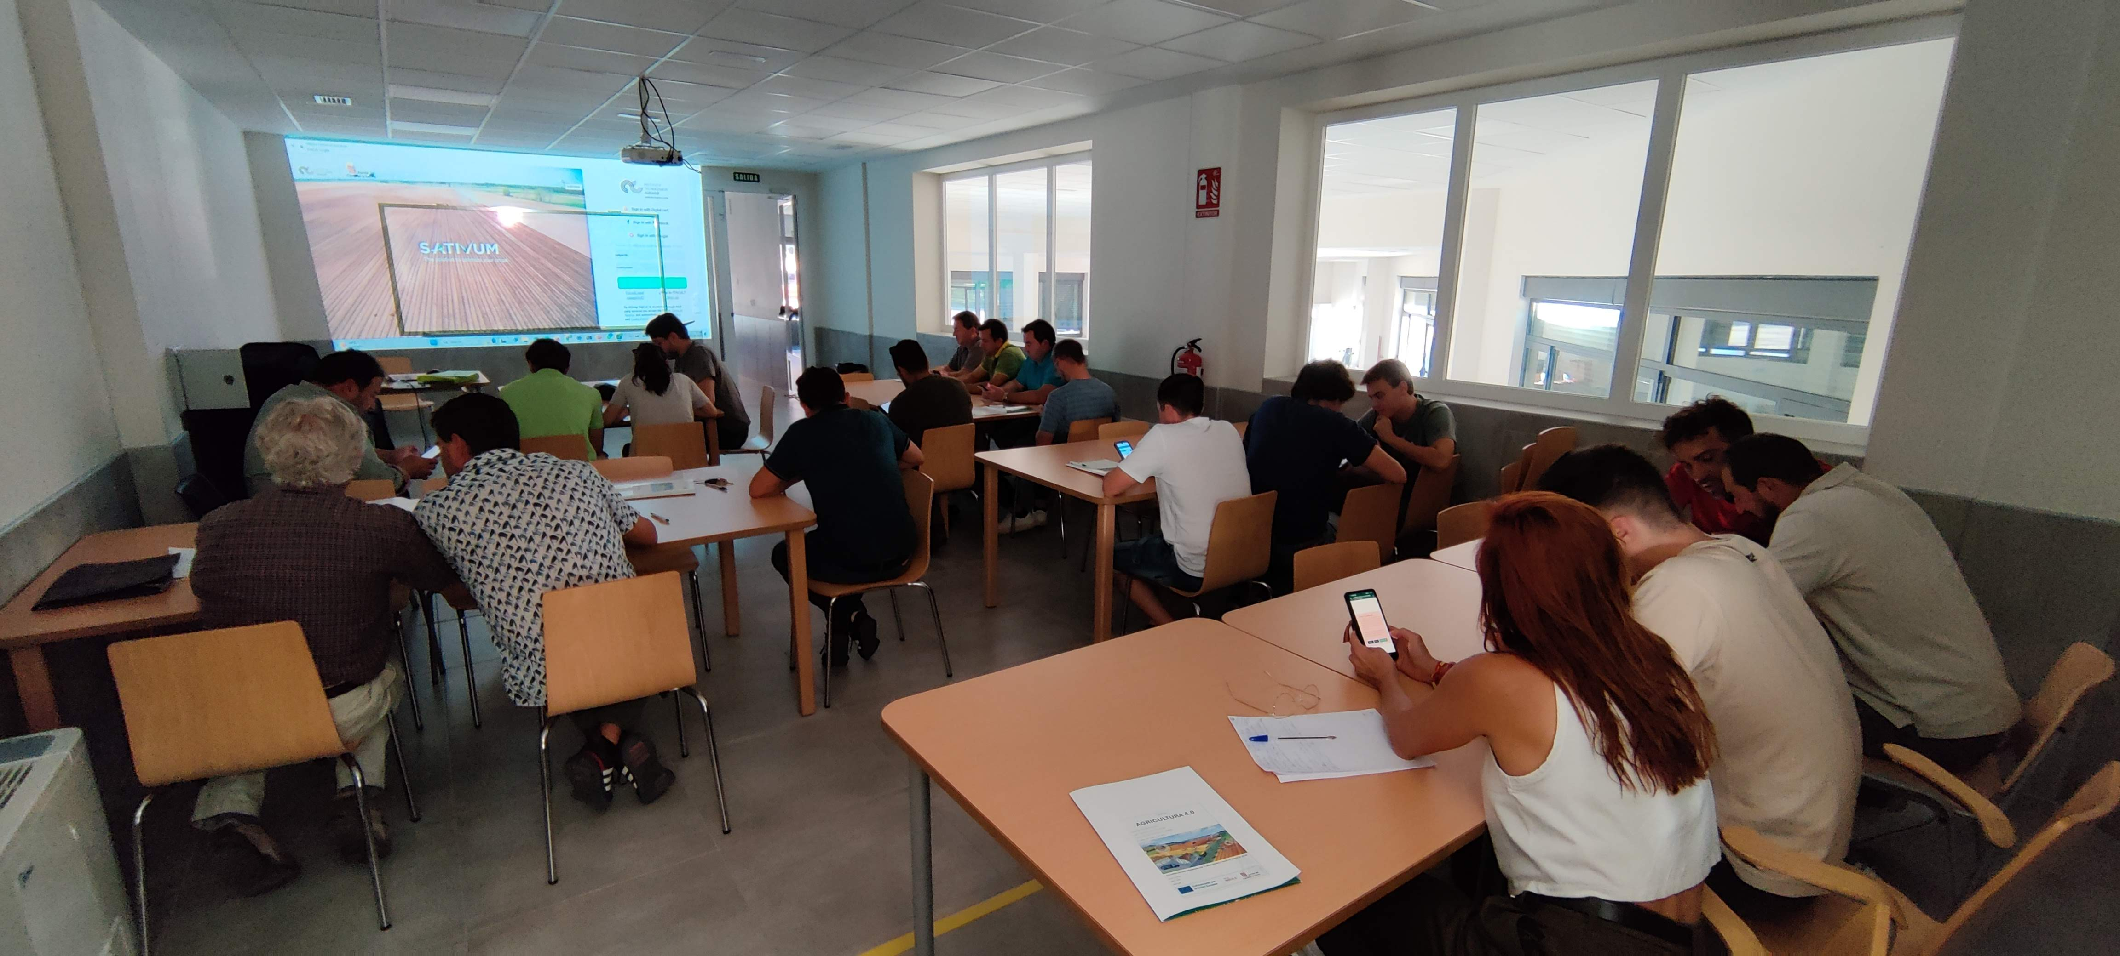
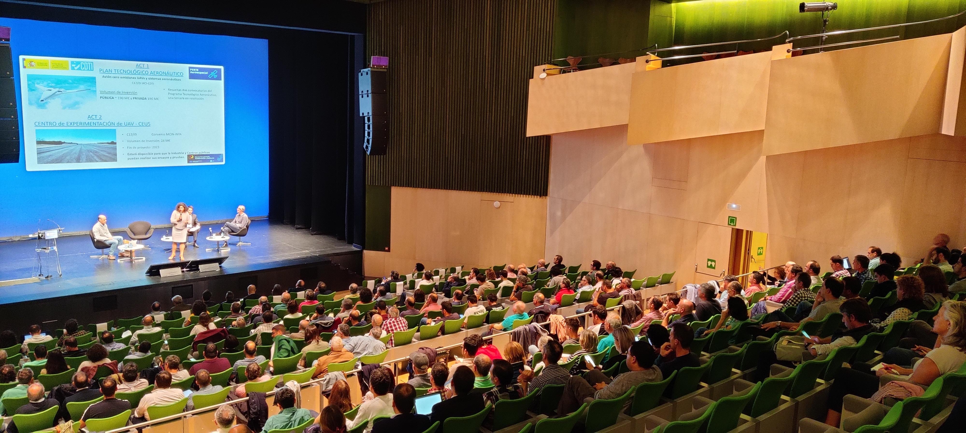
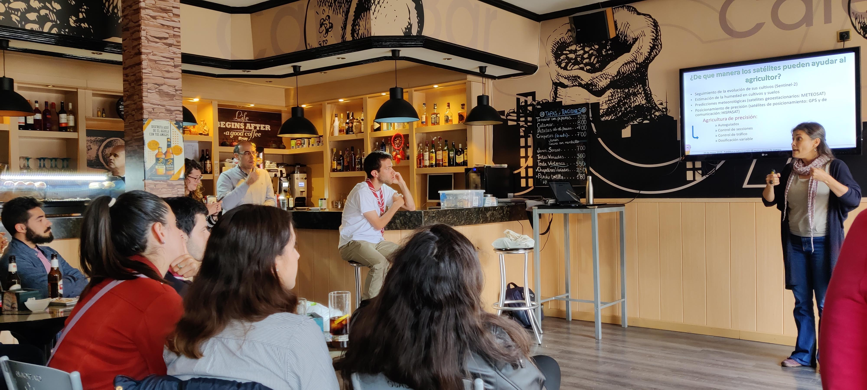
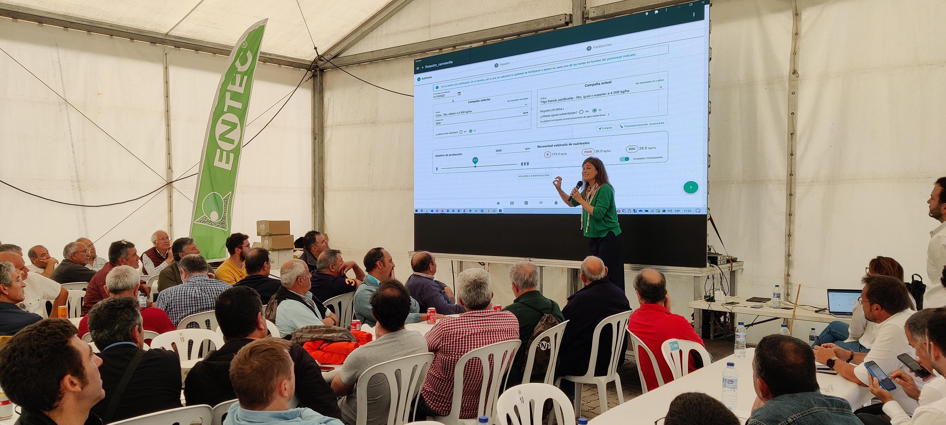
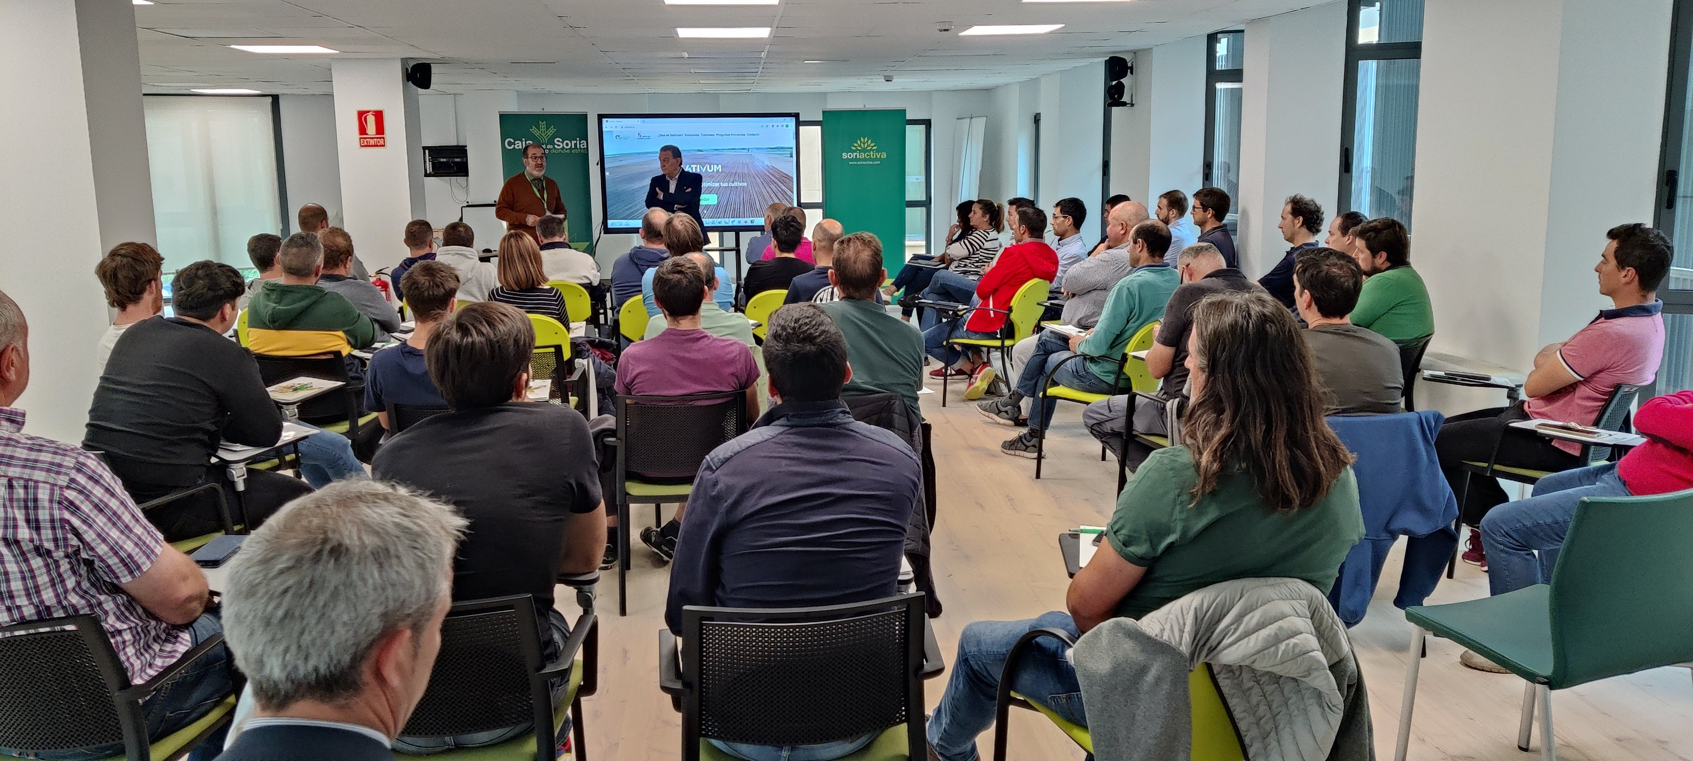
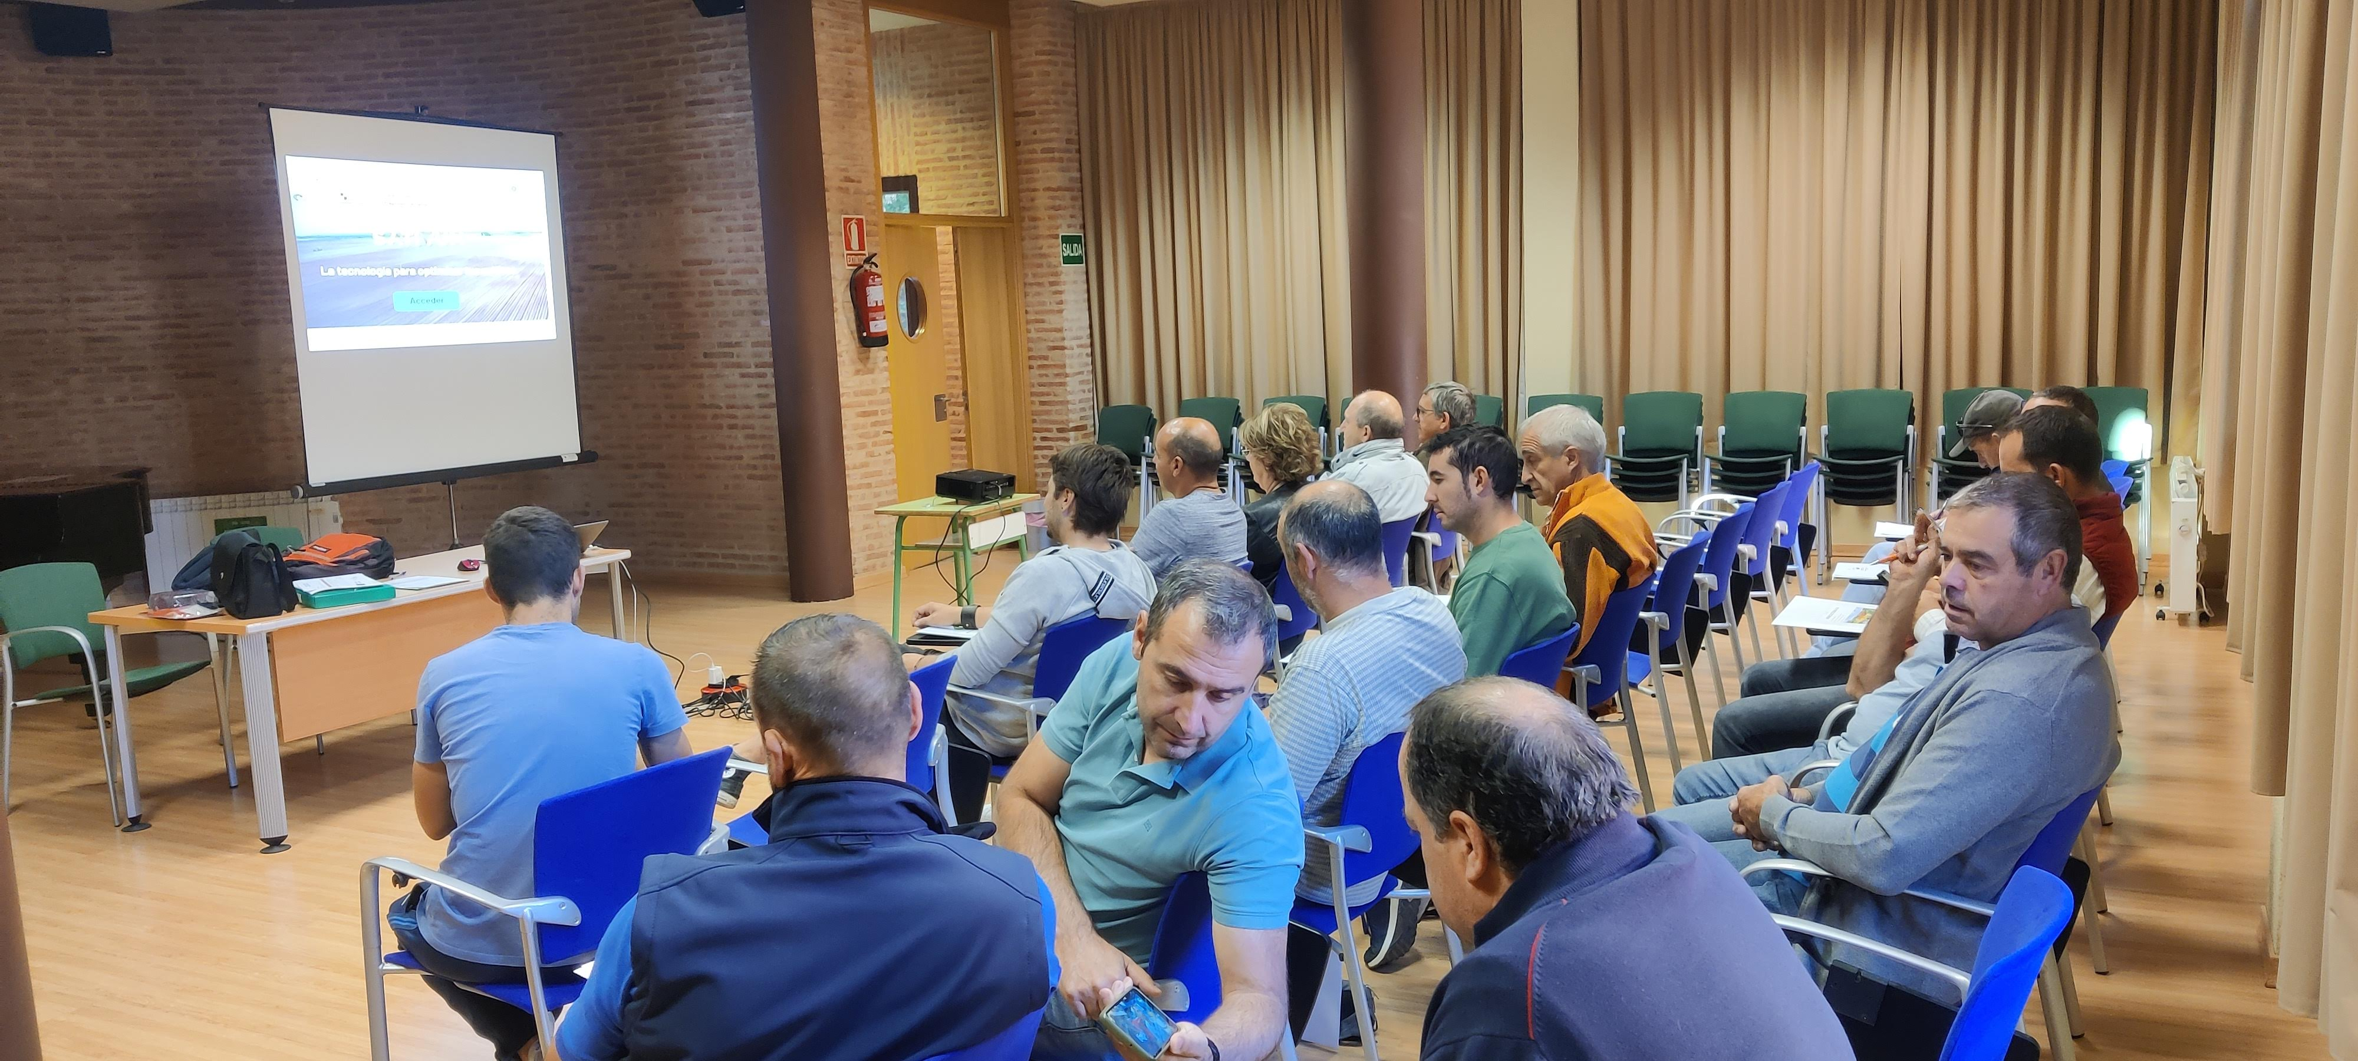
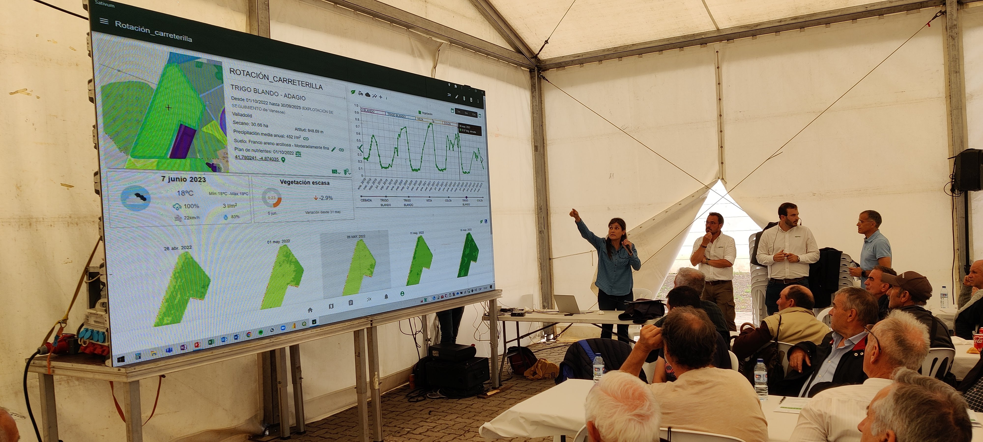
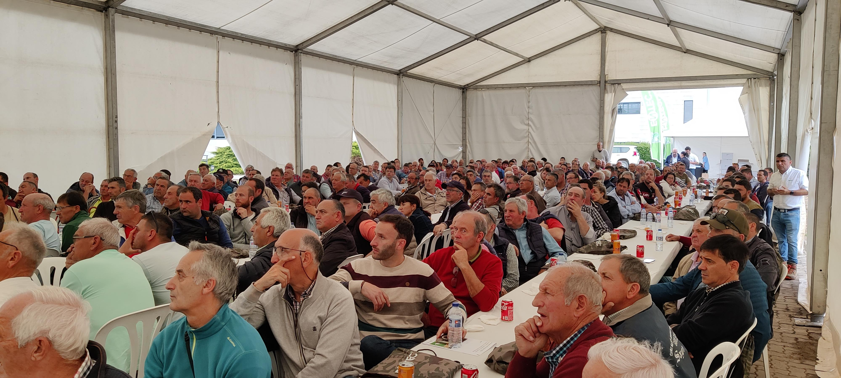
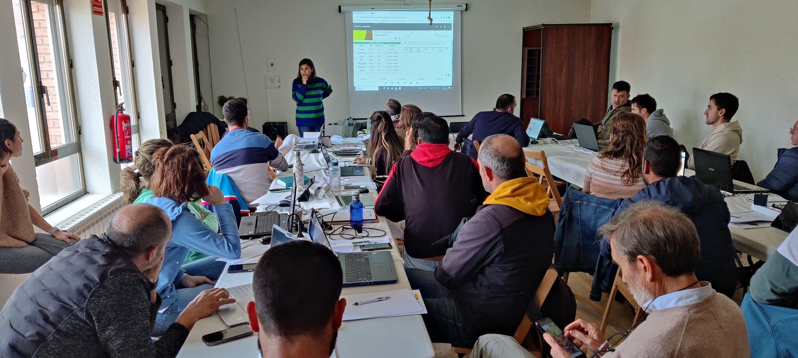

Slide 22
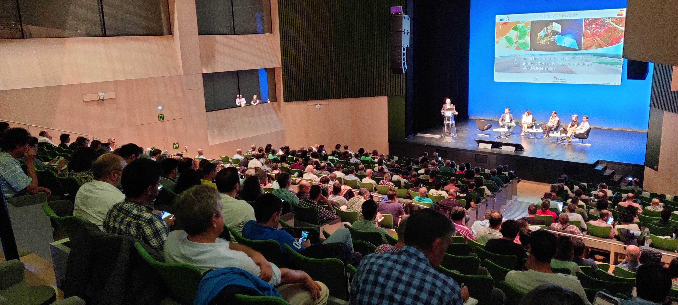

Slide 24



Farmers and their advisors feedback
The ability to perform nutrient balances has made the tool famous
The direct interaction with farmers evolved the tool but Still more evolution is needed. Many farmers don’t pass the testing phase.
What truly motivates them is regulatory pressure or the possibility of escaping it.
Much of the success lies in the fact that the pressure to create nutrient plans already exists within regulations or is being established, while SATIVUM emerges as a problem solver.

Slide 25
Examples of integrations in third party APP

Slide 26


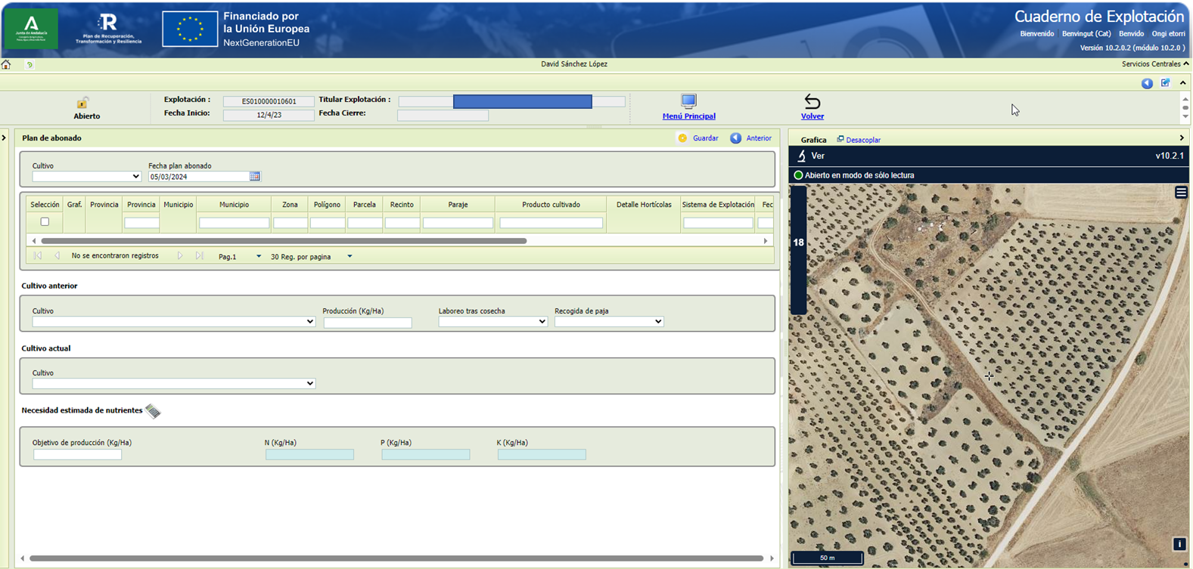
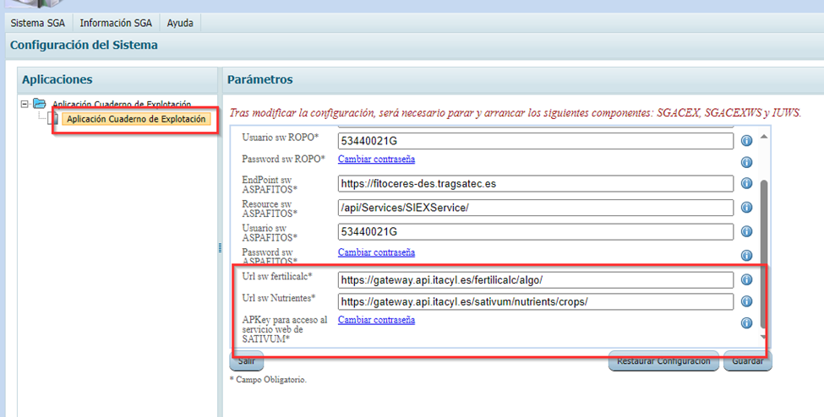

Slide 27

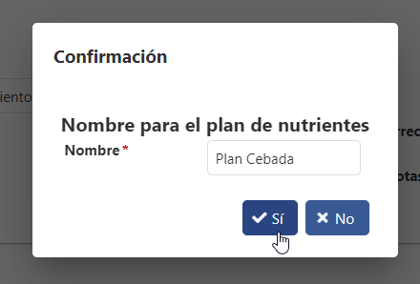
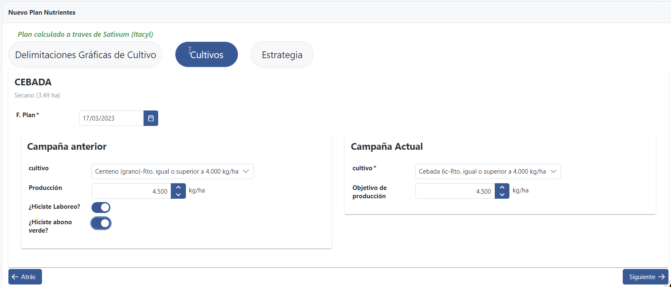
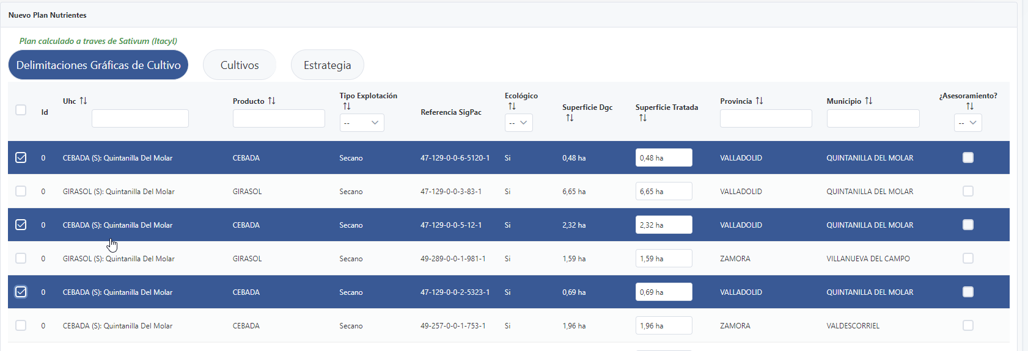

Slide 28
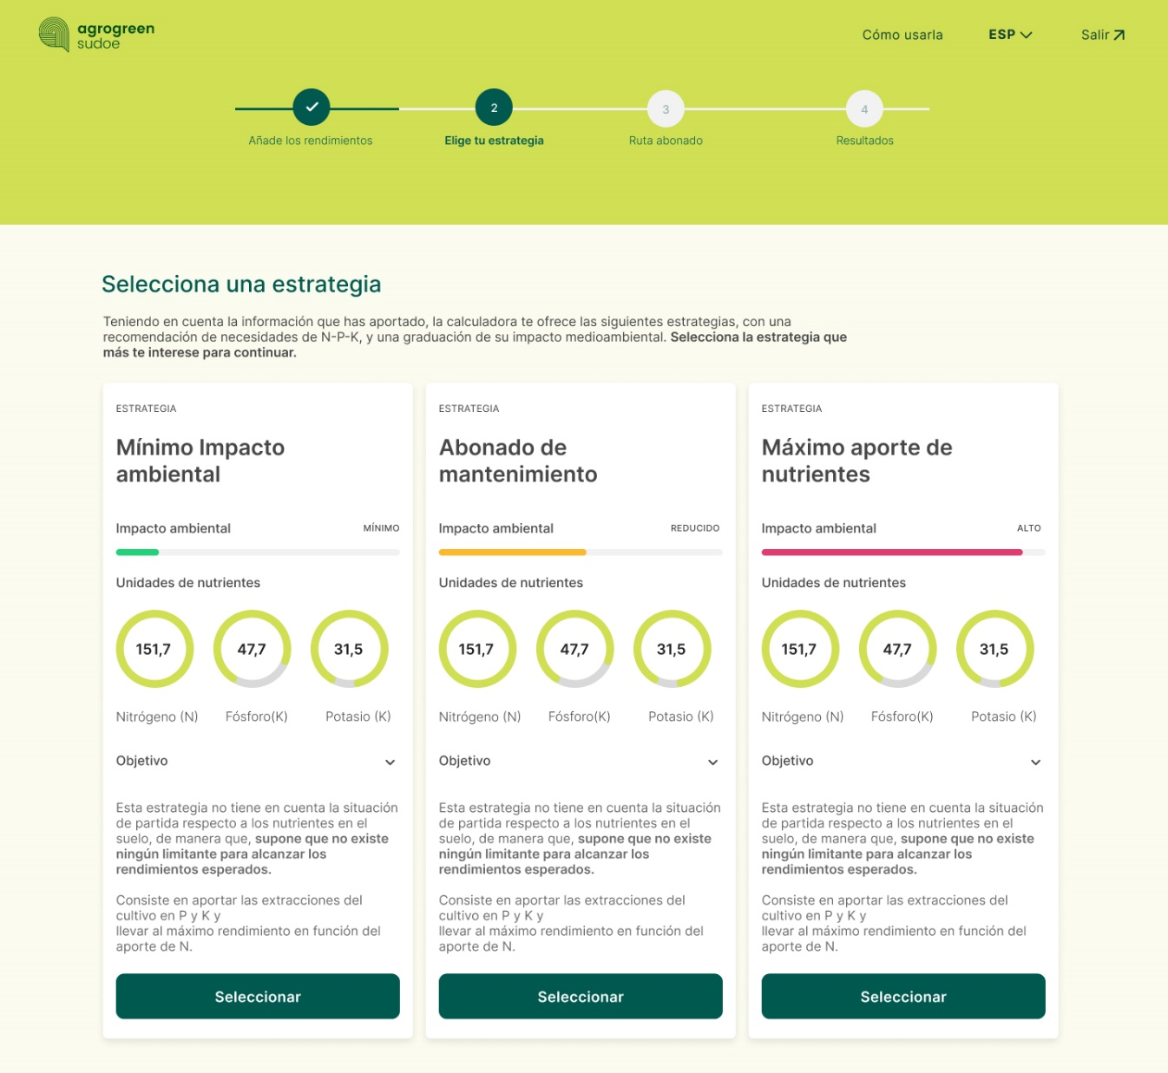


Slide 29
Conclusions
SATIVUM enables Spain to fulfill the obligations of having a Farm Sustainability tool for nutrients.
Spain has gone one step further by making the FAST functionality mandatory in all digital field books.
A plethora of SATIVUM APIs and a portal with call examples allow developers to create their own frontend with the same functionality as SATIVUM.
Be cautious about making a tool mandatory because crop nutrition is incredible complex and agriculture practices is incredibly diverse.
What drives our development is provide service to the farmers.

Slide 30
JORNADAS
IACS DATA SHARING
FORMULARIO DE PREGUNTAS
Martes 9 de abril 2024

