Slide 1
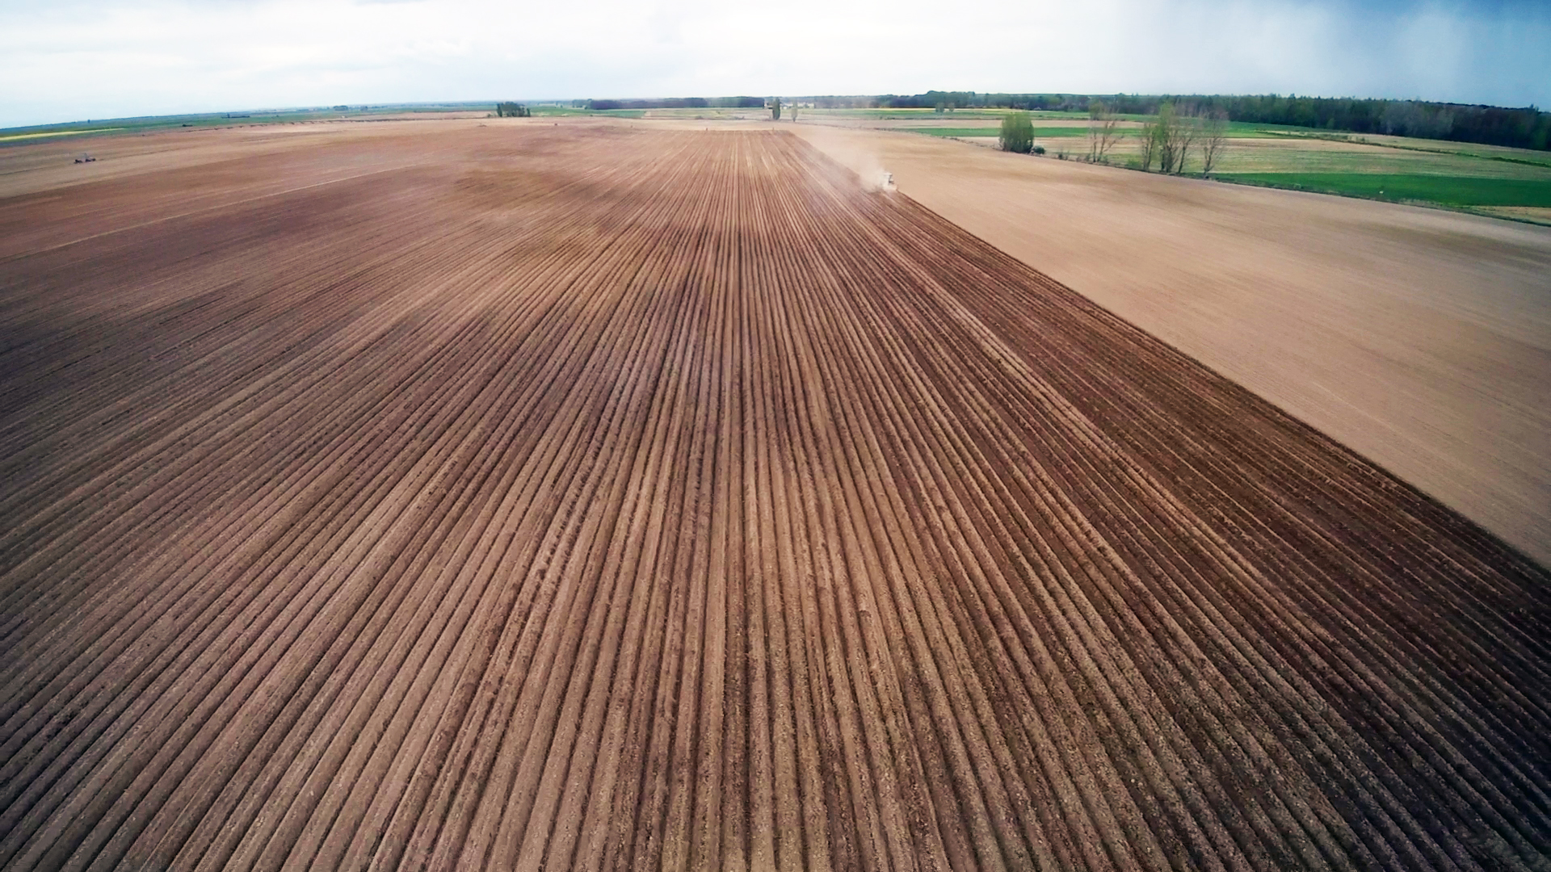

SATIVUM and Farm Sustainability tool for nutrient functionality across Spain
David A. Nafría nafgarda@itacyl.es

Slide 2
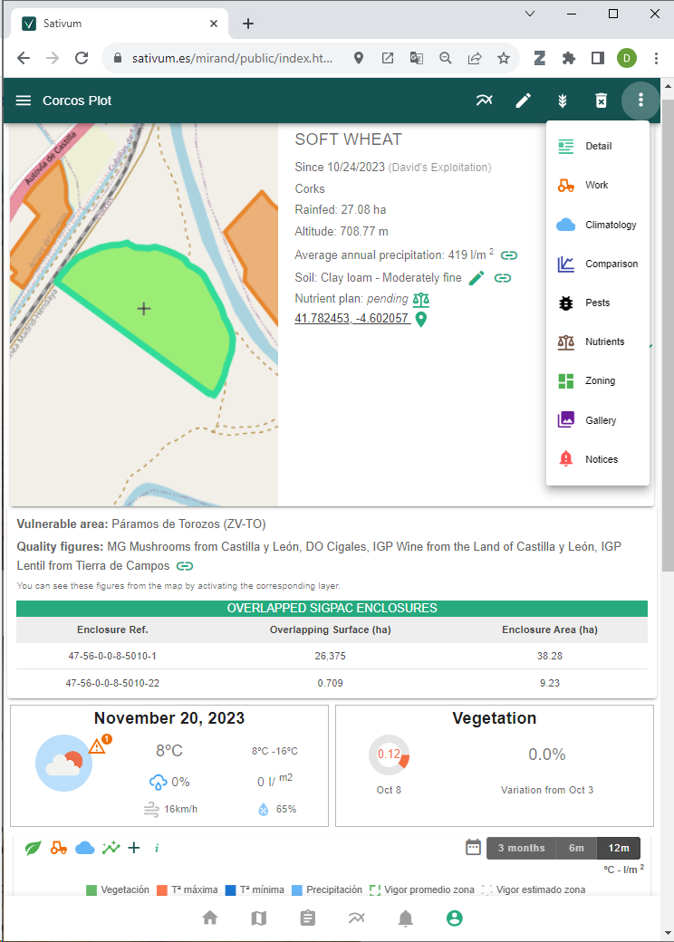
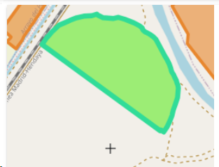

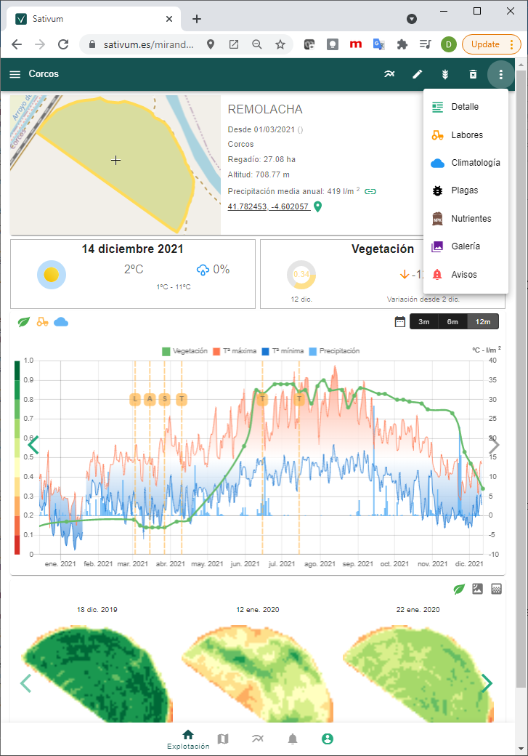
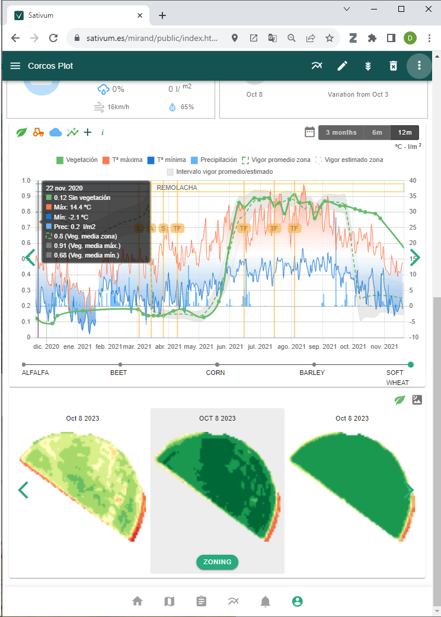
Sativum is a free public APP for agronomic advise based on agricultural parcels from IACS (shared data) with:
  Copernicus satellite (and aerial) data
  Public Soil data(0,3 samples/km2 density)
  Public Climate/meteo data (0,002 stations /km2)
Decision support systems integrated:
  Crop nutrition (FaST)
  Variable Rate Application
  Pest management
  More to come (irrigation)
Compatible with Spanish digital field Book (CUE)
https://www.sativum.es/

Slide 4
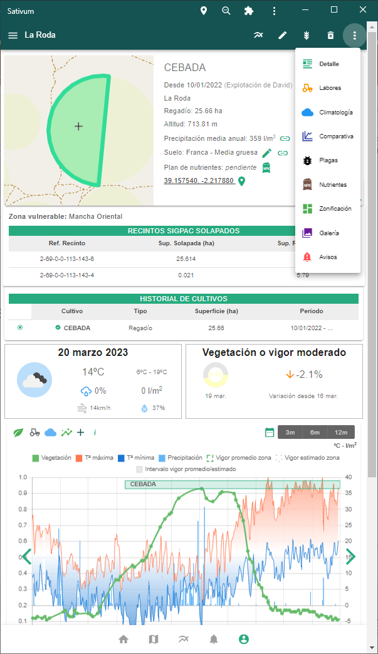
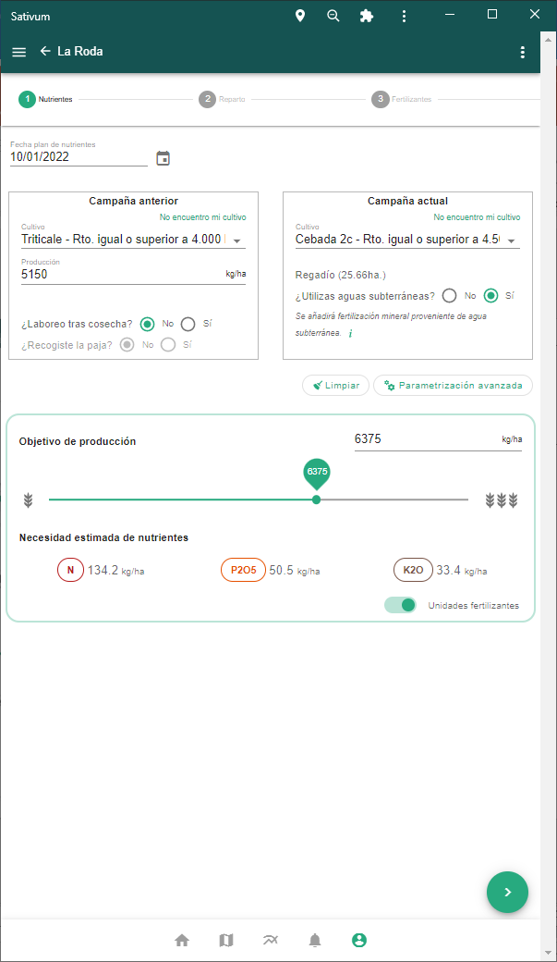
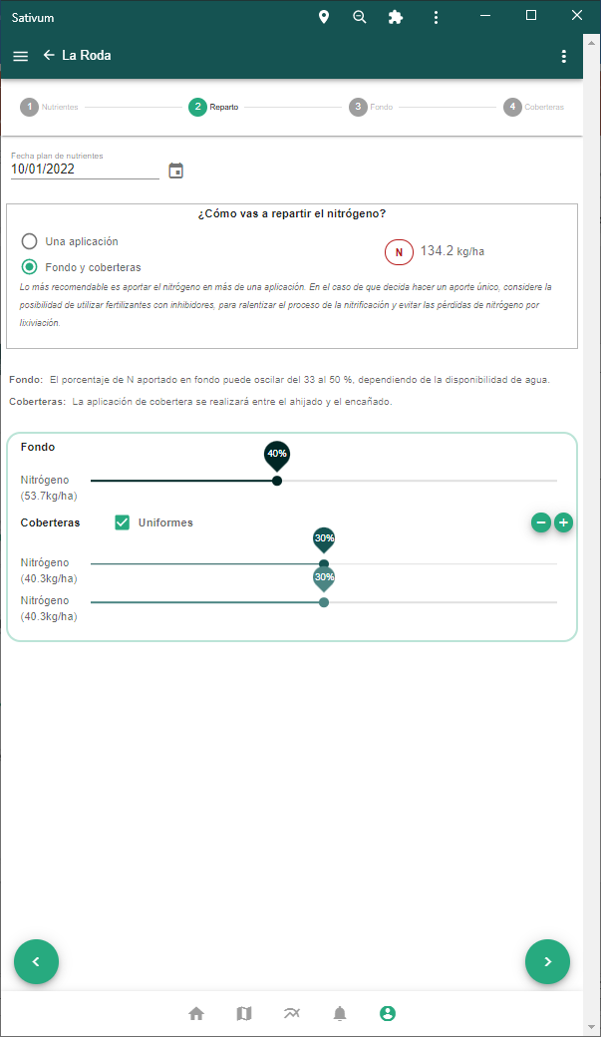
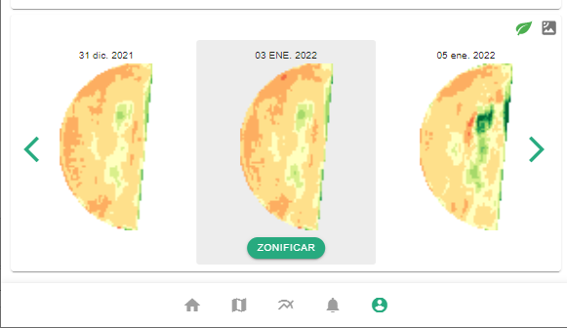

Slide 5
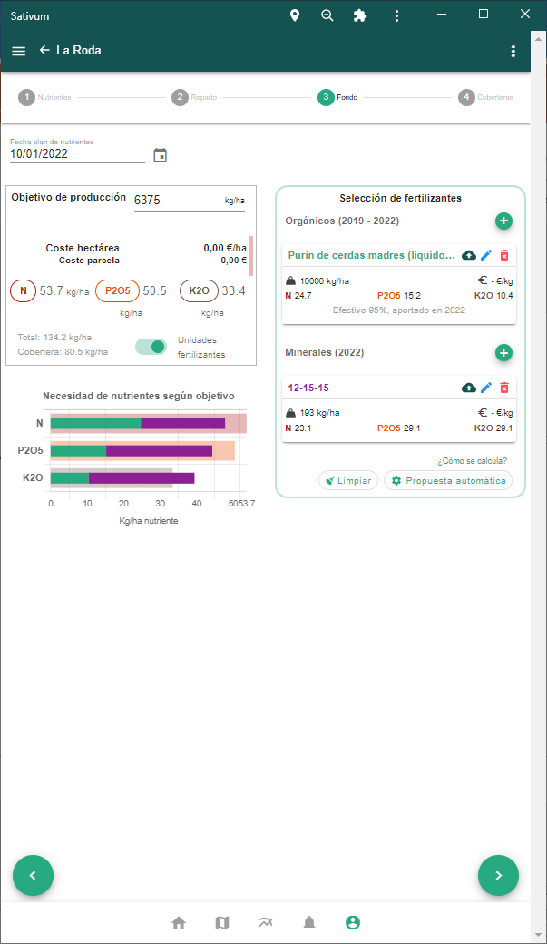
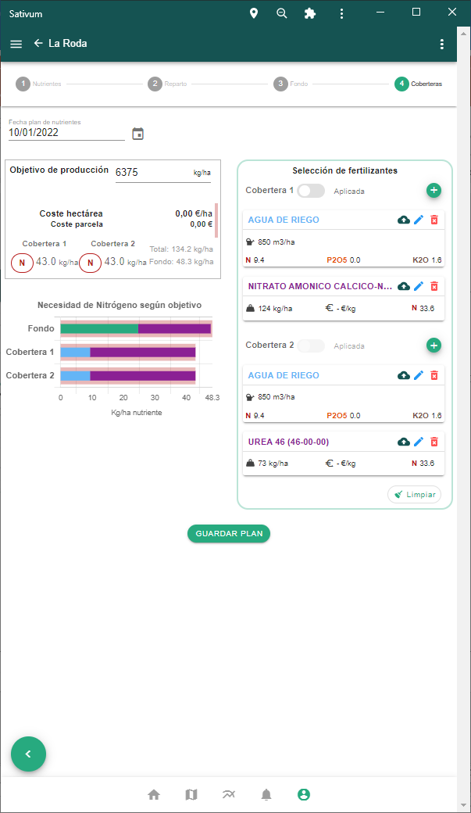
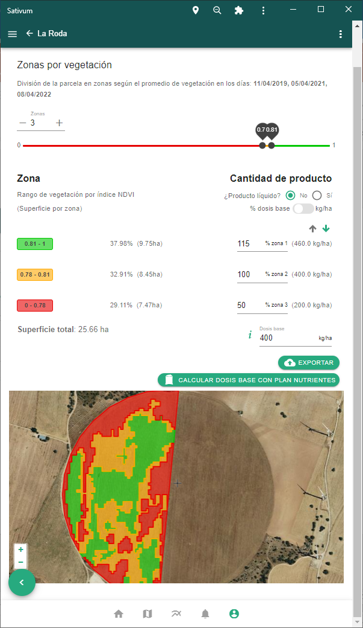

Slide 6

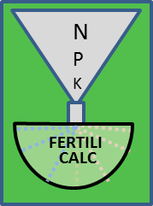

Crop nutrition budget algorithm

Slide 7

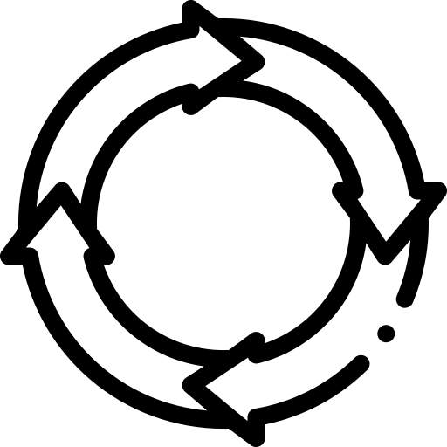
FERTILICALC
Algorithm
(Python GPL)
Development started in 2019, launched in 2021
FaST (Spain) Start in year 2020
SOIL DATA
LPIS+GSAA
NPK NUTRIENT ALGORITHM
(API)
FERTILIZATION FRONTEND
End of phase I (year 2021)
WORKING IN RELEASE 45 AND 46
Merging elements: FERTILICALC + FaST + SATIVUM

Slide 8
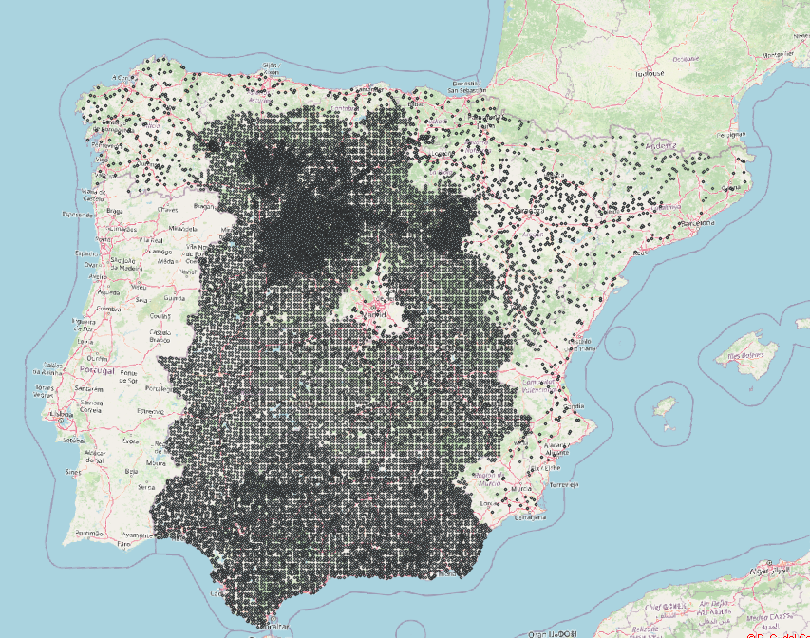

Soil points > Digital Soil Mapping > API
About 50.000 georeferenced soil samples collected all over Spain from multiple sources, including private sector.
SoilDerivedObject
National government will collect and analyse 16,000 new points in 2024 with two depths.
Soil texture, organic matter, P and K are interpolated using Digital Soil Mapping techniques with covariate variables
SoilTheme
Coverage

Slide 9
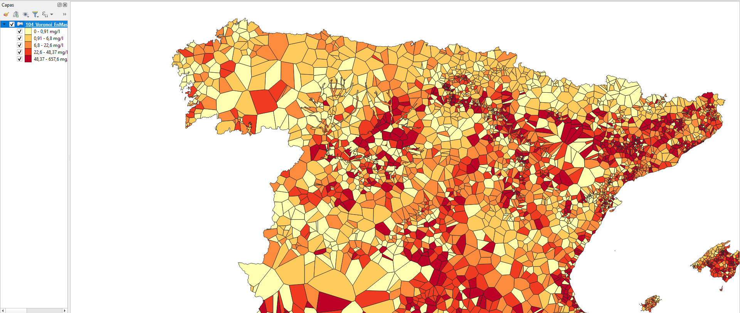
Groundwater N and K content available

Slide 10



New plethora of API for third parties funded by CAP Coordinating body of Spain (FEGA)
Crop nutrient budgetting (balance)
API B for crop parameters for nutrition algorithm
API C for nutrient balance calculation
Fertilizer recommendation
API D for organic fertilizer listing
API E for inorganic fertilizer listing
API G for automatic fertilizer proposal service
Geospatial data services
API A for soil query (from interpolated maps)
API F for N and K content of irrigation water
HTML demo interface: simple PWA and request sequence documentation
OAS 3.1

Slide 11


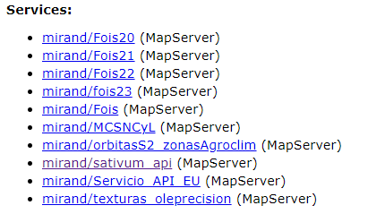


New API schema for third party APPs
fertilicalc_public_apikey
/fertilicalc/
public
Fertilicalc
Sativum App
/sativum/
mirand_private_jwt
/mirand_private_jwt/
private
Mirand
mirand_public_jwt
/mirand_public_jwt/
sativum_apikey
public
mirand_public_apikey
/mirand_public_apikey/
satgeo, uqserv, gambit
mirand_thirdparty_jwt
Third-party:
aemet, openweather
Servicios de Datos Sativum (sativum-geos)
Gateway
Public catalog
https://servicios.itacyl.es/arcgis/rest/services/mirand
Dev Portal

Slide 12
Conclusions
Sativum complies the Farm Sustainability Tool for Nutrients requirements in Spain.
The tool is built on top of IACS data sharing and includes DSS, remote sensing monitoring and digital field book for farmers in a easy environment.
Elements of nutrition budgeting are being opened for third parties using a defined API catalogue.
Commercial and public digital field book Apps will have the possibility to include FaST functionality all over Spain.
A step forward WRT FaST: Digital field book allows to store nutrient budgeting in the IACS.

