Slide 1
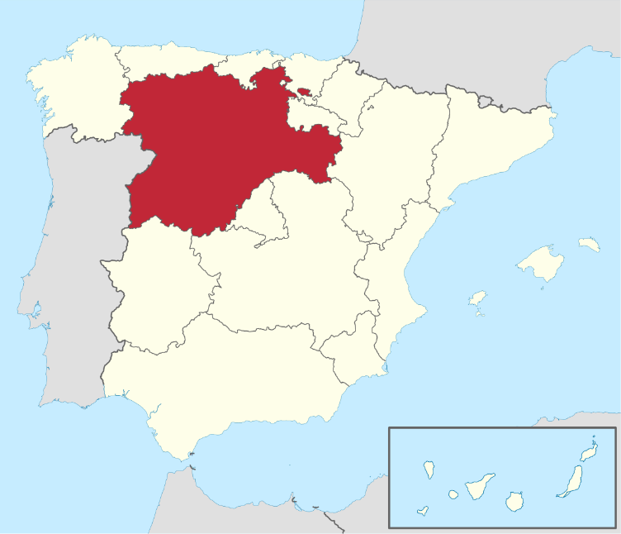

Our organisation in brief
Research and IT public entity that belong to the Regional Ministry of Agriculture of Castile and León –Spain- (12th largest EAGF paying agency in Europe).
300 employees in Research, Rural Infrastructure development, IT, field extension and food certification and promotion
Two departments specialized in Geo-technologies for agriculture.
CAP support (LPIS upkeeping, On the spot checks, and Checks by Monitoring)
Research and innovation (Earth Observation, agrometeorology and soil science, crop modelling, GNSS)

Slide 2
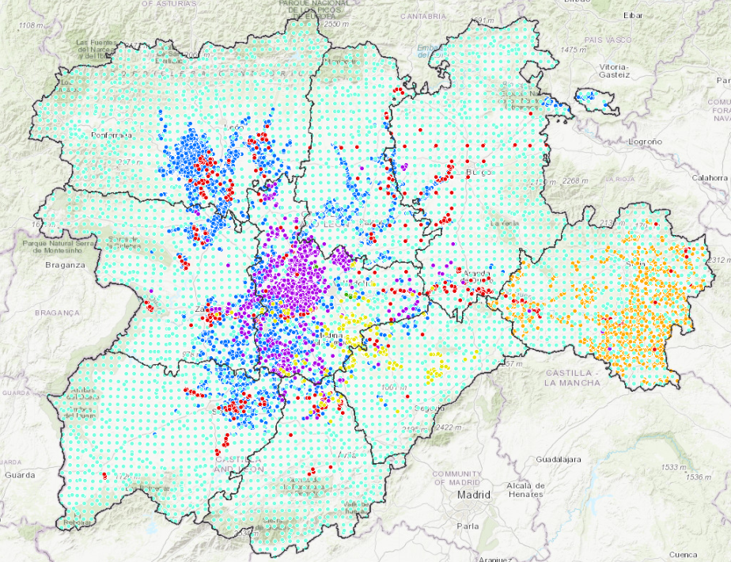
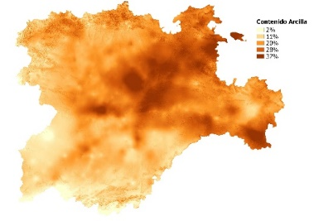
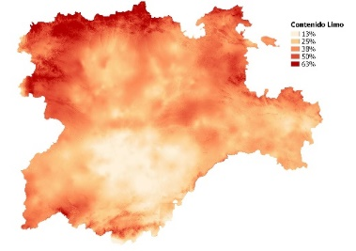
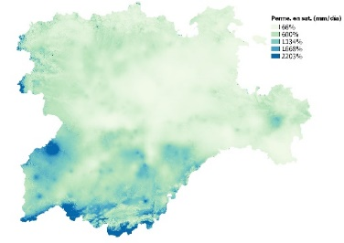
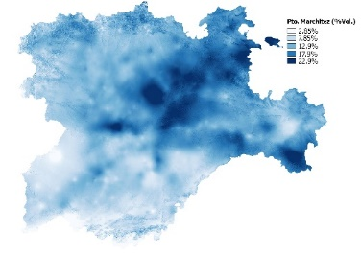
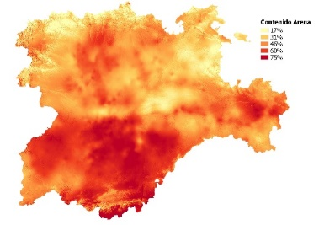
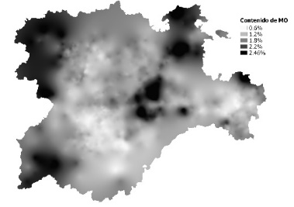
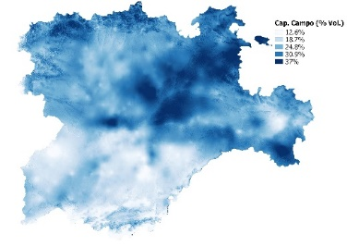
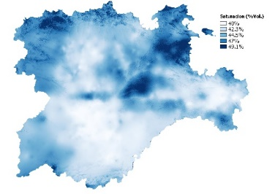
19,000 soil samples analitics and derived maps

Slide 3
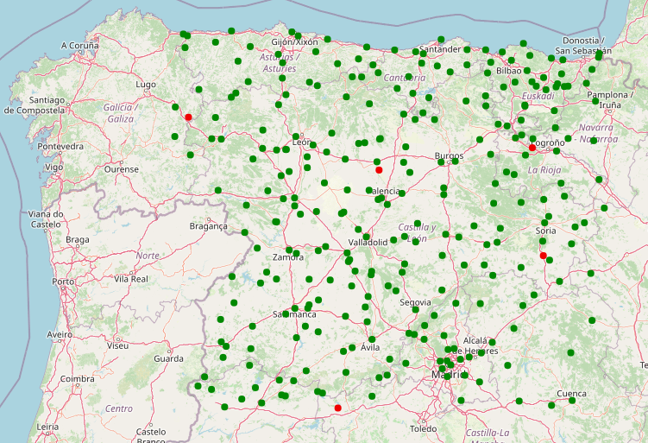
200 automatic meteostations (ITACyL+ National Met agency) some with soil moisture sensor

Slide 4
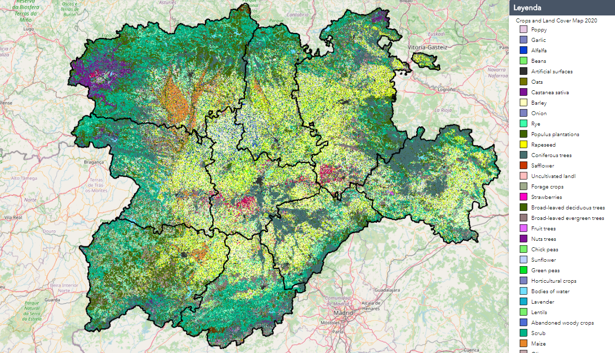
Anual crop mapping since 2011 based on remote sensing and machine learning

Slide 5
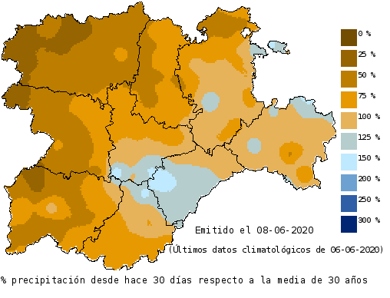
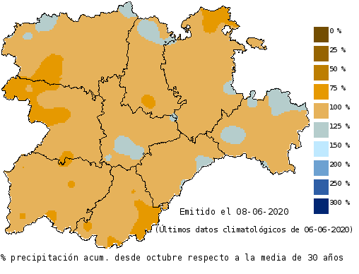
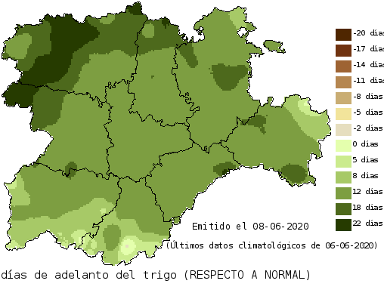
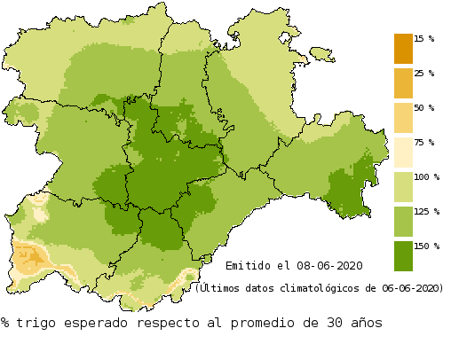
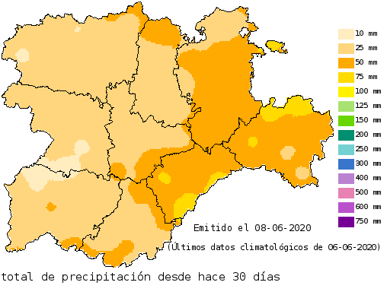
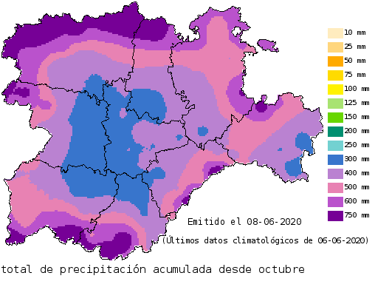
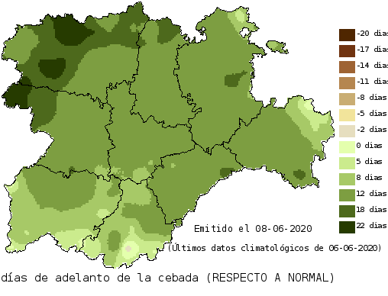
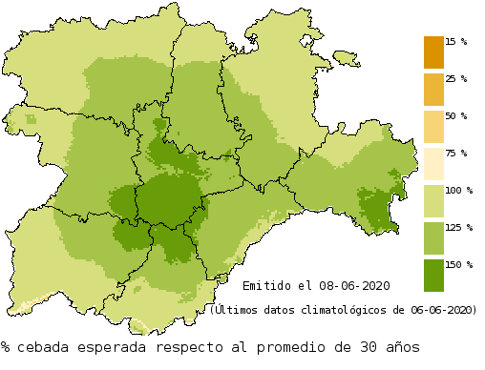
Yield forecasting system

Slide 6
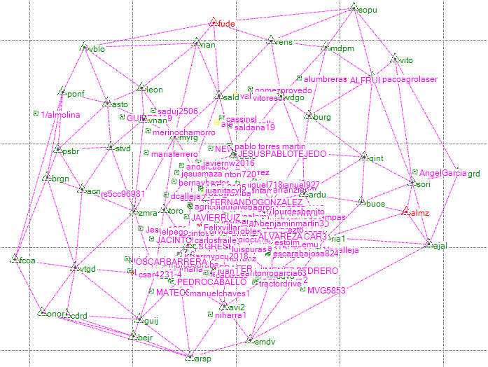
Live machine GNSS tracks from RTK network service
Date,Speed,wkt
25/09/2020 | 0.1446 | point( 42.50659106 -4.5026340933333335)
25/09/2020 | 0.0124 | point( 42.50659096 -4.502634211666667)
25/09/2020 | 0.0033 | point( 42.50659099666667 -4.50263423)
25/09/2020 | 0.0012 | point( 42.50659100833333 -4.50263424)
25/09/2020 | 0.0011 | point( 42.50659101 -4.502634226666666)
25/09/2020 | 0.0015 | point( 42.50659099166667 -4.502634228333333)
25/09/2020 | 0.0034 | point( 42.50659097 -4.502634191666667)
25/09/2020 | 0.0013 | point( 42.506590978333335 -4.5026341783333335)
25/09/2020 | 0.0004 | point( 42.506590978333335 -4.502634183333333)

Slide 7
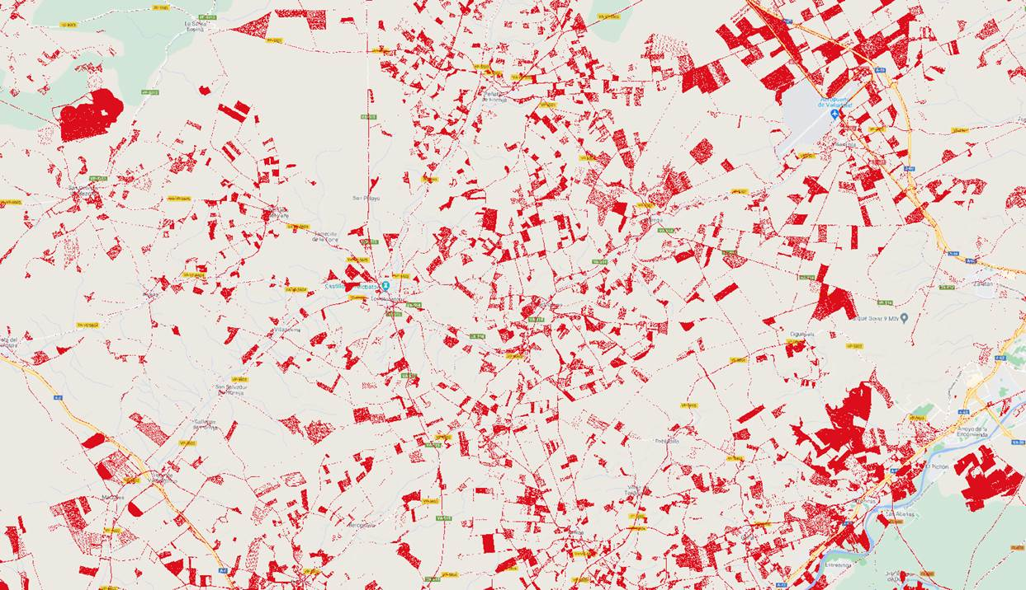
Already receiving machine tracks in RTK service

Slide 8
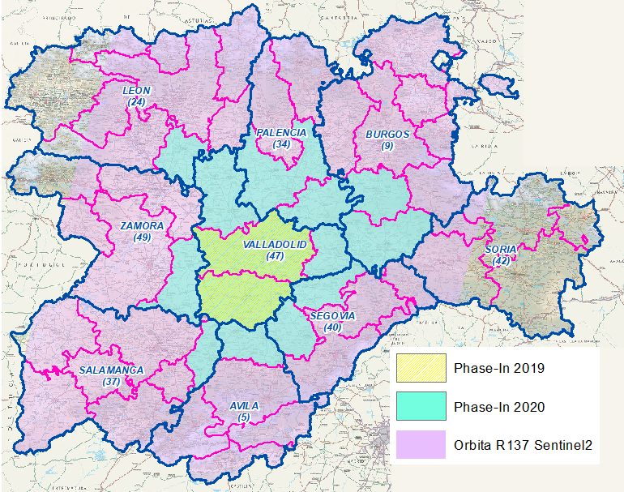
CAP fully implemented Checks by Monitoring 100% of the area full schemes
Schemes
Base payment
BPS / SFS
Crop Diversification
EFA
Grasslands
Protein crops
Oilseed
Legumes HQ
Sugar beet
Nuts and carob beans
Extensive rainfed agroecosystems
Integrated agricultural production
Industrial crops
Grazed forage areas
Organic farming
Areas with naturals constraints
Greening
1st Pillar
VCS
2nd Pillar

Slide 9
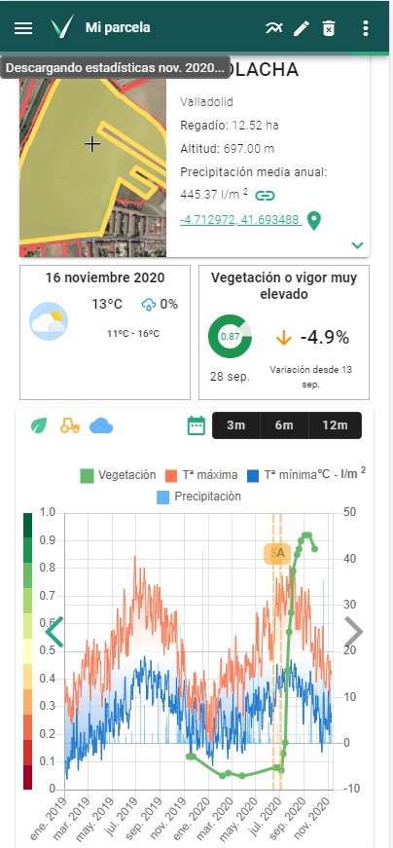
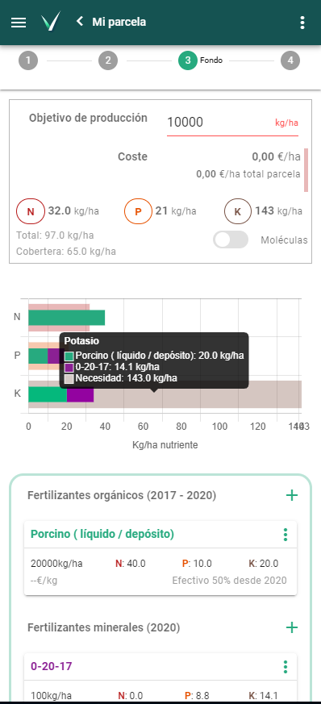
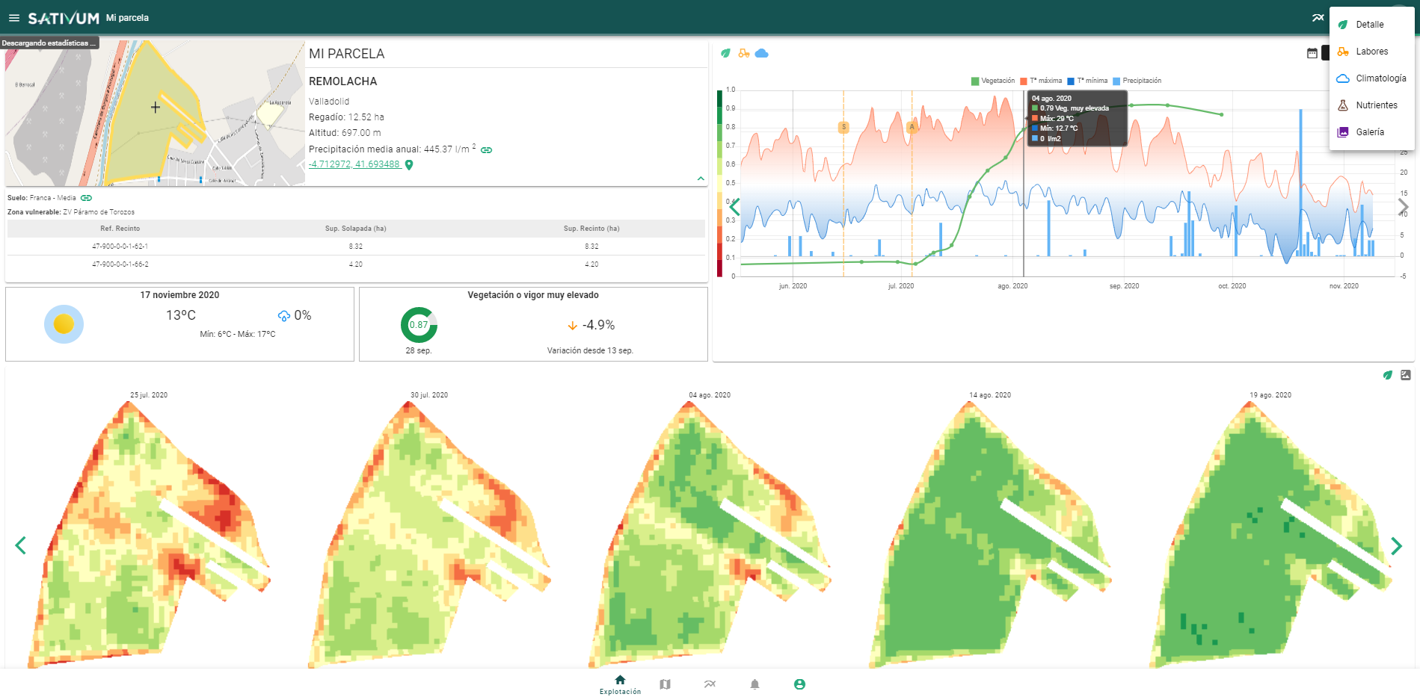
New Agronomic FMIS tool for farmers linked to IACS

Slide 10
Contributions
We can contribute to SARAGRI ....
IACS connection linked to Earth observation infrastructure
Complementary environmental data (Soil, meteo, crop ID)
Good knowledge of user requirements in the agricultural private sector and government monitoring needs

