Slide 1

Integration of sen4cap products in the Check by Monitoring workflow
Paying Agency of Castile and León (Spain) case
David A. Nafría nafgarda@itacyl.es
Alberto Gutiérrez ita-gutgaral@itacyl.es
Vanessa Paredes pargomva@itacyl.es
Sentinels for Common Agricultural Policy Final User Workshop (march 2021)

Slide 2
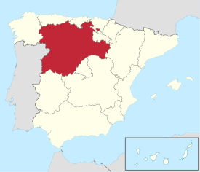
About ITACyL
Research and IT public entity that belong to the Regional Ministry of Agriculture of Castile and León.
Two teams specialized in Geo-technologies for agriculture.
CAP support: LPIS upkeeping, OTSC and CbM
Research and Innovation: Earth Observation, agrometeorology and soil science, crop modelling, GNSS
National Ministry of Agriculture…
FEGA (Coordinating body)
Castilla y León Ministry of Agriculture
DG Common Agricultural Policy
IACS Team
Castile and León is the 12th largest EAGF paying agency in Europe.
94,000 km2
DG Agricultural Technological Institute(ITACyL)

Slide 3

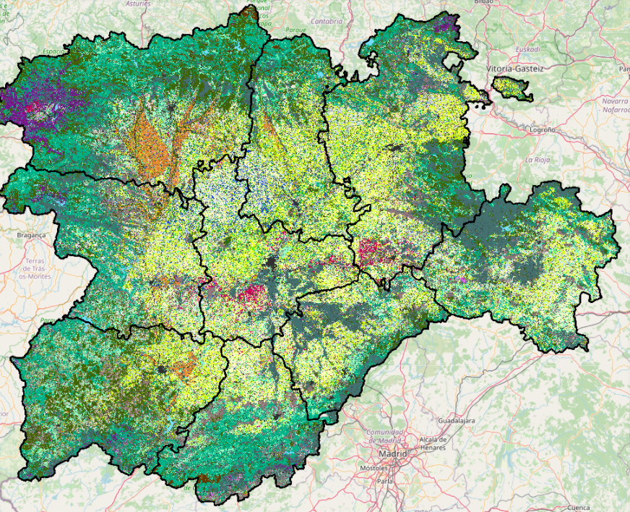
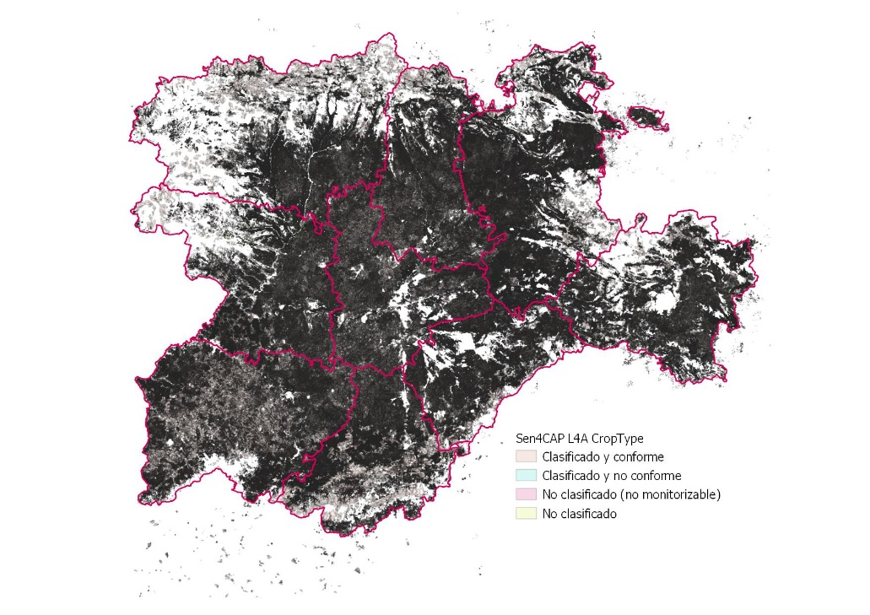
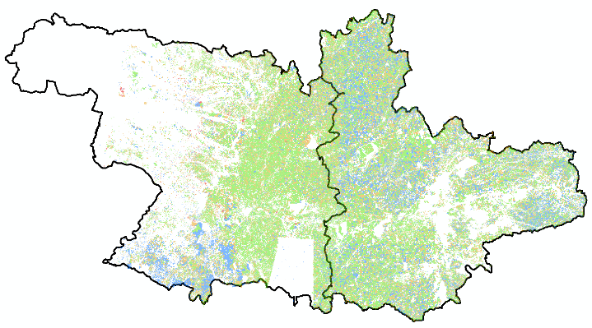

How did we get involved? Pre-CAP monitoring
2014 -2016
2017
2018
USDA (CDL) methodology.
Use of Deimos-1 and Landsat-8
First Crop Map Classification (mcysncyl)
Sentinel-2 images availability
EC shift towards CbM
PA interest for the product
PA requirements collection
Workflow to integrate RS data and Crop Map Classification within IACS.
Deployment of the infrastructure
2011
2016
2020…
1st Evidence
Engagement as test site
User requirements
Prototyping
Notes:
A brief introduction to the context, how/why you got involved ('the story behind')

Slide 4
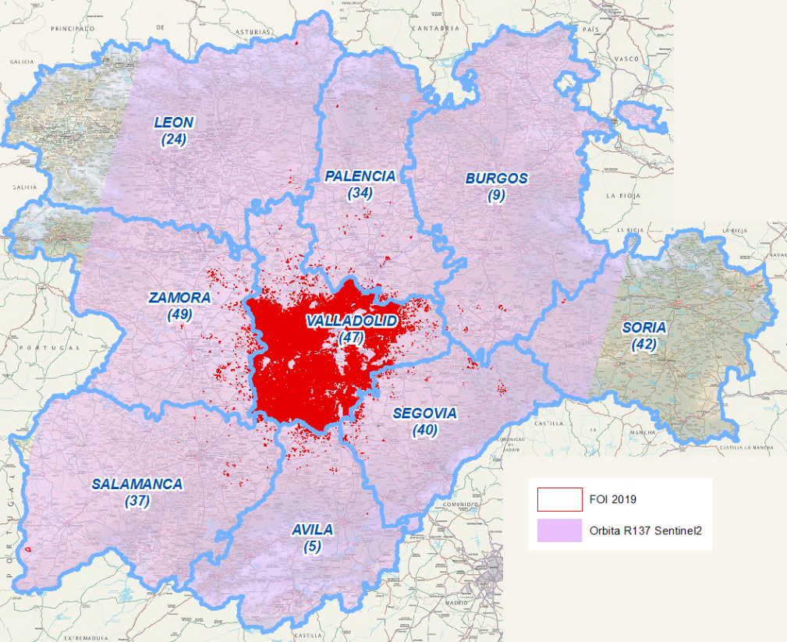
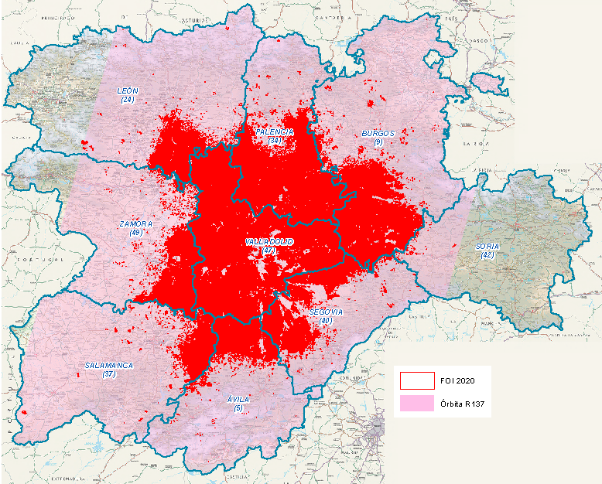
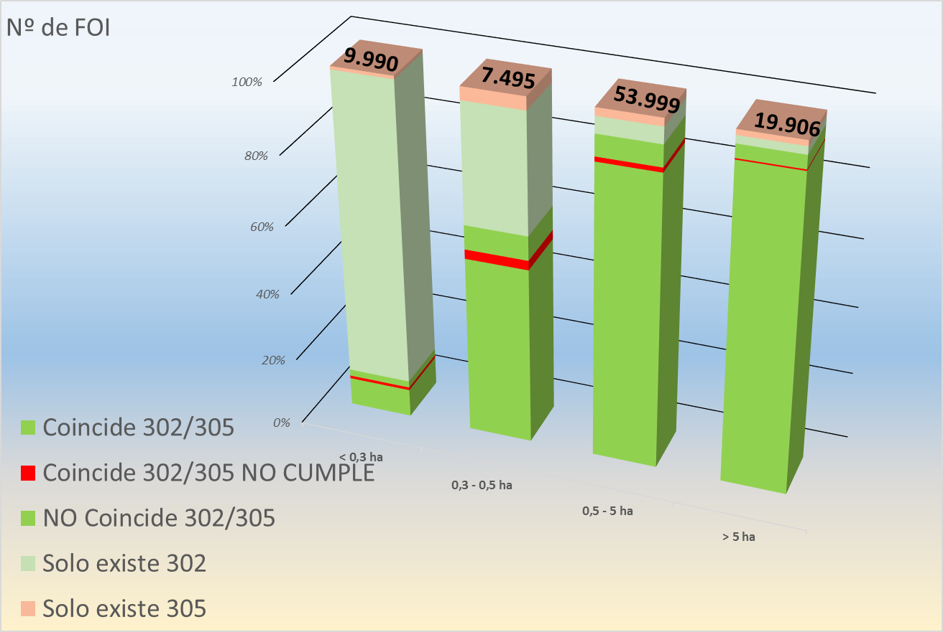

How did we monitor CAP?
2019
Full 1st Pillar
6.4% Claim Area
2020
1st & 2nd Pillar
29.5% Claim Area
Sen4cap run during 2020 campaign
Two sen4cap instances running:
PA premises
Cloud environment: SCAYLE
All processors run in cloud environment
Supervised and managed by sen4cap team
Crop type map integrated in IACS workflow
Notes:
Data use: what have you done with the data, integration with other sources, the role of the PA, ...

Slide 5
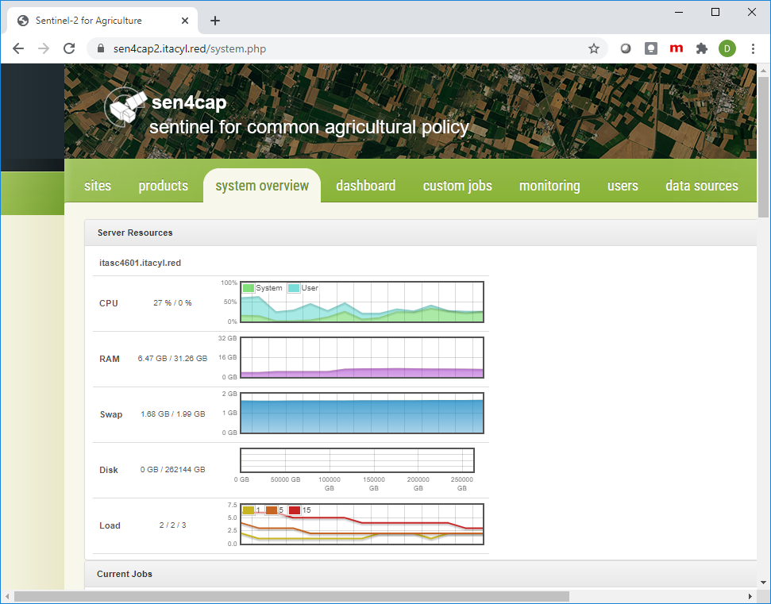
Sen4cap installation from IT perspective
Clean process using scripts with some dependencies.
Well documented
Easy update
Very Good support from Cosmin Udroiu – Cs-Ro
Problem with the disk usage monitoring

Slide 6
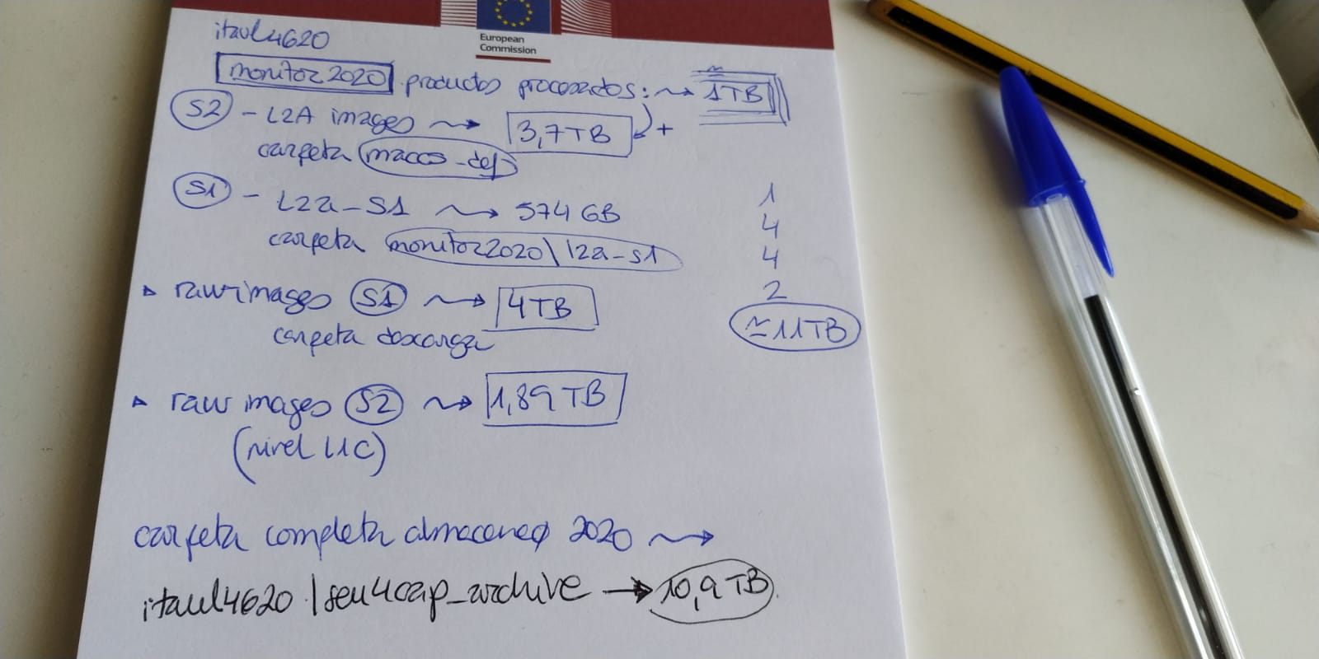
Data usage for CyL PA in 2020 (100,000 km2)
S1 raw 4 TB
S2 raw (L1C) 1,89 TB
S1 derived products 4 TB
S2 derived products 4TB
11 TB full season

Slide 7
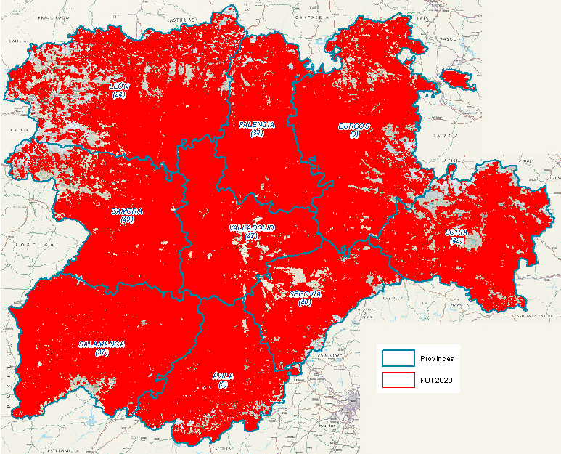
What about 2021?
2021
All 1st & 2nd Pillar
100% Claim Area
(5,293,871 ha)
Replace our downloading system with Sen4cap’s
Define new markers from Sentinel-1 signal and from biophysical products
Take advantage of new markers such as tillage from Sen4CAP 2.0
Technical requirements (~90 000km²)
CPU: 8 Cores
RAM: 64GB
HDD Storage: 8 TB (without S-1, S-2 L1 storage)
SSD Storage: 150 GB (optional)
Notes:
what are the conditions for making it operational (e.g. in relation to downloading biophysical parameters, etc.) ...

Slide 8

What do PAs need to set a monitoring system?
Farmers application software
Updated with current season satellite imaginary
Preloaded markers from previous years and current season land cover
Image downloading and pre-processing scripts (signals)
Derived products for crop and ag. practices identification (markers)
Vector intersection to store markers in Monitoring DB next to IACS DB
Decision rules based in Monitoring and IACS databases.
Expert judgement tool that integrate application data with signals, markers and rules.
Farmer Interaction APP (notifications, geotagged pictures, etc.)
NO
essential
Yes
Some
essential
Yes
essential
NO
essential
NO
NO
Notes:
type of data (for Pillar 1 and Pillar 2 if you can distinguish), its usefulness / value added, the role of the PA in data collection and storage, ...
Challenges encountered and recommendations/tips on how to overcome them: what has worked well,

Slide 9
Conclusions and remarks
Sen4cap looks appealing, it has some features quite interesting for us.
Challenge to integrate with in-home process and IACS. Need to explore:
GSAA live update in sen4cap postGIS layer
Markers API
If we were starting with CbM from scratch right know, sen4cap would be the our starting point.

