Slide 1
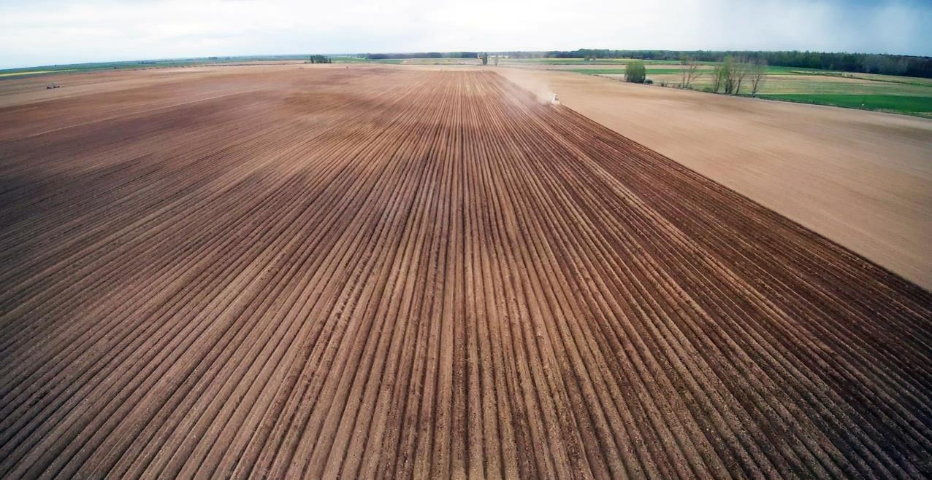


Integrating Meteorological Data into the AMS of Castilla y León Paying Agency
Alberto Gutiérrez García
ita-gutgaral@itacyl.es
Rubén Negro Martín
ita-negmarru@itacyl.es
Miriam Cabrero Carrera
cabcarmi@itacyl.es
Félix Hernando Sancho
hersanfe@itacyl.es

Slide 2
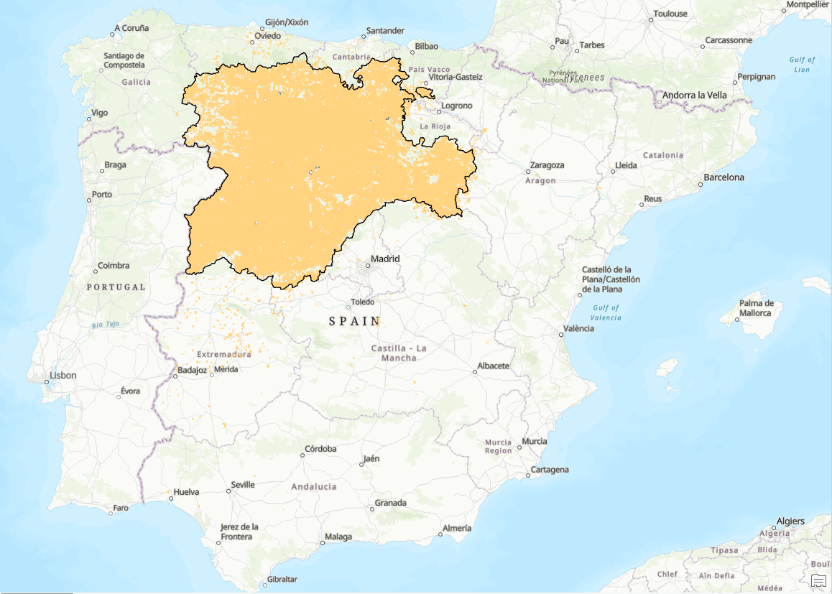


Castilla y León Area Monitoring System
Joint effort of:
Management Segment
Technological support
Monitoring 2026 in CyL
Total area of CyL: ≈ 95,000 Km²
Total arable: > 55,000 Km²
CAP Supported area: 52,059.87 Km²
Dossiers: 53,301

Slide 3
Castilla y León Area Monitoring System
Sentinel Data in the Area Monitoring System of Castilla y León

Slide 4
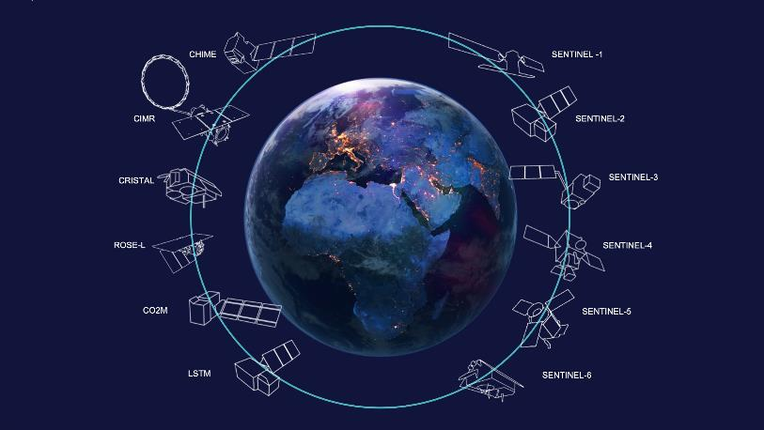
Castilla y León Area Monitoring System
Area Monitoring System (AMS):
“a procedure of regular and systematic observation, tracking and assessment of agricultural activities and practices on agricultural areas by Copernicus Sentinels satellite data or other data with at least equivalent value.”⁽¹⁾
Fuente: https://www.thalesaleniaspace.com/en/press-releases/copernicus-sentinel-1d-earth-observation-satellite-successfully-launched
⁽¹⁾ Regulation (EU) 2021/2116 of the European Parliament and of the Council of 2 December 2021 on the financing, management and monitoring of the common agricultural policy and repealing Regulation (EU) No 1306/2013.

Slide 5
Castilla y León Area Monitoring System
Area Monitoring System (AMS):
“a procedure of regular and systematic observation, tracking and assessment of agricultural activities and practices on agricultural areas by Copernicus Sentinels satellite data or other data with at least equivalent value.”⁽¹⁾
Fuente: https://www.thalesaleniaspace.com/en/press-releases/copernicus-sentinel-1d-earth-observation-satellite-successfully-launched
⁽¹⁾ REGLAMENTO (UE) 2021/2116 DEL PARLAMENTO EUROPEO Y DEL CONSEJO de 2 de diciembre de 2021 sobre la financiación, la gestión y el seguimiento de la política agrícola común y por el que se deroga el Reglamento (UE) n.o 1306/2013

Slide 6
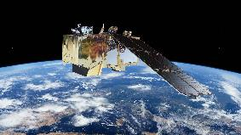
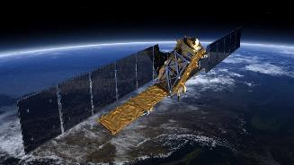
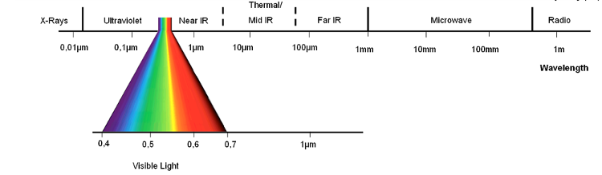
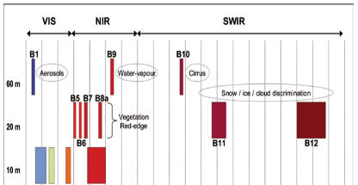
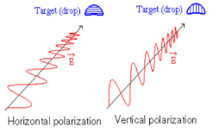
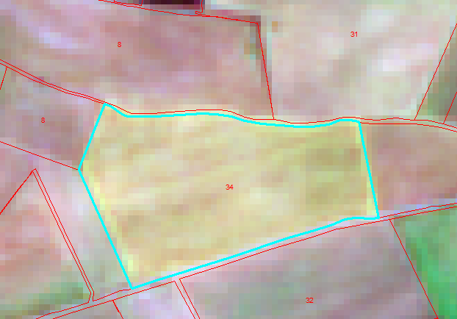
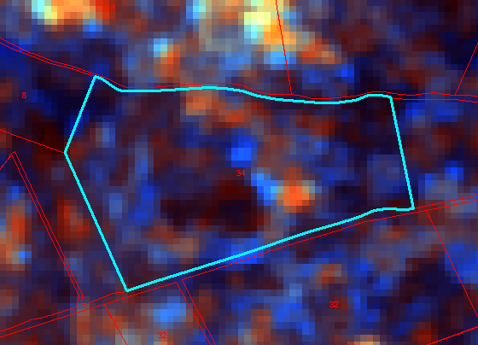
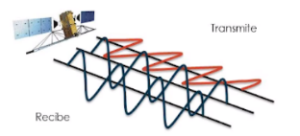
Castilla y León Area Monitoring System
Sentinel-2
From a pragamatical point of view:
Sentinel-1
Pasive optical sensor
13 bands
Vegetation Activity
Cloud limitation
Direct interpretation
Active sensor: microwaves
GRD products: VV, VH (dual-pol)
Coverage structure
Dielectric properties
Challenging interpretation

Slide 7
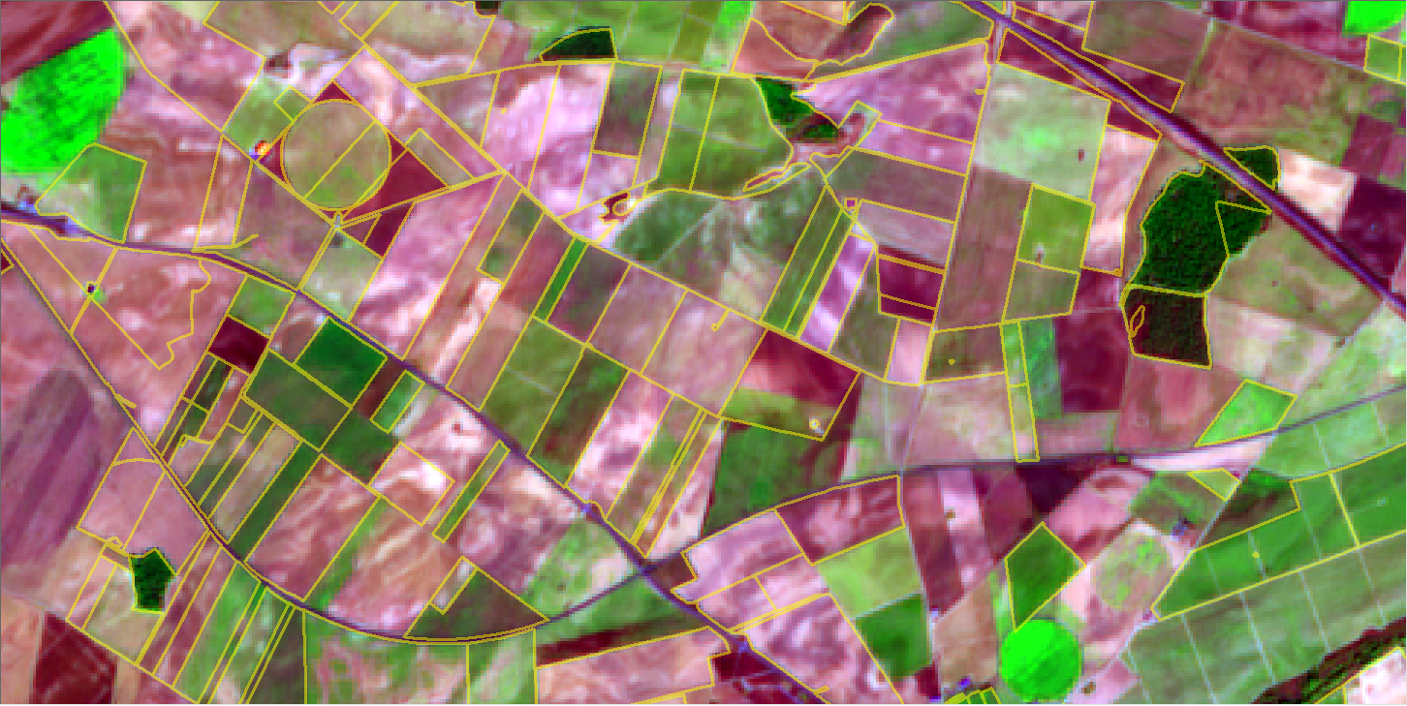
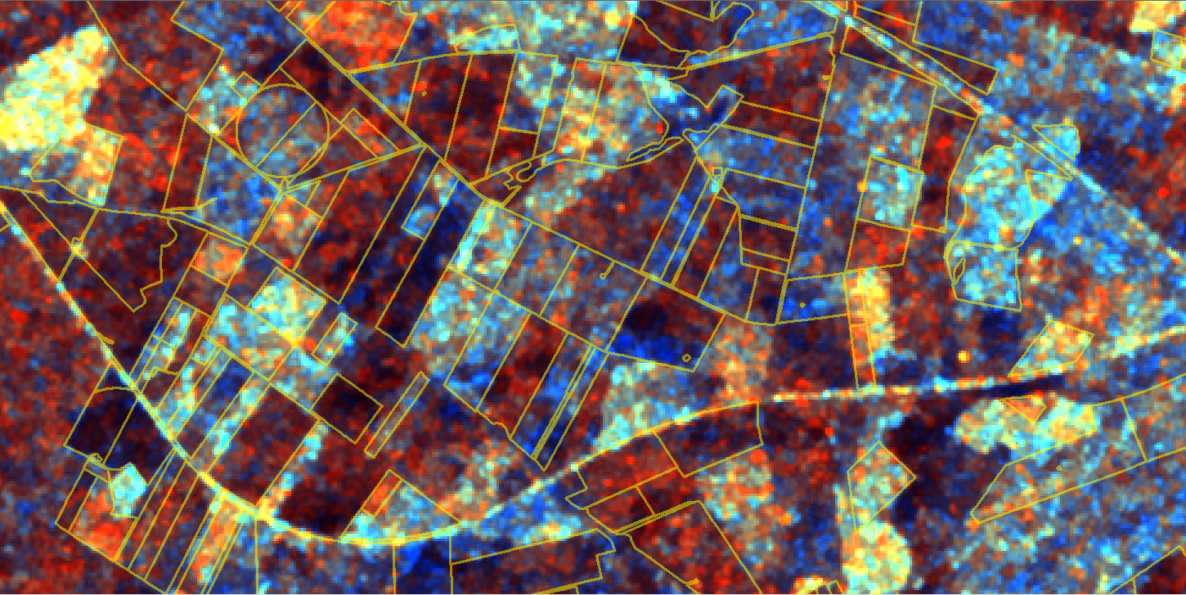
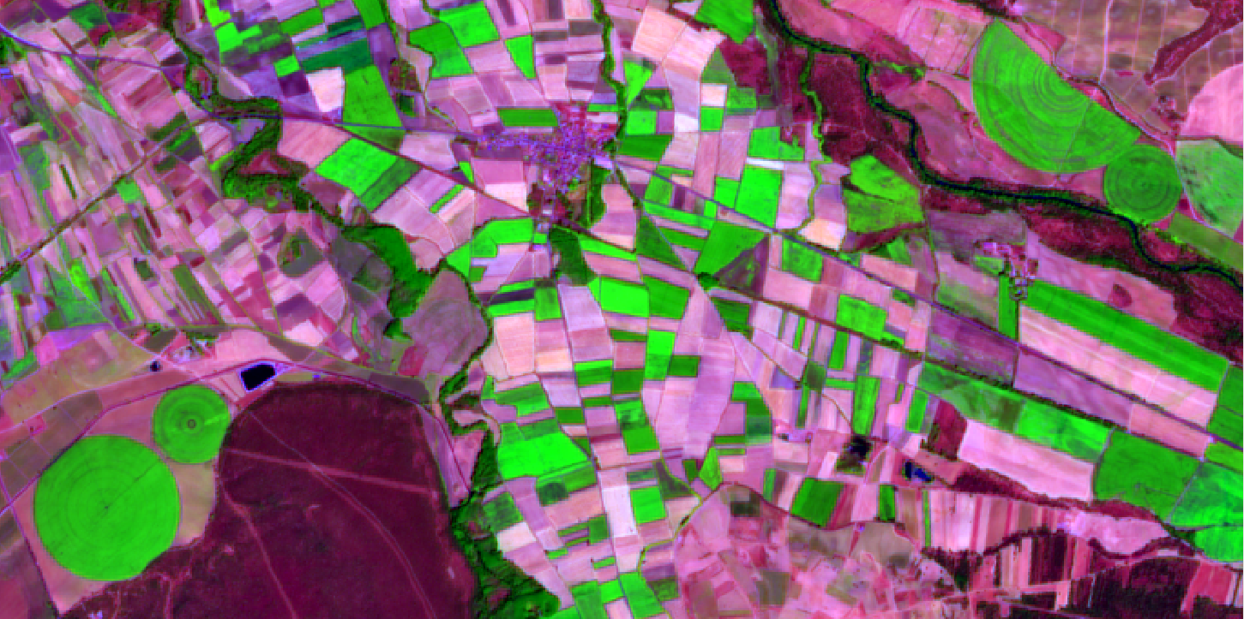
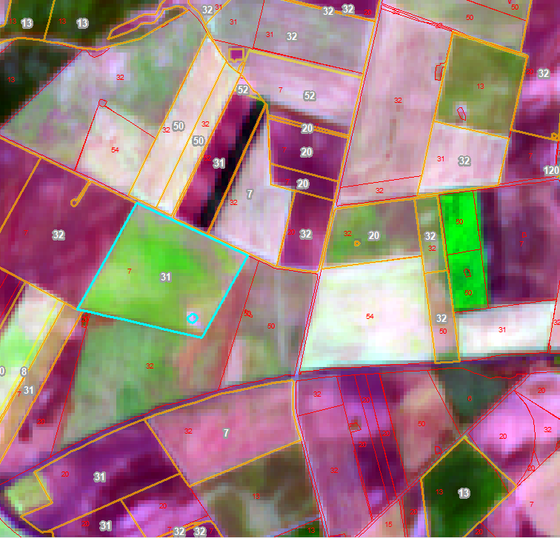
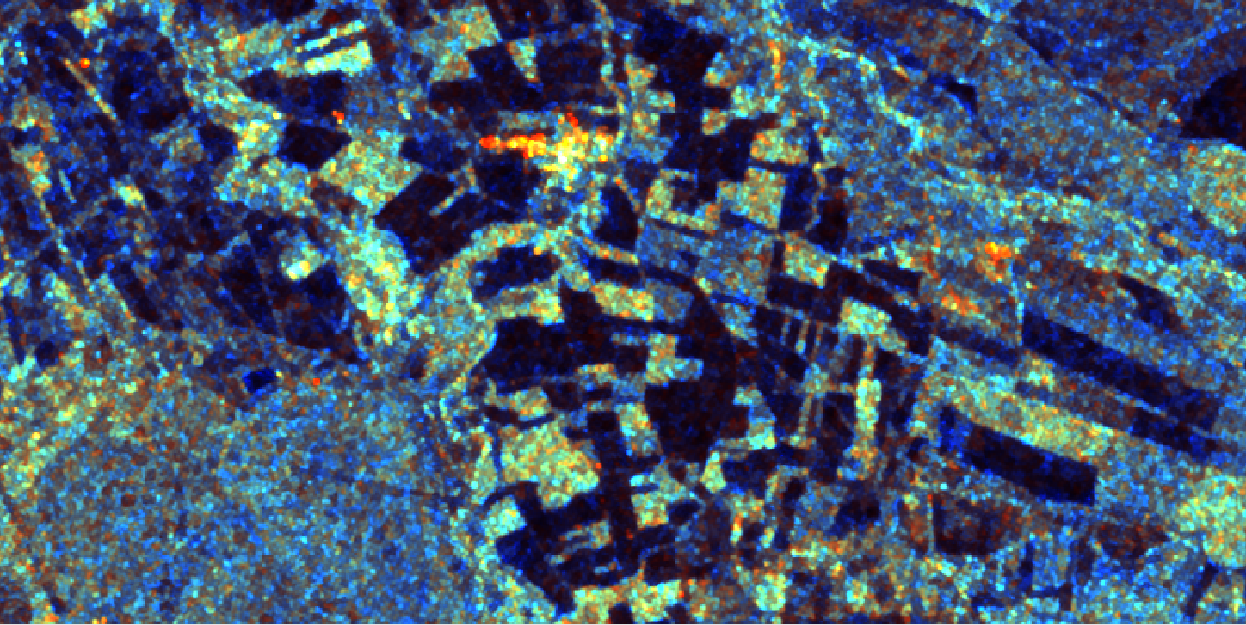
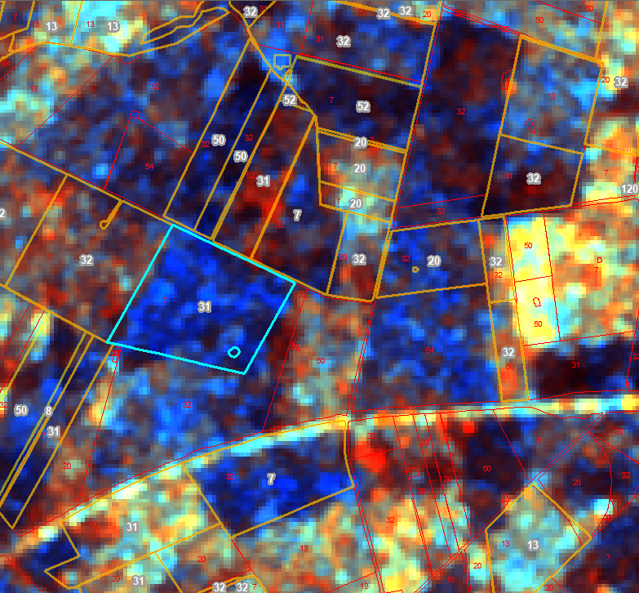

Castilla y León Area Monitoring System
Sentinel-2
R:B11; G:B08; B:B02
Sentinel-1
R:${ σ}_{VV}^{0}$; G: $σ_{VH}^{0}$; B: $σ_{VH}^{0}/σ_{VV}^{0}$
Notes:
Amarillo, verde o turquesa: Vegetación vigorosa (regadíos)
Rojo: suelo desnudo húmedo o rugoso
Azul: vegetación o suelo desnudo

Slide 8



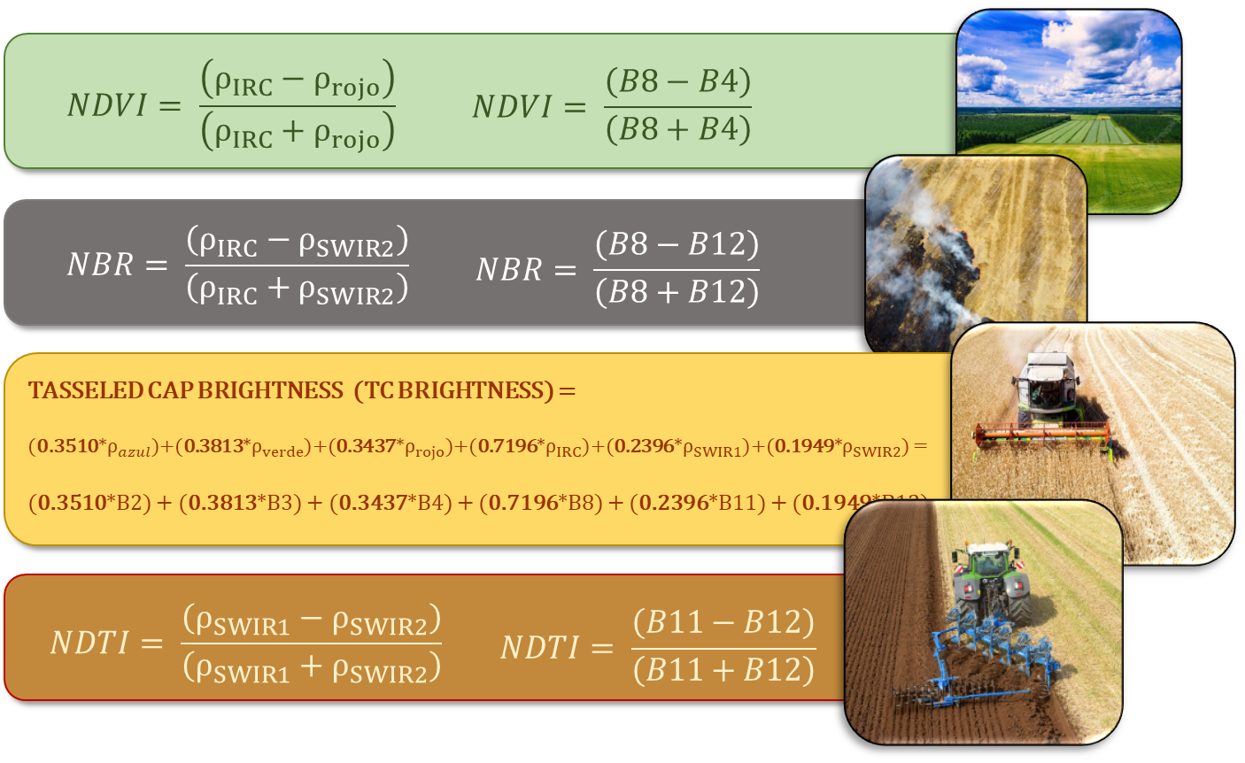

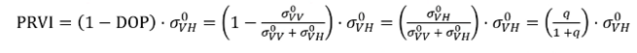
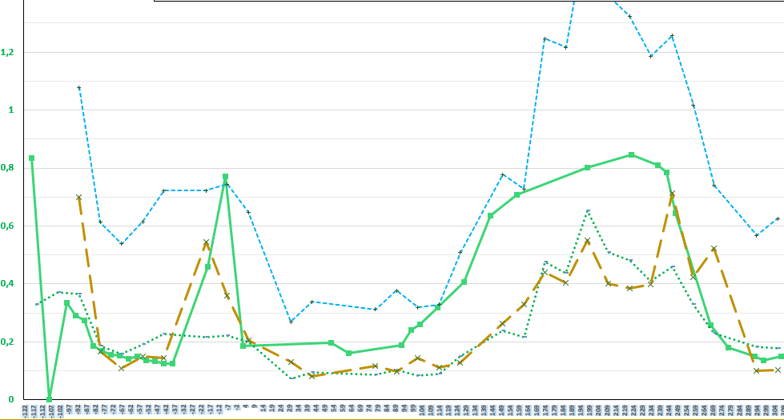
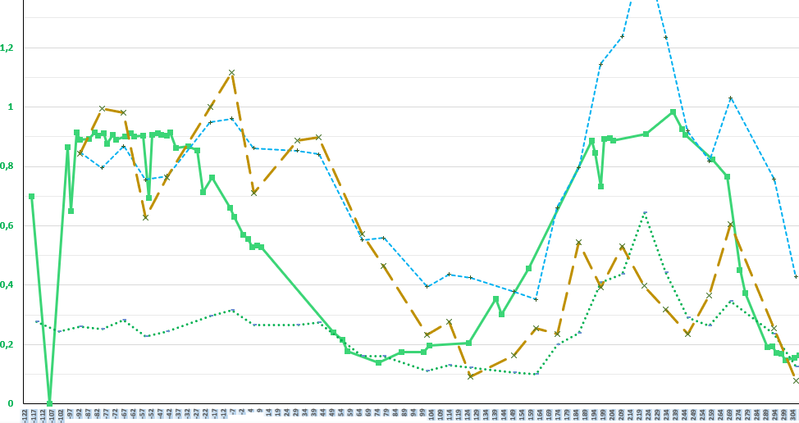
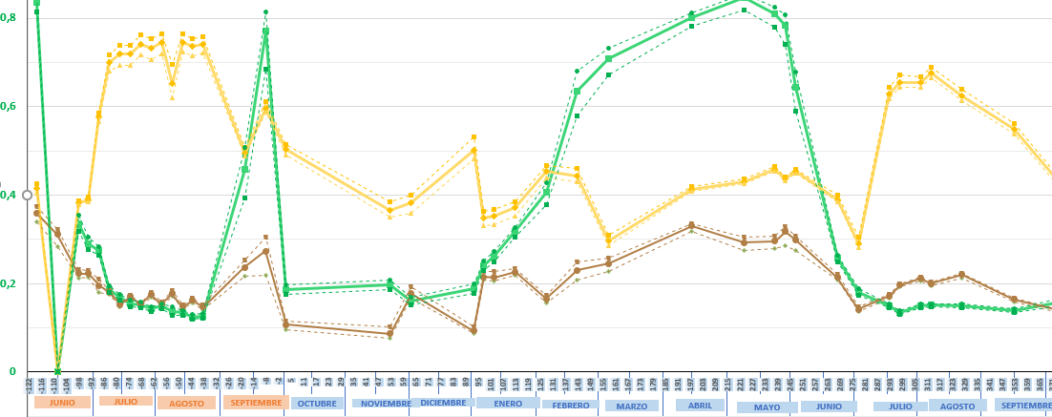
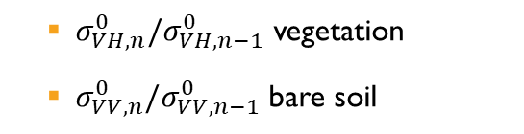
Castilla y León Area Monitoring System
Sentinel-2
Sentinel-1
Ratio cross-polaritation
Radar Vegetation Index
Vegetation Indices
Polarimetric Radar Vegetation Index
  $σ_{VH,n}^{0}/σ_{VH,n−1}^{0}$ vegetation
  $σ_{VV,n}^{0}/σ_{VV,n−1}^{0}$ bare soil
Coverage changes

Slide 9
Castilla y León Area Monitoring System
Sentinel-1 data acquisition and processing

Slide 10
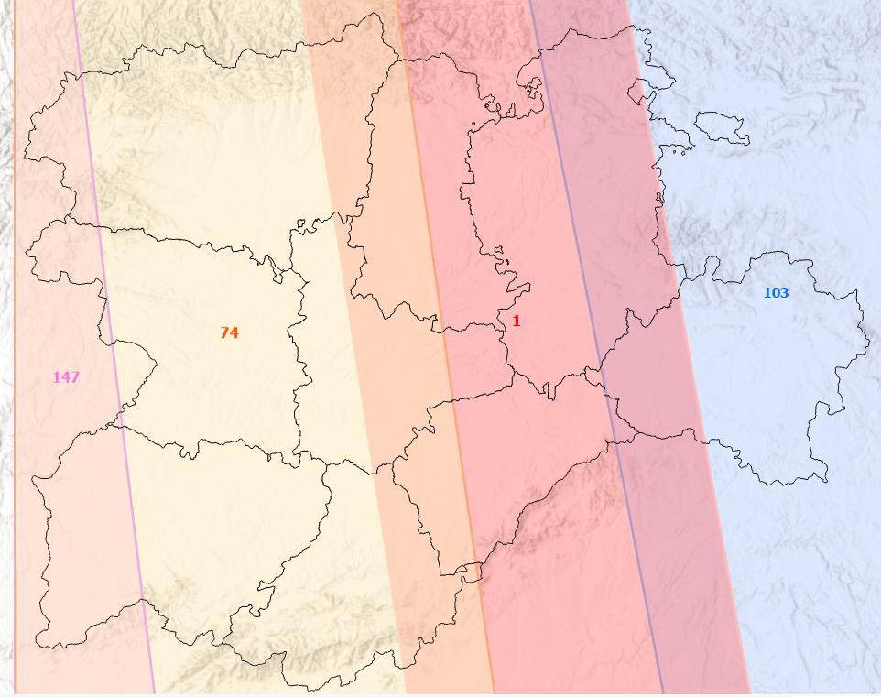

Castilla y León Area Monitoring System
Sentinel-1 over Castilla y León
Considerations
Currently 2 satellites
Ascendent orbit
CyL covered by four orbits
Temporar resolution:
  Every four days CyL is covered
Spatial resolution: 10m

Slide 11

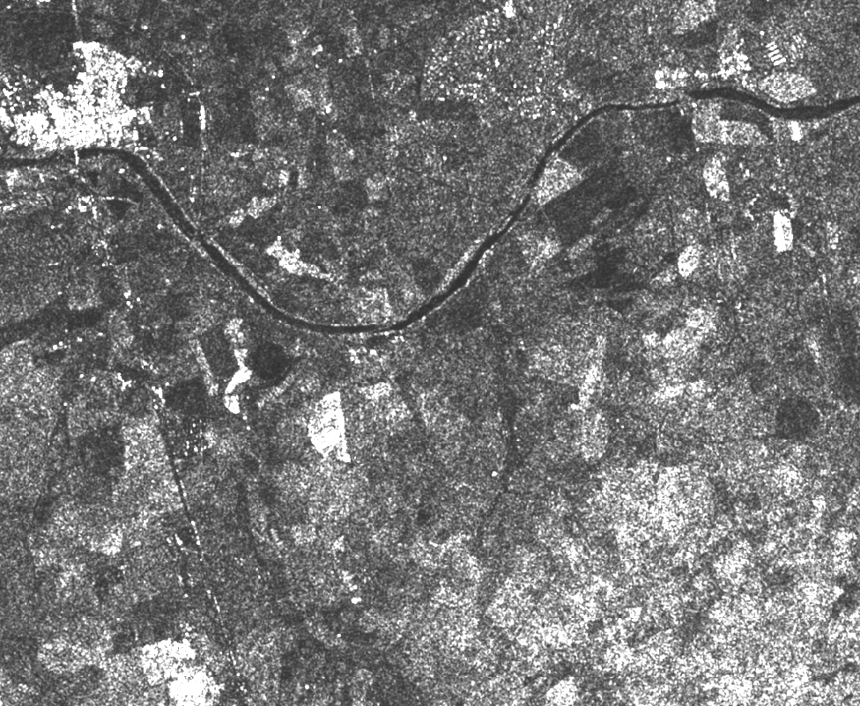
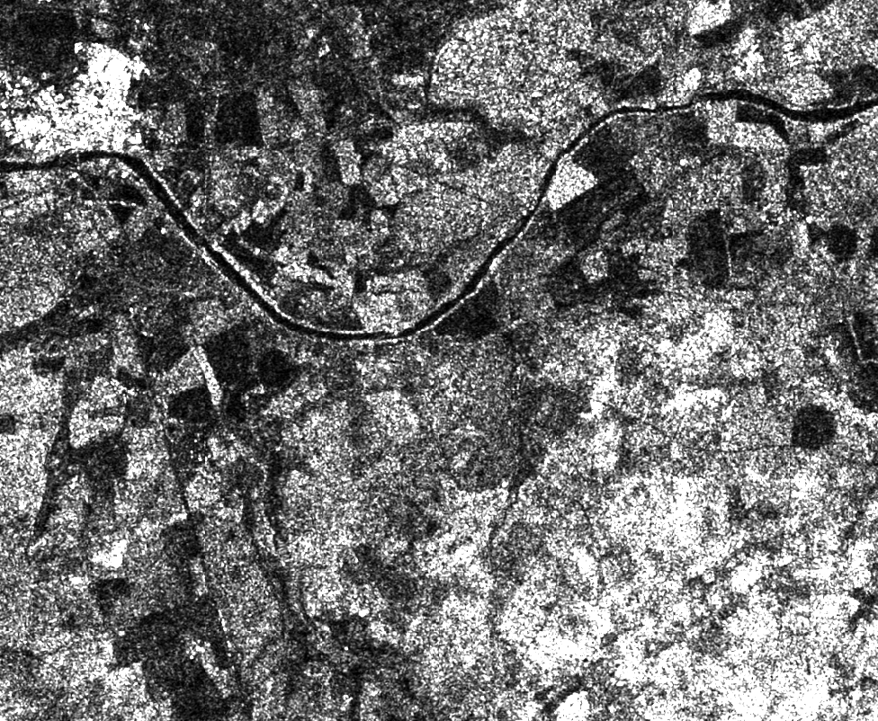
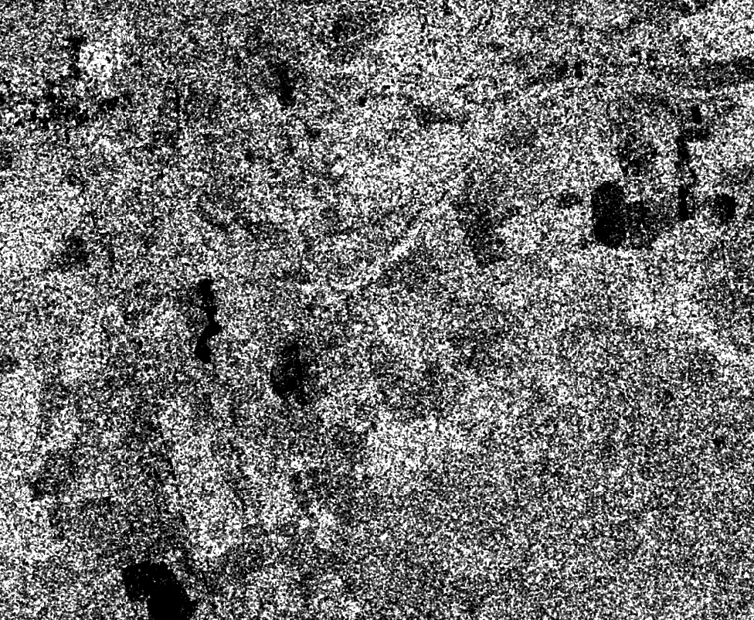


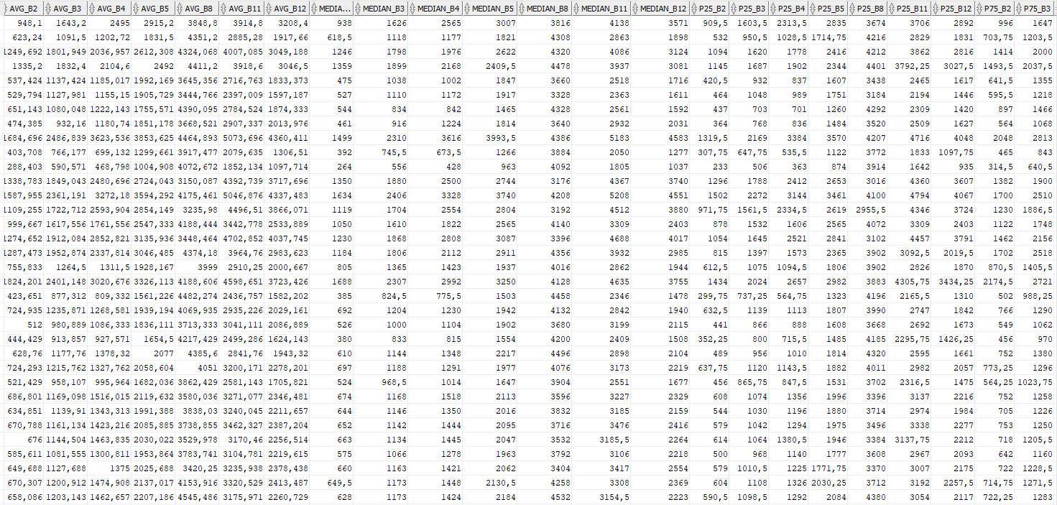
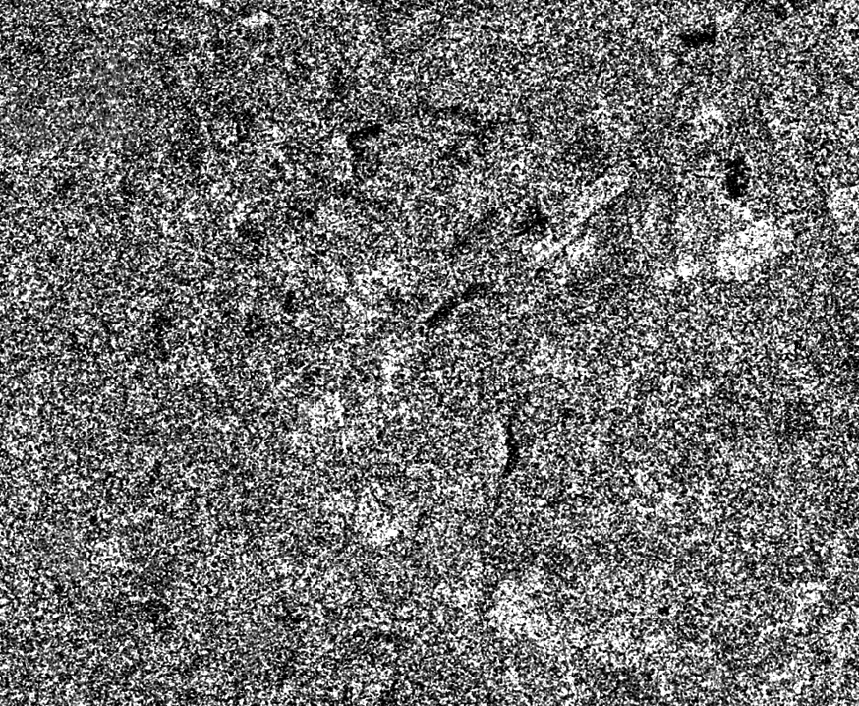








Castilla y León Area Monitoring System
$$σ_{VV}^{0}$$
$$σ_{VH}^{0}$$
$$σ_{VV}^{0}/σ_{VH}^{0}$$
AMS
Database
Sentinel-1
Ground Range Detected
For each Sentinel-1 date acquisition
VV_{(t)}/VV_{(t-1)}
VV_{(t)}/VV_{(t-1)}
VV_{(t)}/VV_{(t-1)}
$$VV$$
$$VH$$
VH_{(t)}/VH_{(t-1)}
VH_{(t)}/VH_{(t-1)}
VH_{(t)}/VH_{(t-1)}
VH/VV
VH/VV
VH/VV
VH
VH
VH
VV
VV
VV
Day t-1
Day t
Start of the season
End of the season

Slide 12
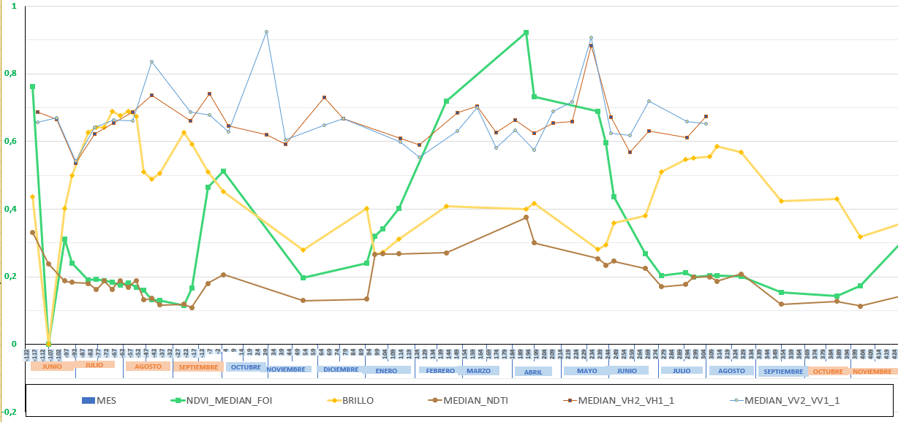
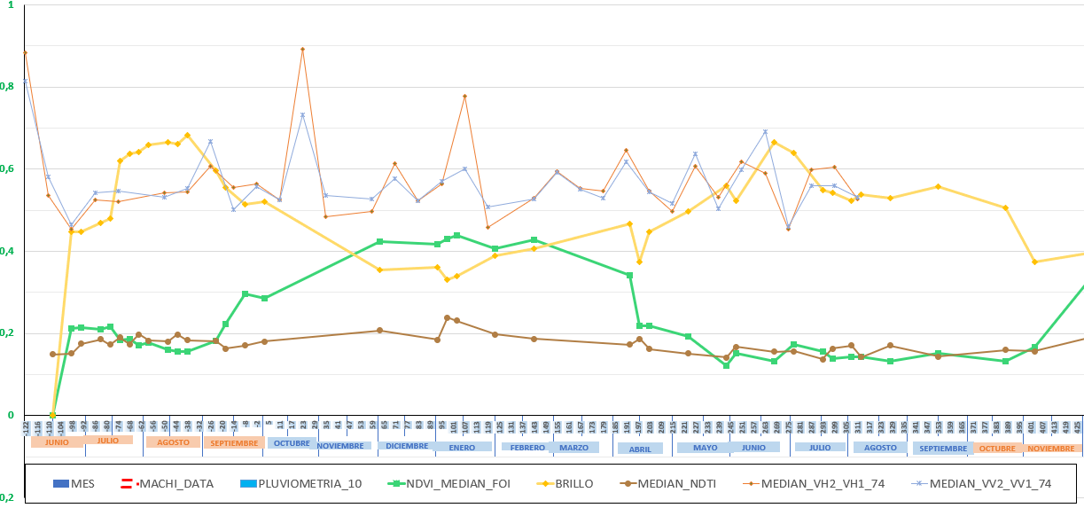
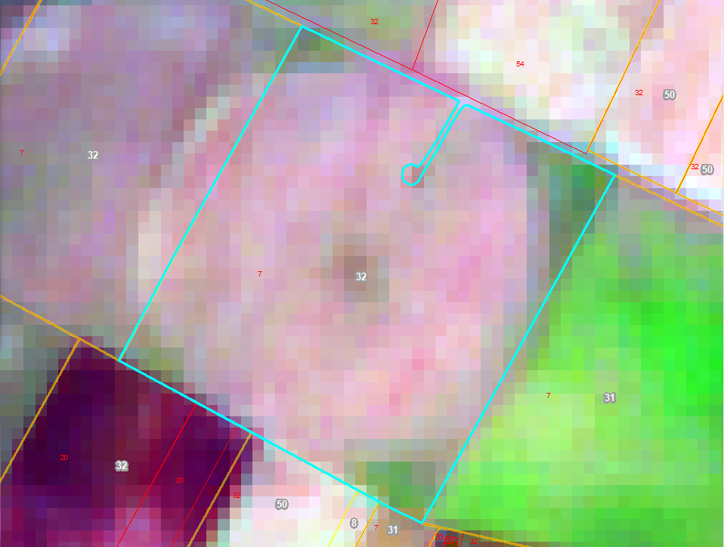
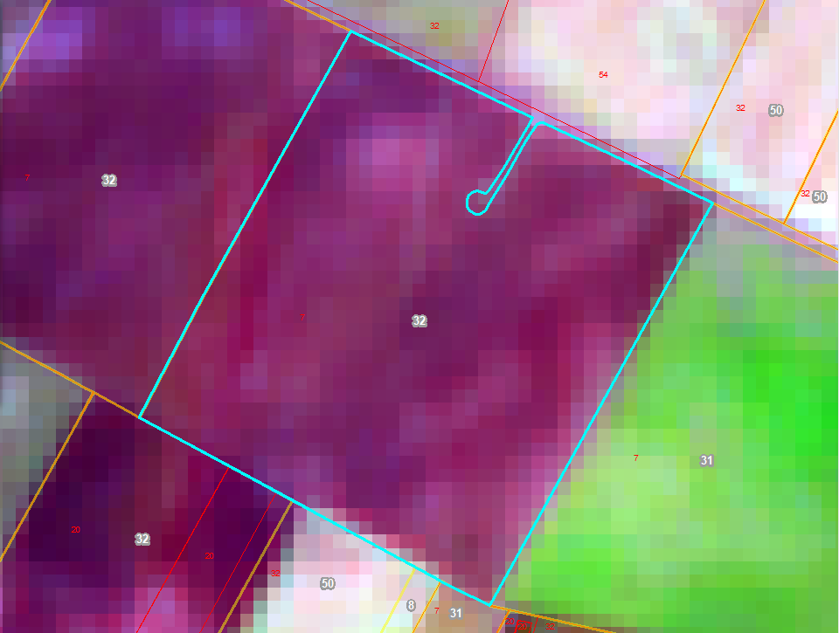
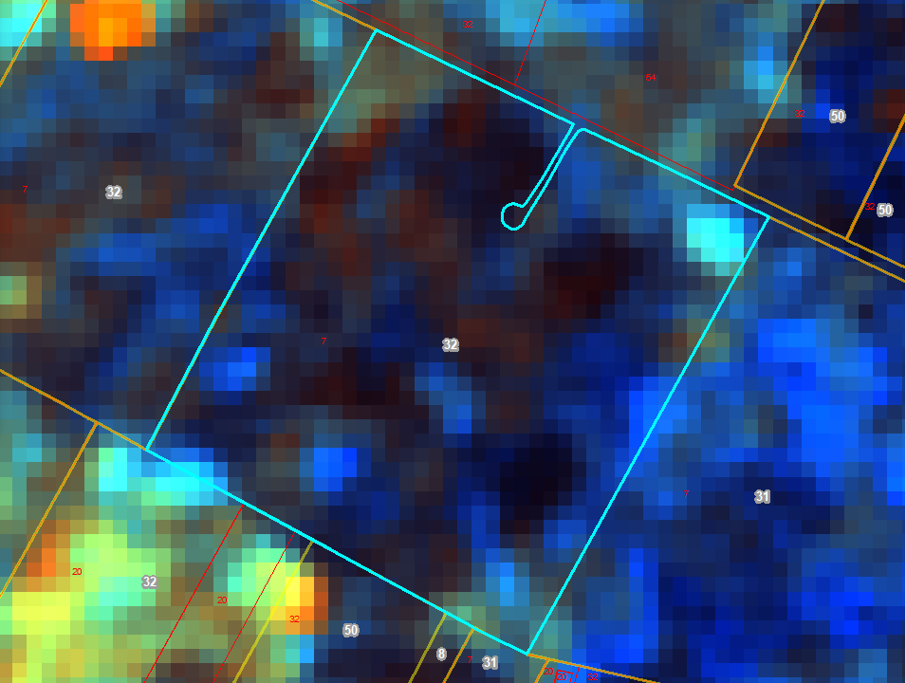
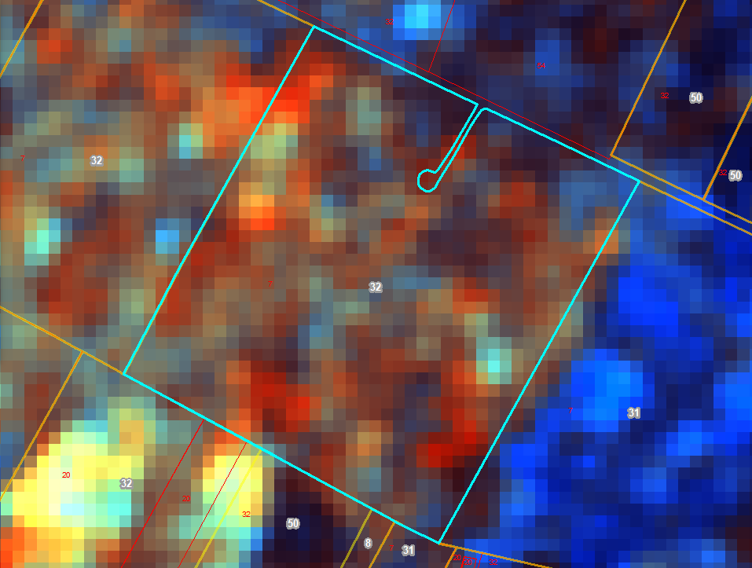
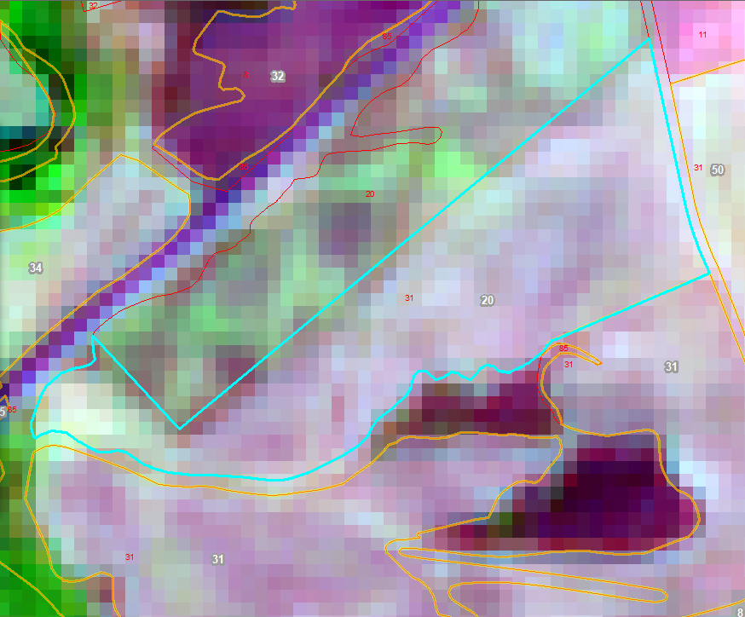
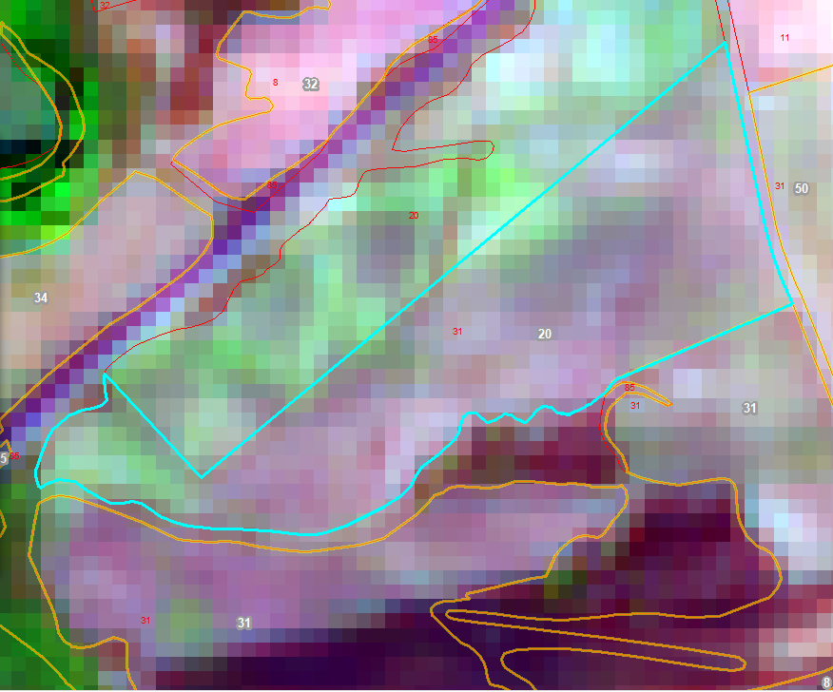
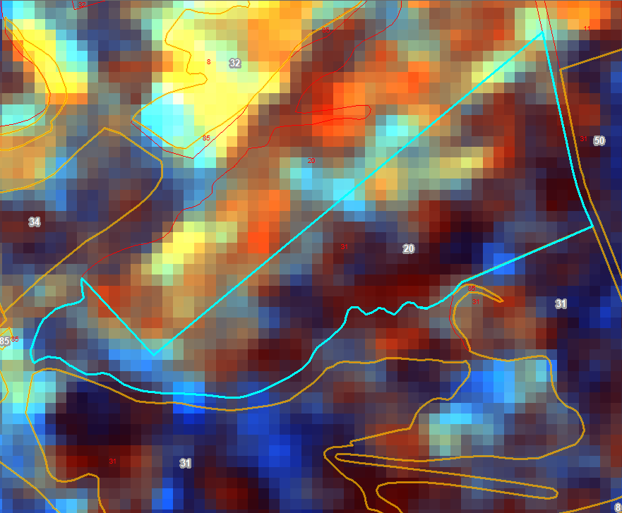
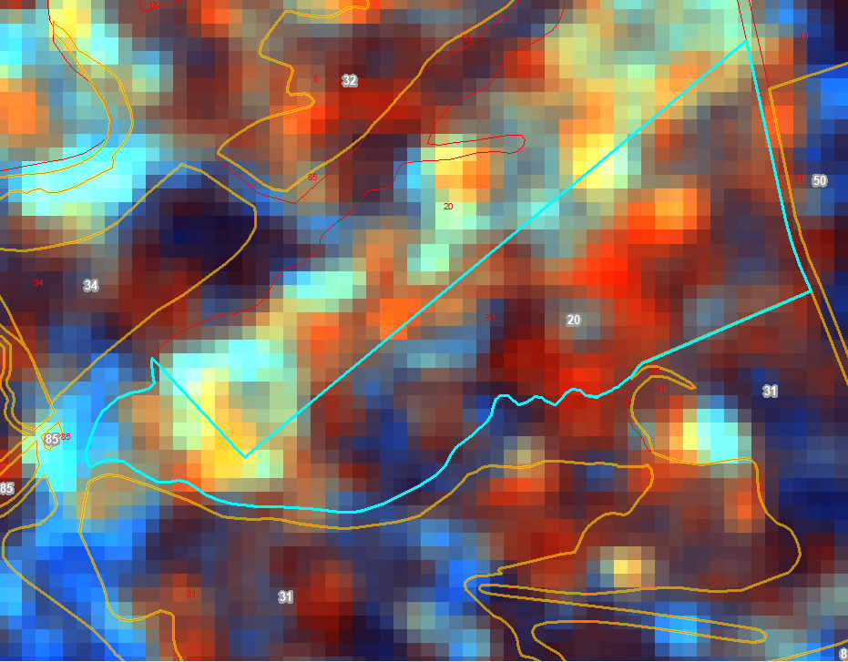



Castilla y León Area Monitoring System
Coverage change
$$Δ{(σ}_{VV,n}^{0}/σ_{VV,n−1}^{0})$$
  Bare soil
→
→
$$Δ{(σ}_{VV,n}^{0}/σ_{VV,n−1}^{0})$$
$$Δ{(σ}_{VV,n}^{0}/σ_{VV,n−1}^{0})$$
FOI_ID:202430679185
FOI_ID: 20241011265

Slide 13
Castilla y León Area Monitoring System
Coverage changes
$$Δ{(σ}_{VV,n}^{0}/σ_{VV,n−1}^{0})$$
  Bare soil
→
→
$$Δ{(σ}_{VV,n}^{0}/σ_{VV,n−1}^{0})$$
Rainfall influence?
$$Δ{(σ}_{VV,n}^{0}/σ_{VV,n−1}^{0})$$
FOI_ID:202430679185
FOI_ID: 20241011265

Slide 14
Castilla y León Area Monitoring System
Meteorological data acquisition and processing

Slide 15

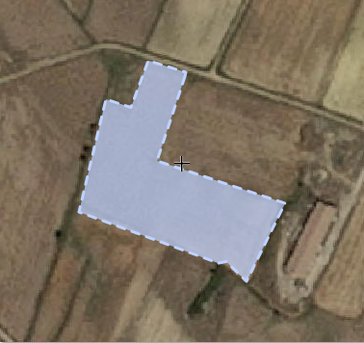
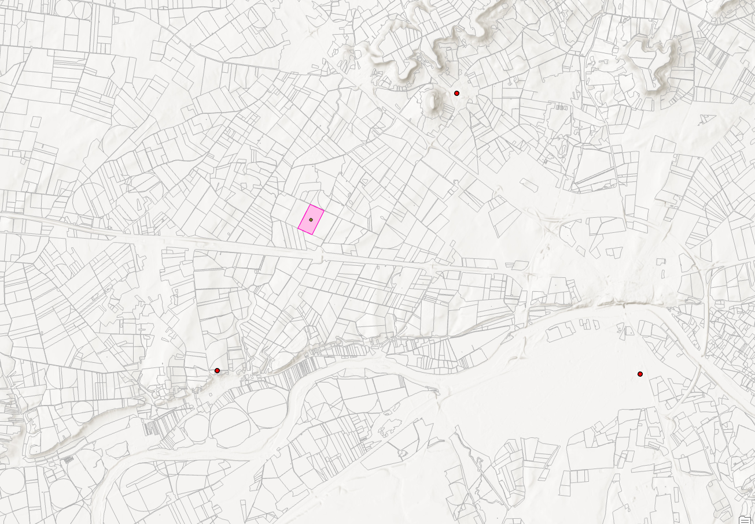


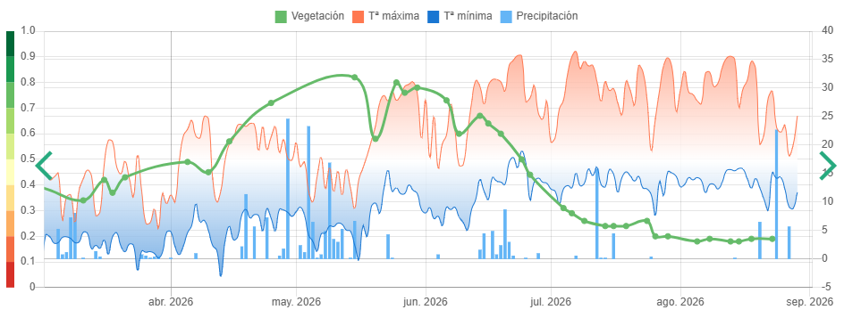
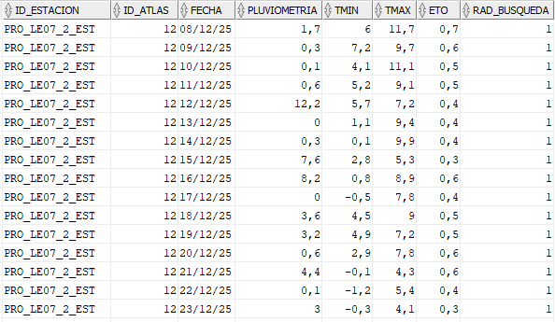
Castilla y León Area Monitoring System
Meteorological Data acquisition
R = 5 Km
API
d = 4,7 Km
d = 4,6 Km
d = 9 Km

Slide 16
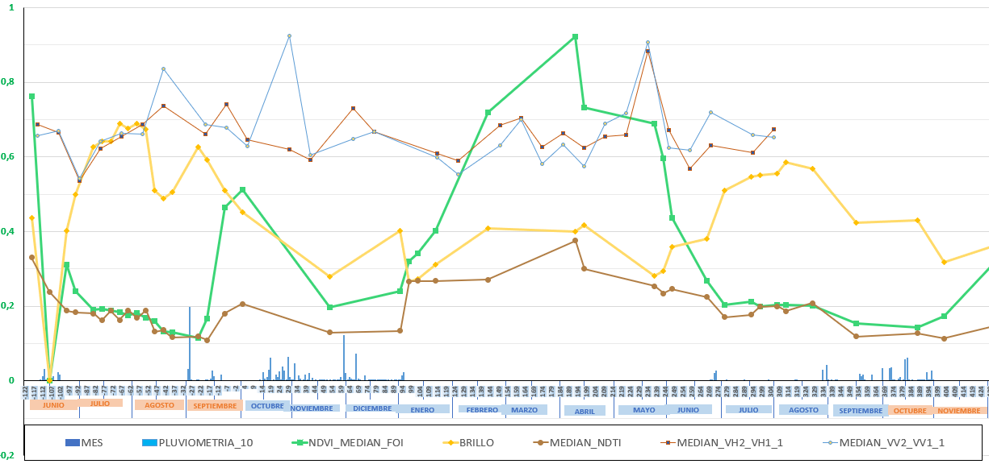
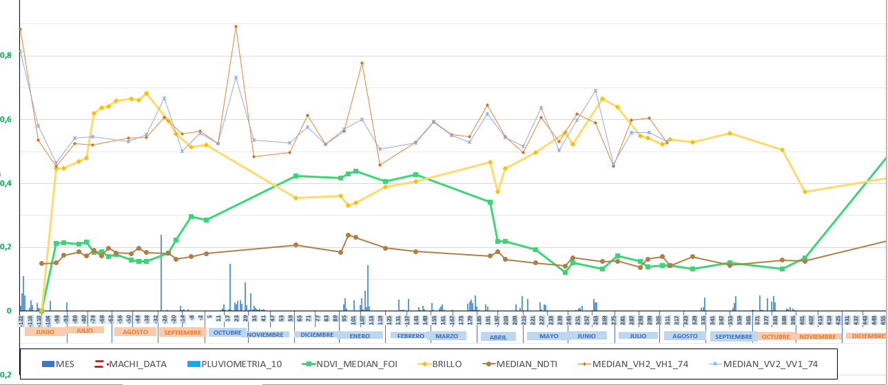


Castilla y León Area Monitoring System
Coverage change
$$Δ{(σ}_{VV,n}^{0}/σ_{VV,n−1}^{0})$$
  suelo desnudo
→
→
$$Δ{(σ}_{VV,n}^{0}/σ_{VV,n−1}^{0})$$
Rainfall
$$Δ{(σ}_{VV,n}^{0}/σ_{VV,n−1}^{0})$$
FOI_ID:202430679185
FOI_ID: 20241011265

Slide 17
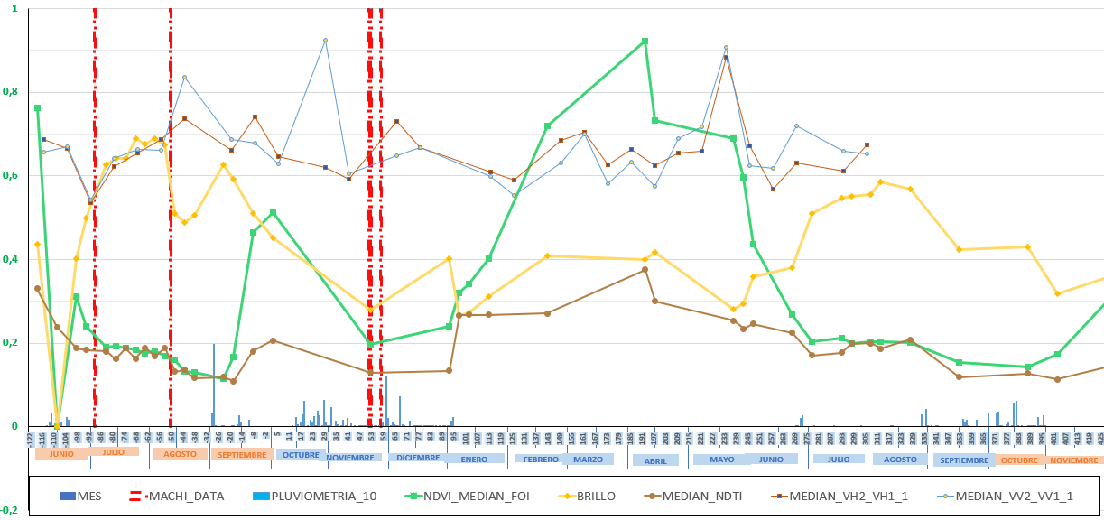
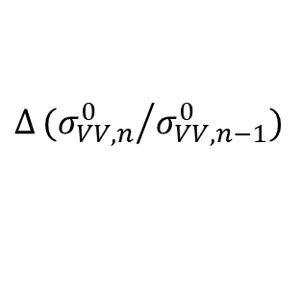
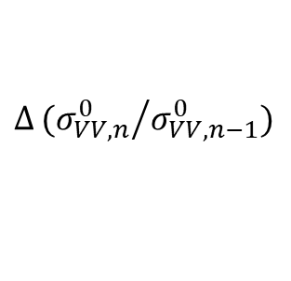
Castilla y León Area Monitoring System
Coverage change
$$Δ{(σ}_{VV,n}^{0}/σ_{VV,n−1}^{0})$$
  Bare soil
→
→
$$Δ{(σ_{VV,n}^{0}}/{σ_{VV,n−1}^{0}})$$
RTK
$$Δ{(σ_{VV,n}^{0}}/{σ_{VV,n−1}^{0}})$$
FOI_ID:202430679185
FOI_ID: 20241011265

Slide 18
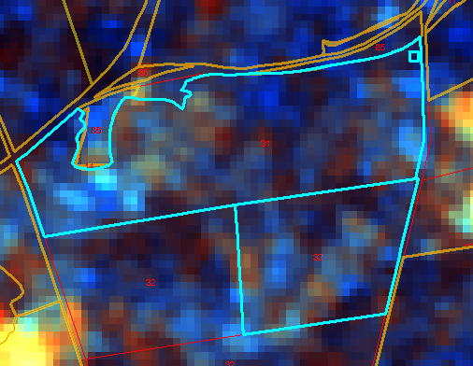
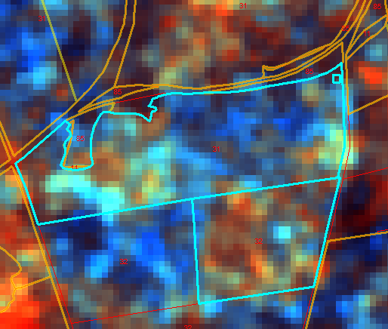

Castilla y León Area Monitoring System
$$Δ{(σ_{VV,n}^{0}}/{σ_{VV,n−1}^{0}})$$
Most common scenario:
Farmers take advantage of the rainfall events to perform tillage or ploughing
Notes:
FOI_ID: 2024500065
FOI_ID: 2024602689

Slide 19



Castilla y León Area Monitoring System
$$Δ{(σ_{VV,n}^{0}}/{σ_{VV,n−1}^{0}})$$
Notes:
FOI_ID: 2024500065
FOI_ID: 2024602689

Slide 20
Castilla y León Area Monitoring System
Achievement:
Design a marker combining Sentinel-1 images with observed meteorological data to decouple the effects of rainfall from tillage events.
The marker had a limited impact due to the conservative approach we followed, nevertheless
  It lays the foundations for exploring the synergies between Sentinel-1 and Sentinel-2 spectral indices.
  It paves the way for integrating additional data sources into the AMS workflow.
Challenges:
Refine the designed marker based on the local context, distinguishing between generalized and localized changes.
Integrate this marker for additional eligibility conditions check.
Acquire and integrate additional meteorological data (e.g., temperature, ET₀, etc.) into the AMS workflow.

Slide 21
Muchas gracias por vuestra atención

