Slide 1
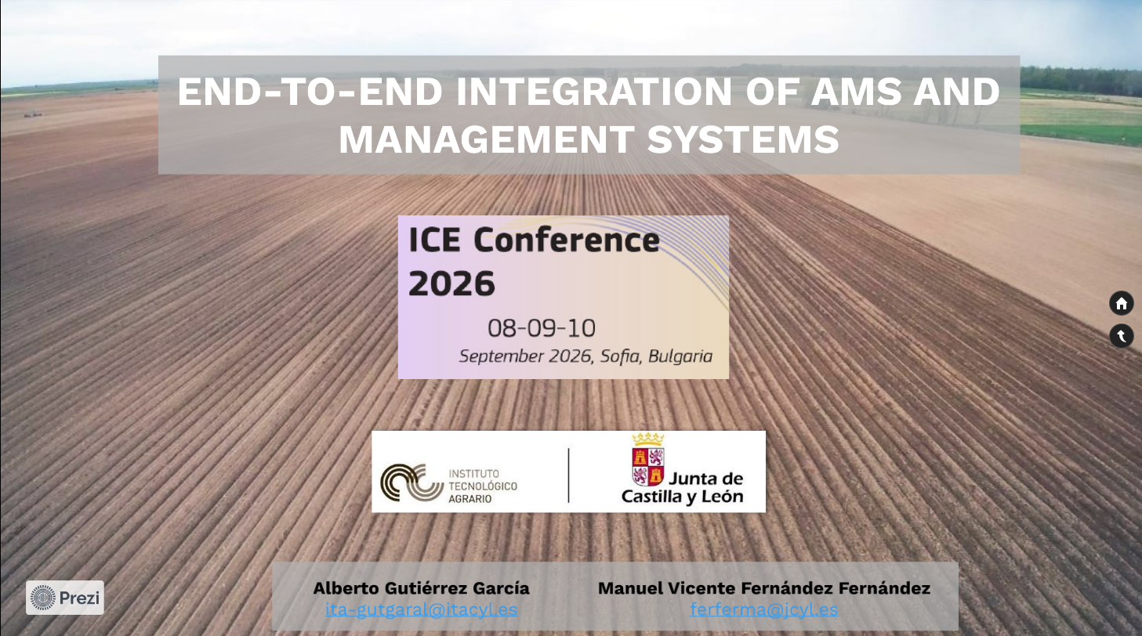
Notes:
In this presentation, we would like to stress the importance of having a unique application that collects and integrates all the necessary information to assess beneficiaries’ compliance with the eligibility conditions for receiving CAP support and, where applicable, proceeding with the payment.
To do so, we will follow the general workflow of the IACS of CyL, presenting how this application facilitates the entire process by integrating not only beneficiaries’ geospatial declarations and the results delivered by the AMS, but also additional data sources, such as VHR and HHR imagery and geotagged photos, to support the expert assessment of non-conclusive cases and, ultimately, the final payment.
We would also like to highlight the difficulty of developing this type of application, which can become even more challenging if the requirements of the interventions increase their complexity.

Slide 2
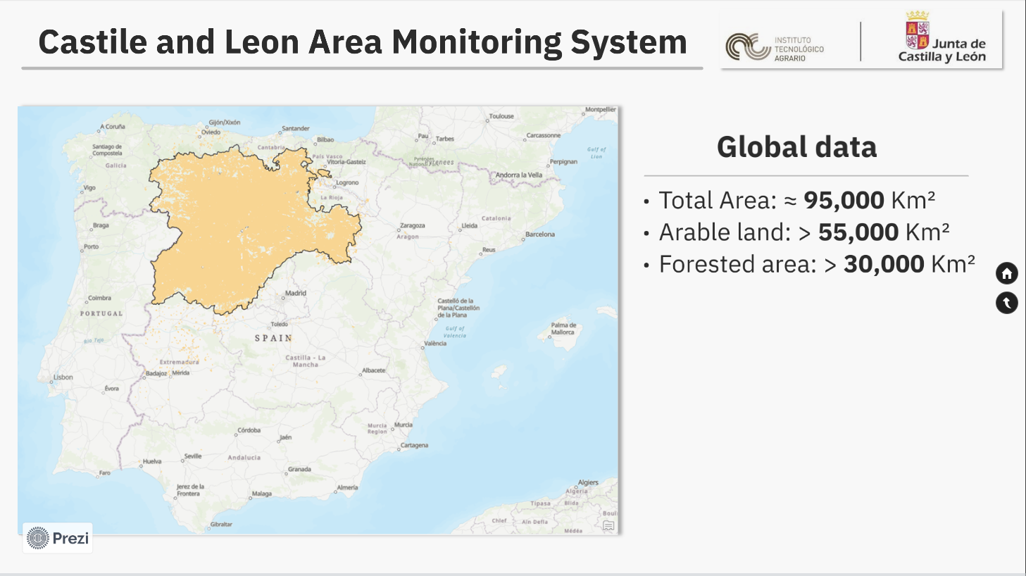
Notes:
Before starting, I´d like to share some figures on CyL region, just to frame the context of the presentation.
CyL is the largest region in Spain, it is almost 9 million 5 hundred thousand ha. We have more than 5 million and a half hectares of arable land (this includes grassland) and more than 3 millions hectares of forested land.

Slide 3
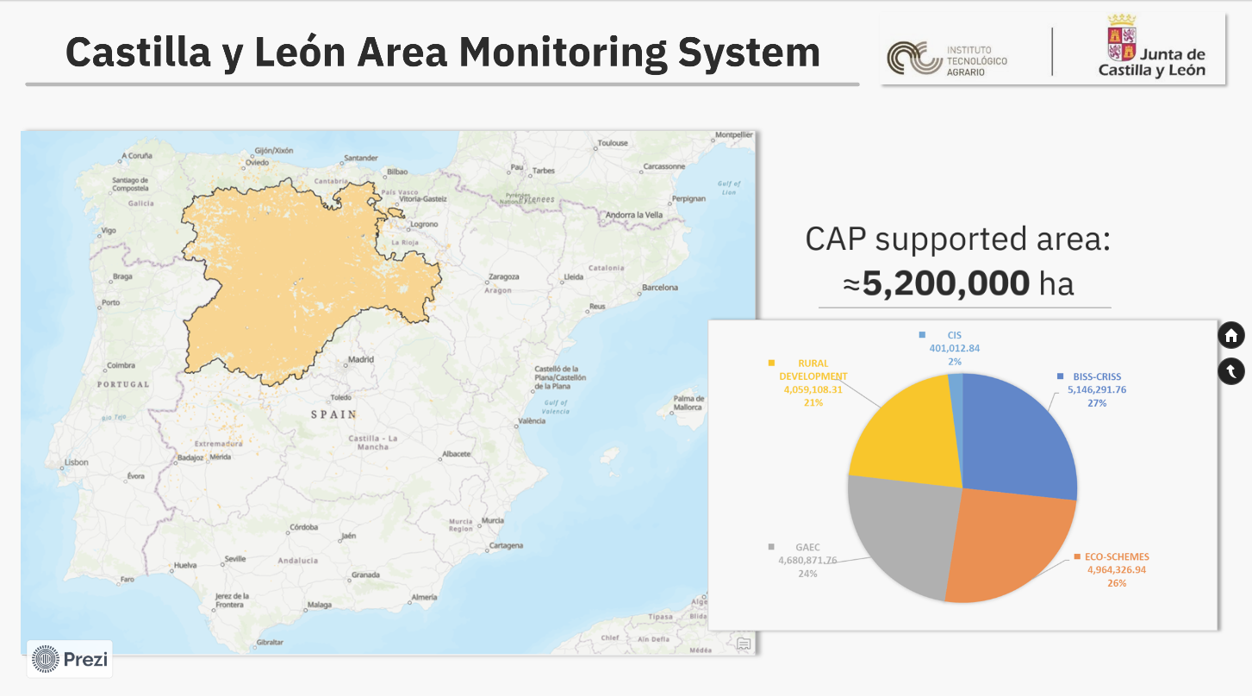
Notes:
If we focus on the supported area by the CAP, it is around 5 millions 2 hundred thousand hectares. I won’t go into detail about the distribution of the area by aid scheme, as I’d like to focus on the main topic of the presentation

Slide 4
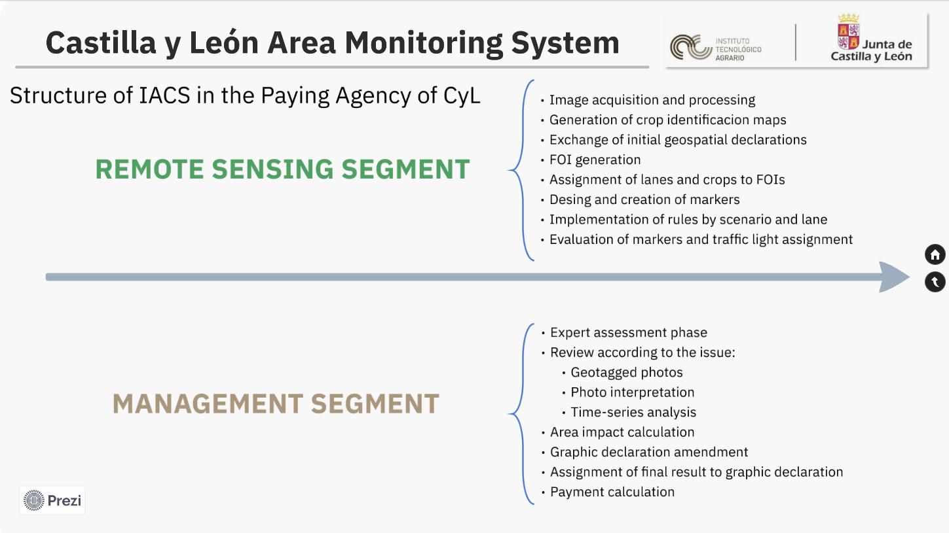
Notes:
The IACS of CyL is structured in two segments: a remote sensing segment and a management segment. Each of them performs different but tightly related tasks.
The remote sensing segment is where the AMS runs and is in charge of:
Image acquisition and processing
Generation of crop identificacion maps
Exchange of initial geospatial declarations
FOI generation
Assignment of lanes and crops to FOIs
Design and creation of markers
Implementation of rules by scenario and lane
Evaluation of markers and traffic light assignment
My name is Manuel Fernández, and I work for the Paying Agency of Castilla y León.
During the monitoring process, we exchange information with the remote sensing segment on a daily basis. Based on the data received, we initiate the photointerpretation and expert judgment phase, drawing upon all available information—including time-series analysis, satellite imagery, and geotagged photographs. We then calculate the area impact, adjust the spatial declaration where necessary, assign the final eligible area to each GSA parcel, and calculate the corresponding payment for each claim.

Slide 5
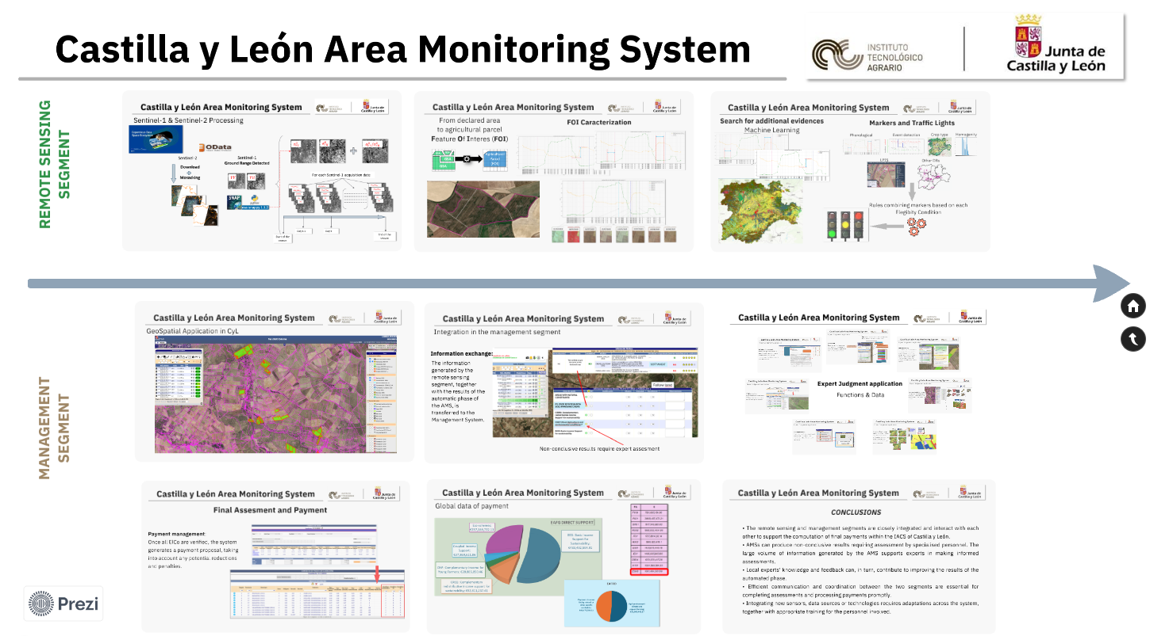
Notes:
If we take an overall view of the IACS workflow, we can identify key elements and stages that interacts each other and exchange information throughout the whole process.

Slide 6
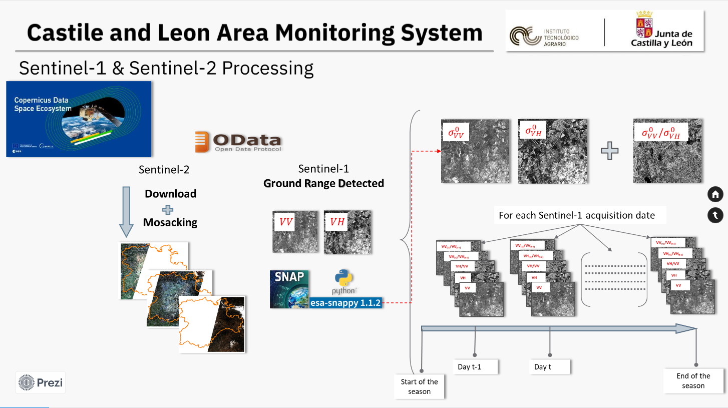
Notes:
We start in the remote sensing segment. The first step in this segment is the acquisition and processing both Sentinel-1 and Sentinel-2 images. This is a continuous process throughout the year. In our case we obtain the images from the CDSE. To do so, we take advantage of the ODATA API which permits us automatized the downloading task which greatly ease the subsequent processes. In this direction, we also benefit from SNAP software and Python scripting for, in the case of GRD product, computing backscattering images.

Slide 7
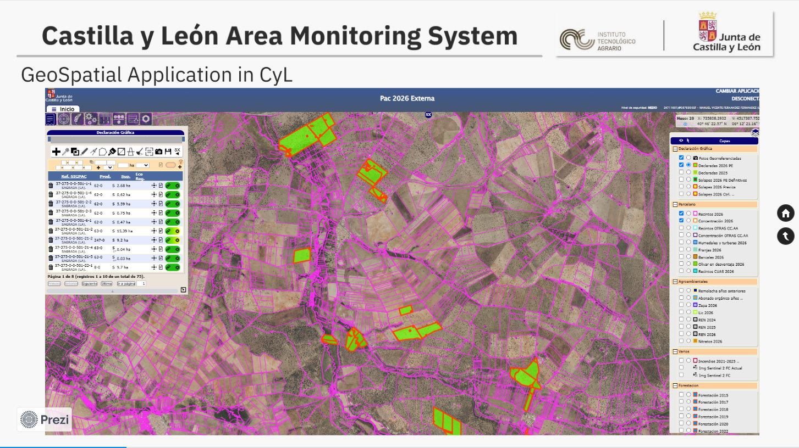
Notes:
When the application period starts, we make available for beneficiaries the GSAA.
In our case, the GSAA software enables seamless spatial declarations across various LPIS parcels. Equipped with advanced mapping tools, the system allows for the precise delineation of specific features within a given parcel, such as accurately plotting a pivot irrigation System.
Once the beneficiary finalizes the application process, the information is transmitted to the remote sensing segment. Since beneficiaries can modify theirs application, the exchange of information is performed daily.

Slide 8
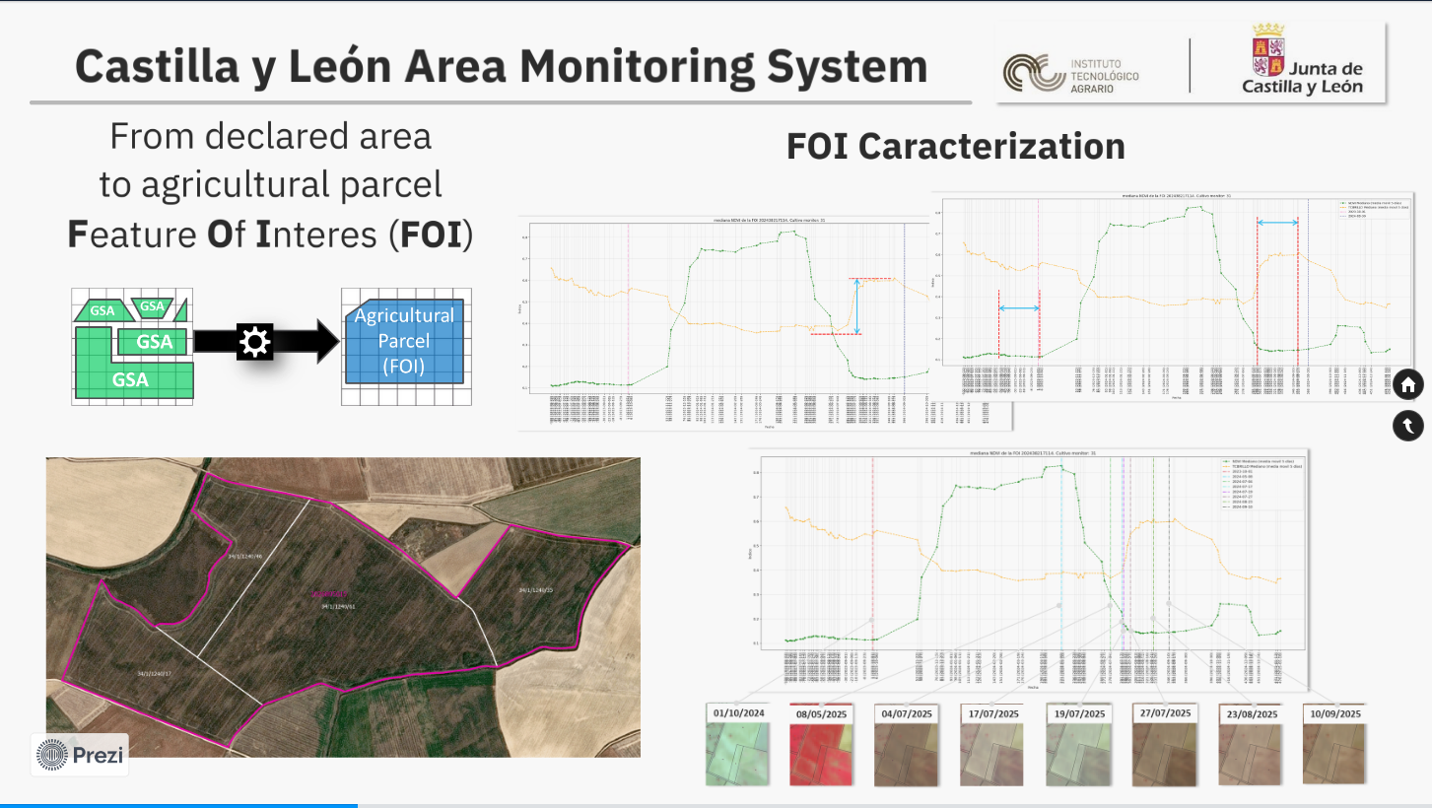
Notes:
Once GSA parcels are in the database of the remote sensing segment, we start with all tasks related to functions of the AMS. In our case, based on the geometries retrieved from the management segment we build the so-called FOI, that basically are agriculture management units. Following, we characterize each FOI based on the signal of sentinel-1 and Sentinel-2 images time-series.

Slide 9
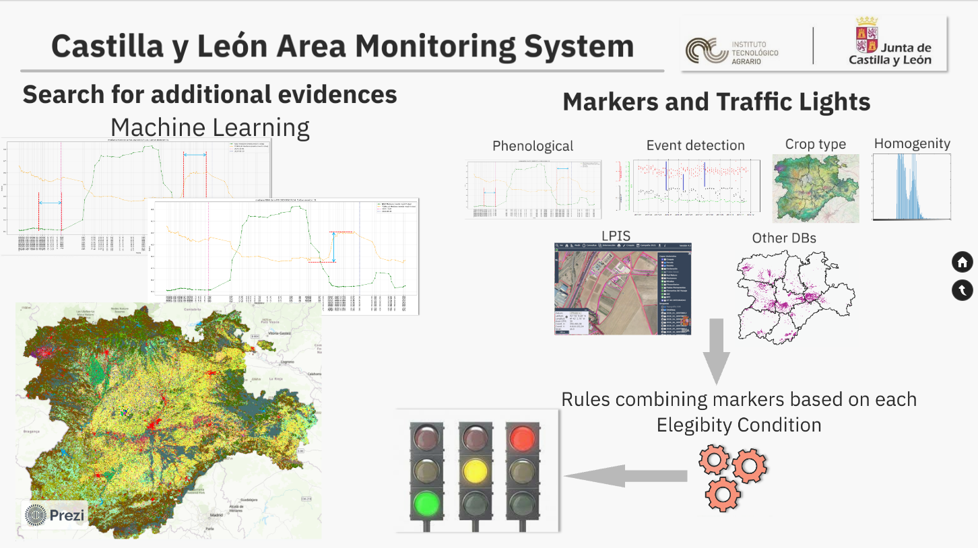
Notes:
This characterization allows us create several sets of evidences, that is, markers.
Apart from he markers derived from the analysis of several spectral indices, we employ machine learning algorithms to produce crop type maps. These maps enable creating additional marker not only related to crop identification but also related to the distribution of the crop within the parcel that is, homogeneity.
The set of markers are group into 6 different families of markers. Finally, depending on the eligibility conditions to check, these markers are combined following certain rules to deliver an automatic decision on the compliance which are communicated to the management segment following a traffic light system.

Slide 10
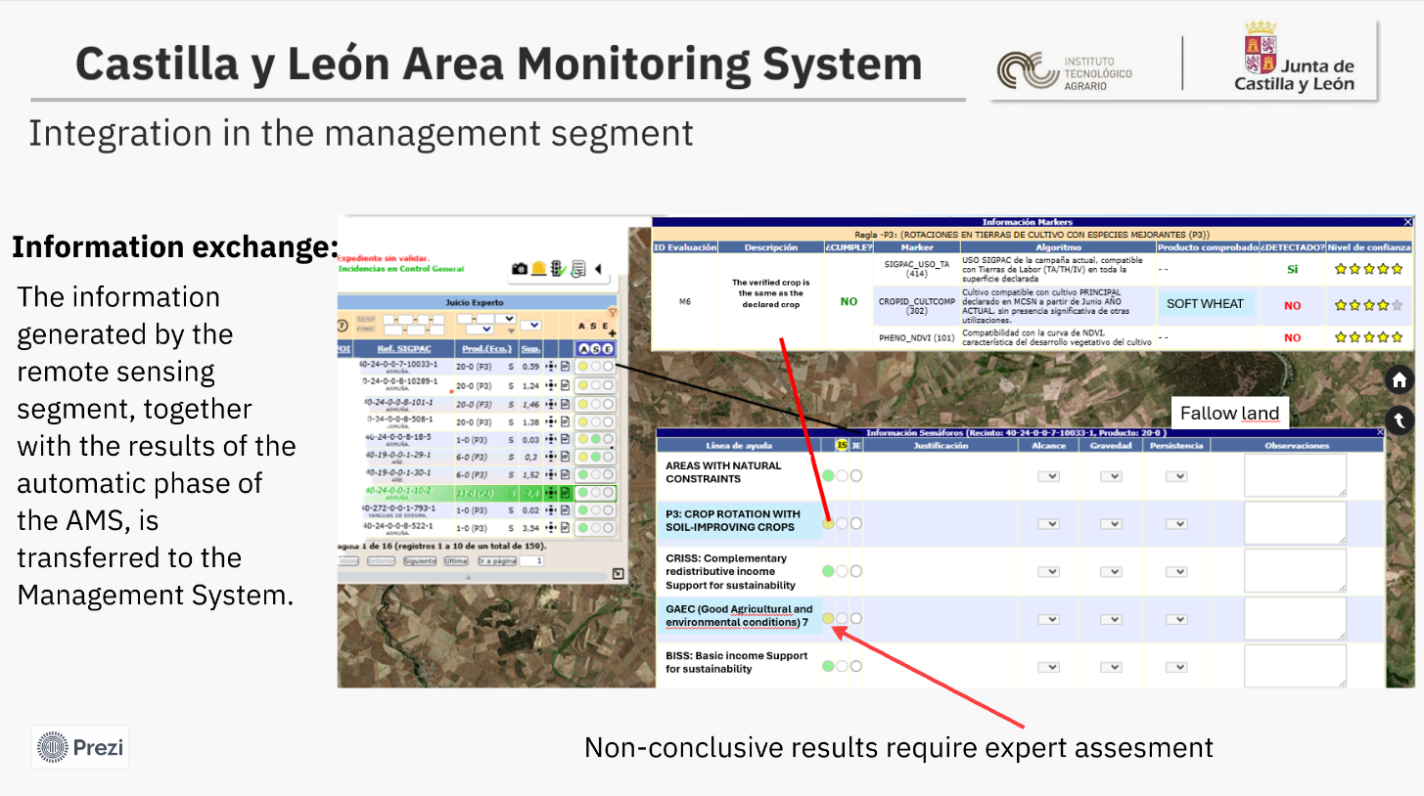
Notes:
The information generated by the remote sensing system goes beyond the outcome of the automated phase for each agricultural parcel. For every plot, we identify the specific underlying cause behind an inconclusive traffic light status, which then allows us to trigger targeted expert judgment based on that exact root cause.

Slide 11
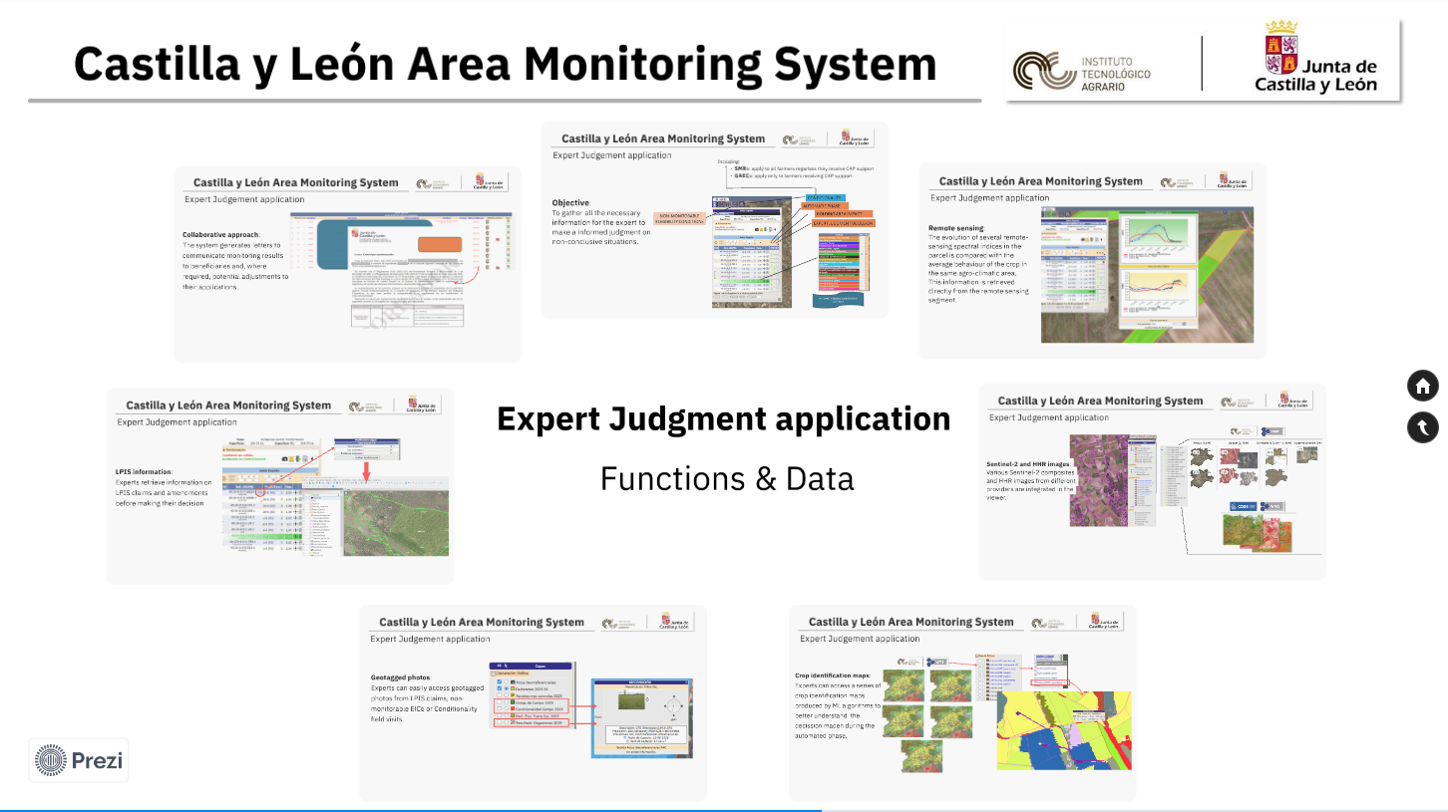
Notes:
With all this information in the database of the management segment the expert jugdment phase begins.

Slide 12
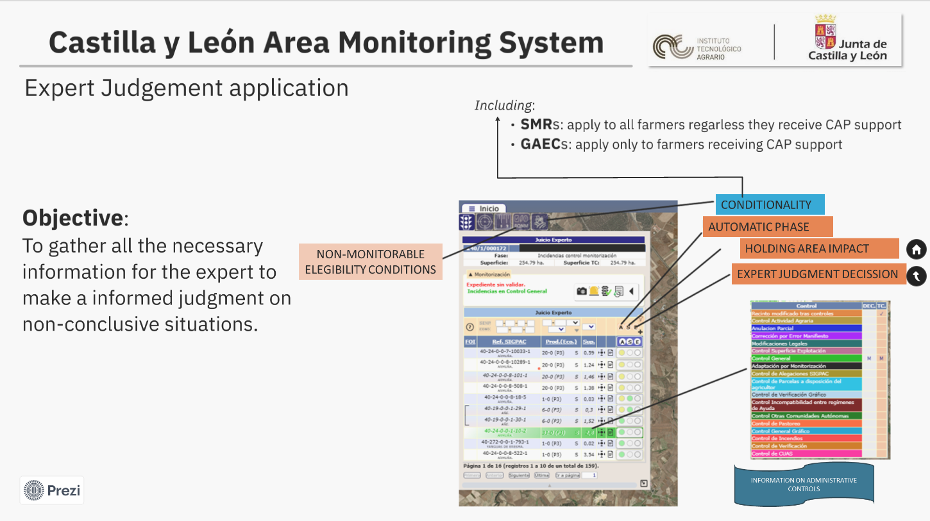
Notes:
As mentioned earlier, the expert judgment application not only allows us to view the outcome of the automated phase, but also automatically calculates the area impact—identifying LPIS parcels whose size enables them to meet eligibility criteria. This parcels are subject to subsequent quality control. The application also allows us to apply expert judgment where required. Furthermore, this single interface provides a comprehensive overview of every parcel on the farm, covering administrative checks, non-monitorable requirements, and compliance issues related to both GAEC and SMR conditionality

Slide 13
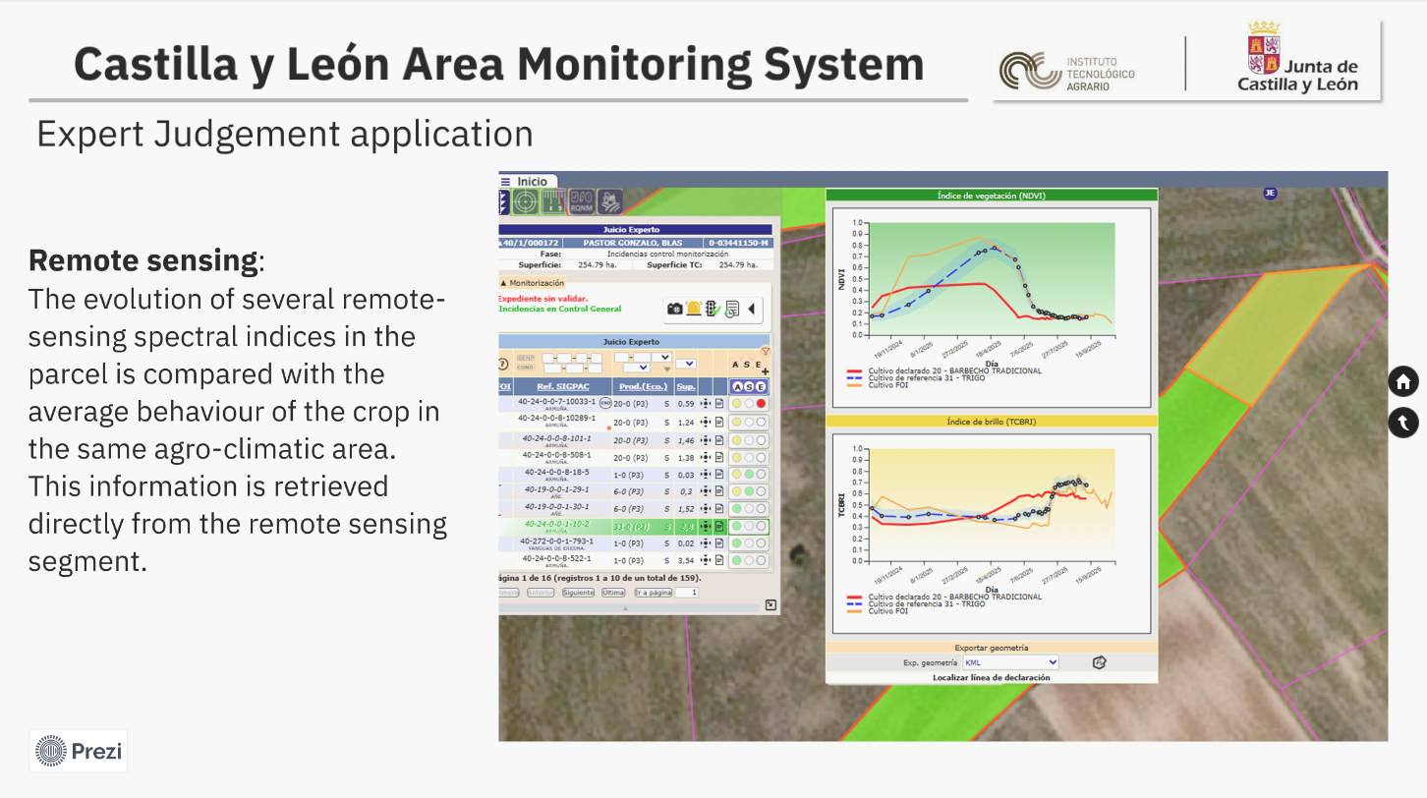
Notes:
In order to enable the expert to resolve these inconclusive traffic lights, the system provides several vegetation and spectral indices—such as NDVI and TCBRI—allowing for the most accurate and technically sound decision possible.

Slide 14
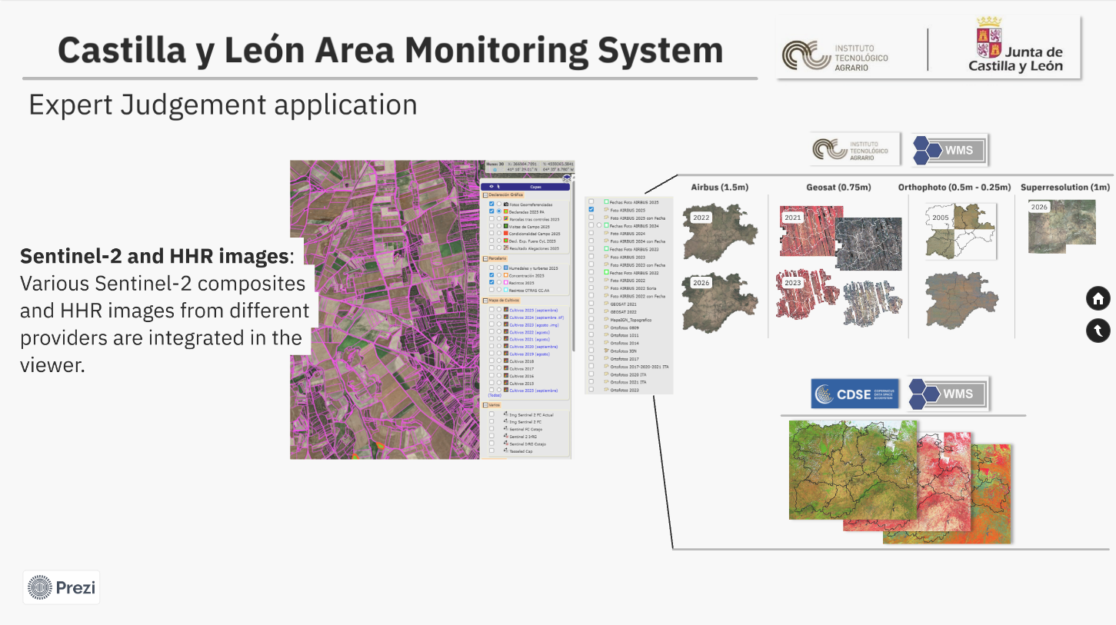
Notes:
The remote sensing segment also provides us with a collection of Sentinel and Very High Resolution (VHR) imagery, which proves extremely helpful in resolving inconclusive traffic lights in many cases

Slide 15
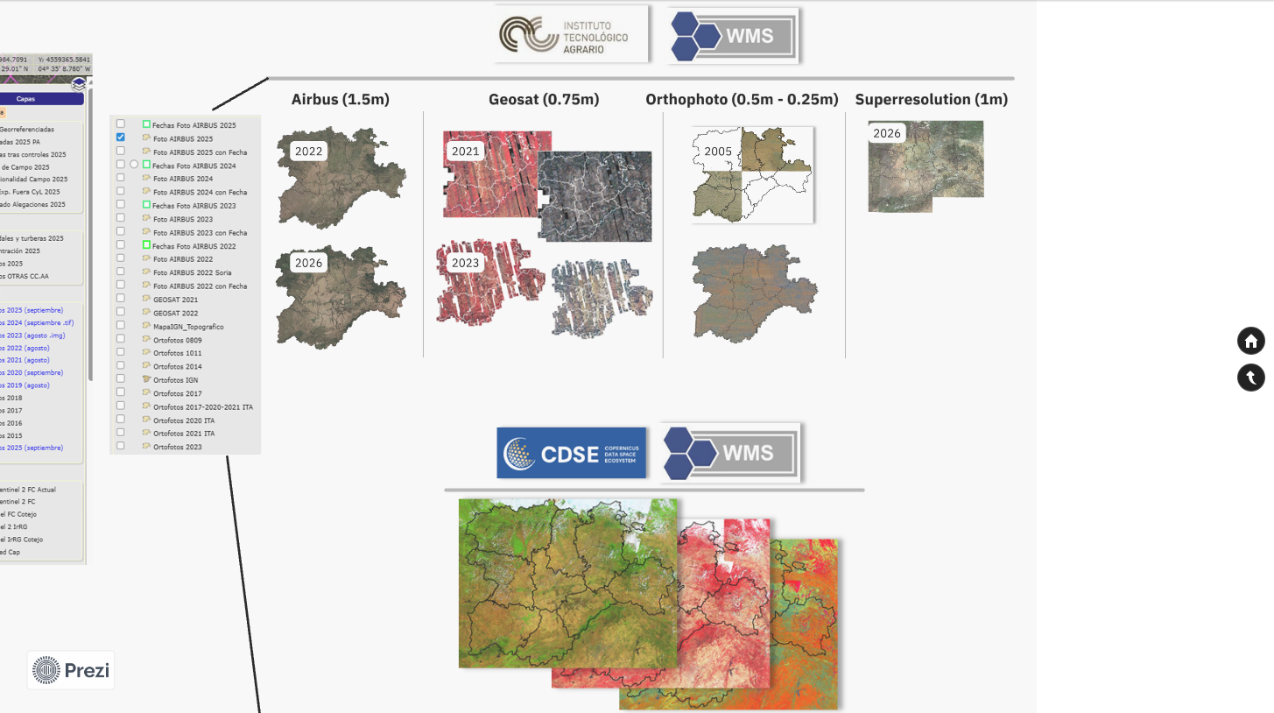
Notes:
We publish this information by means of standard OGC services. We offer this information taking advantage of two different systems. As for the VHR and HHR images we employ our own servers to provide these data and, on the other hand, we benefit from the CDSE capabilities that permits us publish quarterly composites of sentinel-2 through standard OGC services.

Slide 16
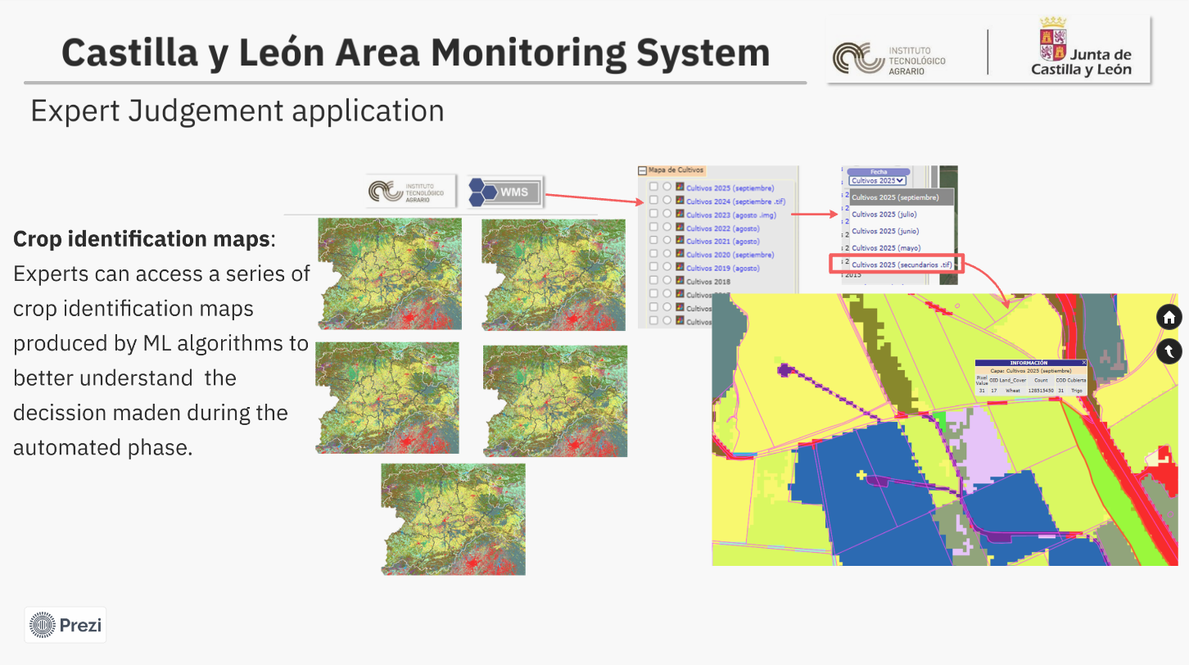
Notes:
Likewise, experts have access to monthly crop maps generated by the remote sensing segment, significantly enhancing the efficiency and effectiveness of their work when resolving inconclusive traffic lights.

Slide 17
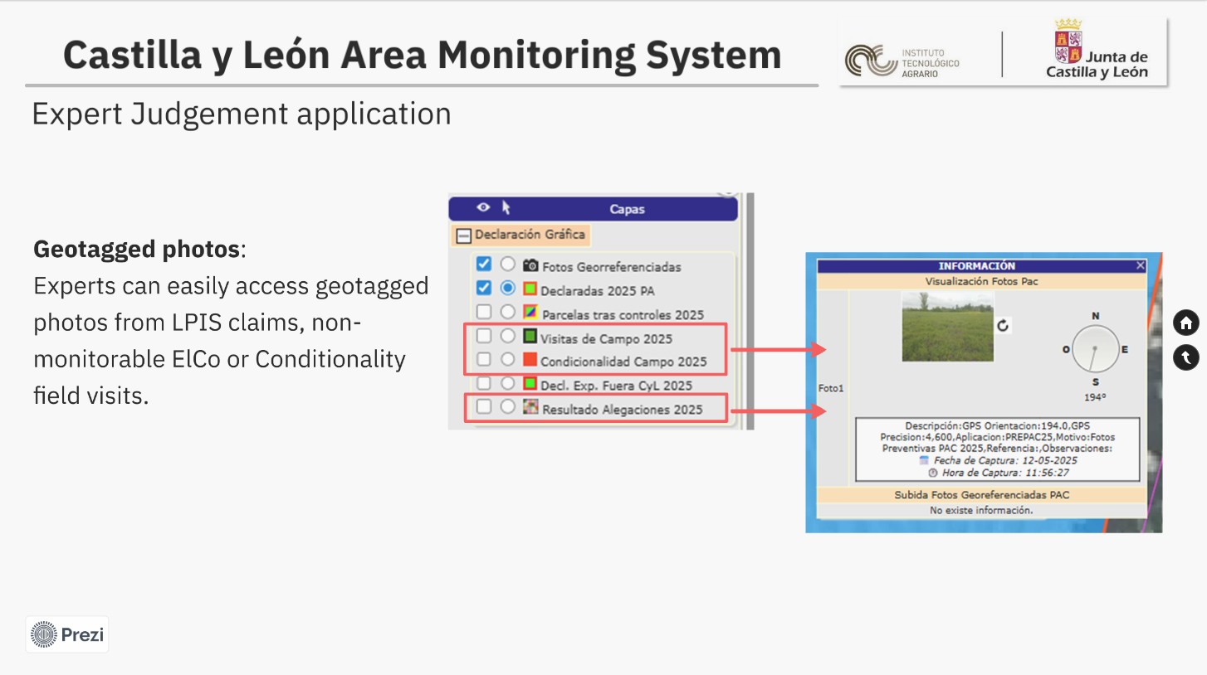
Notes:
Furthermore, as an added value, the system enables proposed modifications to the Land Parcel Identification System (LPIS) as a direct outcome of integrating the Earth observation findings with the expert judgment assessment

Slide 18
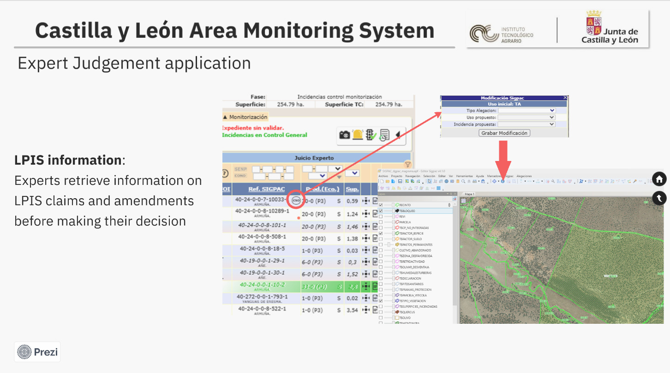
Notes:
Furthermore, as an added value, the system enables proposed modifications to the Land Parcel Identification System (LPIS) as a direct outcome of integrating the Earth observation findings with the expert judgment assessment

Slide 19
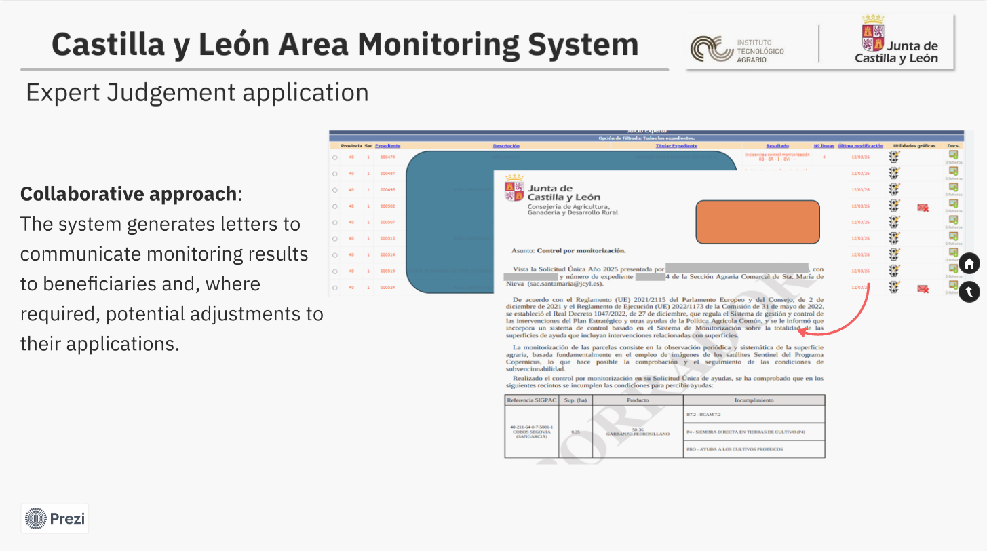
Notes:
The results and adjustments resulting from the monitoring process and expert judgment are automatically communicated to the farmer.

Slide 20
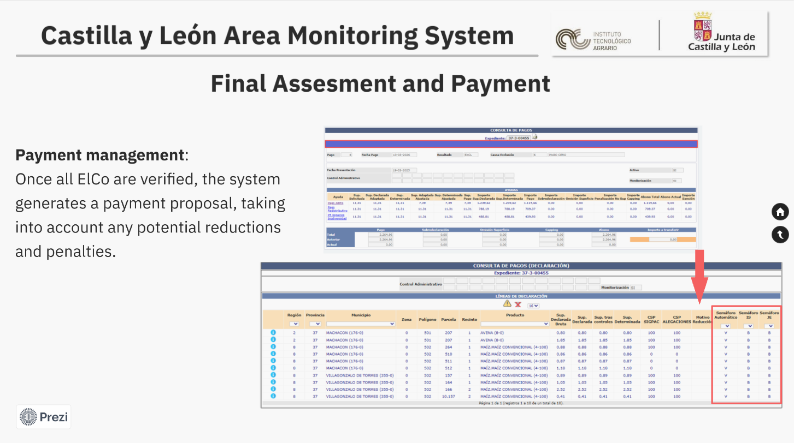
Notes:
Likewise, all results are automatically transferred to the payment calculation application for each CAP beneficiary

Slide 21
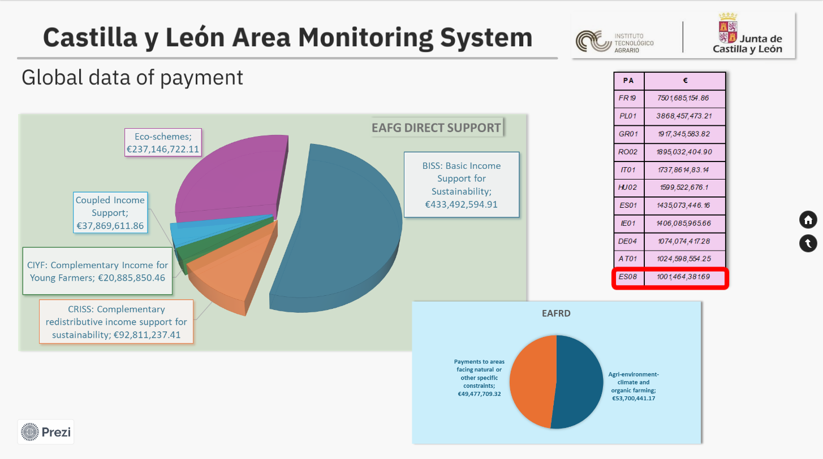
Notes:
The Paying Agency of Castile and León ranks 14th out of more than 72 paying agencies across the European Union. This highlights the critical need for seamless integration between the remote sensing system and the management system.

Slide 22
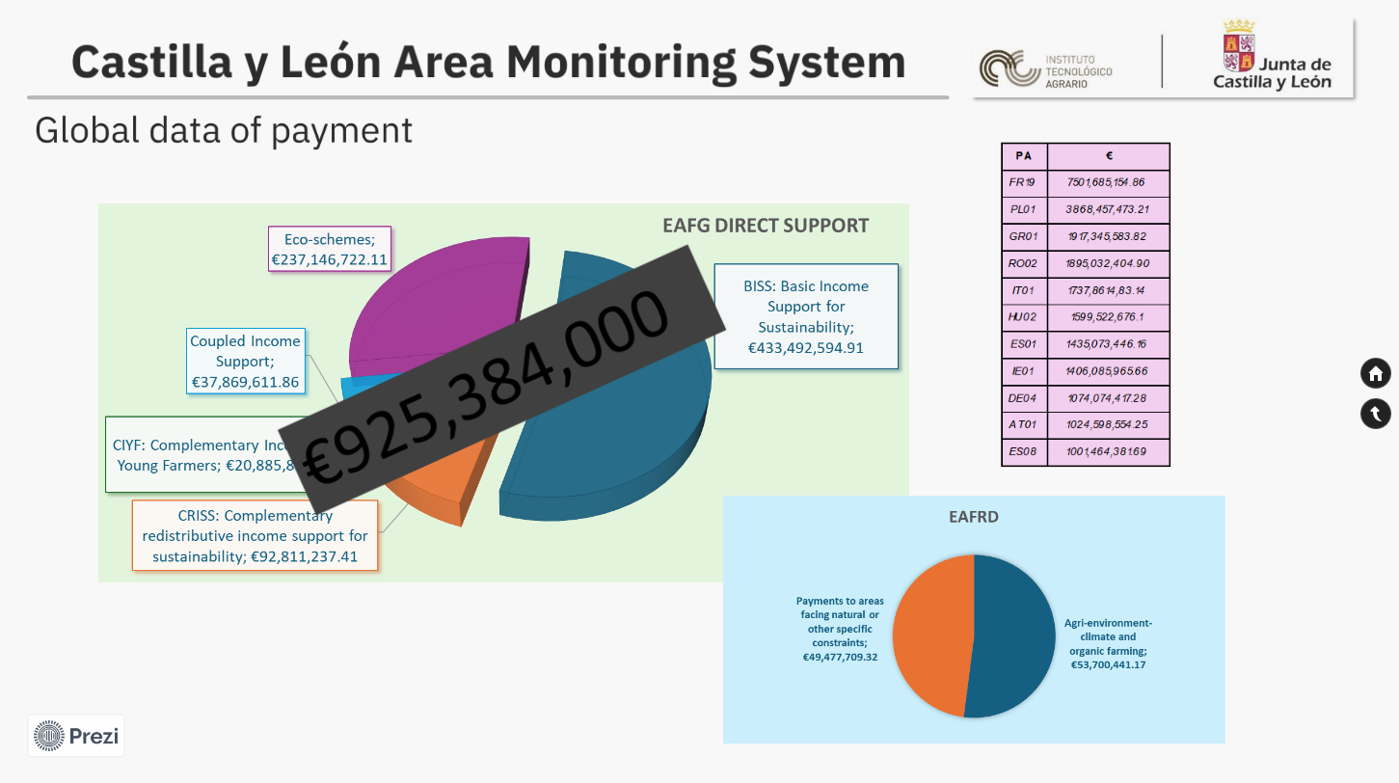
Notes:
Ultimately, we are responsible for disbursing over 925 million euros in EAGF funds and more than 100 million euros in EAFRD support, representing a total budget exceeding 1 billion euros for our paying agency.

Slide 23
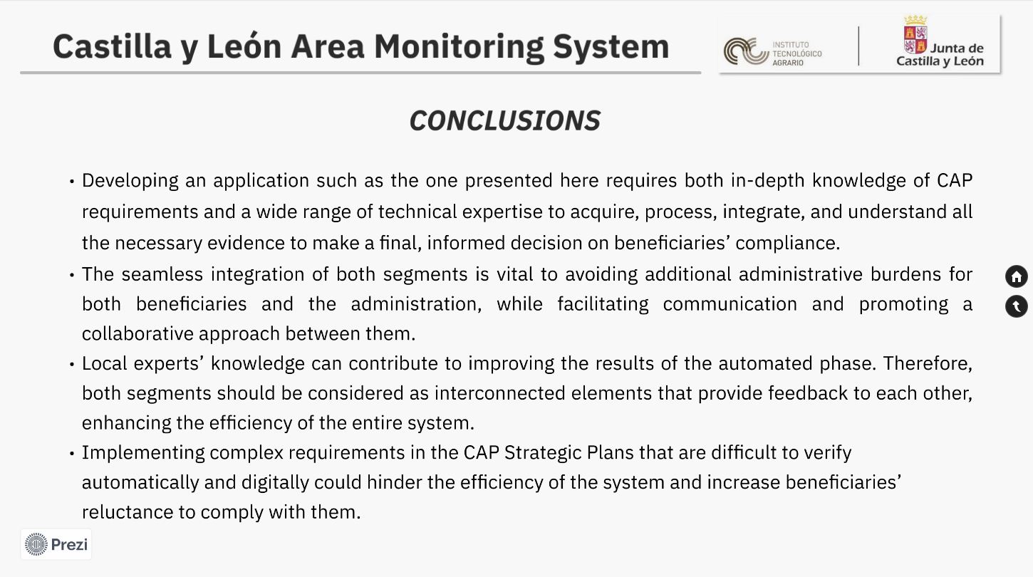
Notes:
Developing an application such as the one presented here requires both in-depth knowledge of CAP requirements and a wide range of technical expertise to acquire, process, integrate, and understand all the necessary evidence to make a final, informed decision on beneficiaries’ compliance.
The seamless integration of both segments is vital to avoiding additional administrative burdens for both beneficiaries and the administration, while facilitating communication and promoting a collaborative approach between them.
Local experts’ knowledge can contribute to improving the results of the automated phase. Therefore, both segments should be considered as interconnected elements that provide feedback to each other, enhancing the efficiency of the entire system.
Implementing complex requirements in the CAP Strategic Plans that are difficult to verify automatically and digitally could hinder the efficiency of the system and increase beneficiaries’ reluctance to comply with them.

Slide 24
