Slide 1
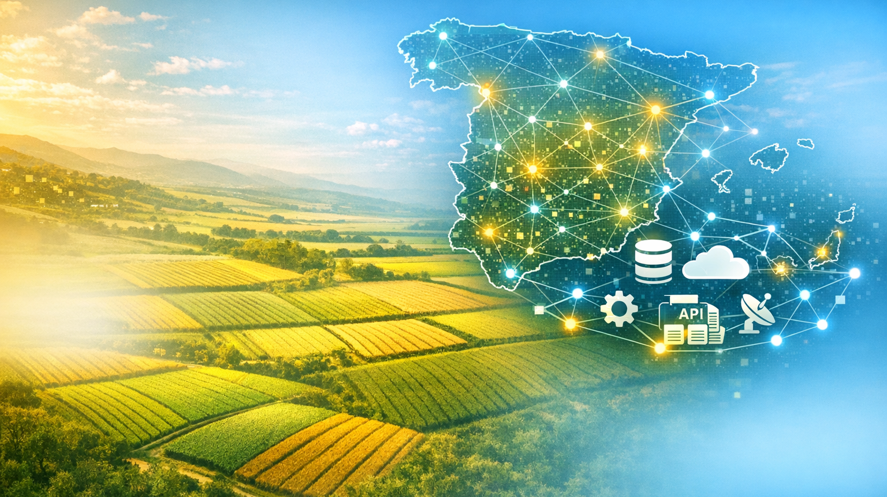


Moving towards an ELMS in Spain: SIEX and SATIVUM
Session 4. IACS foretold: mapping the path beyond 2027
Wednesday 9 September 2026. Sofia, Bulgary

Slide 2
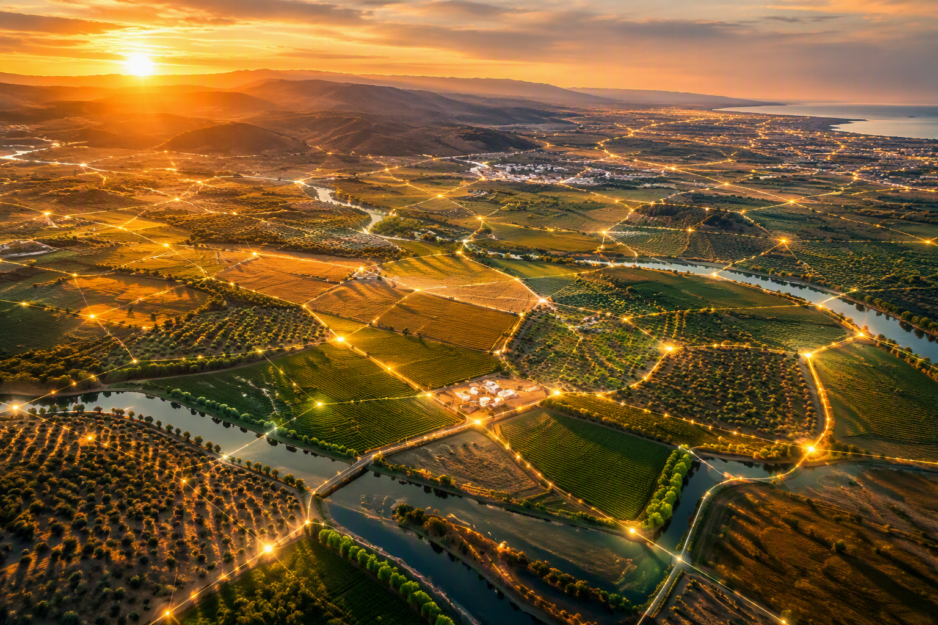
Spain is not building ELMS.
Spain is becoming ELMS.
"When we talk about ELMS, we often speak about the future.
But in Spain, the most interesting question is no longer how to build it.
The question is how to CONNECT what already exists."
Moving towards an ELMS in Spain: SIEX and SATIVUM

Slide 3


Why SIEX?
Introducing SIEX
System Architecture, Governance and Roles
APIs & Private initiatives
Why SATIVUM?
Introducing SATIVUM
Main Challenges & Scaling Hurdles
ELMS - Implementation in SPAIN
Conclusions
INDEX

Slide 4
1
Why SIEX?

Slide 5
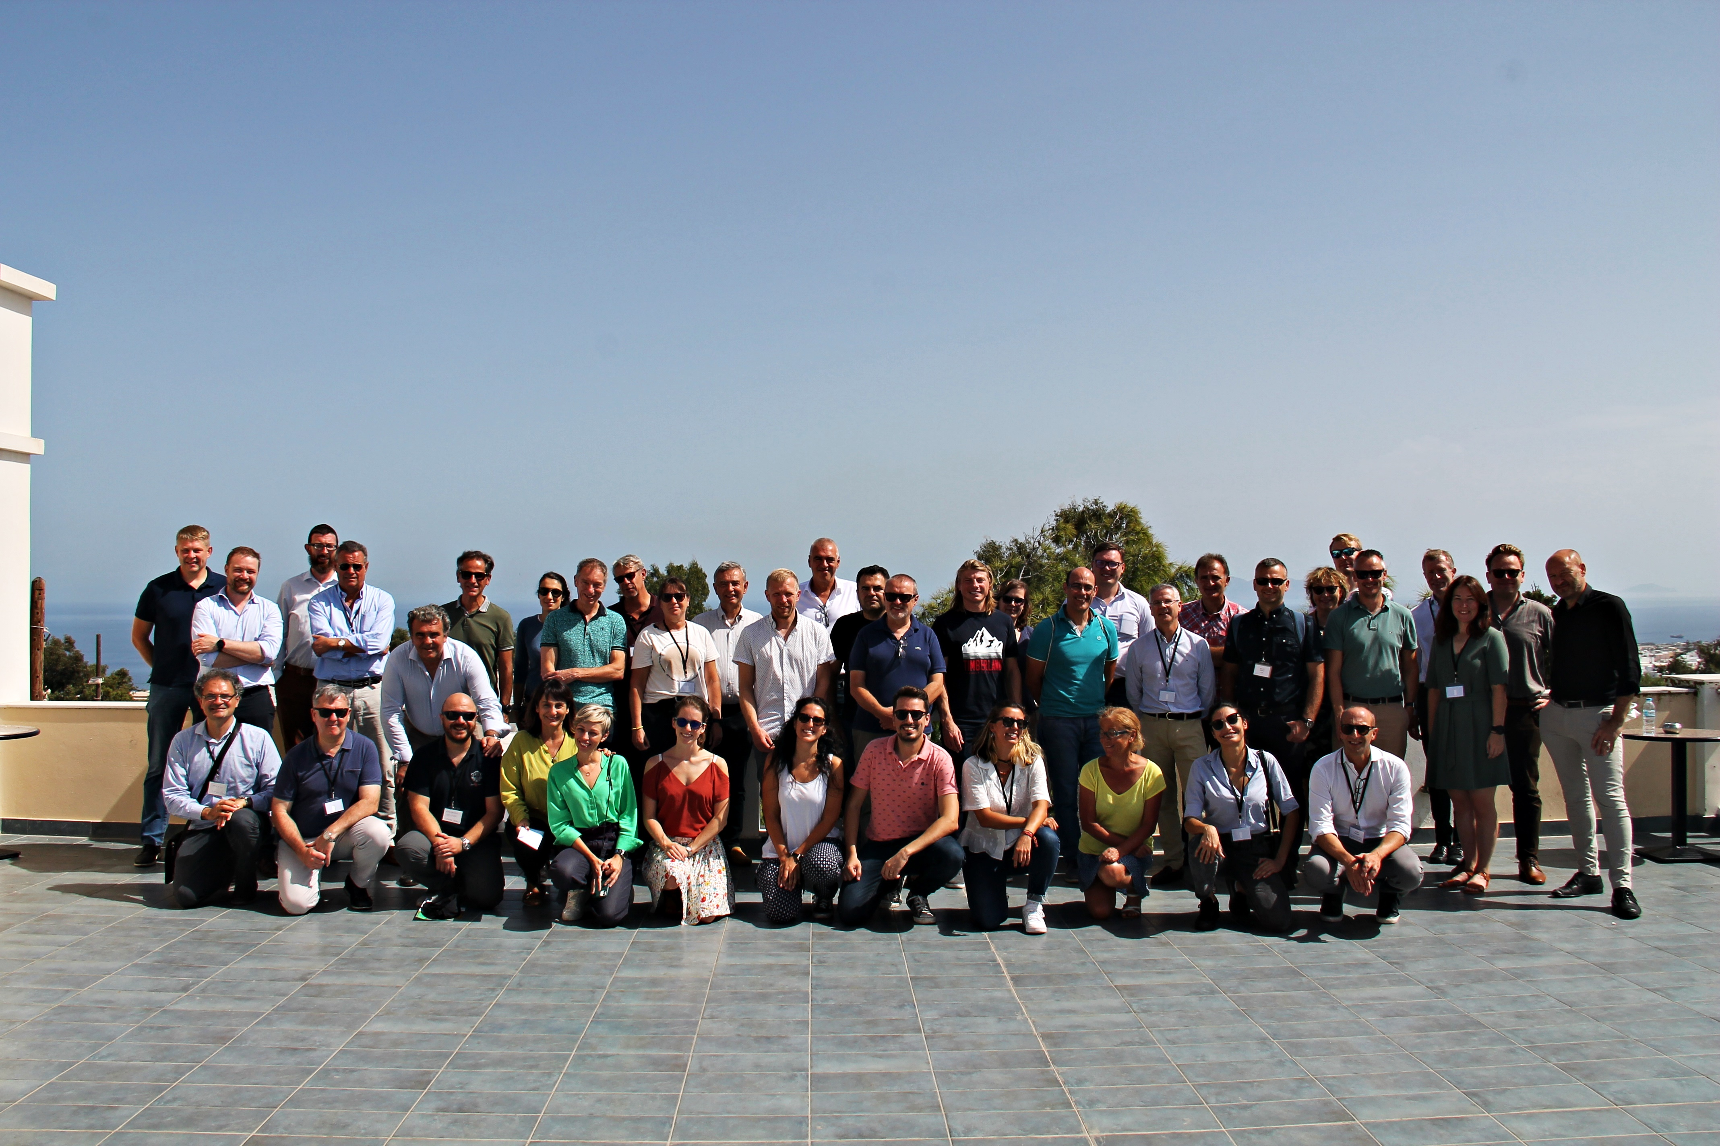
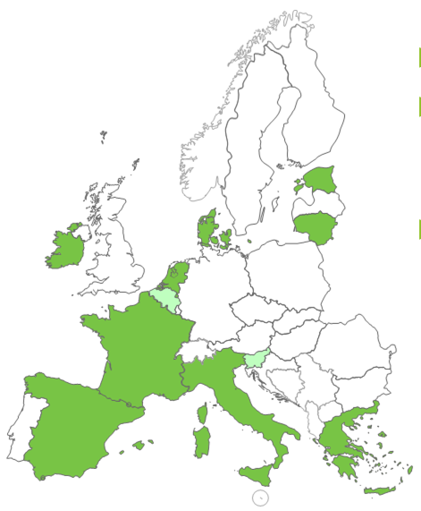
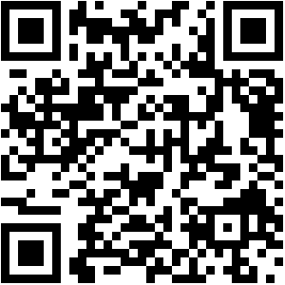

1
  Why SIEX?
But this story has a beginning…
A broader approach:
Knowledge of the different sectors
Consistency across data sources and statistics
Economic information on farms
Knowledge of farmer activities
Traceability of productions
Participation in the H2020 NIVA Project had a very positive effect in Spain
https://cordis.europa.eu/project/id/842009/reporting
5
5

Slide 6
2
Introducing SIEX

Slide 7
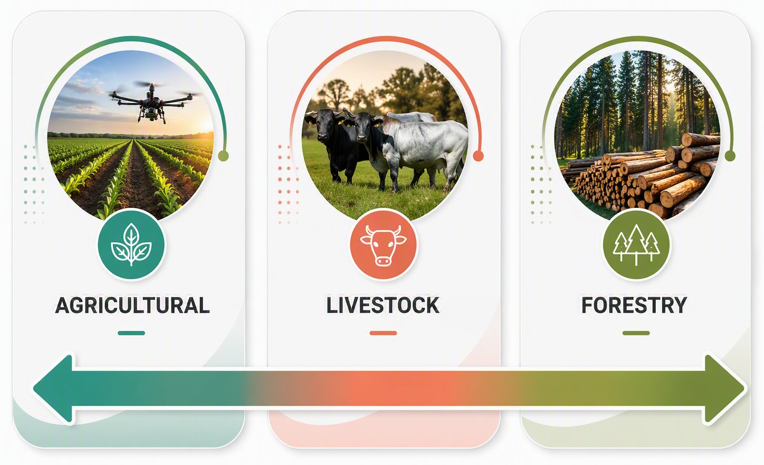

2
  SIEX project
Connecting information sources so they can work together:
+ Standardization
+ Interoperability
+ Data Analysis and use

Slide 8
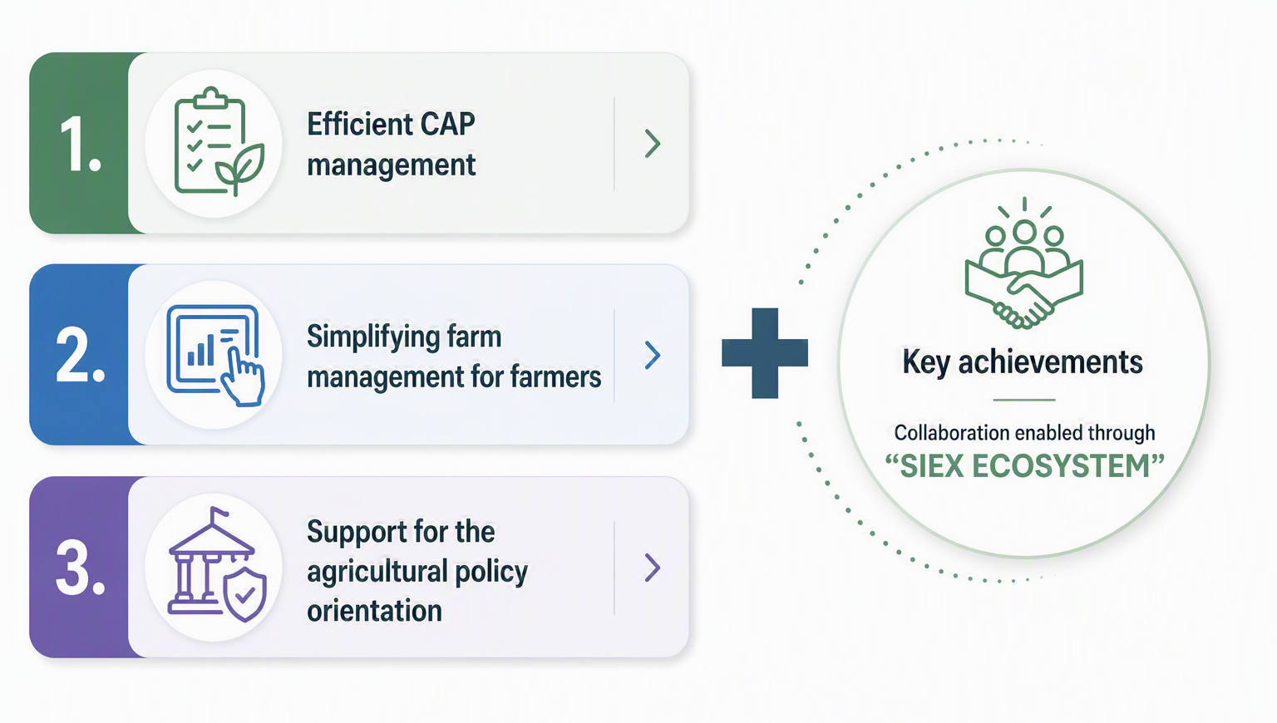
2
  Objectives & Regulation
National Regulation: Royal Decree 1054/2022

Slide 9
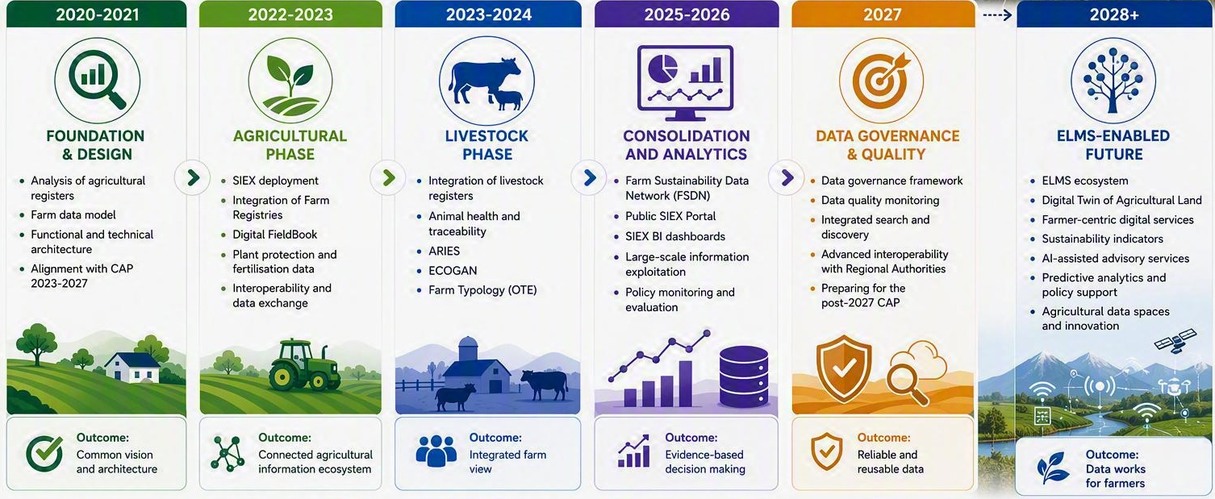
2
  Milestones
Building SIEX for the future…

Slide 10
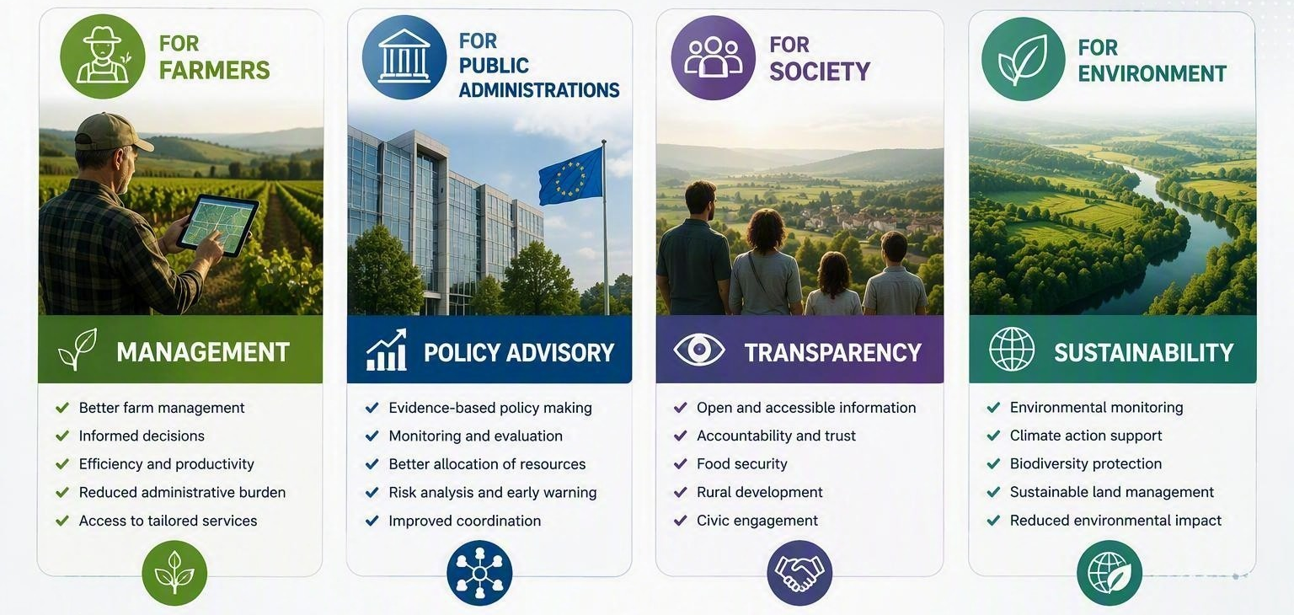
2
  Value

Slide 11
3
System Architecture, Governance and Roles

Slide 12
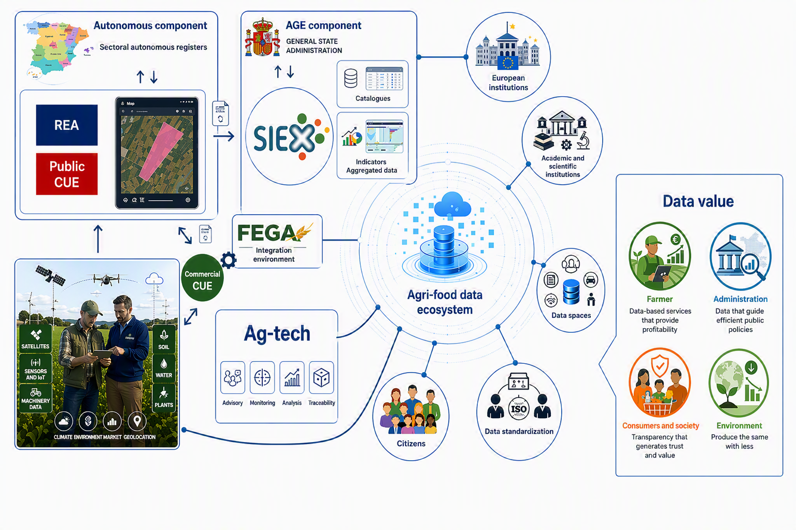
3
  Architecture
ELMS
National & Regional Governance
SATIVUM
12

Slide 13

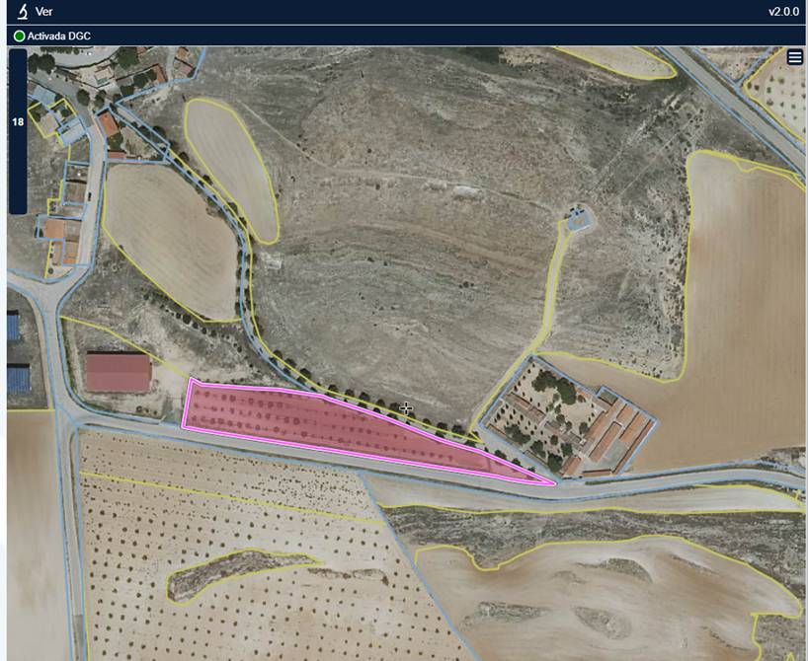
3
  Farm Registry (REA)
What & Where
Mandatory since 2023 under Royal Decree 1054/2022
Responsibility development: Autonomous Communities
Minimum content: Annex I of Royal Decree 1054/2022 (SIEX)
SGARex and other regional REAs (REACYL, REAGA, DUN etc.)
Access profiles: Autonomous Community administrators, Farmers, as well as representatives, co‑holders, authorized entities, and data entry operators
Pistachio, var. Kerman
Pétrola, Albacete (Castilla‑La Mancha)
Rainfed
0.42 ha
Certified in conversion (to organic farming)

Slide 14

3
  Digital Farm Book (CUE)
How
Voluntary
Responsibility development: Autonomous Communities
Minimum content: Annex II of Royal Decree 1054/2022 (SIEX)
SGACex and other regional CUE systems (CUECYL, QIE, XEAGA, KOADERNO) + (CUE-Comerciales/ Private Digital Farm Book).
Access profiles: Autonomous Community administrators, Farmers, as well as representatives, co‑holders, authorized entities, and data entry operators
10/02/2026 – Fertilization
4 t/ha of composted sheep manure
John Deere 5090M tractor + solid manure spreader (6 m³)

Slide 15
4
APIs & Private initiatives

Slide 16
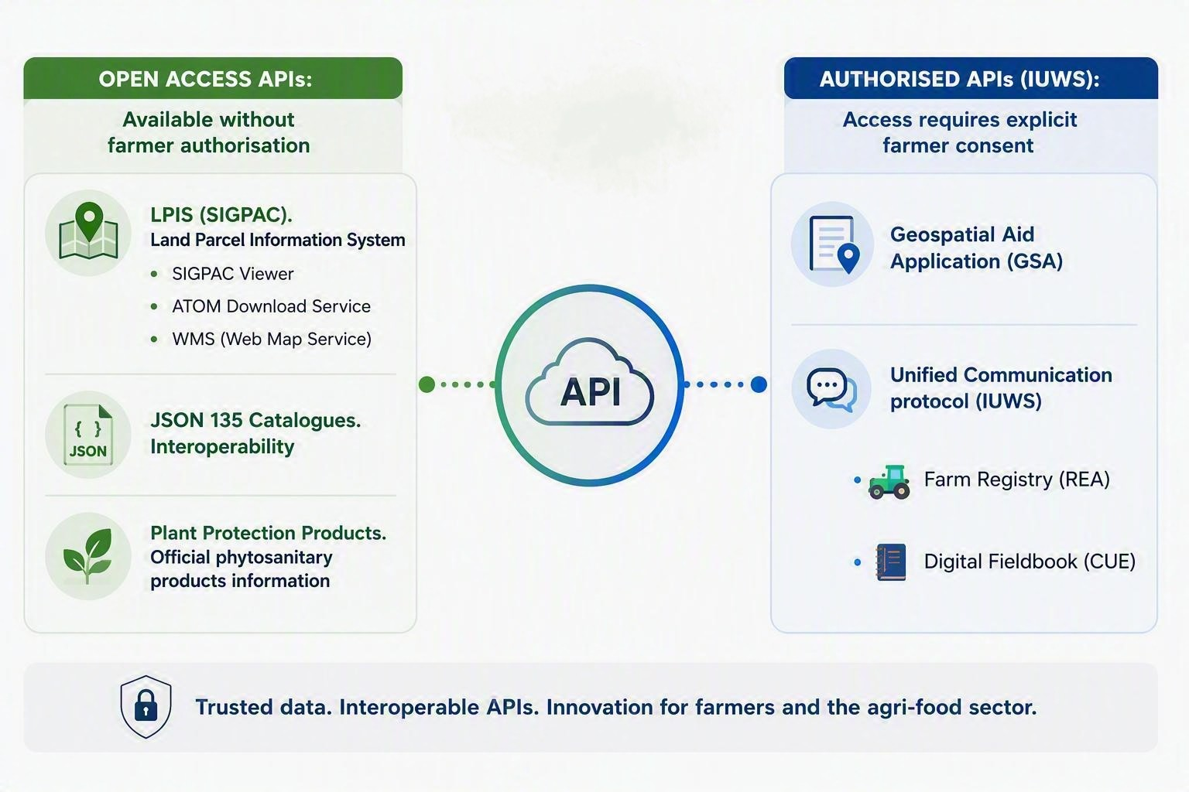

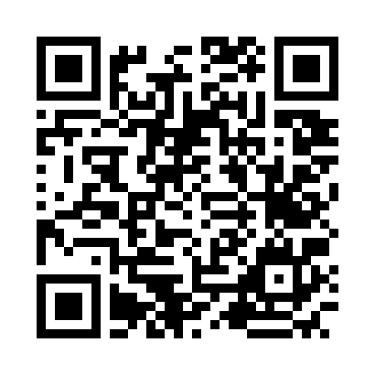
4
  APIs
https://sigpac-hubcloud.es/

Slide 17
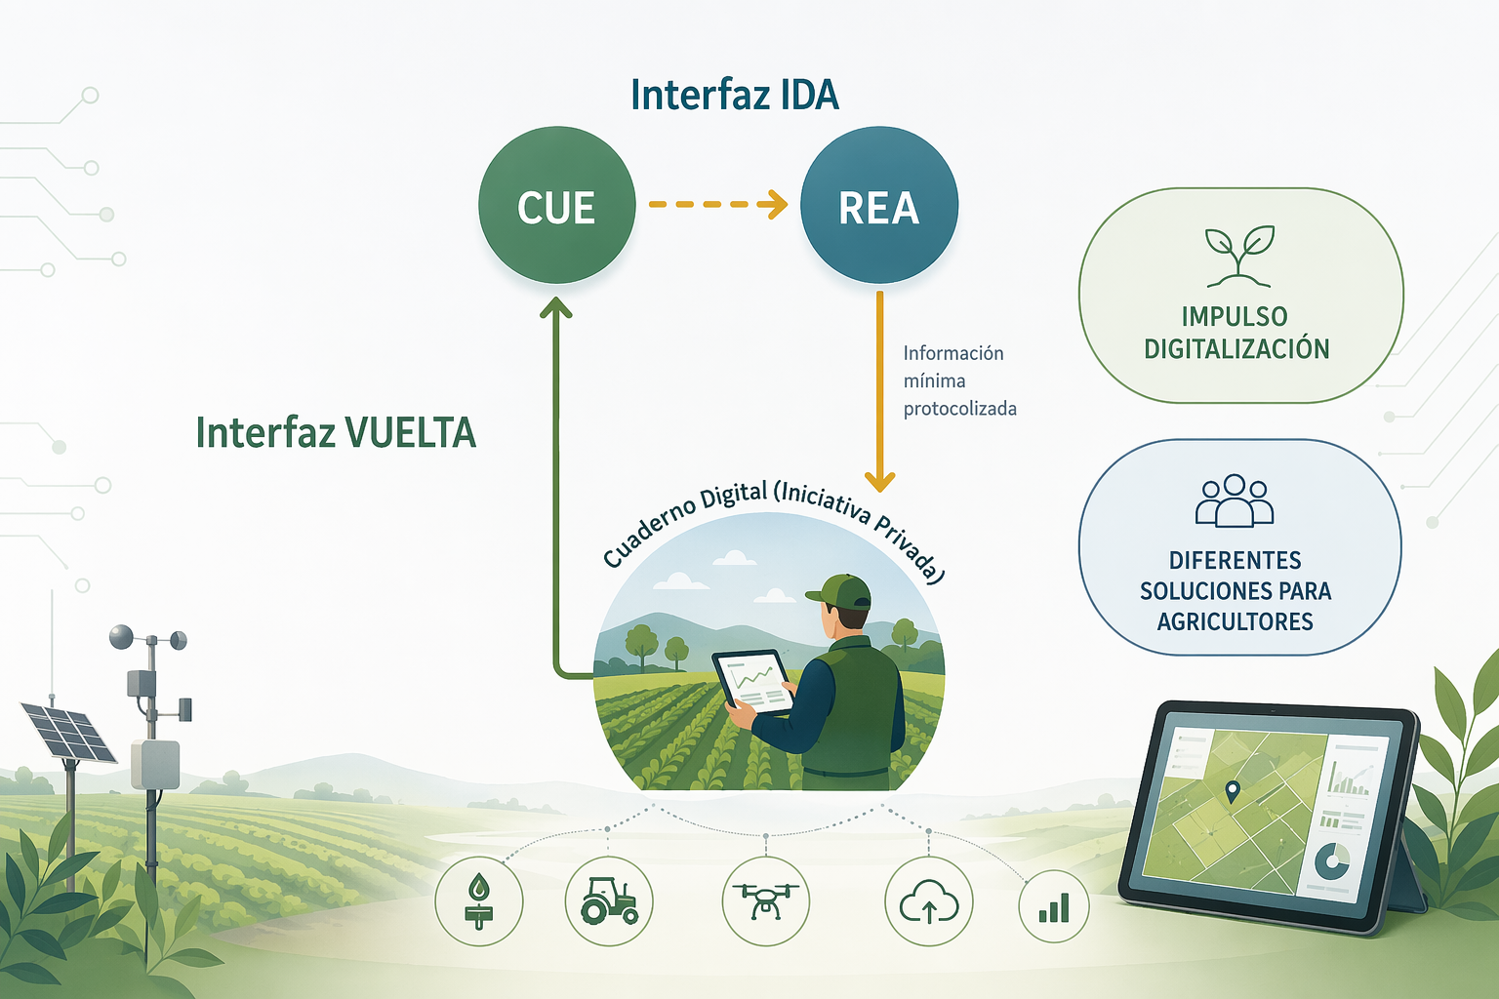
4
  Public–Private Cooperation
Private Digital FieldBook
Unified Interface
A key pillar of the SIEX
A key driver for the dissemination use of the Digital FieldBook (CUE)
IUWS

Slide 18
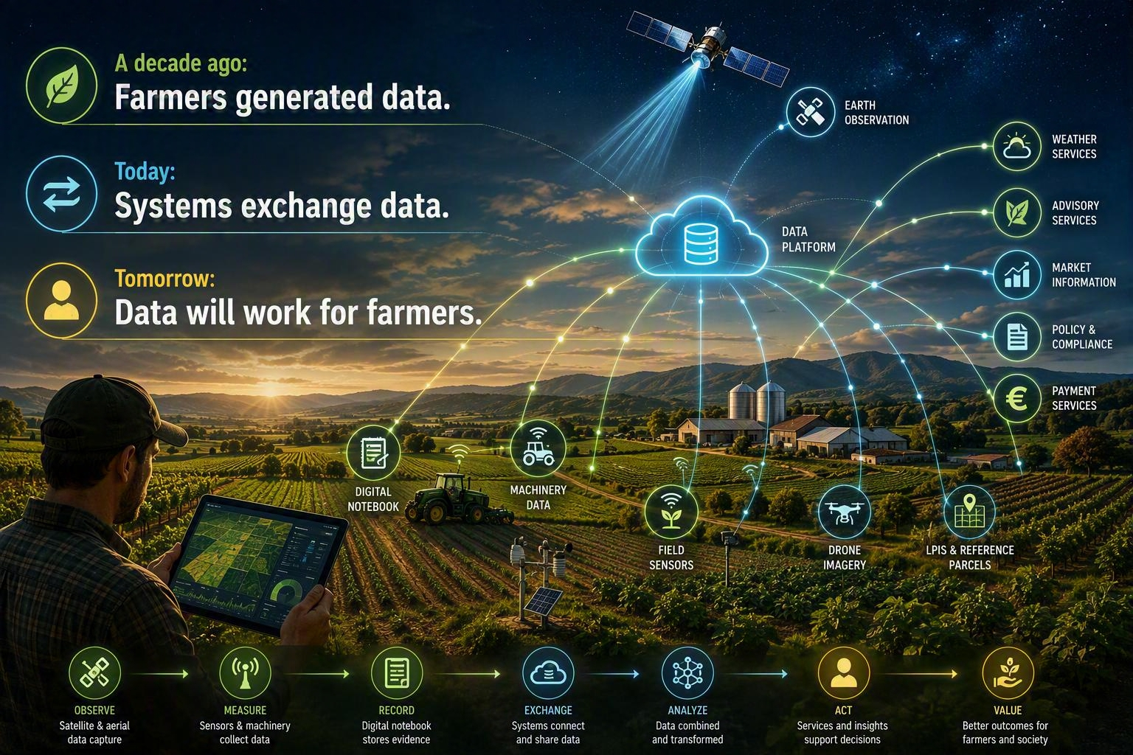

Slide 19
5
Why SATIVUM?

Slide 20




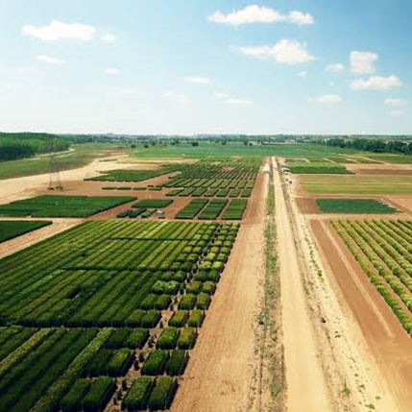




5
  ITACyL Strategy: From Inspection to Empowerment
ITACyL Identity
Technical Synergies
Regional public research entity providing tech services directly to administration and local farmers across Castilla y León.
Agronomic background combined with in-house IT infrastructure and a dedicated software development team.
2018 Baseline
Strategic Evolution
Initial AMS satellite monitoring focused primarily on CAP compliance checks and administrative controls.
Harnessing satellite infrastructure to deliver direct decision support and value to farmers — moving beyond inspection to empowerment.
Transforming satellite monitoring (AMS) from administrative control into active decision-support services for farmers.

Slide 21
6
Introducing SATIVUM

Slide 22
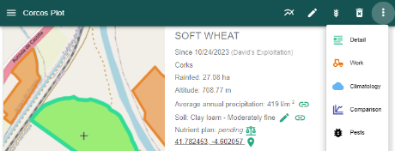
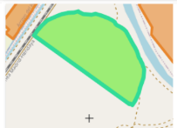


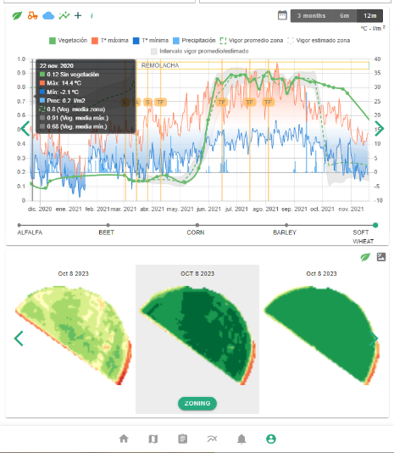



6
  How We Built It: Platform Ecosystem
Multi-Source API & Data Access
Proprietary In-House Sources (Open Public Data)
Multi-Stream Ecosystem Funding
https://www.sativum.es/

Slide 23
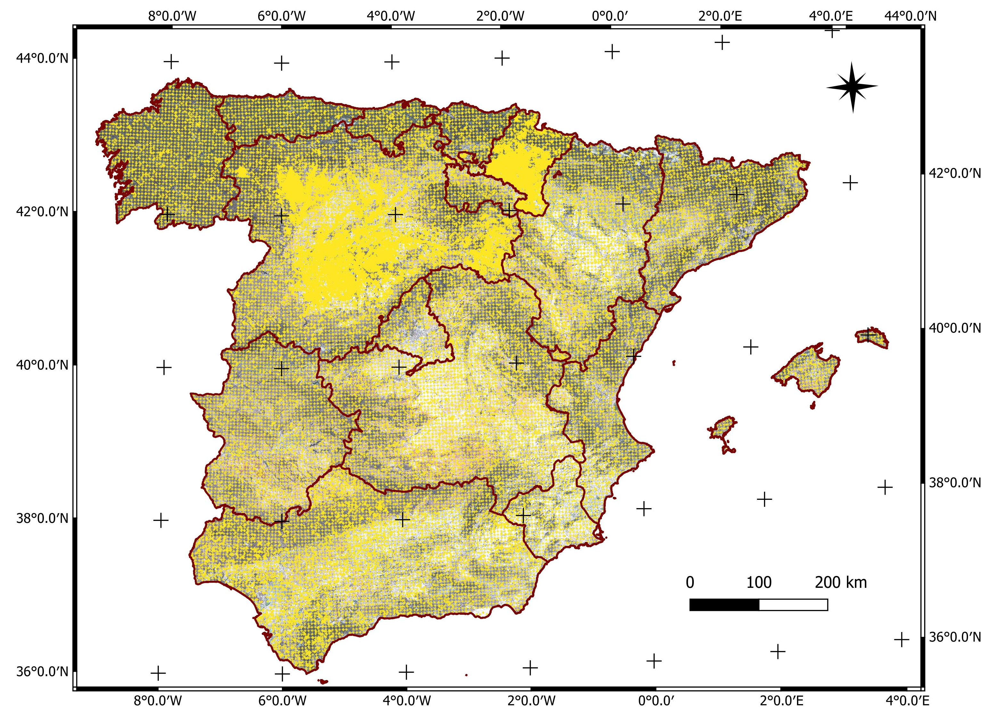

6
  Soil information and fertilization API
Jiménez-Beneite, A.; Gutiérrez, A.; Paredes-Gómez, V.; Nafría, D.A. A National High-Resolution Digital Soil Information System for Spain Based on More Than 50,000 Harmonized Soil Observations and Machine Learning. Agronomy 2026, 16, 1695. https://doi.org/10.3390/agronomy16171695

Slide 24
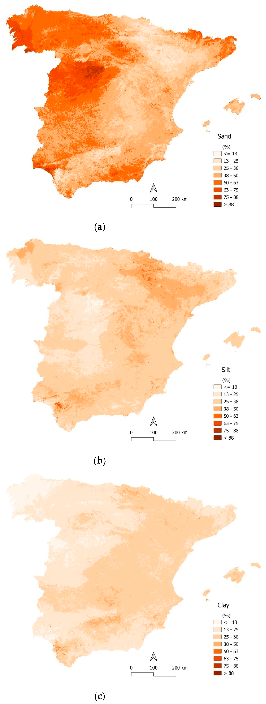
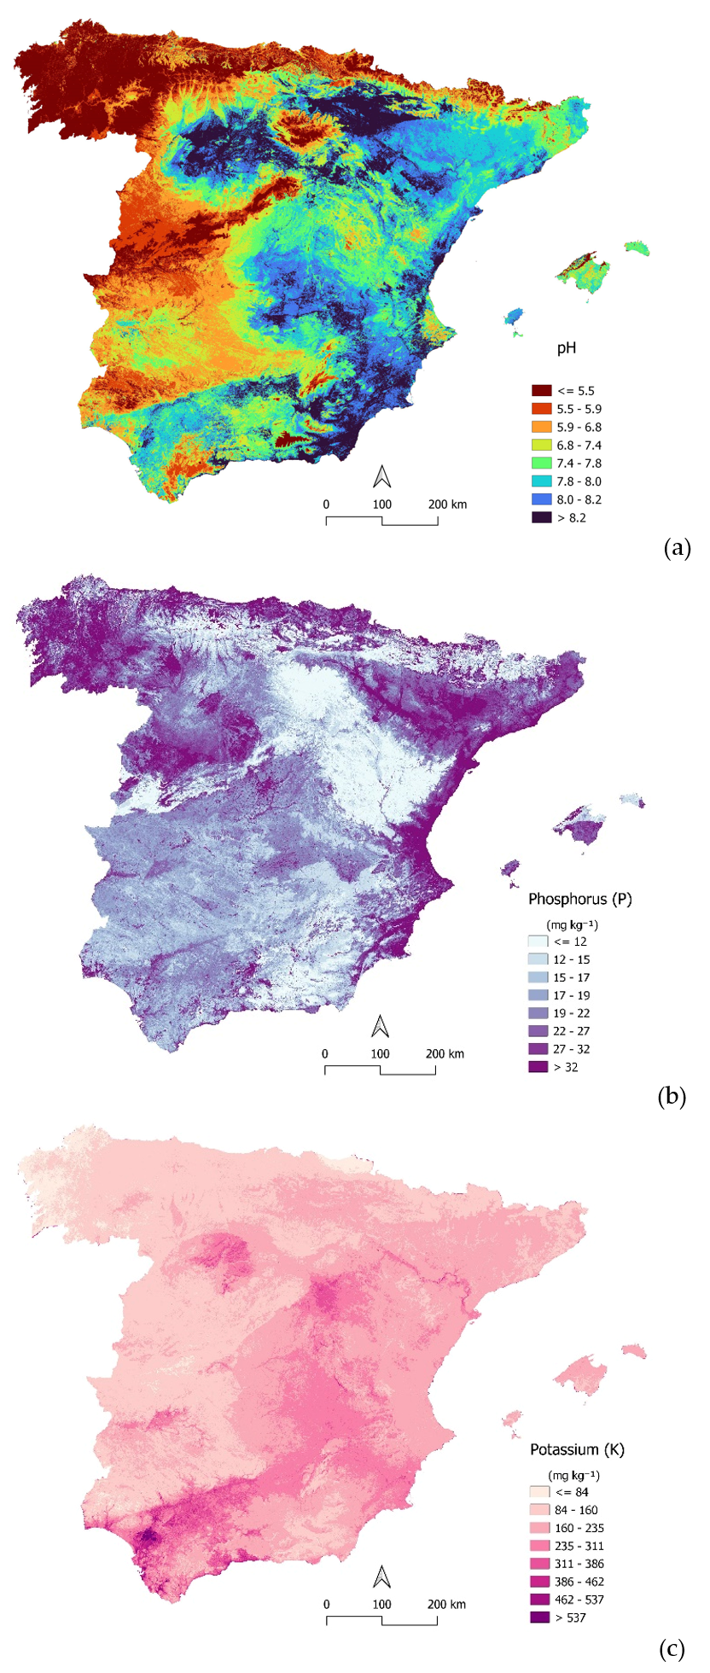
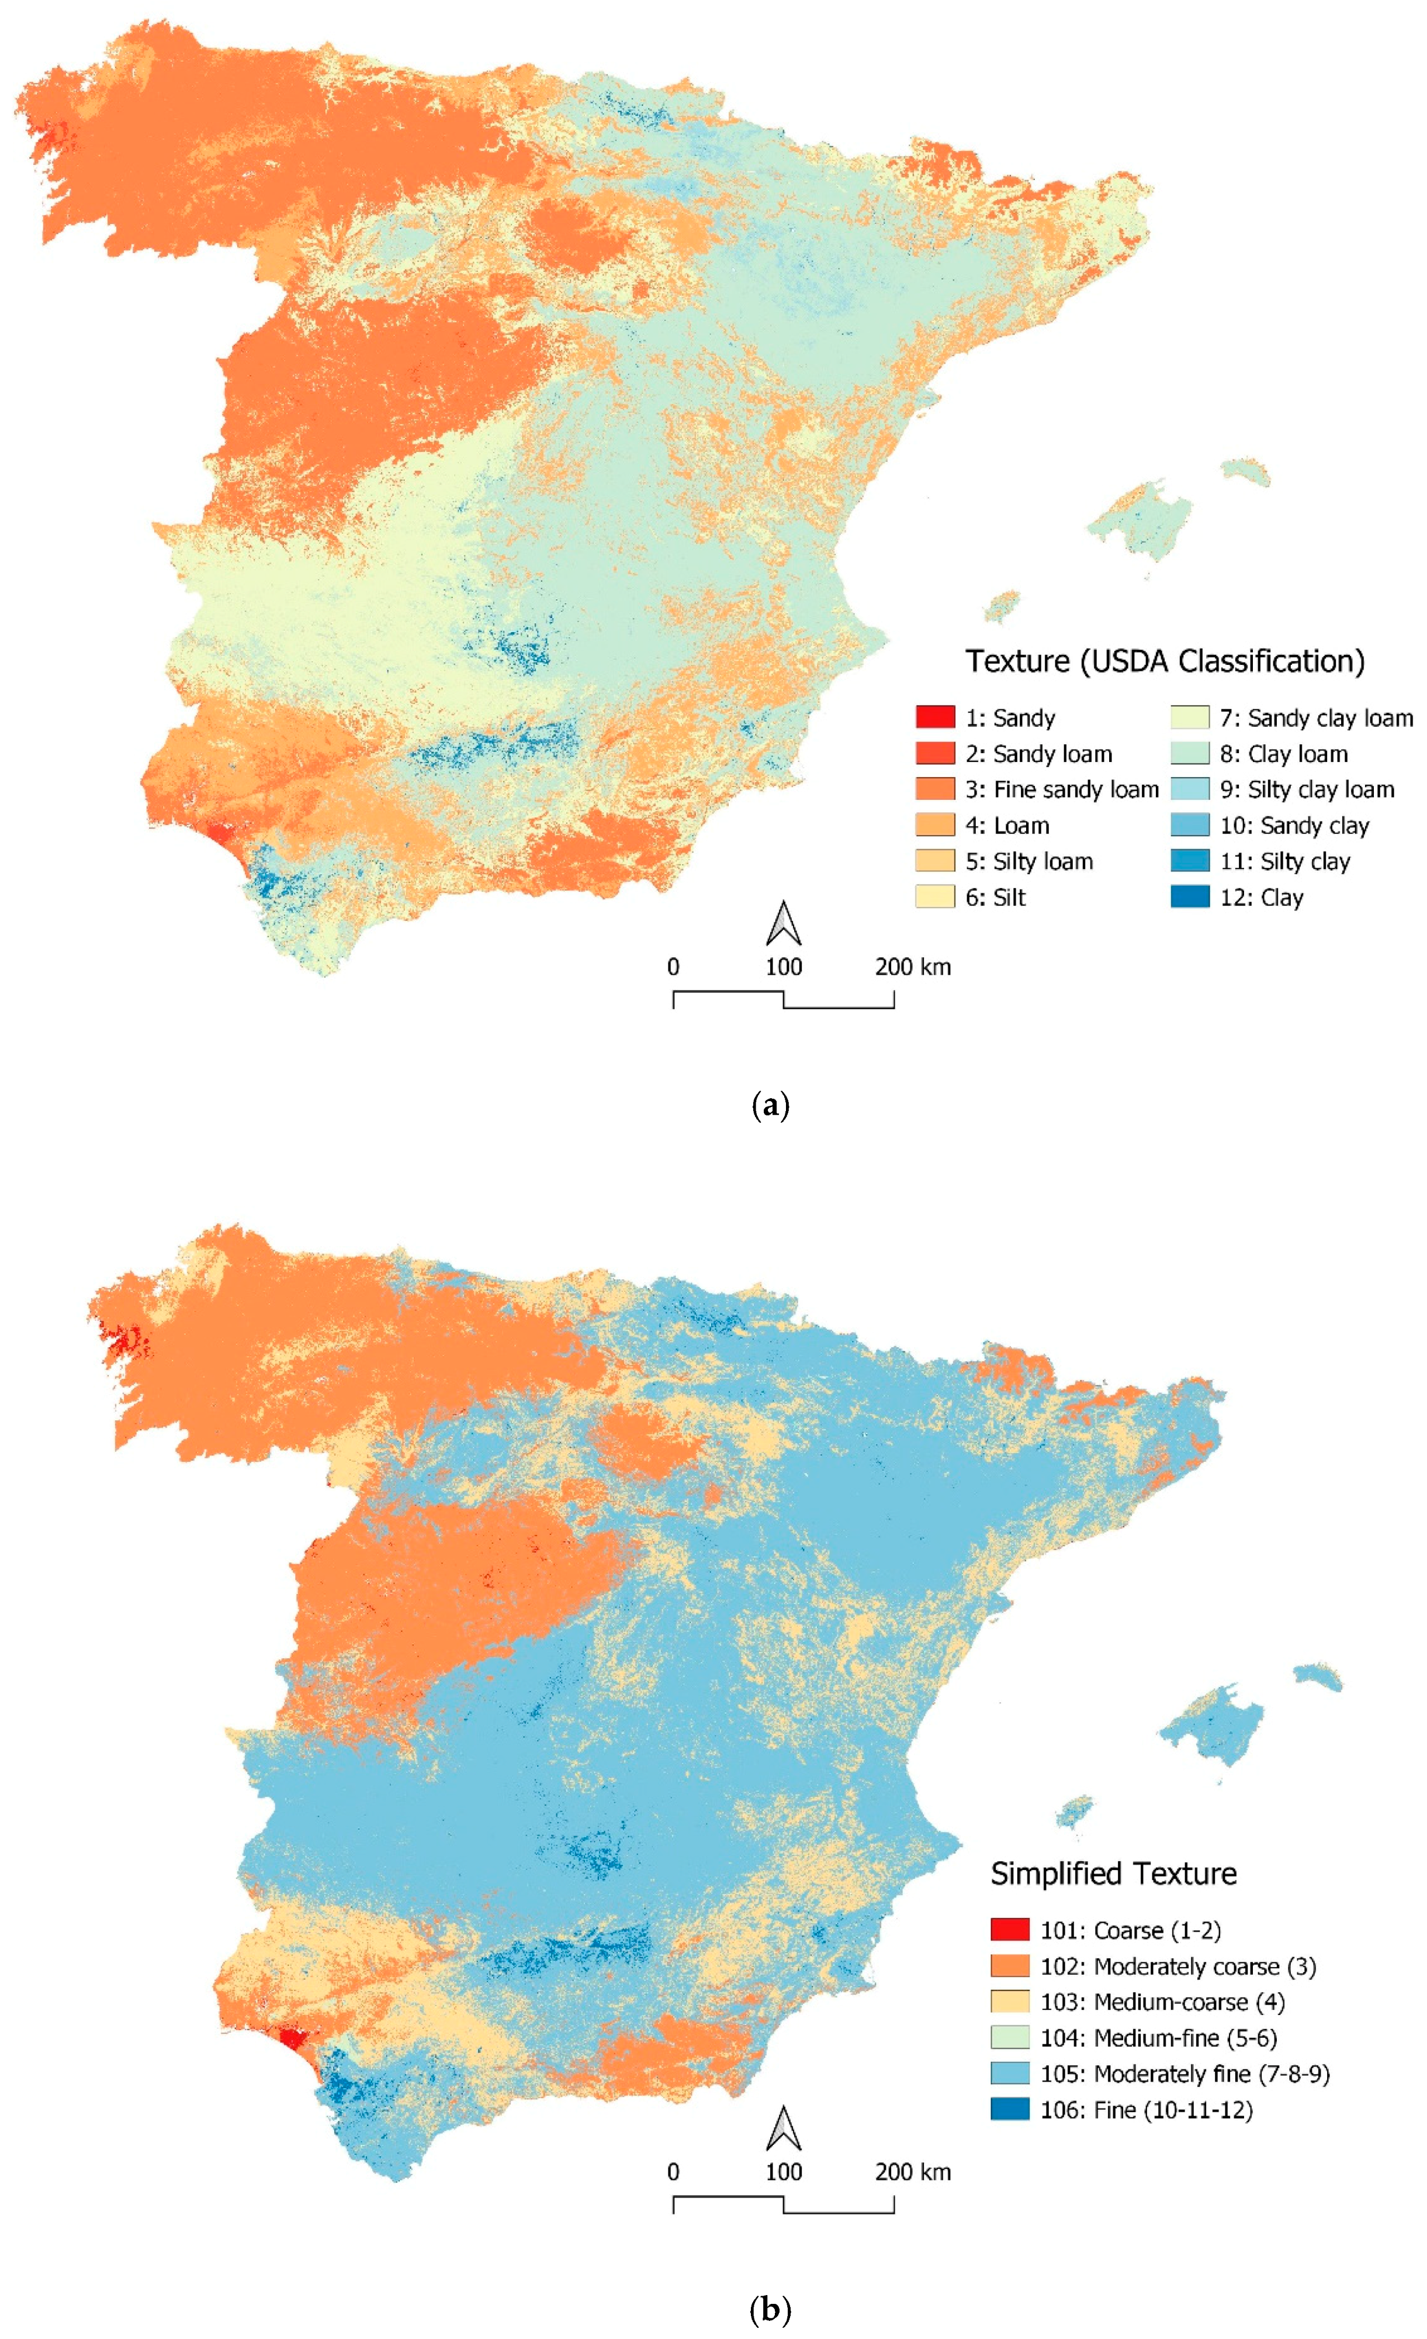
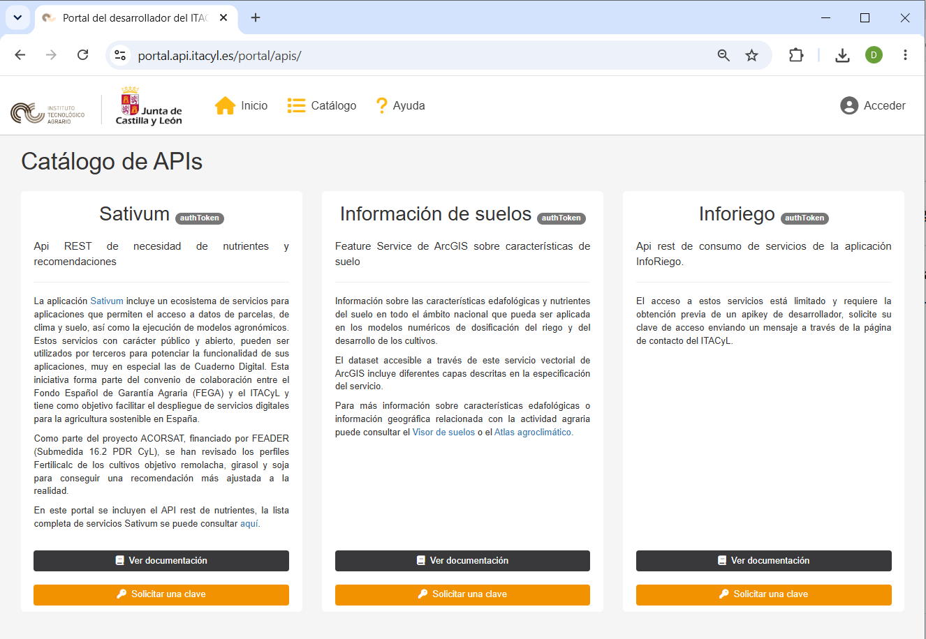

Slide 25
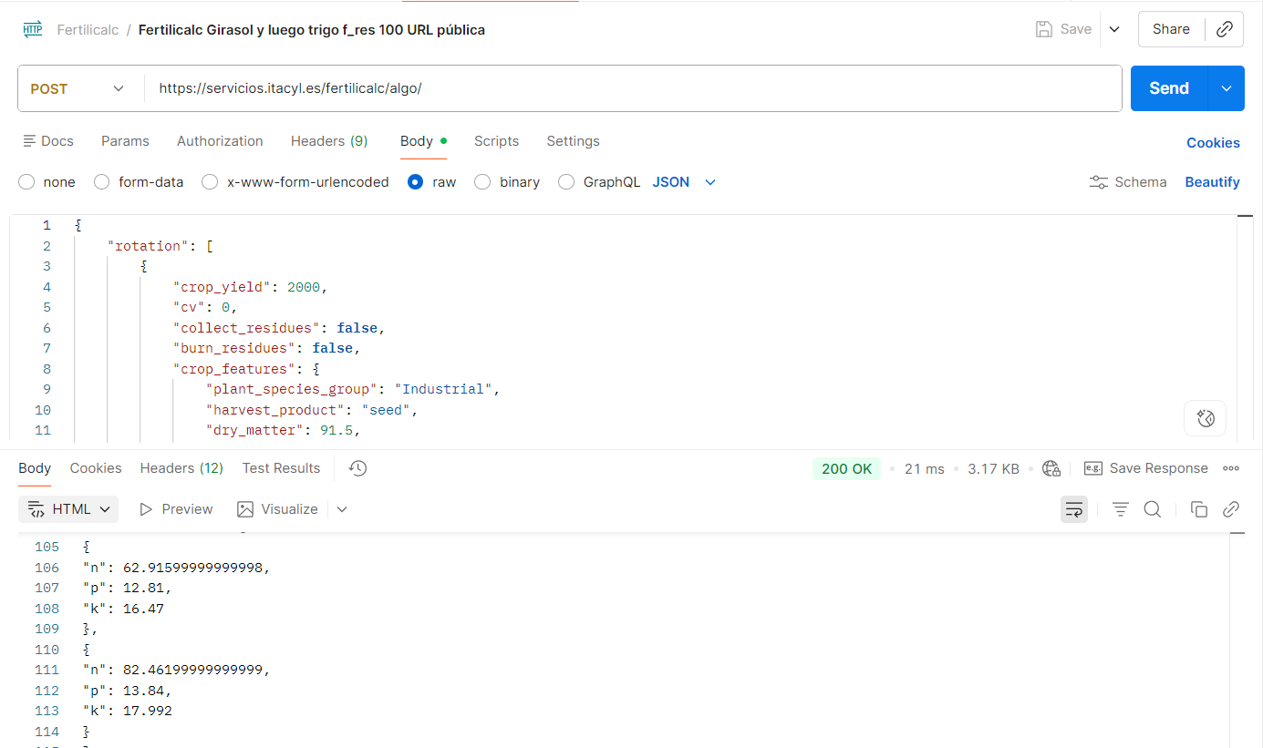

6
  Soil information and fertilization API
197 current users

Slide 26
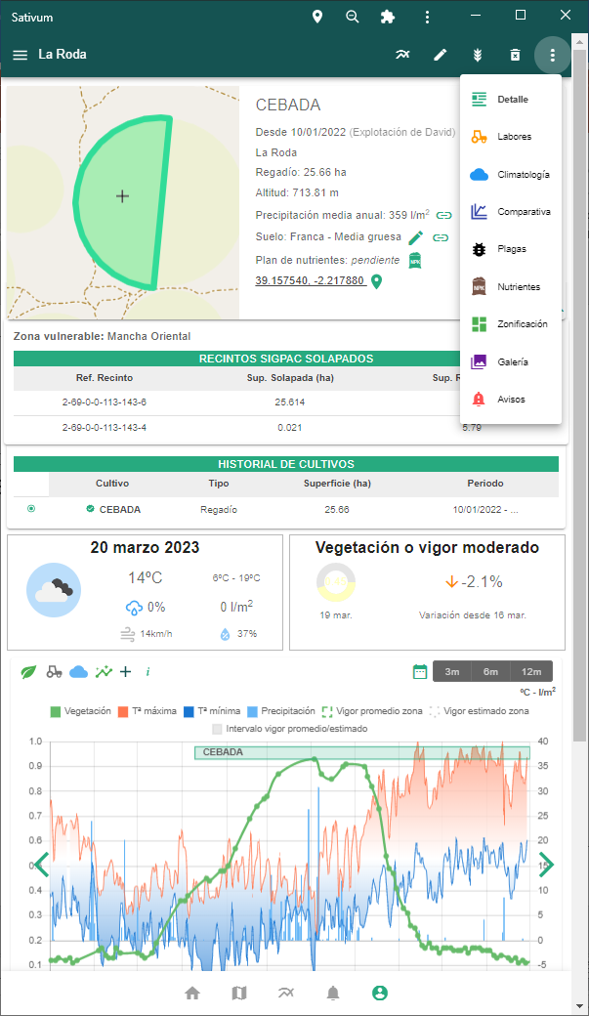
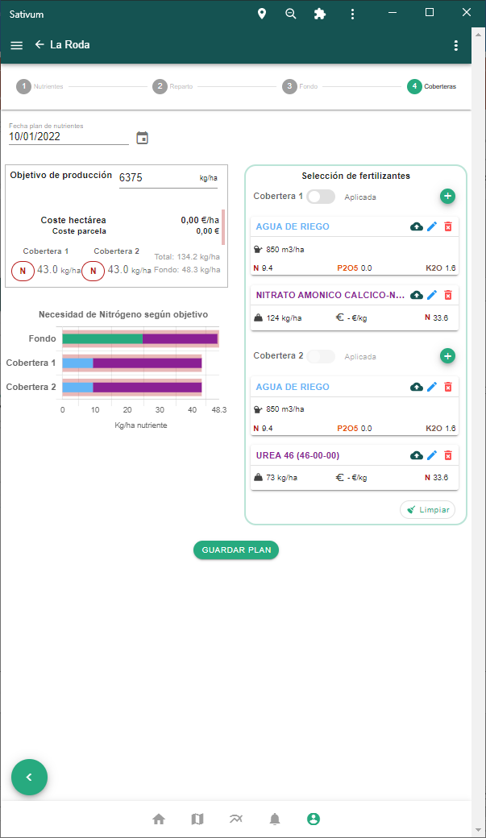
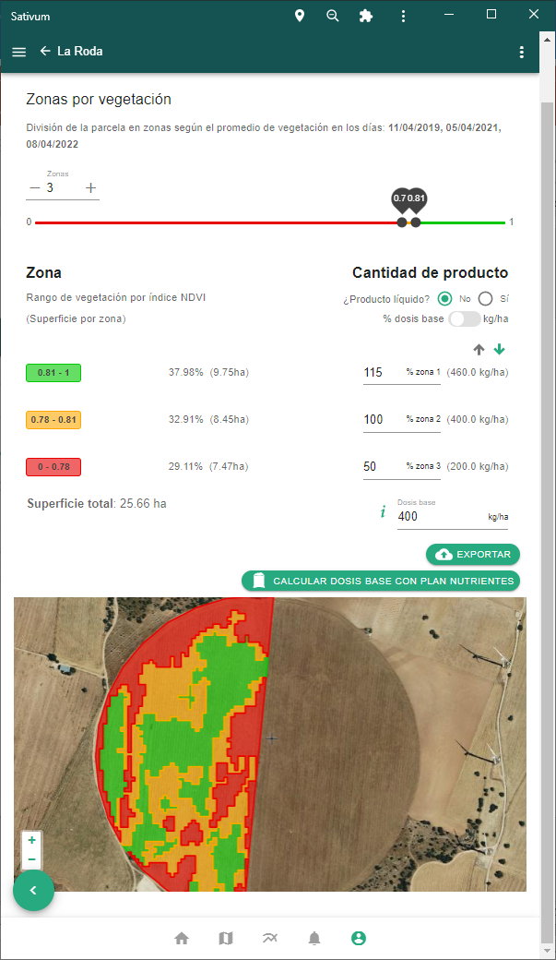
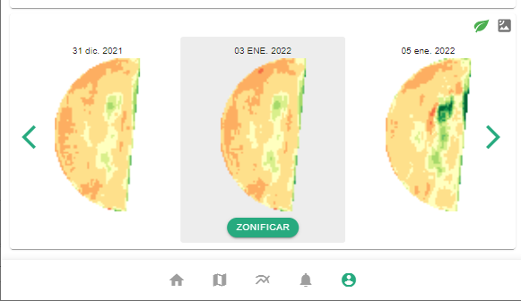

Slide 27
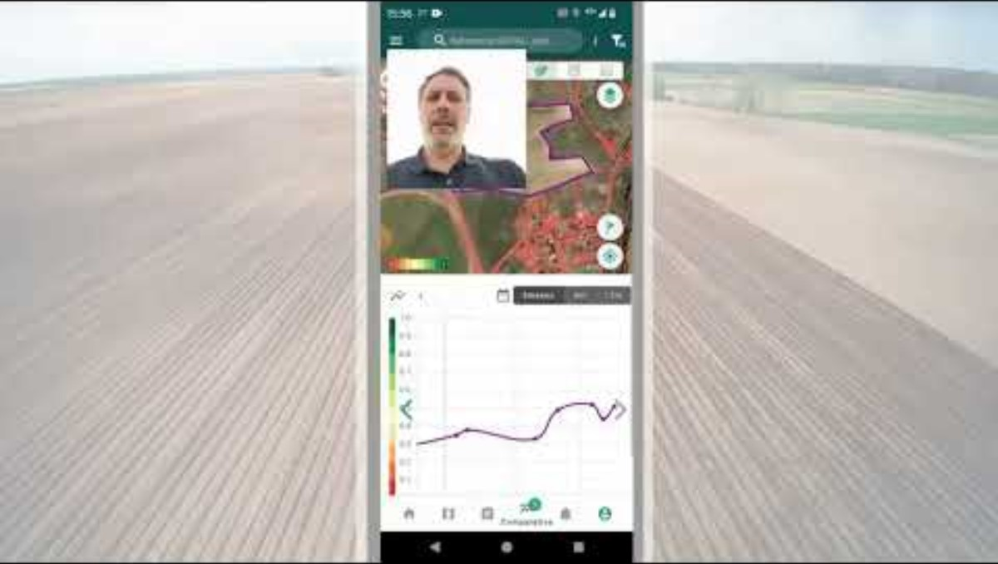

Slide 28
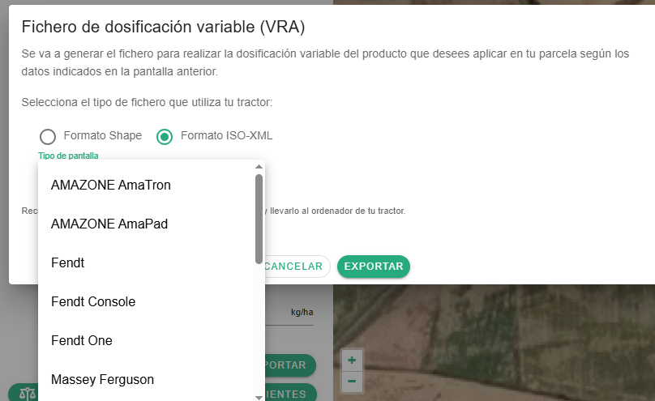



6
  Machinery integration

Slide 29
7
Main Challenges & Scaling Hurdles

Slide 30
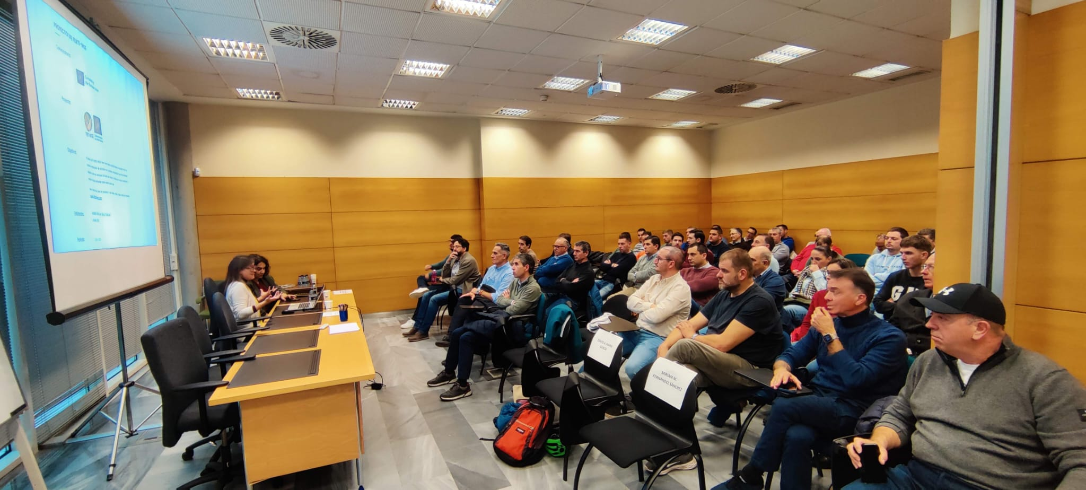




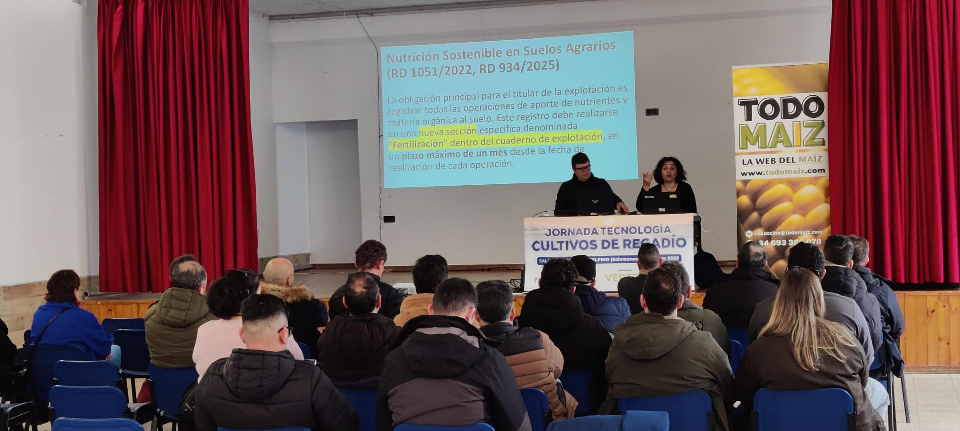




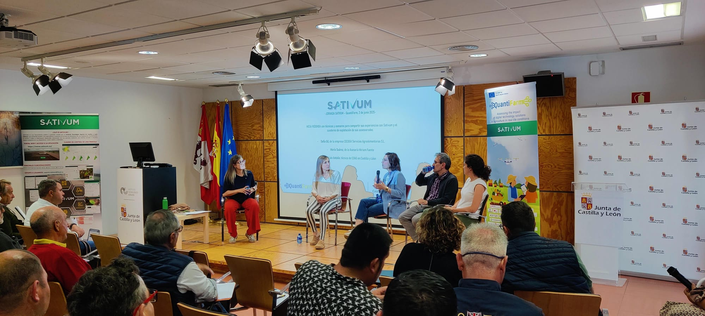
7
  Main Challenges & Scaling Hurdles
Agronomic Relevance
Dual User Profiles
Delivering truly reliable and useful data requires deep agronomic expertise and seamless integration with daily agricultural operations.
Serving two distinct target groups — individual farmers and professional advisors— with contrasting technical needs and workflows.
Adoption Ceiling & Training
Trust & Regulatory Friction
Active user growth plateaued at ~6,000 users. Adoption is highly sensitive to training effort, ~ 100 training sessions per year across 2024–2025.
Overcoming skepticism toward government apps. Mandatory tools (Field Book, Nutrient Plan) drive onboarding but can create user pushback.
After 5 years AMS and SATIVUM almost does not share infrastructure / data / staff

Slide 31
8
ELMS - Implementation in SPAIN

Slide 32
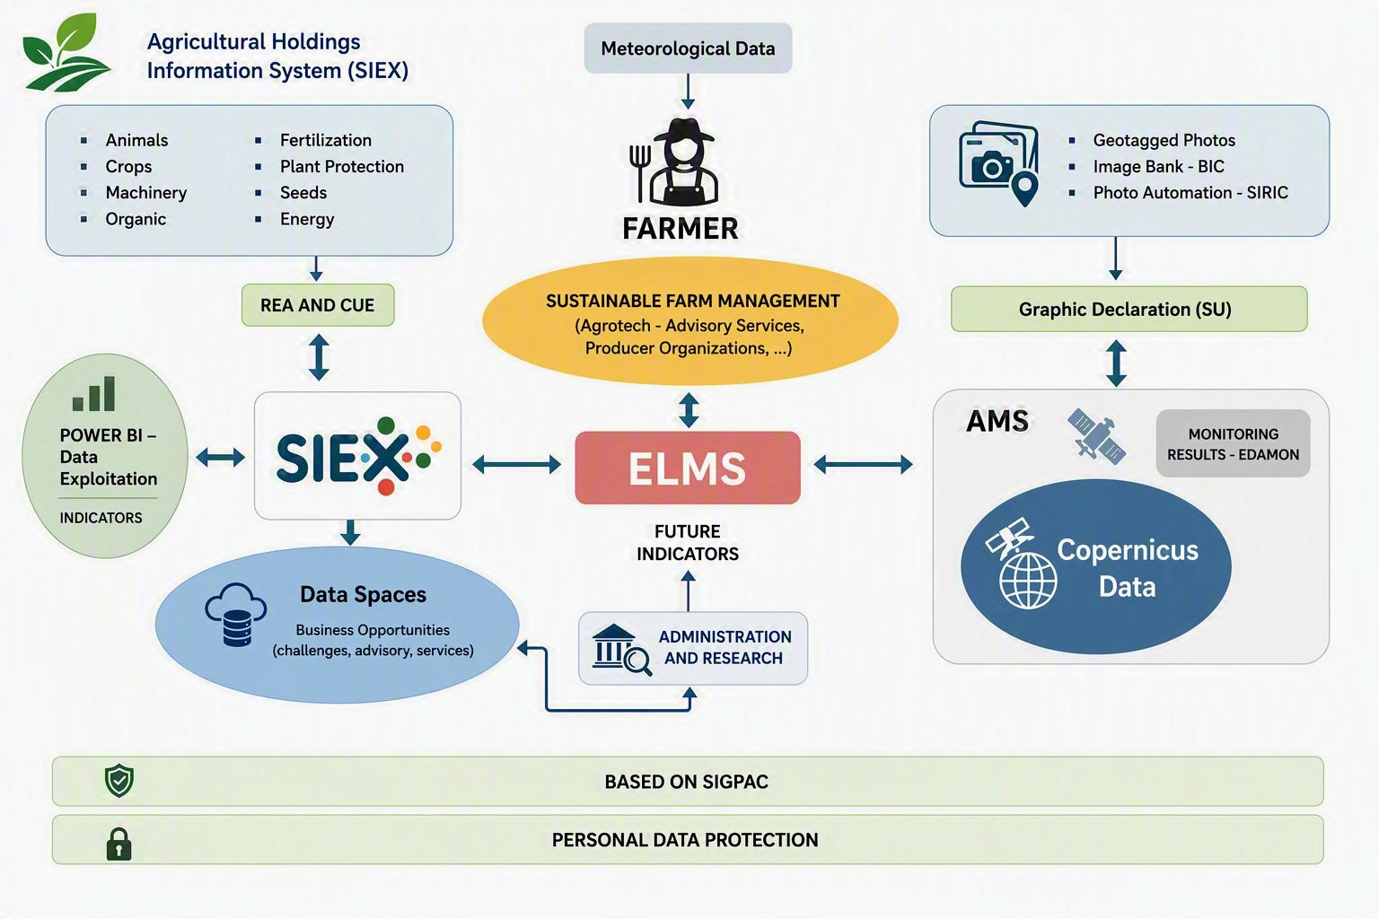

8
  Proposed scheme for the ELMS (IACS/ (SIEX + GSAA+ AMS))
Potential future ELMS architecture in SPAIN!!!

Slide 33
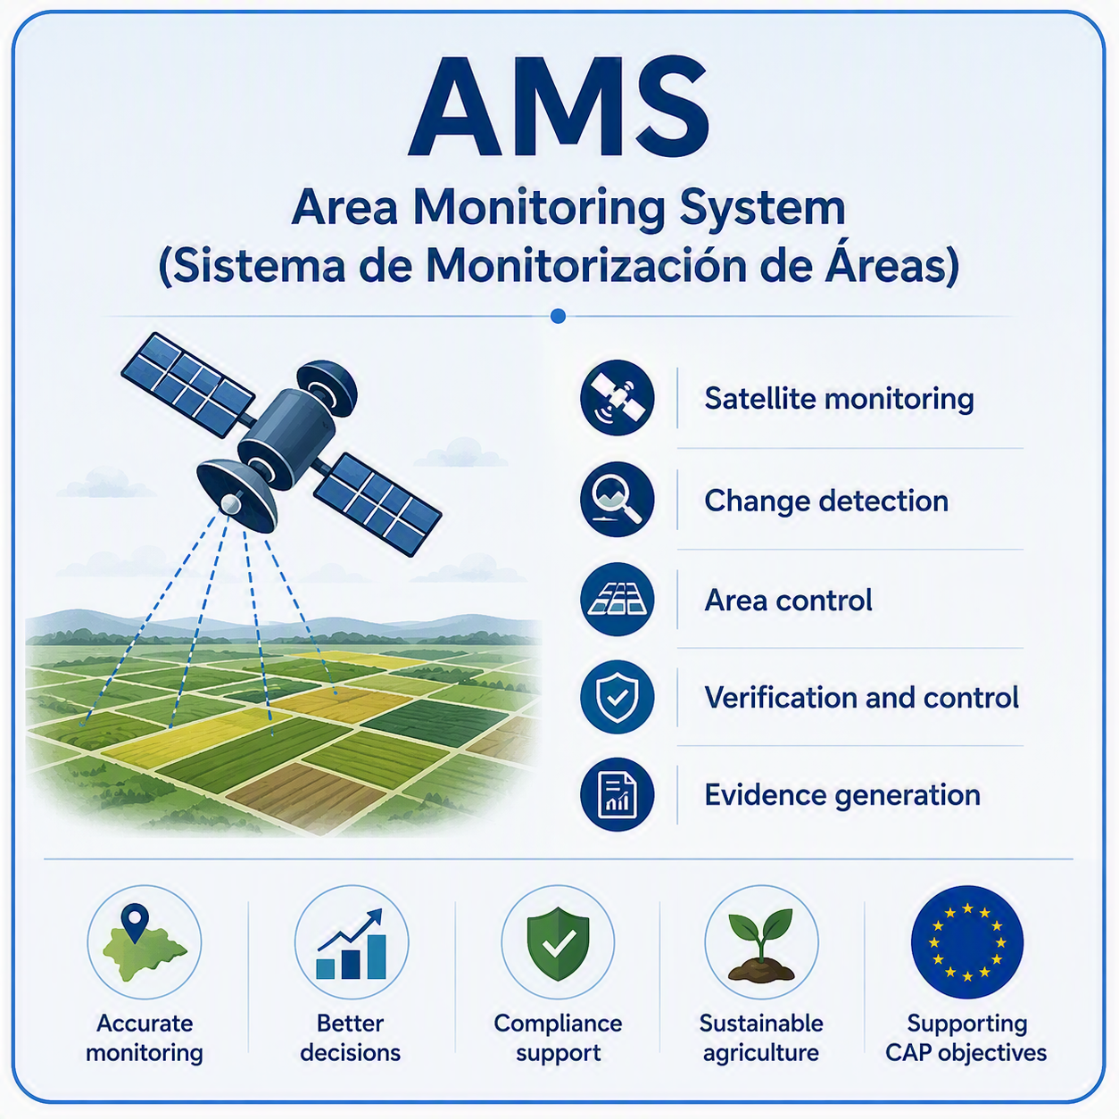
8
  Spanish Land Monitoring System
ELMS
33

Slide 34
8
  Potential Benefits of the ELMS Spain Prototype
For the Farmer
For Technology SMEs
For the Administration:
Today
Today
Today
Crop monitoring and CAP compliance.
Tomorrow
Sustainable, data-driven farm management.
Limited access to agricultural data. Limited cross-countries IACS Data
Tomorrow
New services: carbon, irrigation and yield prediction
Digital CAP management and automated controls.
Tomorrow
Better policies through interoperable data.
34

Slide 35
9
CONCLUSIONS

Slide 36
9
  Conclusions
A high level of interoperability already exists among key IACS components
Spain is not building ELMS. Spain is becoming ELMS.
Data sharing is the cornerstone of ELMS. When the necessary information is available and shared, ELMS can be generated automatically.
36

Slide 37
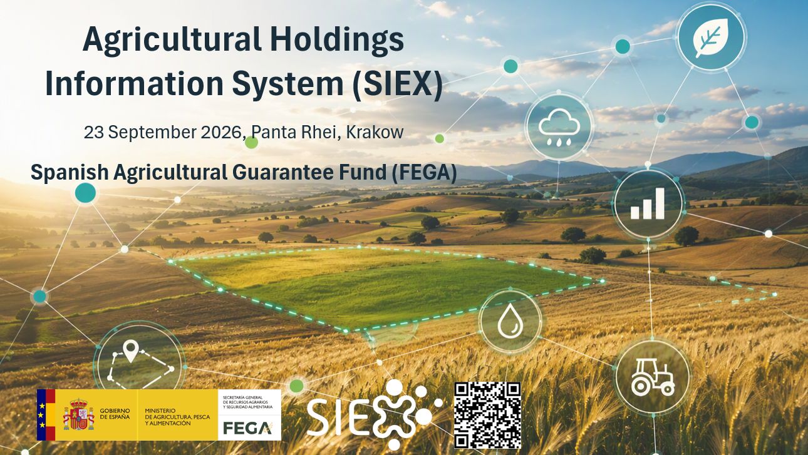
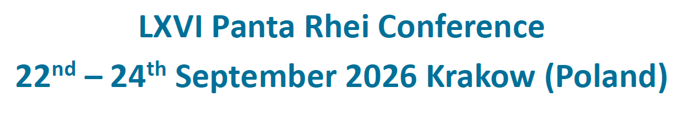
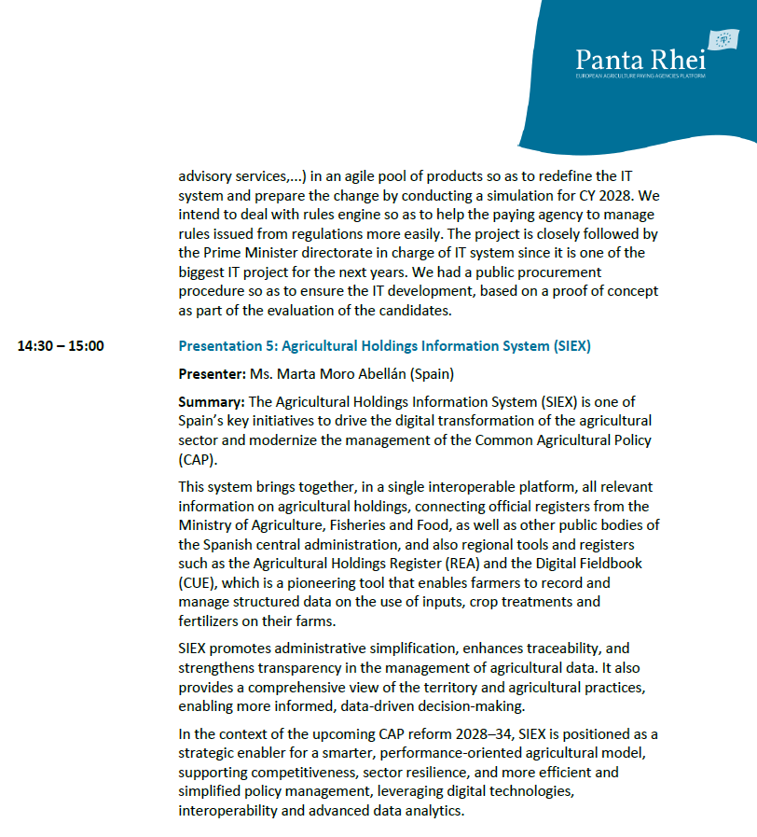
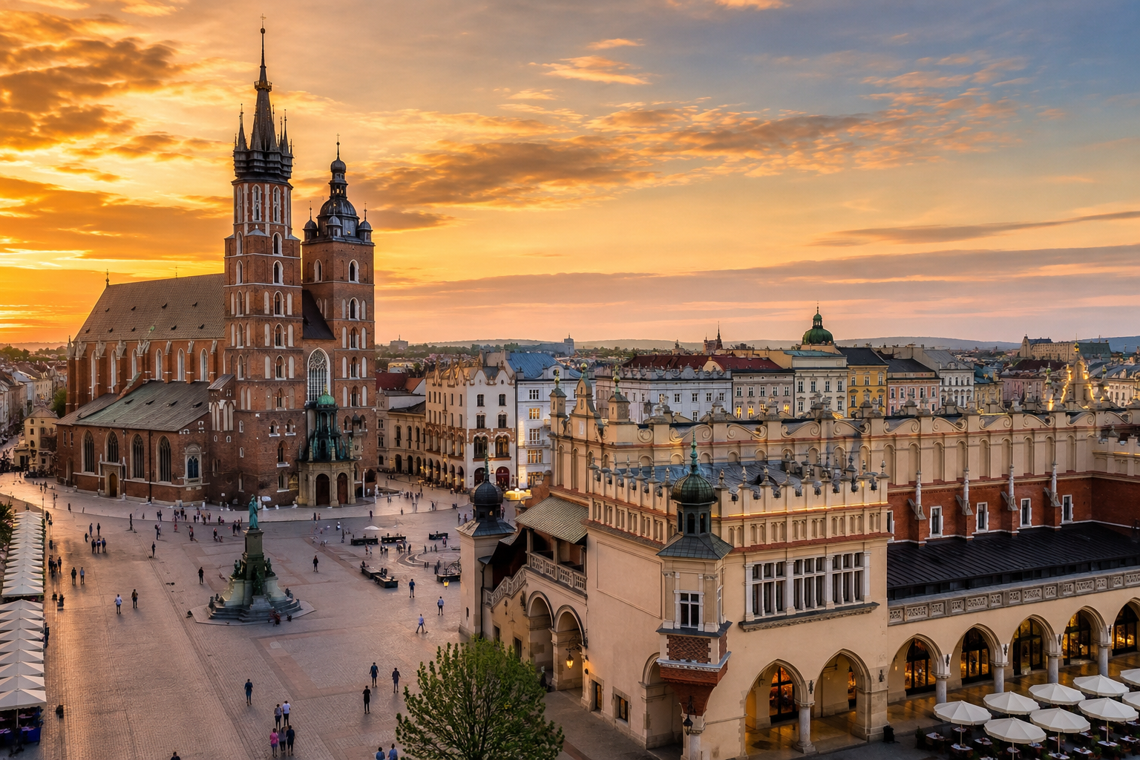
  Know more about the project…
37

Slide 38



Thank you ;)
Área de Innovación – FEGA, O.A - ITACyL
innovacion.ad@fega.es & nafgarda@itacyl.es

