Slide 1
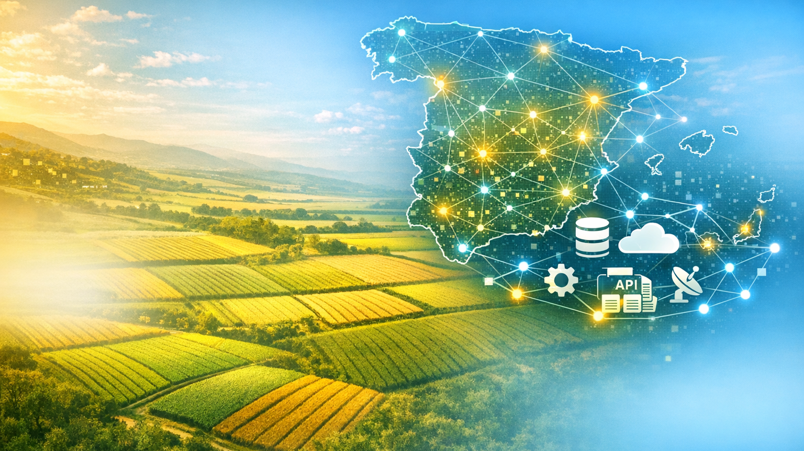


Moving towards an ELMS in Spain: SIEX and SATIVUM
Session 4. IACS foretold: mapping the path beyond 2027
Wednesday 9 September 2026. Sofia, Bulgary

Slide 2
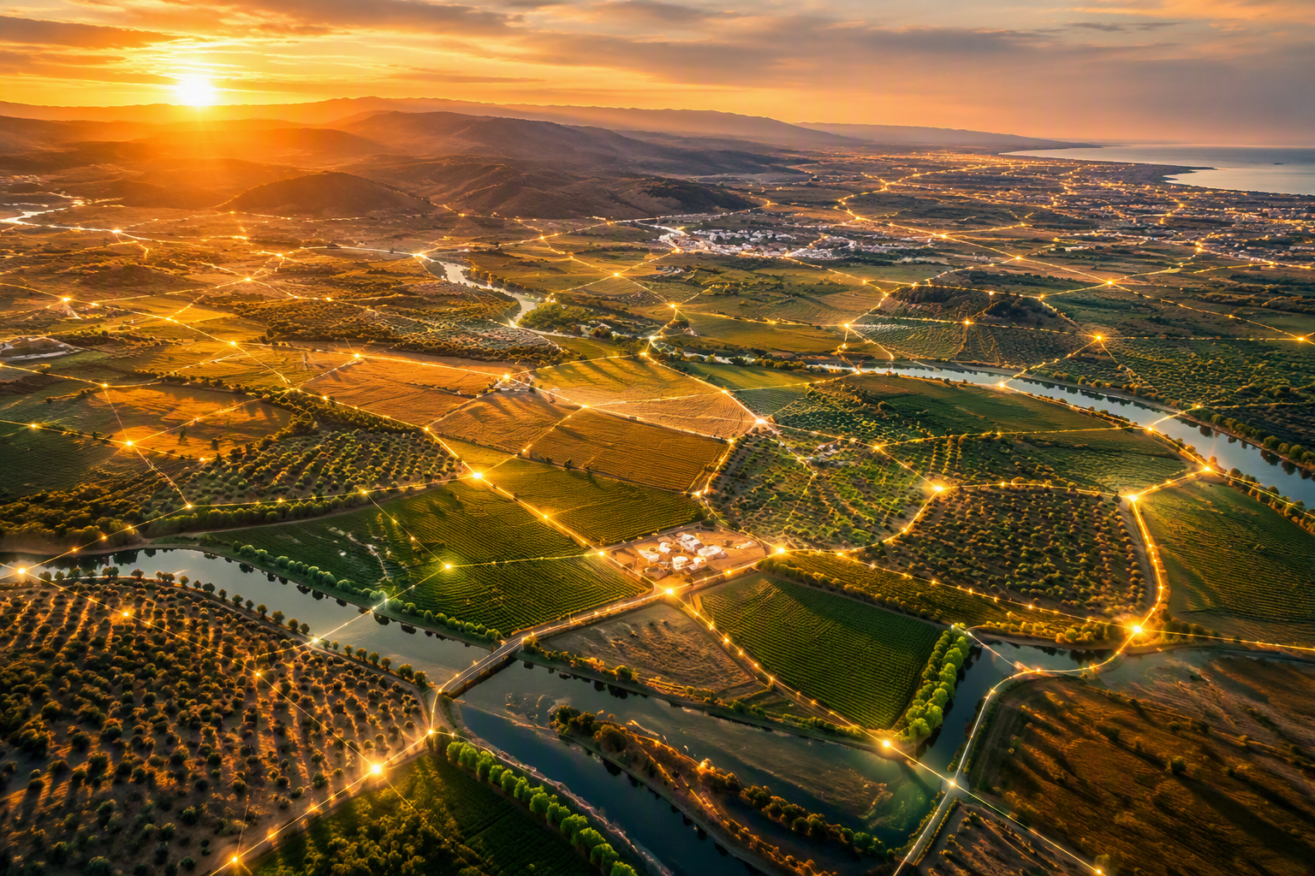
Spain is not building ELMS.
Spain is becoming ELMS.
"When we talk about ELMS, we often speak about the future.
But in Spain, the most interesting question is no longer how to build it.
The question is how to CONNECT what already exists."
Moving towards an ELMS in Spain: SIEX and SATIVUM

Slide 3

Why SIEX?
Introducing SIEX
System Architecture, Governance and Roles
APIs & Private initiatives
Why SATIVUM?
Introducing SATIVUM
Training, Vision, Agronomic Approach
ELMS - Implementation in SPAIN
Conclusions
INDEX

Slide 4
1
Why SIEX?

Slide 5
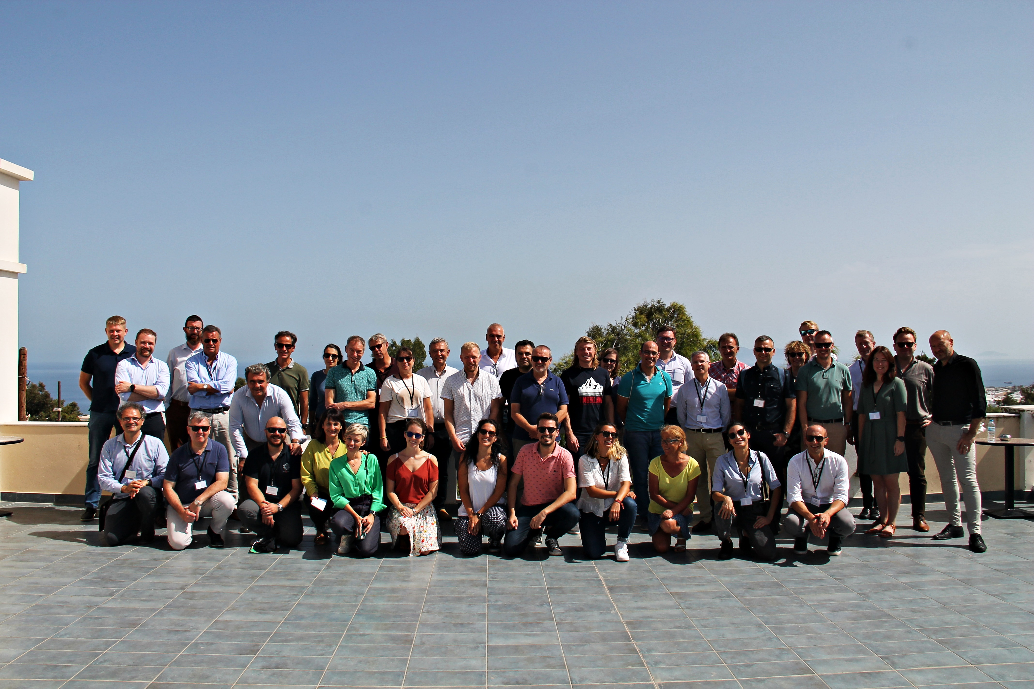
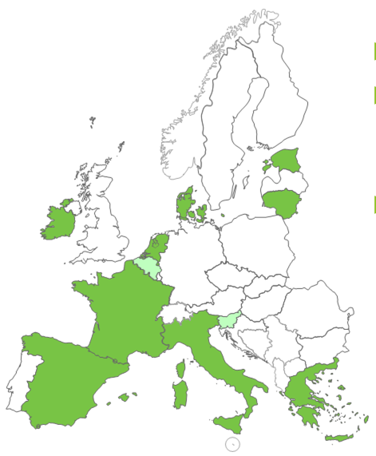



1
  Why SIEX?
But this story has a beginning…
A broader approach:
Knowledge of the different sectors
Consistency across data sources and statistics
Economic information on farms
Knowledge of farmer activities
Traceability of productions
Participation in the H2020 NIVA Project had a very positive effect in Spain
https://cordis.europa.eu/project/id/842009/reporting
5
5

Slide 6
2
Introducing SIEX

Slide 7
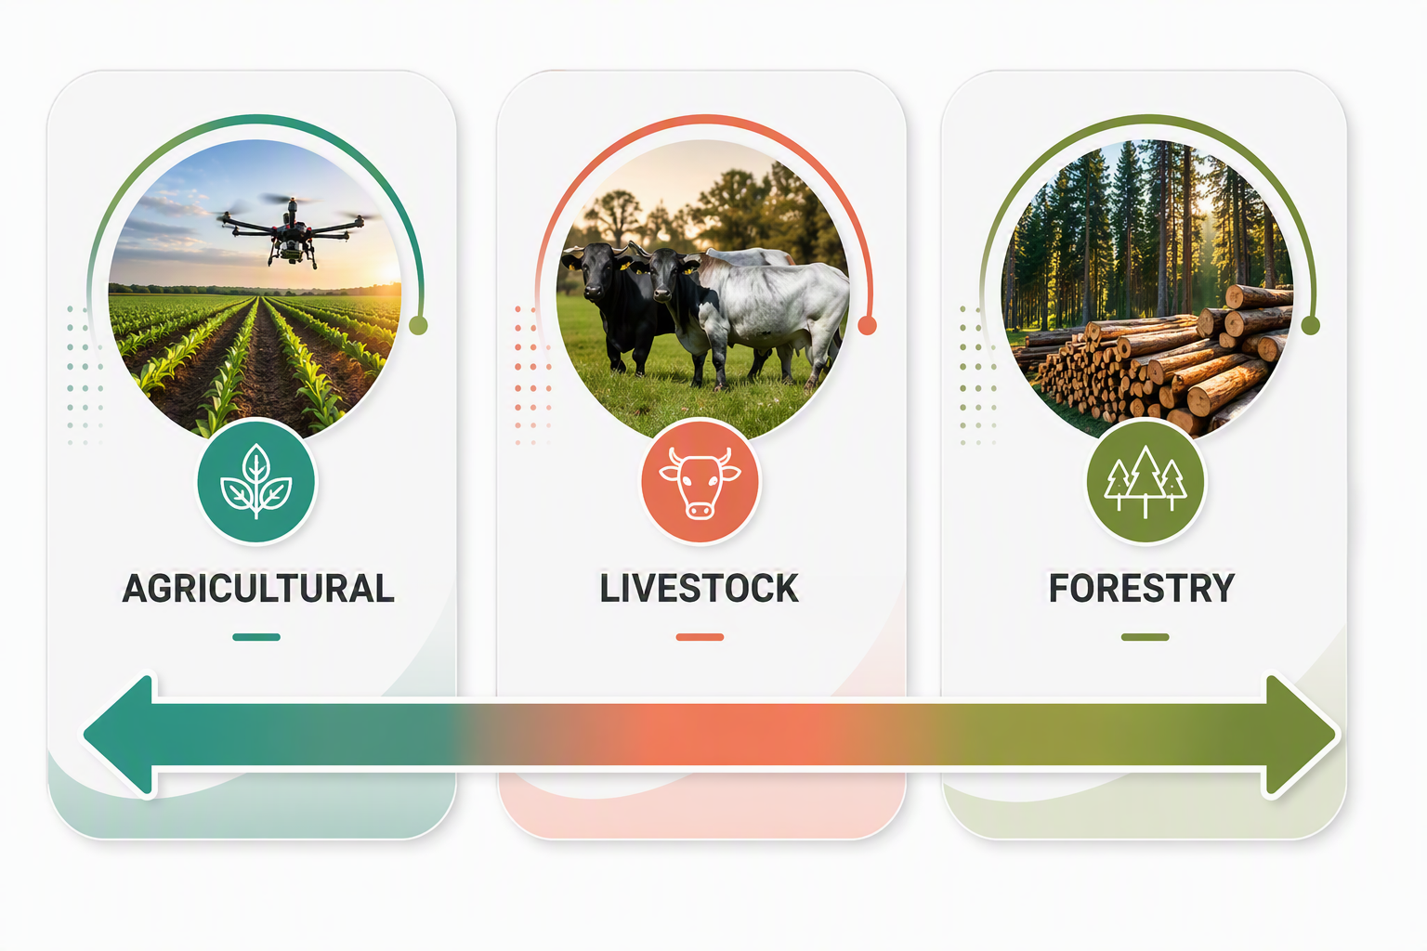


2
  SIEX project
Connecting information sources so they can work together:
2022 & 23

Slide 8

2
  SIEX project
A system that digitally integrates and centralizes all available information from the agricultural sector
Governance structure: National & Regional
(AGRICULTURE + LIVESTOCK + FORESTRY)
+ Standardization
+ Interoperability
+ Data Analysis and use

Slide 9
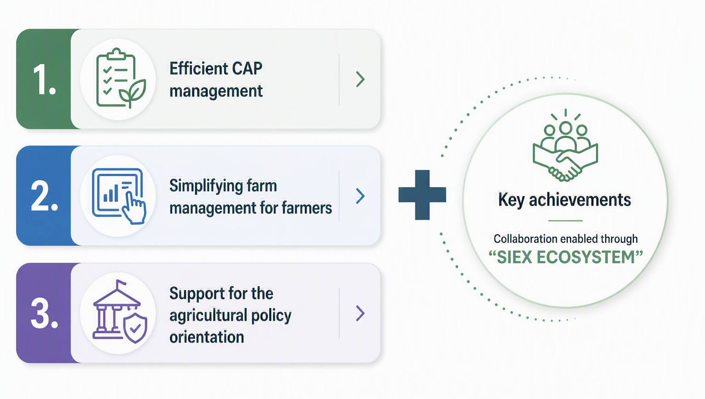
2
  Objectives
National Regulation: Royal Decree 1054/2022

Slide 10
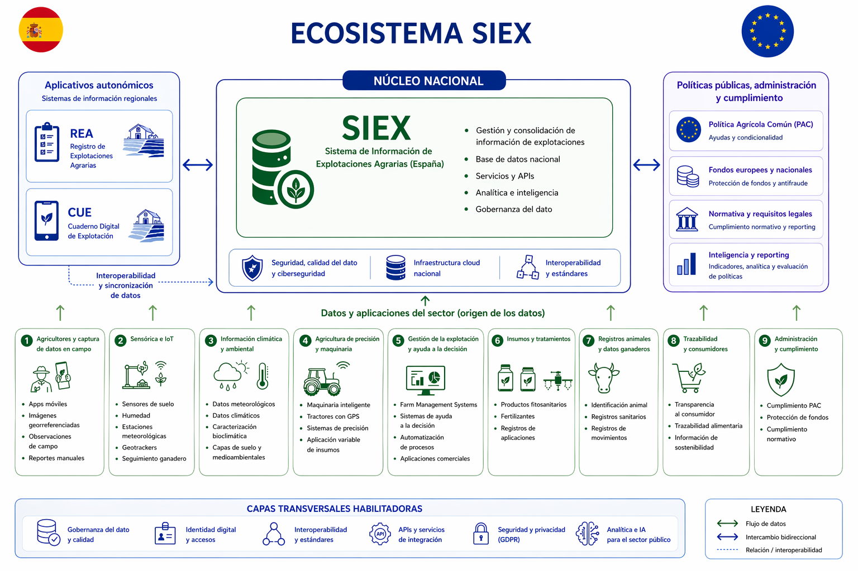
2
  SIEX ecosystem
“Please note that some elements shown in this slide are still under development and subject to further refinement.”
“Data flows are indicative and may not fully reflect the national design.”

Slide 11
2
  Value for Farmers & Public Administrations
For farmers
For public administrations
For society
For environment
MANAGEMENT
POLICY ADVISORY
TRANSPARENCY
SUSTAINABILITY

Slide 12
3
System Architecture, Governance and Roles

Slide 13
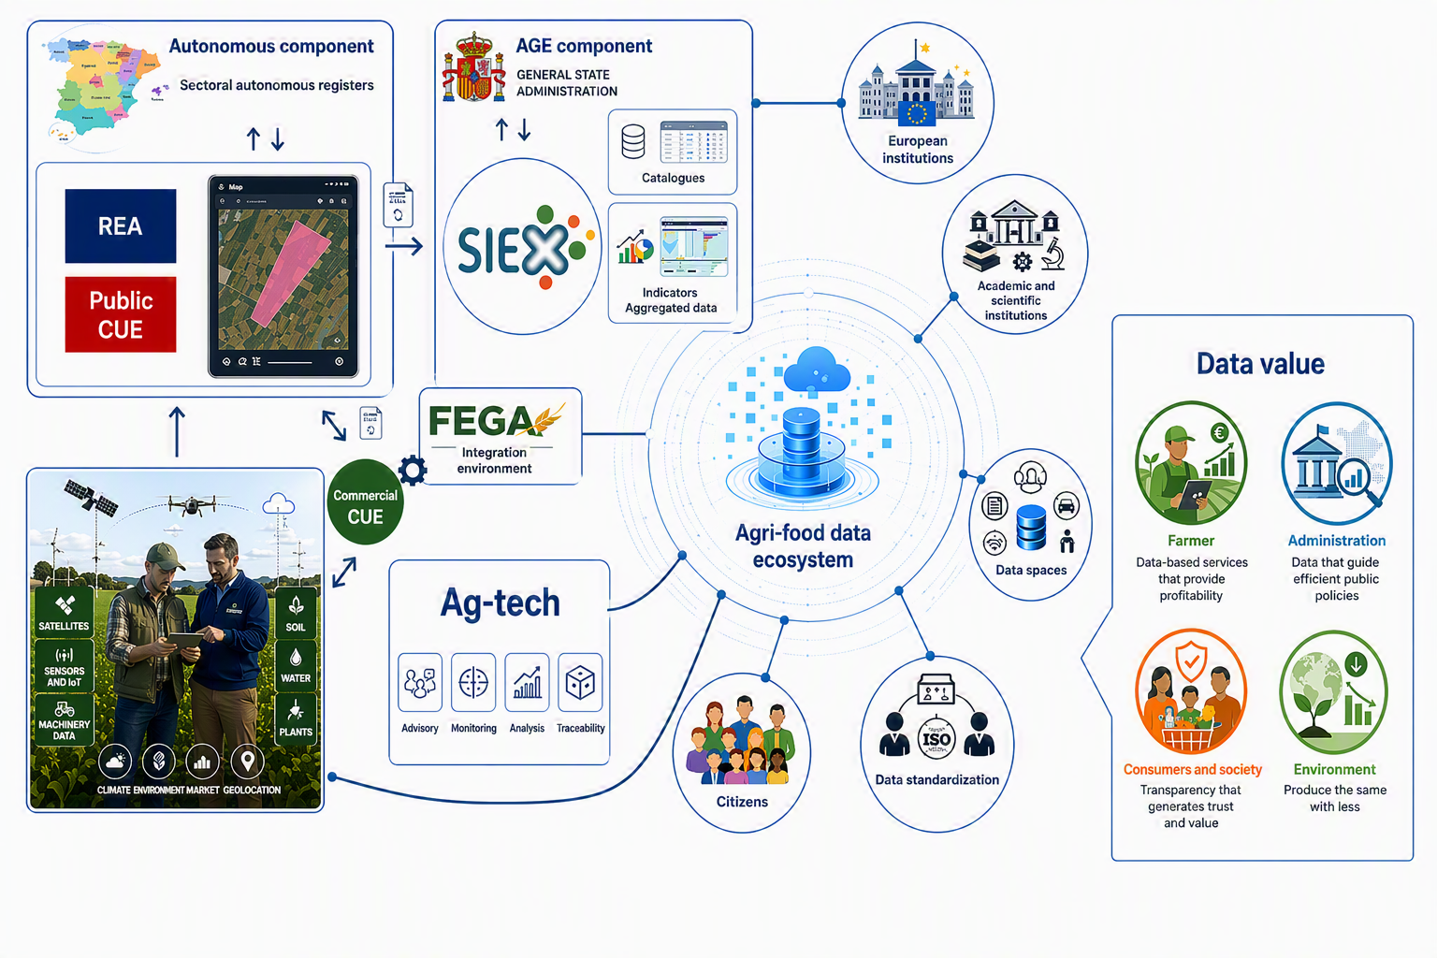
3
  Architecture
ELMS
SATIVUM
13

Slide 14
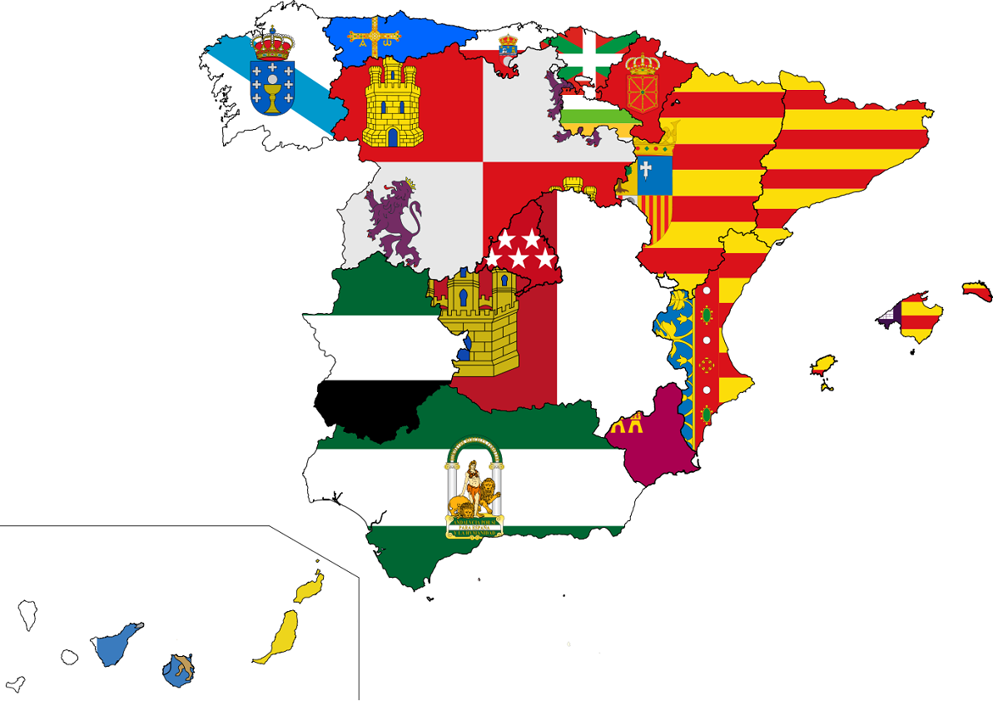
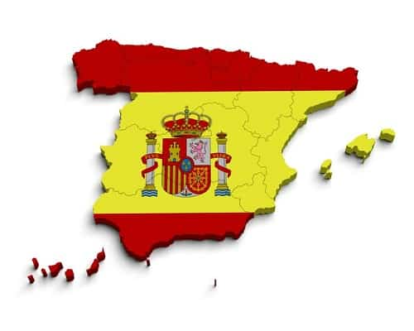



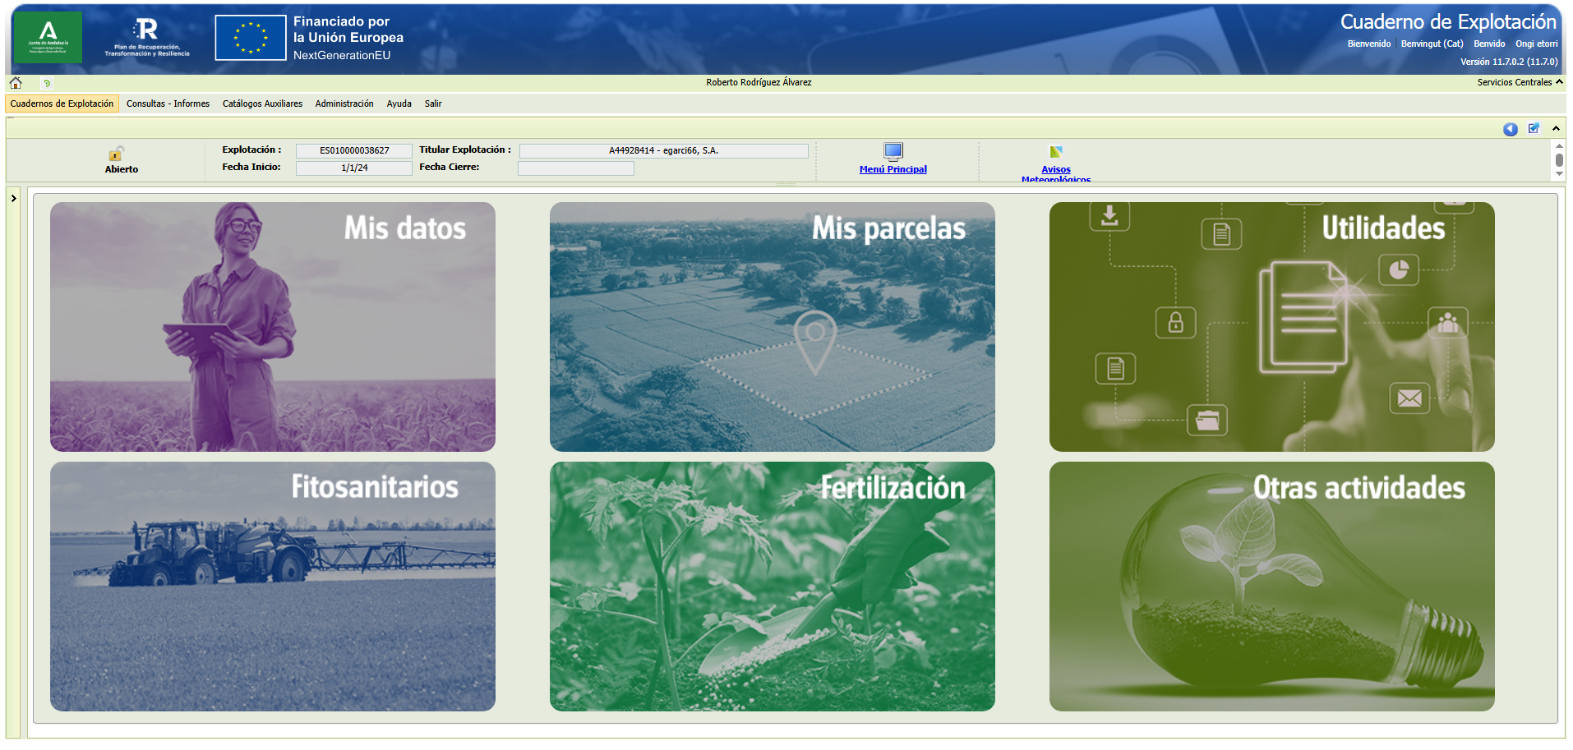


3
  Governance and Roles
REGIONAL
Regional counterpart
NATIONAL
Strategic decision‑making
Coordination and Regulatory
Technical, financial and IT responsibility
In‑house system
4 Autonomous Communities
National system (SGA)
13 Autonomous Communities
14
14

Slide 15
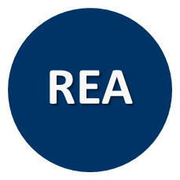
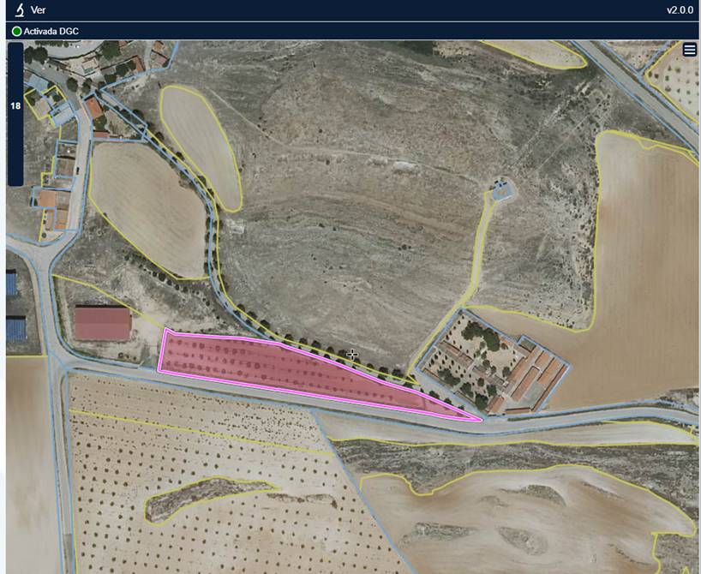
3
  Regional Register of Agricultural Holdings (REA)
What & Where
Mandatory since 2023 under Royal Decree 1054/2022
Responsibility development: Autonomous Communities
Minimum content: Annex I of Royal Decree 1054/2022 (SIEX)
SGARex and other regional REAs (REACYL, REAGA, DUN etc.)
Access profiles: Autonomous Community administrators, Farmers, as well as representatives, co‑holders, authorized entities, and data entry operators
Pistachio, var. Kerman
Pétrola, Albacete (Castilla‑La Mancha)
Rainfed
0.42 ha
Certified in conversion (to organic farming)

Slide 16

3
  Digital Farm Book (CUE)
How
Voluntary
Responsibility development: Autonomous Communities
Minimum content: Annex II of Royal Decree 1054/2022 (SIEX)
SGACex and other regional CUE systems (CUECYL, QIE, XEAGA, KOADERNO) + (CUE-Comerciales/ Private Digital Farm Book).
Access profiles: Autonomous Community administrators, Farmers, as well as representatives, co‑holders, authorized entities, and data entry operators
10/02/2026 – Fertilization
4 t/ha of composted sheep manure
John Deere 5090M tractor + solid manure spreader (6 m³)

Slide 17
4
APIs & Private initiatives

Slide 18
DIAPO SOBRE APIs FEGA

Slide 19
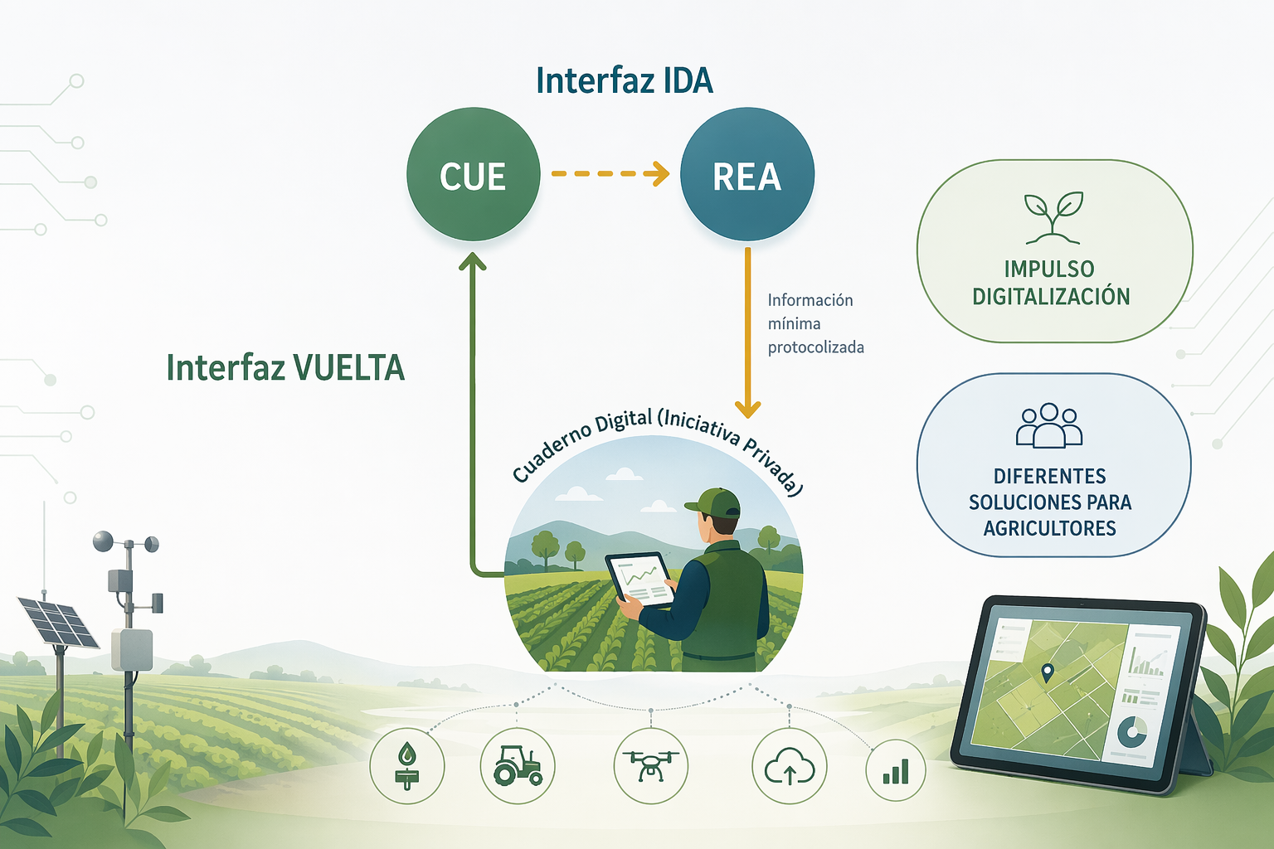
3
  Public–Private Cooperation
Private Digital FieldBook
Unified Interface
A key pillar of the SIEX
A key driver for the dissemination, adoption and widespread use of the Digital Farm Book (CUE)
IUWS

Slide 20
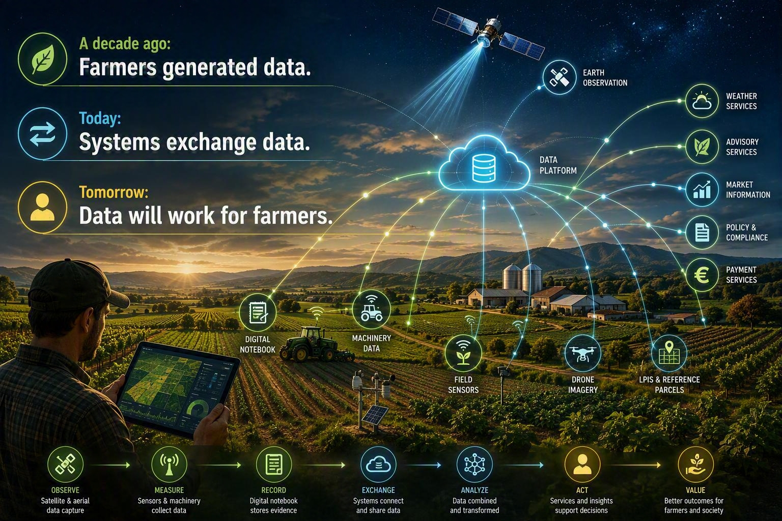

Slide 21

5
Why SATIVUM?

Slide 22




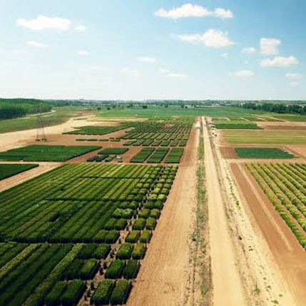




5
  ITACyL Strategy: From Inspection to Empowerment
ITACyL Identity
Technical Synergies
Regional public research entity providing tech services directly to administration and local farmers across Castilla y León.
Agronomic background combined with in-house IT infrastructure and a dedicated software development team.
2018 Baseline
Strategic Evolution
Initial AMS satellite monitoring focused primarily on CAP compliance checks and administrative controls.
Harnessing satellite infrastructure to deliver direct decision support and value to farmers — moving beyond inspection to empowerment.
Transforming satellite monitoring (AMS) from administrative control into active decision-support services for farmers.

Slide 23
6
Introducing SATIVUM

Slide 24
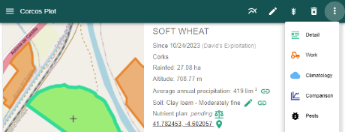
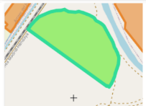


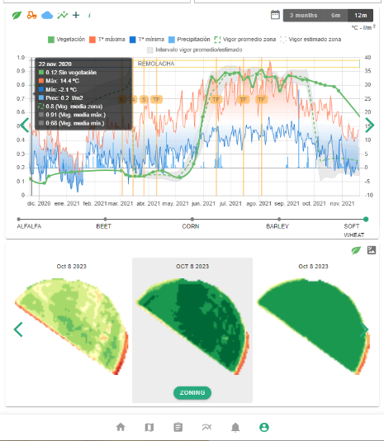


6
  How We Built It: Platform Ecosystem
Multi-Source API & Data Access
Proprietary In-House Sources (Open Public Data)
Multi-Stream Ecosystem Funding

Slide 25
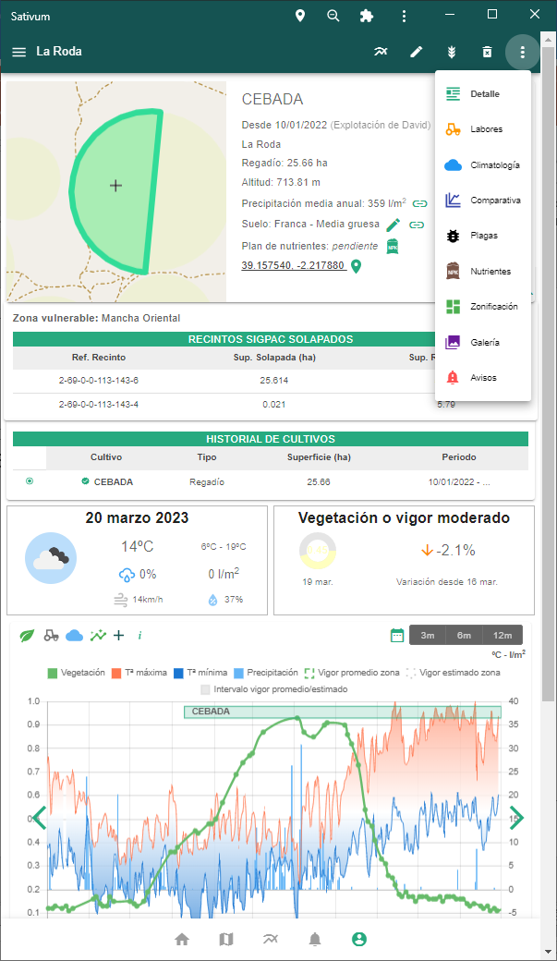
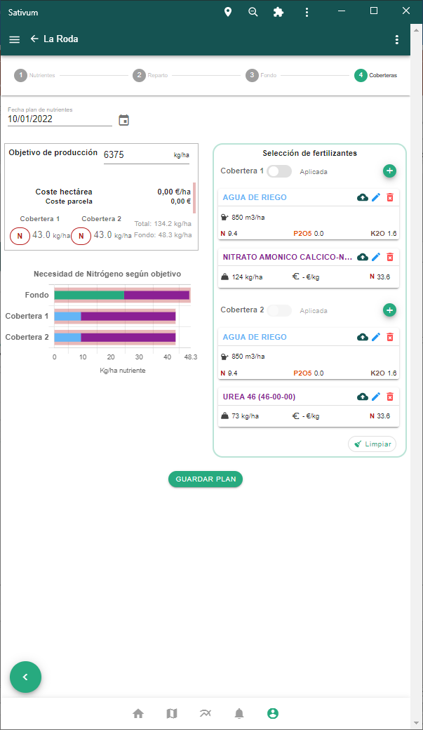
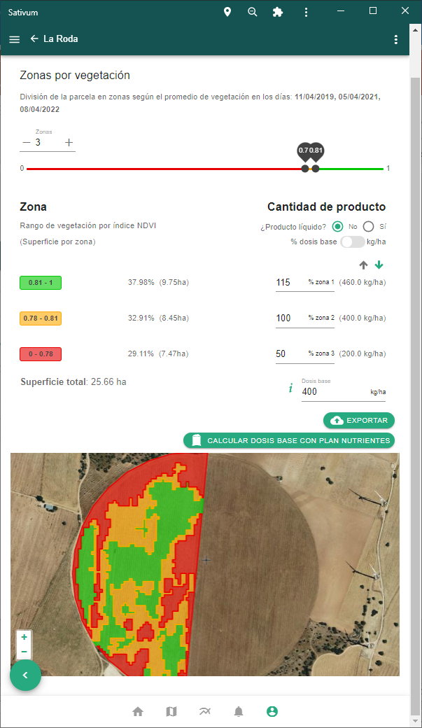
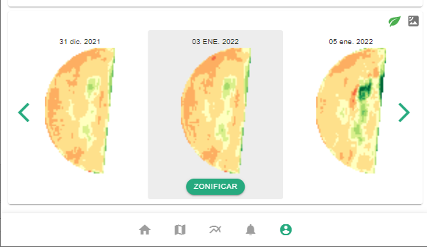

Slide 26
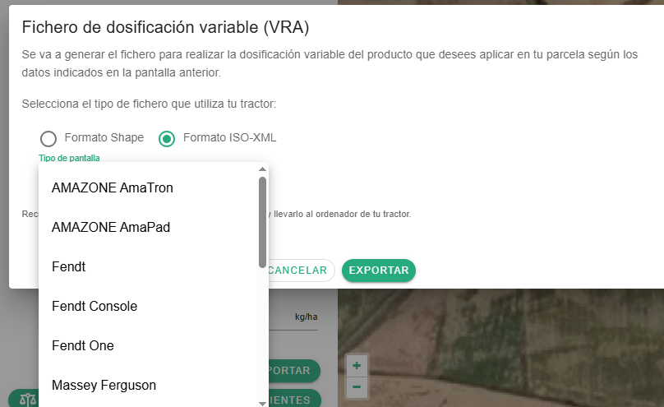



6
  Machinery integration

Slide 27
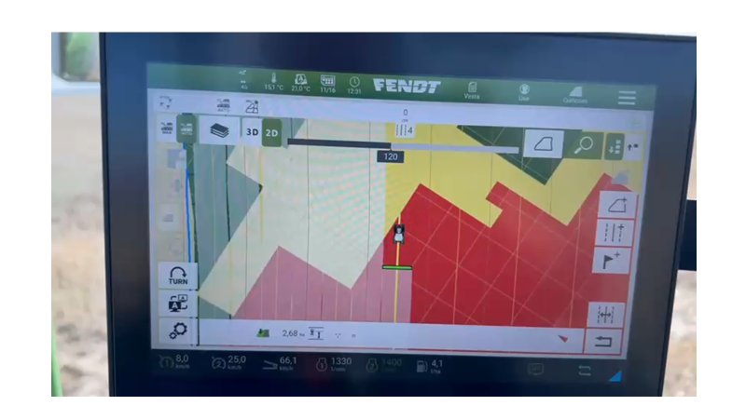
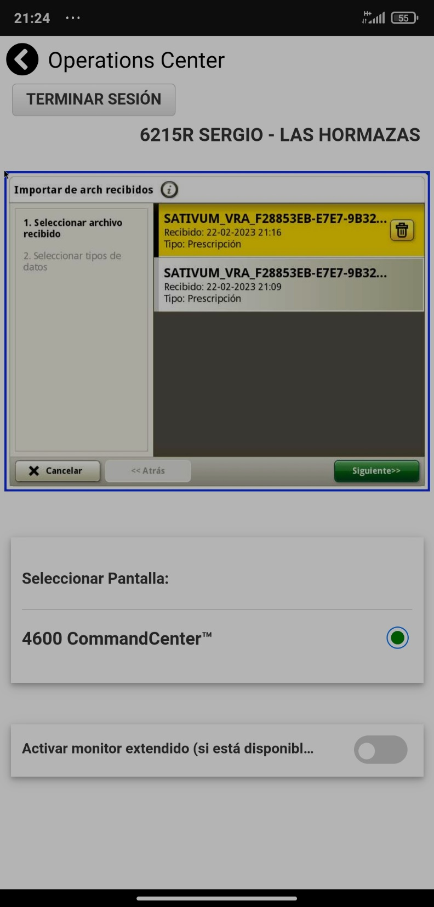
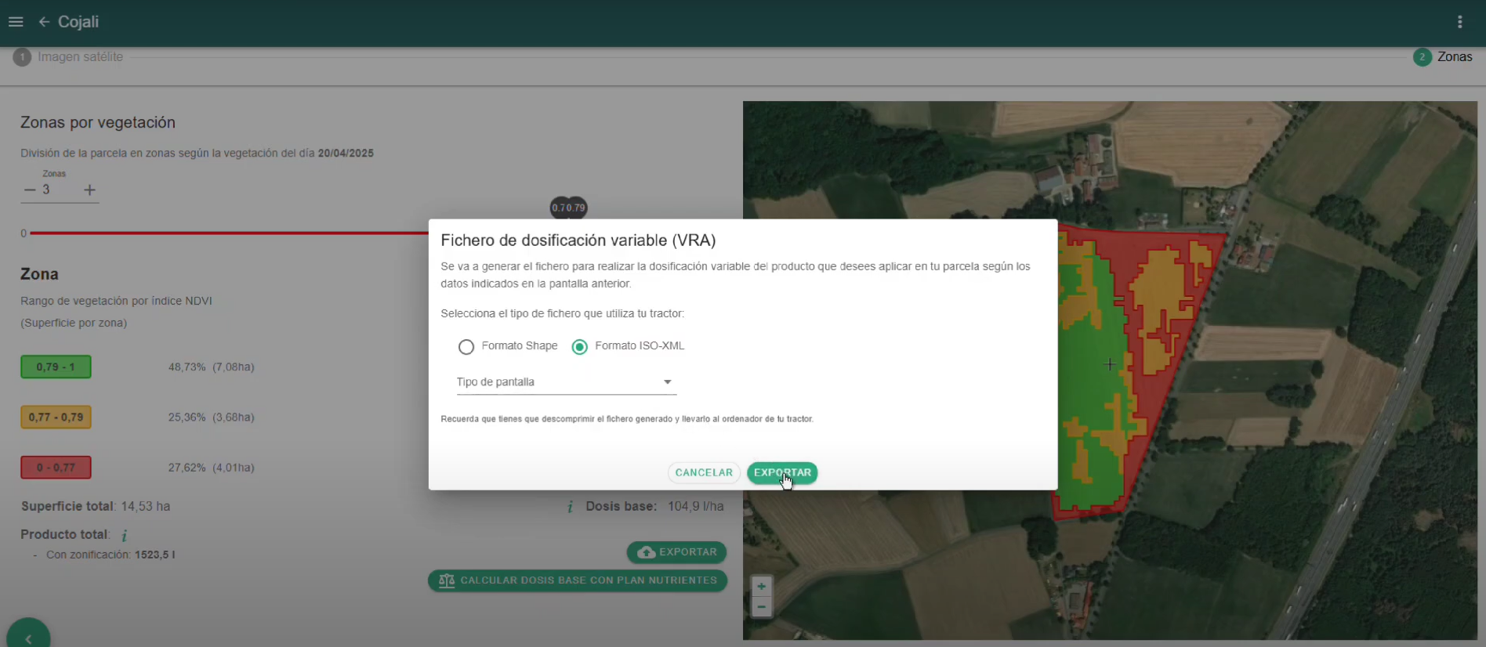
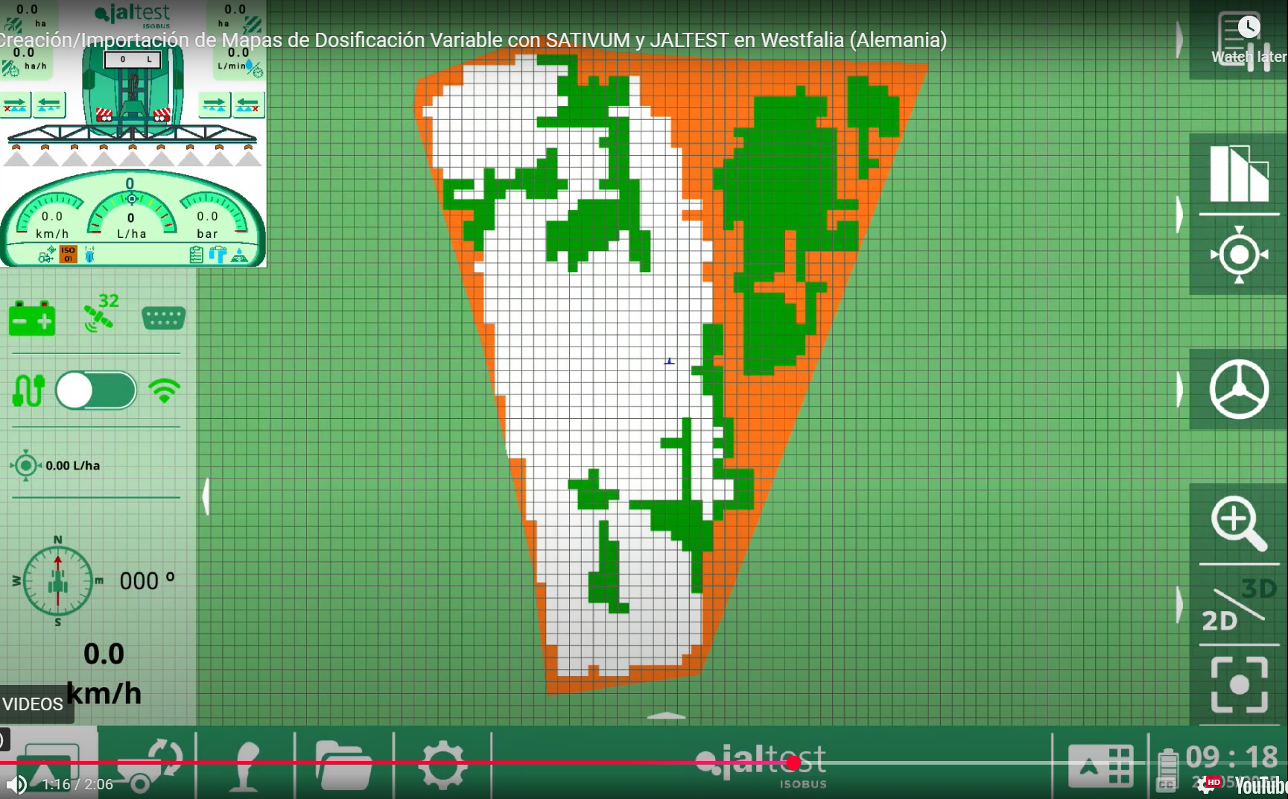

Slide 28
7
Training, Vision, Agronomic Approach

Slide 29
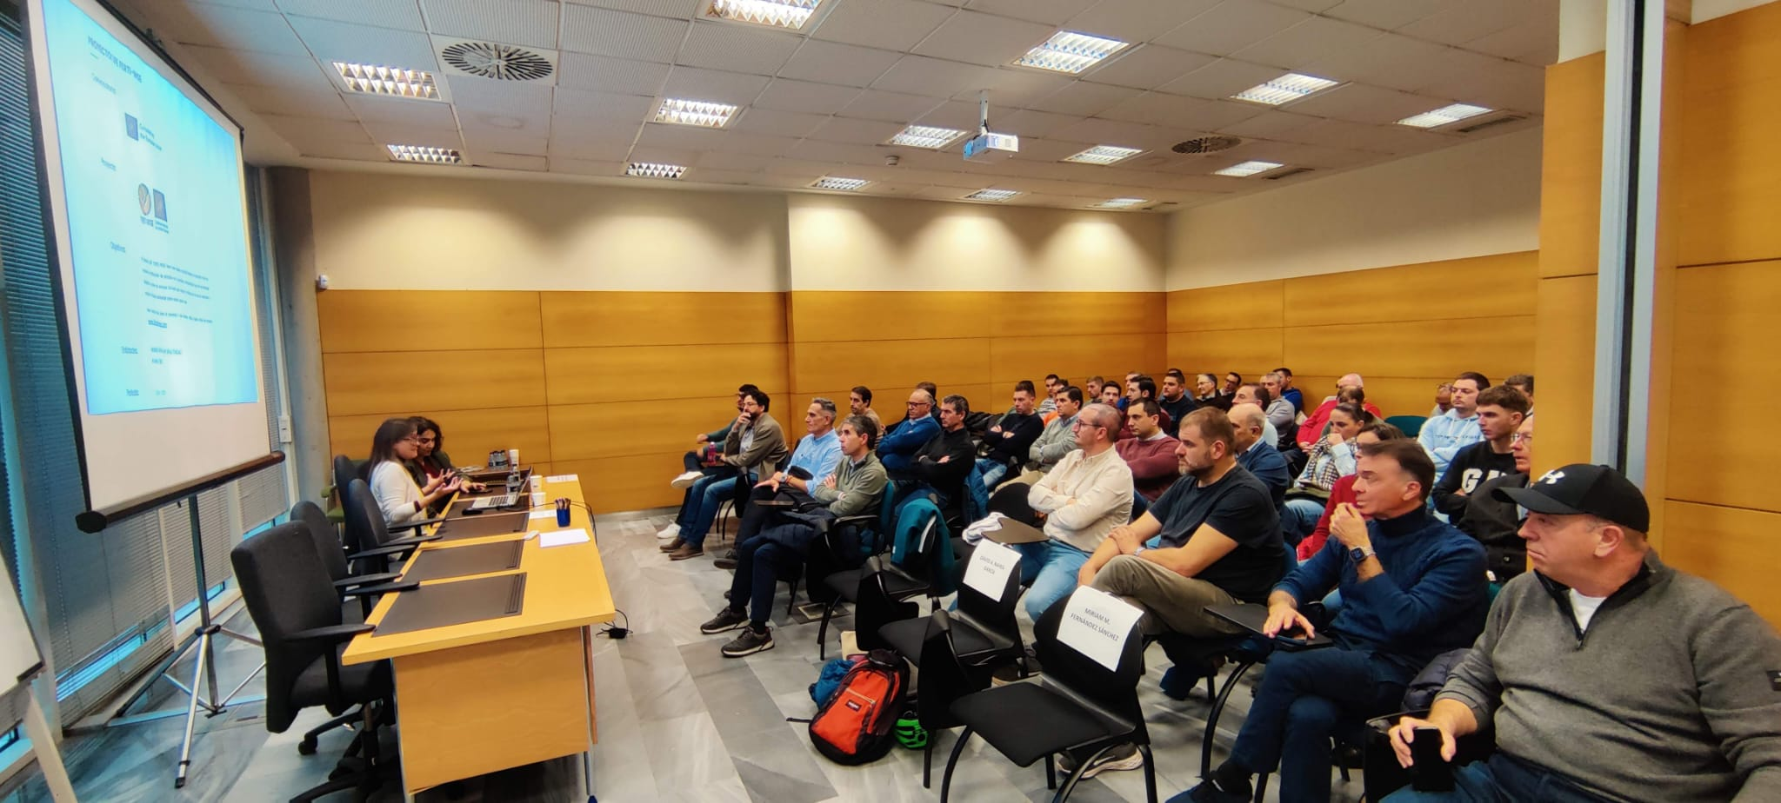




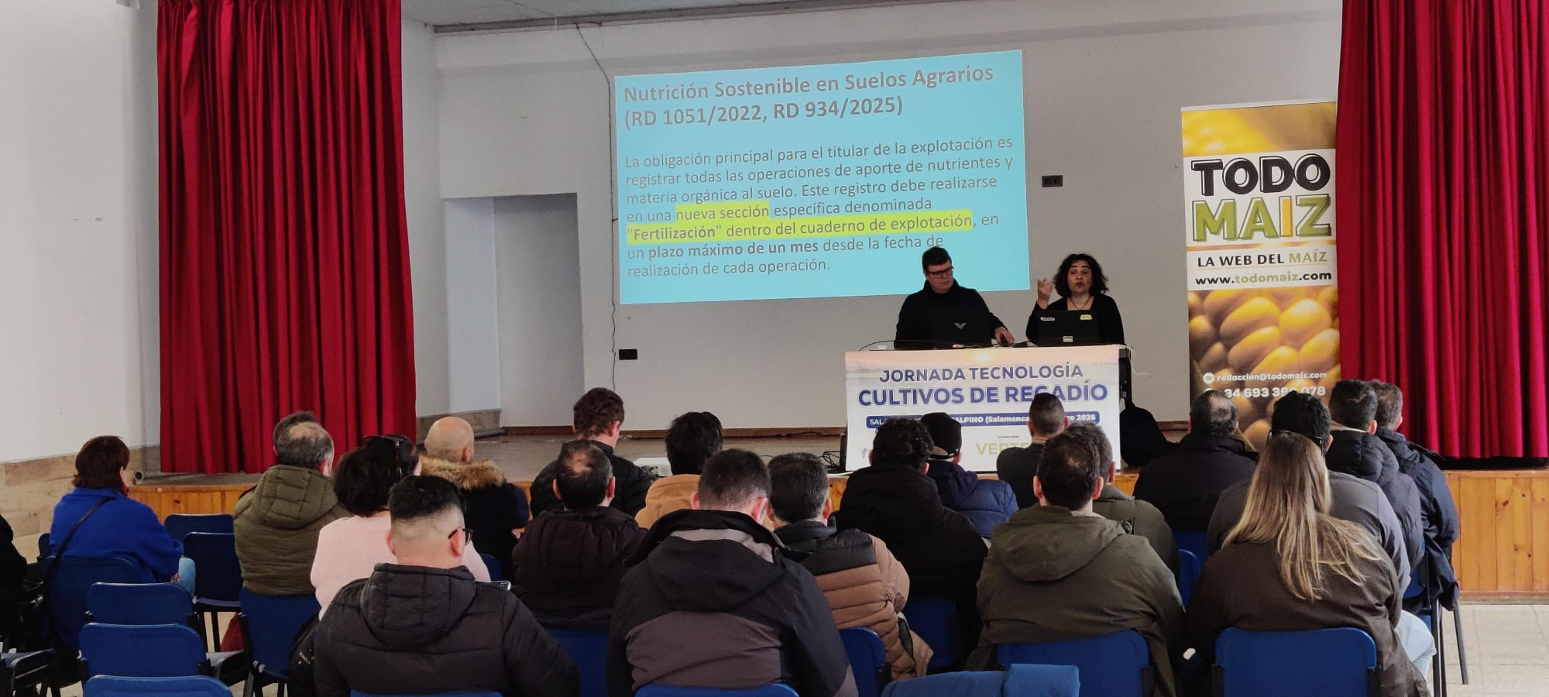




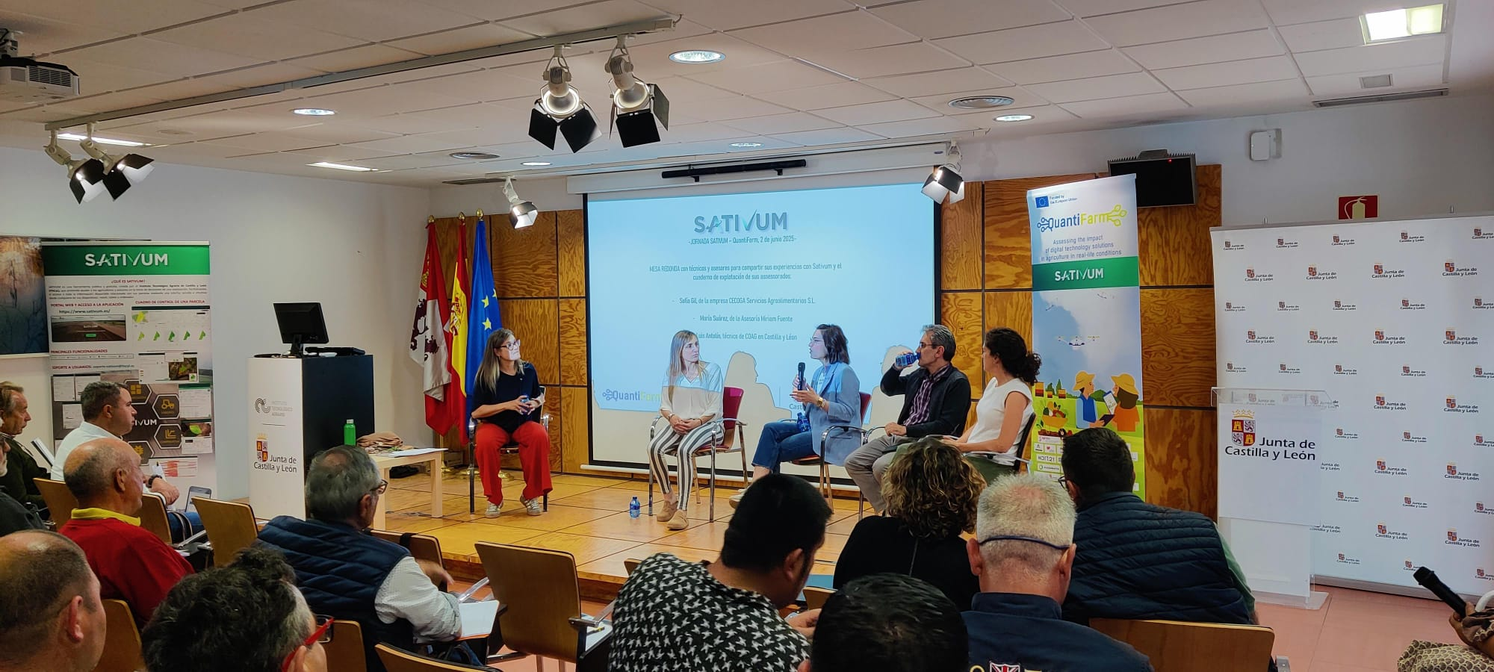
7
  Main Challenges & Scaling Hurdles
Agronomic Relevance
Dual User Profiles
Delivering truly reliable and useful data requires deep agronomic expertise and seamless integration with daily agricultural operations.
Serving two distinct target groups — individual farmers and professional advisors— with contrasting technical needs and workflows.
Adoption Ceiling & Training
Trust & Regulatory Friction
Active user growth plateaued at ~6,000 users. Adoption is highly sensitive to training effort, ~ 100 training sessions per year across 2024–2025.
Overcoming skepticism toward government apps. Mandatory tools (Field Book, Nutrient Plan) drive onboarding but can create user pushback.
•Provide reliable and useful information for farmers. Agronomic expertise and link with agriculture sector.
•Cover two different user profiles (Farmers and advisors) with different needs.
•Stack in a celling of 6000 active users for the last year. Very sensible to the training effort. Around 100 training sessions in 2024 and 2025.
•Build confidence. Lack of trust in a public (government funded) APP
Regulatory issues (Digital field book, nutrient plan) bring users but also bring problems

Slide 30
8
ELMS - Implementation in SPAIN

Slide 31

4
  Proposed scheme for the ELMS (IACS/ (SIEX + GSAA+ AMS))
Meteorological Data
Animals
Crops
Machinery
Organic
Fertilization
Plant Protection
Seeds
Energy
Geotagged Photos
Image Bank - BIC
Photo Automation - SIRIC
FARMER
SUSTAINABLE FARM MANAGEMENT
(Agrotech - Advisory Services, Producer Organizations, …)
REA AND CUE
POWER BI – Data Exploitation
INDICATORS
Graphic Declaration (SU)
SIEX
AMS
ELMS
MONITORING RESULTS - EDAMON
Copernicus Data
Data Spaces
Business Opportunities (challenges, advisory, services)
FUTURE INDICATORS
ADMINISTRATION AND RESEARCH
BASED ON SIGPAC
31
PERSONAL DATA PROTECTION

Slide 32
4
  Potential Benefits of the ELMS Spain Prototype
For the Farmer
For Technology SMEs
For the Administration:
Currently: the ability to see the evolution of their crops (NDVI) and avoid CAP penalties through the preventive correction of yellow warnings. Future: Transforms control data into decision-making tools for the sustainable and profitable management of their farm. Agile modeling and certification of agricultural practices. Promotion of green practices
Currently: limited or fragmented access to base data. Future: The ability to access broader base information (with the user's permission) to create carbon calculator tools, harvest predictors, or low-cost smart irrigation tools.
Currently: The CAP application is digitized and controls are largely automated. Future: fosters the sustainability of the sector with full interoperability that benefits the farmer, who has enriched information for better design and evaluation of agricultural policies.
32

Slide 33
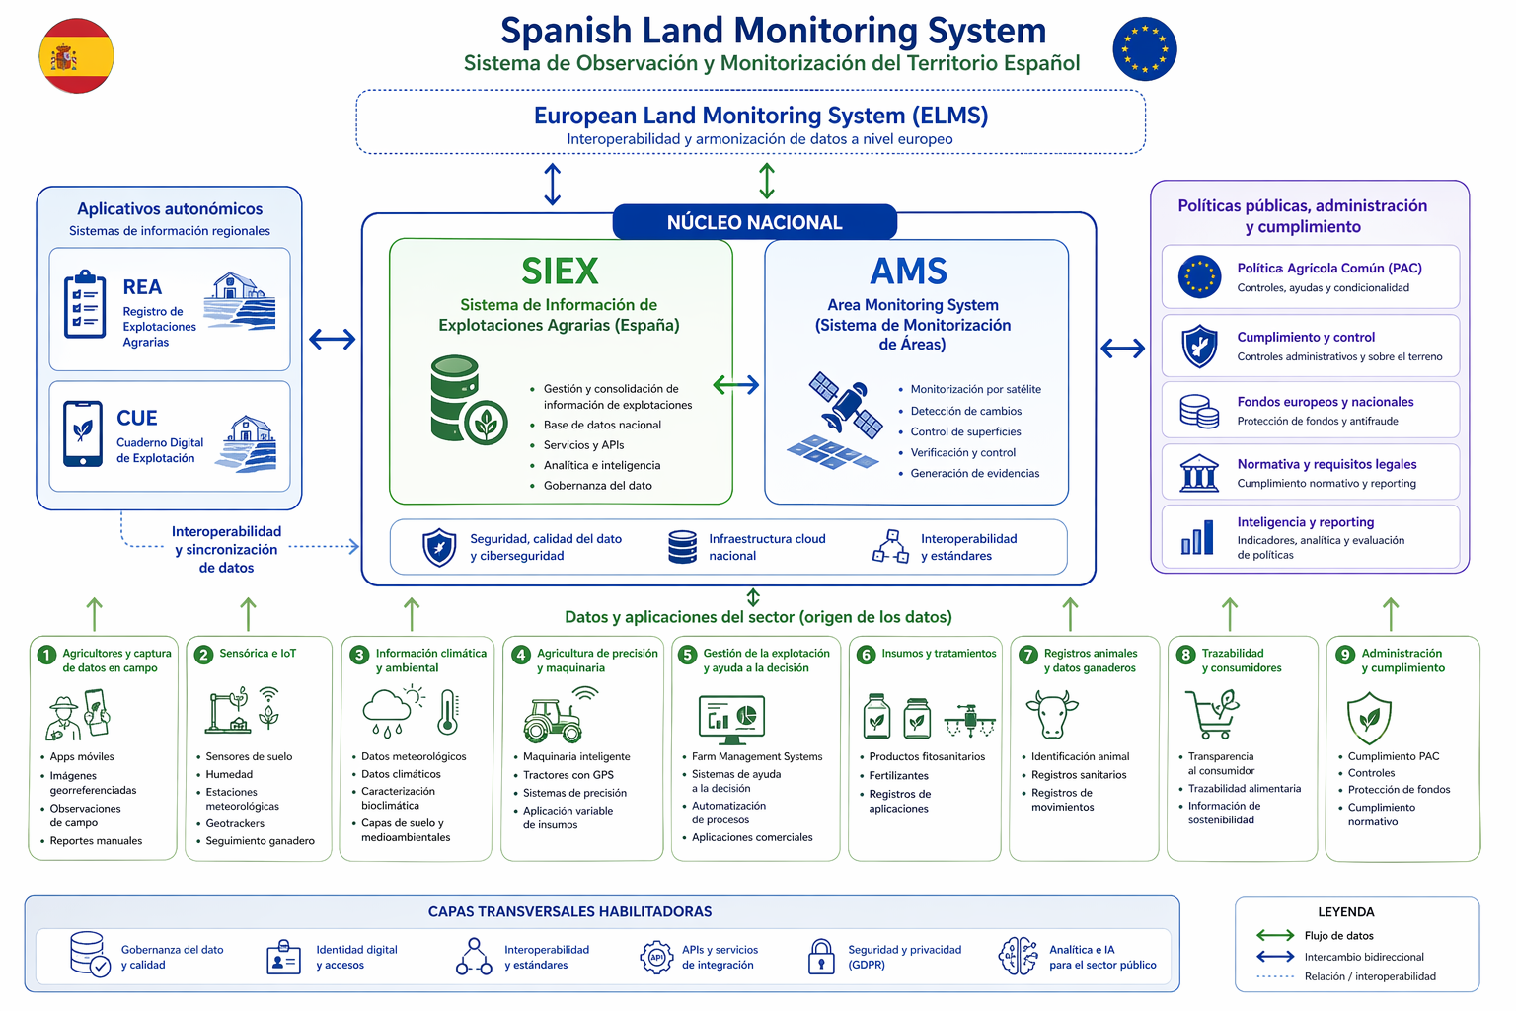

4
  Spanish Land Monitoring System
Potential future ELMS architecture in SPAIN!!!
33

Slide 34


4
  ELMS - SPAIN
 | SPAIN | ELMS
Overall objective | Support farmers and CAP policy delivery
Core approach | Integrated national system based on existing national & regional systems | Integrated EU system based on existing MS systems
Geographical scope | National & Regional | EU-wide built from MS systems
Focus on farmers | Provide useful information to farmers and simplified compliance
Use of Earth Observation | Systematic use of satellite data for land and practice monitoring
Land parcel reference | Strong reliance on LPIS as a core spatial reference
Integration with CAP systems | Built on IACS
Farm-level data | Combination of administrative and farmer data
Data standardization | Harmonised national and European code lists | Common EU requirements
Interoperability | Vertical and horizontal interoperability (State–Regions–EU) | Cross‑MS interoperability
Monitoring outputs | Practice monitoring, indicators and land use information
Data reuse | Policy management and analytics
Governance | National framework with regional operation and shared governance | EU framework with national implementation
Data protection | Role‑based access and aggregation
34

Slide 35
9
CONCLUSIONS

Slide 36
4
  ELMS – Implementation in Spain
“A high level of interoperability already exists among key IACS components.”
Both systems are built on the same core principles:
build on LPIS + monitoring systems
combine administrative and farmer data
use Earth Observation as a backbone
aim to return value to farmers, not only control
36

Slide 37

Thank you ;)
Área de Innovación – FEGA, O.A - ITACyL
innovacion.ad@fega.es & nafgarda@itacyl.es

